Slide 1
POSTER ART · T-P21-ART · coming
Day 5
Artwork for T-P21 · Test it side by side
Two small plots side by side, divided by a string line. Left plot: bare soil, small pale plants. Right plot: mulched soil with compost, taller dark-green plants. A group of five farmers crouches between them: one measures a plant against a marked stick, one draws on a clipboard, one holds a handful of soil from each side, two discuss, pointing. Along the…
Ready to teach
Day 5 of 5
T-D5-01 · Poster T-P21
Teach the Teachers
Notes:
T-D5-S0. Look at the side-by-side pots; if nothing is up yet, gently dig one seed per pot.
Poster: T-P21

Slide 2
Fill the plate
• Fill a child's plate for a day
• What's missing?
IMAGE · T-IMG-12 · coming
Beans in tins
On a wooden table: two tins, one with a drawn arrow pointing in, one with an arrow pointing out (arrows as shapes, no letters); a pile of dried beans; a ruled sheet with small pictures heading each column (a calendar page, a coin going in, a coin going out, a spinach bunch); a plate with vegetables of many colours (orange butternut, dark green leaves,…
T-D5-02 · Poster F-P19
Teach the Teachers
Notes:
T-D5-S1 step 1. Eat the rainbow — many colours, and beans or eggs most days.
Poster: F-P19

Slide 3
YOUR TURN
Beans and tins
• One bean = R5
• Move beans for each event
• Draw it in the money book
IMAGE · T-IMG-12 · coming
Beans in tins
On a wooden table: two tins, one with a drawn arrow pointing in, one with an arrow pointing out (arrows as shapes, no letters); a pile of dried beans; a ruled sheet with small pictures heading each column (a calendar page, a coin going in, a coin going out, a spinach bunch); a plate with vegetables of many colours (orange butternut, dark green leaves,…
T-D5-03 · Poster F-P20
Teach the Teachers
Notes:
T-D5-S1 step 2. Answer: R105 in the tin; in R115, out R60. Records in the app: Records (/records),
tabs Picked · Sold · Spent.
Poster: F-P20

Slide 4
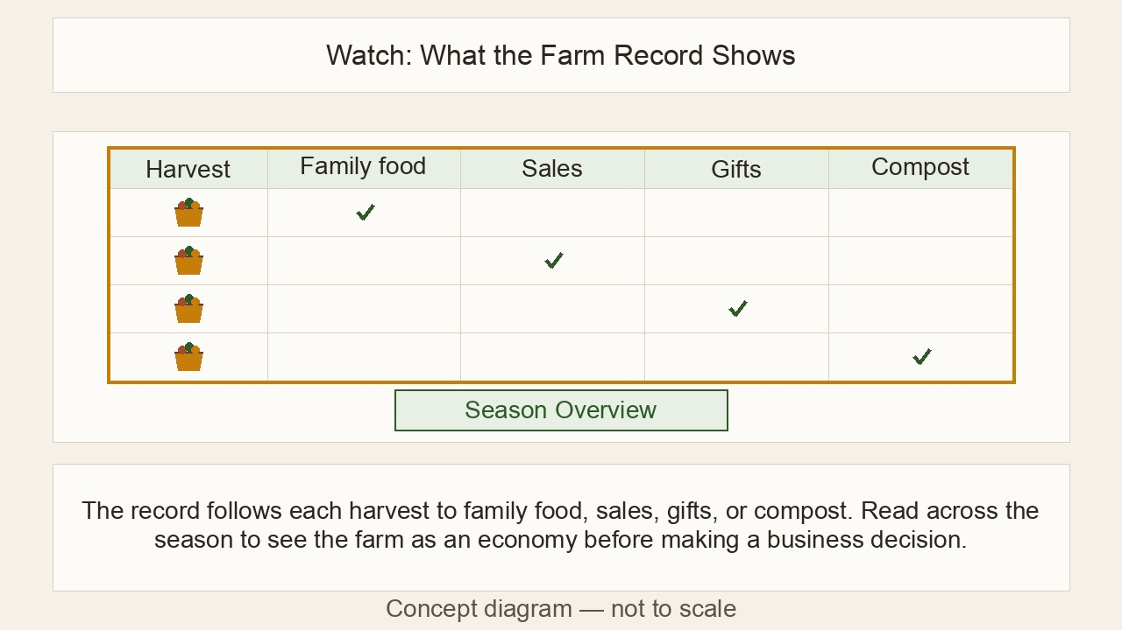
Numbers without reading
• Beans, tins, picture cards
• One event at a time
• Groups check each other
▶ Clip T-ANI-23 · play from the tablet: watch-04-farm-record.mp4
T-D5-04 · Poster F-P20
Teach the Teachers
Notes:
T-D5-S1 steps 3–5. Never promise income: "save money on food", "sell surplus".
Poster: F-P20
Clip T-ANI-23: public/course-animations/market-community/watch-04-farm-record.mp4

Slide 5
IMAGE · T-IMG-11 · coming
Final teaching practice
Two facilitators, one lesson
In front of a seated group, a young woman facilitator hands a seedling tray to a young man facilitator, both smiling, like passing a relay baton. Behind them a crate of tools and a clipboard with tally marks on a chair. Learners watch, one already reaching toward the tray.
30 minutes, pairs
A real Course 1 session
T-D5-05 · Poster T-P03
Teach the Teachers
Notes:
T-D5-S2. Streams: A = Bean + Maize (lead), B = Pumpkin + Marula (co-trainer).
Poster: T-P03

Slide 6
YOUR TURN
We are your farmers
• Your hand-made poster up
• Practical in two groups of 4
• Expect real questions
IMAGE · T-IMG-05 · coming
A micro-teach in a small circle
Five adults in a small circle of chairs in the corner of a hall. One young man (teaching) holds up a cut-open 2 ℓ bottle of soil while three peers lean forward, one pouring water. A fourth person, an older woman, sits slightly back with a clipboard, making tally marks (simple strokes). A second person holds up a small red card (the STOP card, no text). A…
T-D5-06 · Poster T-P07
Teach the Teachers
Notes:
T-D5-S2 steps 1–2. Brief two "farmers" per slot to ask one real question each.
Poster: T-P07

Slide 7
Feedback: 10 minutes
• Partners star each other
• Observers: numbers and stars
• Trainer: two stars and a wish
POSTER ART · T-P10-ART · coming
Artwork for T-P10 · Two stars and a wish
A small group of four seated in a circle after a lesson. A young woman (the teacher) speaks first, hand open. Opposite her, an older man with a clipboard (the observer) speaks kindly; above him float two big Ochre star shapes and one Leaf-green sprouting seedling shape. The teacher, now with hand on heart, listens and nods. A third person smiles and…
T-D5-07 · Poster T-P10
Teach the Teachers
Notes:
T-D5-S2 steps 3–5. Trainer readiness note is private. Final talk % on the scoreboard.
Poster: T-P10

Slide 8
POSTER ART · T-P15-ART · coming
Did they learn it?
Artwork for T-P15 · Did they learn it?
Three stacked scenes. ① A co-facilitator with a clipboard watches a farmer adjust the string on an A-frame; on the clipboard three simple symbols: a tick, a half circle, a cross. ② A room with three corners, each with a large picture card on the wall (a sun low, a mulched bed, a bare bed); learners walk to the corners. ③ A group holds up fingers (one to…
Watch · Quiz · Ask
T-D5-08 · Poster T-P15
Teach the Teachers
Notes:
T-D5-S3.
Poster: T-P15

Slide 9
YOUR TURN
Picture quiz
• Walk to corner A, B or C
• Count heads, not names
IMAGE · F-IMG-70 · coming
Picture quiz card 1
Question (said aloud, not printed in the art): 'Where is the sun at midday in winter?' Art: three panels A/B/C: sun to the north of a house (shadow south) · sun to the south · sun straight overhead. Three equal panels with a large A, B and C typeset below each panel in the layout (not in the art).
T-D5-09 · Poster T-P15
Teach the Teachers
Notes:
T-D5-S3 step 1. Run 4 of the 8 questions from forms.md §5. Nobody needs to read.
Poster: T-P15

Slide 10
Three ways to check
• Watch them do it
• Picture quiz, Day 1 and Day 5
• Ask them: fingers and stickers
POSTER ART · T-P15-ART · coming
Artwork for T-P15 · Did they learn it?
Three stacked scenes. ① A co-facilitator with a clipboard watches a farmer adjust the string on an A-frame; on the clipboard three simple symbols: a tick, a half circle, a cross. ② A room with three corners, each with a large picture card on the wall (a sun low, a mulched bed, a bare bed); learners walk to the corners. ③ A group holds up fingers (one to…
T-D5-10 · Poster T-P15
Teach the Teachers
Notes:
T-D5-S3 steps 2–4. Tick the skills checklist while they work. It's a record, not a qualification.
Poster: T-P15

Slide 11
YOUR TURN
The flip folder
• Eight forms, in order
• When is each one used?
POSTER ART · T-P16-ART · coming
Artwork for T-P16 · Ready by Day 0 — the course kit
A flat-lay seen from above on a green tarp: four crates, each with a different plant symbol drawn on it (bean, pumpkin, maize cob, marula fruit), holding spades, string, jars and tins; a poster tube; an open flip folder with forms (lines, not letters); a first aid kit with a cross symbol, open; a clipboard with a register grid; a stack of blank…
T-D5-11 · Poster T-P16
Teach the Teachers
Notes:
T-D5-S3 step 5. [APP] Mentor → Training and Mentor → Learning hold the same records.
Poster: T-P16

Slide 12
Look how far you came
• Talk %: Round 2 to Round 5
POSTER ART · T-P04-ART · coming
Artwork for T-P04 · The teacher-talk meter
Top half: a big half-circle gauge, like a fuel gauge, split into ten equal wedges — three Ochre wedges on the left, seven Leaf-green wedges on the right (the Leaf wedges also carry small dot pattern so it works in black and white). A thick Ink needle points into the third Ochre wedge. Bottom half: a facilitator stands to one side with an open hand…
T-D5-12 · Poster T-P04
Teach the Teachers
Notes:
T-D5-S4 step 1. Read the scoreboard together. Applause.
Poster: T-P04

Slide 13
Keep the teacher strong
• Three courses, then rest
• Day 0 always, save your voice
• Evening buddy, listen then refer
POSTER ART · T-P18-ART · coming
Artwork for T-P18 · Keep the teacher strong
A facilitator stands at the centre, relaxed, with six small scenes around her in a ring: (1) three small hall shapes followed by a house with a garden (three courses, then home); (2) a facilitator alone setting out chairs in an empty hall (Day 0); (3) a facilitator drinking from a water bottle, one hand raised as a quiet signal; (4) a facilitator sitting…
T-D5-13 · Poster T-P18
Teach the Teachers
Notes:
T-D5-S4 step 2. Ask what drains them and what they'll do about it.
Poster: T-P18

Slide 14
YOUR TURN
My teaching plan
• My first course, my sessions
• Two strengths, one growth area
• Observed again within 8 weeks
IMAGE · T-IMG-11 · coming
Two facilitators, one lesson
In front of a seated group, a young woman facilitator hands a seedling tray to a young man facilitator, both smiling, like passing a relay baton. Behind them a crate of tools and a clipboard with tally marks on a chair. Learners watch, one already reaching toward the tray.
T-D5-14 · Poster T-P14
Teach the Teachers
Notes:
T-D5-S4 steps 3–4. 2-minute private readiness talks while trainees write. Then pairs share.
Poster: T-P14

Slide 15
YOUR TURN
Your evaluation
• Fingers 1 to 5
• Two stickers on each list
POSTER ART · T-P15-ART · coming
Artwork for T-P15 · Did they learn it?
Three stacked scenes. ① A co-facilitator with a clipboard watches a farmer adjust the string on an A-frame; on the clipboard three simple symbols: a tick, a half circle, a cross. ② A room with three corners, each with a large picture card on the wall (a sun low, a mulched bed, a bare bed); learners walk to the corners. ③ A group holds up fingers (one to…
T-D5-15 · Poster T-P15
Teach the Teachers
Notes:
T-D5-SC step 1. Six questions in the day file. Then the partner circle: one star each.
Poster: T-P15

Slide 16
IMAGE · T-IMG-13 · coming
Well done, teachers
The certificate handshake
Inside a hall decorated with posters, an older male trainer shakes hands with a young woman trainee while handing her a certificate (a sheet with a border and a seal shape, no readable text). Colleagues around them clap. Warm, proud mood.
Certificate of attendance
Your first farmers are waiting
T-D5-16 · Poster T-P01
Teach the Teachers
Notes:
T-D5-SC steps 3–4. Read each name clearly; photos only without a green dot. It is not an
accredited qualification. One word, the song, register PM, posters down together.
Poster: T-P01

