Slide 1


Computer Science
Final Year Project
2025-26

Slide 2
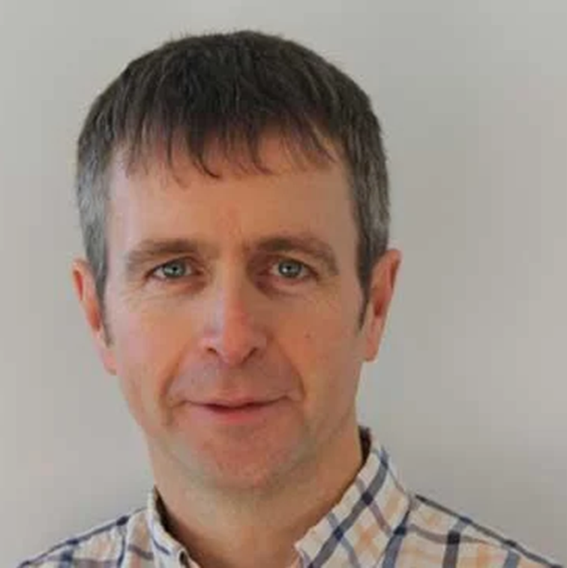
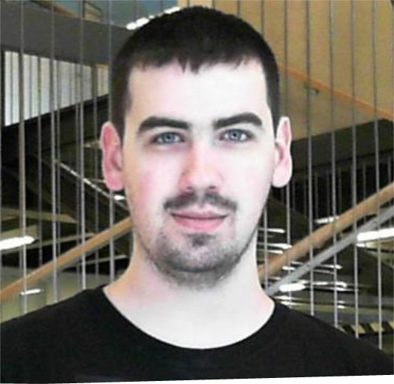


Diarmuid O’Donoghue
diarmuid.odonoghue@mu.ie
Coordinator
Mark Noone
mark.noone@mu.ie
Co-coordinator
Glen O’Keeffe
Administrator

Slide 3

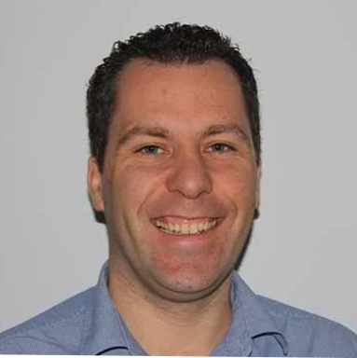
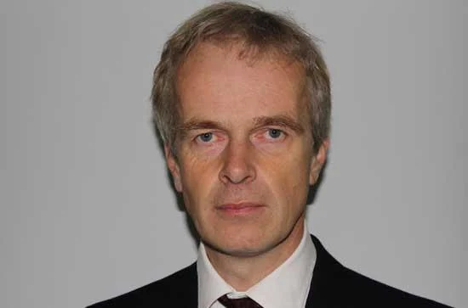
Supervisor, Course Coordinator and HOD

Slide 4

What is a Final Year Project?
Your capstone project displays your creativity!
You own your project.
  It is up to you to drive its progress.
Your supervisor's role is to guide and advise you
FYP is your chance to combine your collected abilities and display your own mastery of CS
  FYP outcomes will attest to your: time, effort, dedication, skill, persistence, wisdom, ability to take and seek guidance…

Slide 5
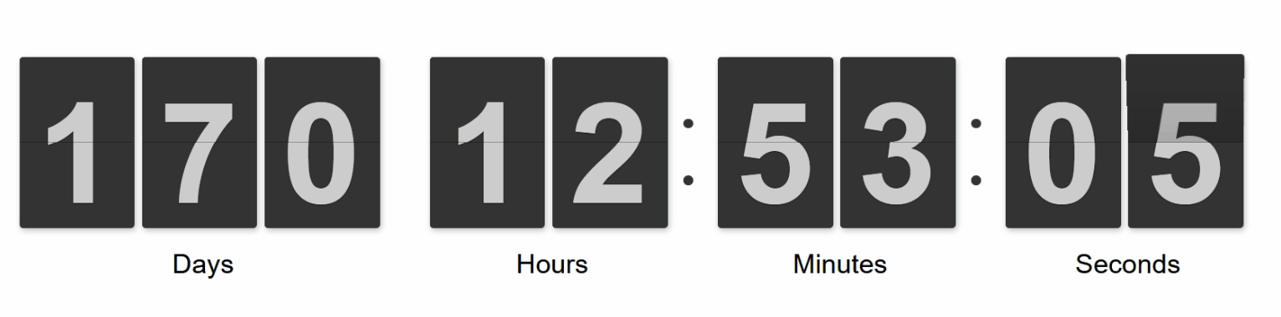
Project Deadline – March 16th 2026 @ 23:59

Slide 6

Timeline and other deadlines
Start: 22nd September 2025
  The clock has already started
Interim Report: 30th November 2025
Final Report: 15th March 2025
Deliverables: Thesis, codebase, video, results…
Plan your year.

Slide 7
ECTS and Hours
1 ECTS = 25-30 hours of work
5 ECTS => 125-150 hours = 3.5 x weeks x 40 hour (140 hrs)
15 ECTS => 375-450 hours = 10 weeks x 40 hour (400 hrs)
Plan your year - 24 weeks * 16 hours/week = 384, but…
  January exams.
  You may have much practical work due in December.
  How many hours will you work on your FYP during mid-term break?
  During the final weeks?

Slide 8
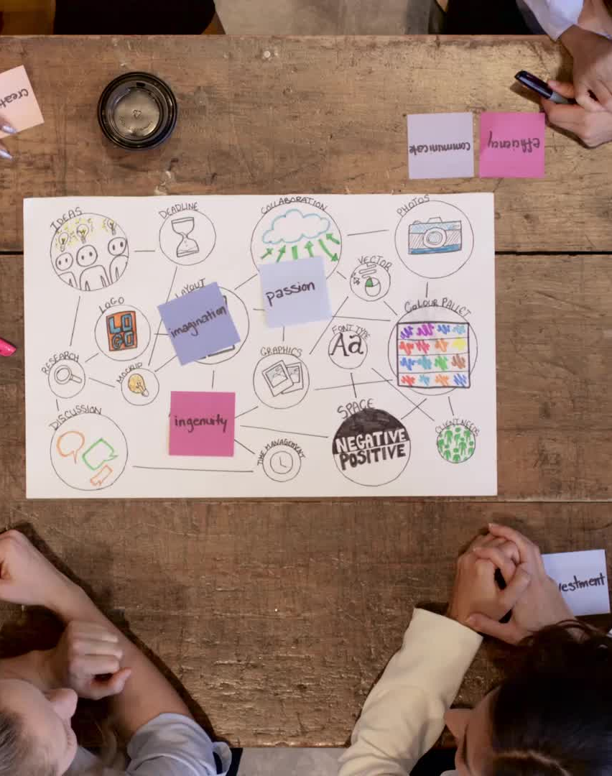
FYP Part 1 – Find a Project
Find a project & supervisor that suits you.
At the start of week #3, students without projects will be allocated to supervisors.
Make your choice while you can.
Ensure weekly/regular meetings to
  1) report progress
  2) take guidance on your next steps
Regular updates to GitLab, diary, etc..

Slide 9

Interim Report
November 30th 2025 (~8 weeks)
2-page document
Worth 5% of the overall grade
Practise writing English and get some detailed feedback
Describe work done
Include evidence and some details
Briefly outline your planned work
Template will follow in a few weeks

Slide 10
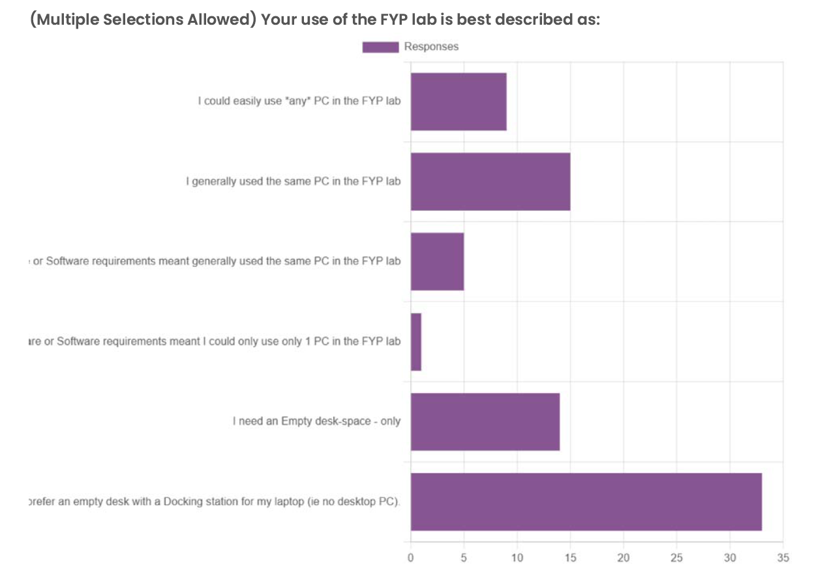
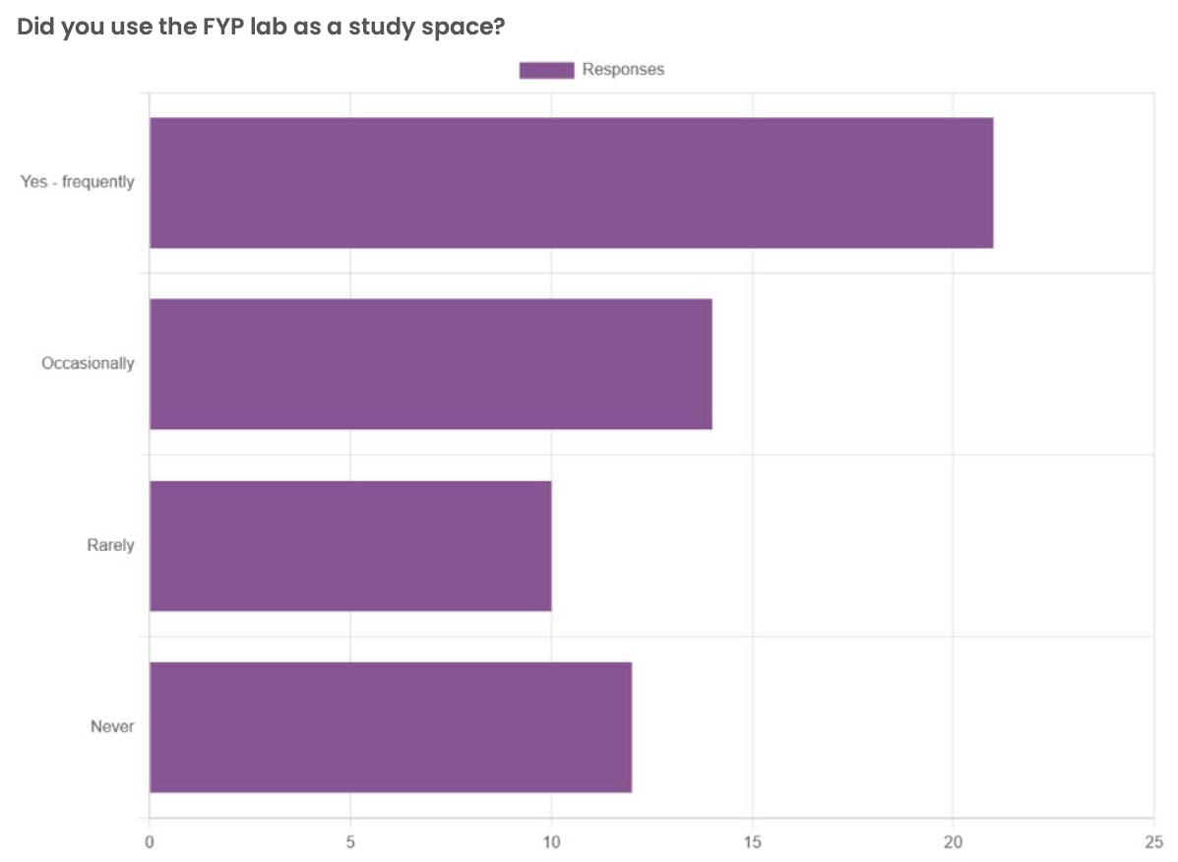
FYP Exit Survey 2023-24

Slide 11

FYP Lab
Card Access should be available from Monday
You should have a project before using the lab
Docking stations + some machines
Some projects come with specialist machine requirements -> discuss with supervisor if relevant (mostly Machine Learning / AI / intensive programs)
We and/or James Cotter will be in touch with more details

Slide 12
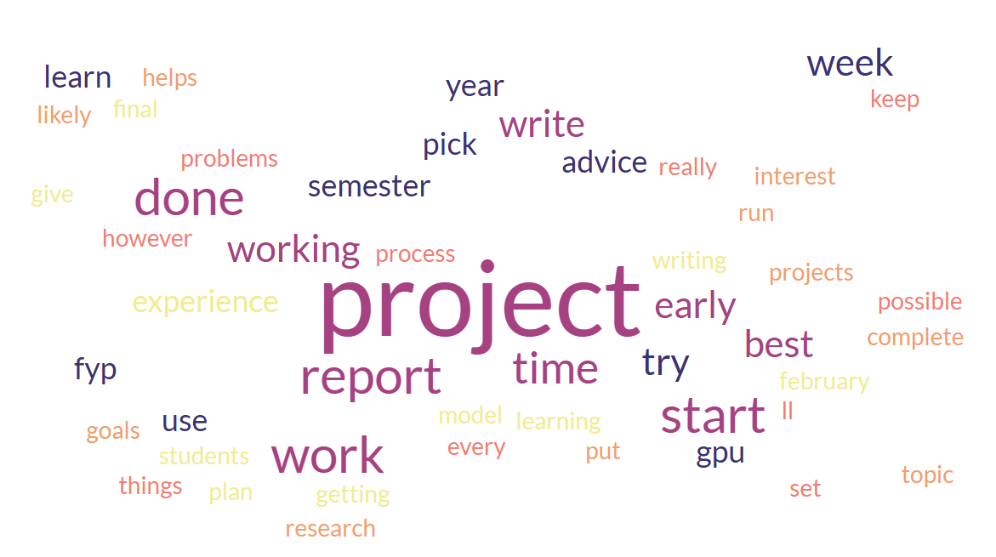
From Previous FYP Students

Slide 13
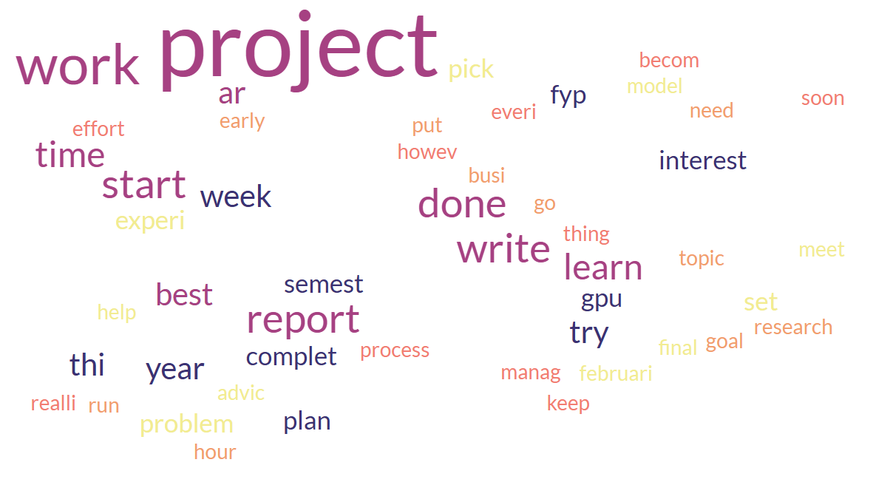

Slide 14
Recommendations from FYP Students
Carefully select a project
Start early
Rewarding process
Bi / weekly meeting
Structured meetings
GPU availability
Balance your yearly workload
Listen to your mentor
Get project sorted asap
Finish report 1 week early – proofread & finesse
Write important notes regularly
Focus on report more than project

Slide 15
- Take more modules in the Autumn semester to reduce pressure in Spring.
- Proactively seek advice from your supervisor.
- Start writing the final report in February to explore further avenues for research.
- Allocate time for primary functionalities in semester 1 and document all research materials.
- Manage project time effectively and consistently work towards progress.
- Choose a topic of deep interest or passion for better engagement.
- Overcome initial challenges and gain confidence as you progress.
- Close the FYP Lab door to prevent interruptions.
- Aim to complete significant tasks before Christmas and begin writing early.
- Focus on meaningful business projects aligned with your skill set.
- Plan and maintain a good schedule for success.
- Select a topic of personal interest.
- Set aside specific days for FYP work and maintain a diary.
- Consider using CUDA and renting a GPU from vast.ai for machine learning models.
- Apply for projects as soon as they become available and dedicate full effort.
- Complete the report ahead of time and review for errors.
- Carefully choose projects based on previous experience or desire to learn.
Do you have any advice You would like to give to next year's FPY students?

Slide 16
Good Outcomes vs Bad Outcomes
Chose project early
Stuck to realistic weekly plan
Steady progress
Detailed Interim Report
Regular commits on GitLab
Regular guidance on progress
Started writing early
Didn’t choose a project
Insufficient hours per week
Last minute rush
Interim report with little evidence
Occasional commits on GitLab
Occasional contact with supervisor
Late to Start writing

Slide 17
PROJECT: | WEEKLY-TRACKED PROJECT
Project Manager: | Your Name
 | Today is | 22/09/2025
Task name | Start date | End date | Planned Hours | Actual Hours | Progress
Choose a Project | 22/09/2025 | 28/09/2025 | 10 |  | 0%
Task 1 | 29/09/2025 | 05/10/2025 | 15 |  | 0%
Task 2 | 06/10/2025 | 12/10/2025 | 15 |  | 0%
Task 3 | 13/10/2025 | 19/10/2025 | 15 |  | 0%
Subtask 3.1 | 20/10/2025 | 26/10/2025 | 15 |  | 0%
Study Week - 32 hours? | 27/10/2025 | 02/11/2025 | 30 |  | 0%
 | 03/11/2025 | 09/11/2025 | 15 |  | 0%
 | 10/11/2025 | 16/11/2025 | 15 |  | 0%
 | 17/11/2025 | 23/11/2025 | 15 |  | 0%
Interim Report | 24/11/2025 | 30/11/2025 | 16 |  | 0%
 | 01/12/2025 | 07/12/2025 | 20 |  | 0%
 | 08/12/2025 | 14/12/2025 | 10 |  | 0%
Winter Exam Prep | 15/12/2025 | 21/12/2025 | 3 |  | 0%
Xmas Week | 22/12/2025 | 28/12/2025 | 0 |  | 0%
January Exam Prep | 29/12/2025 | 04/01/2026 | 0 |  | 0%
January Exams | 05/01/2026 | 11/01/2026 | 0 |  | 0%
January Exam | 12/01/2026 | 18/01/2026 | 0 |  | 0%
40 hours Possible here | 19/01/2026 | 25/01/2026 | 35 |  | 0%
 | 26/01/2026 | 01/02/2026 | 20 |  | 0%
 | 02/02/2026 | 08/02/2026 | 20 |  | 0%
 | 09/02/2026 | 15/02/2026 | 20 |  | 0%
 | 16/02/2026 | 22/02/2026 | 20 |  | 0%
 | 23/02/2026 | 01/03/2026 | 20 |  | 0%
Proof-read thesis. Create Video | 02/03/2026 | 08/03/2026 | 20 |  | 0%
 | 09/03/2026 | 15/03/2026 | 25 |  | 0%
Study Week | 16/03/2026 | 22/03/2026 | 10 |  | 0%
 |  | Planed Hours | 384 | 0 | 0%
 |  | 5 ECTS target | 150
 |  | 15 ECTS target | 450
Expect to average 15-20 hrs/week
Study week offer greater flexibility
Suggest 0 hrs/week around exams

Slide 18
Plagiarism
Presenting the work of others as you own is against University policy
The reader must be able to clearly distinguish between your own work and the work of others.
If you use the work of others, either as a direct copy, or summarising or using their ideas, you must (a) cite their work at every place where you make use of it, and (b) include a full reference to their work.
See the university Plagiarism policy

Slide 19

GenAI
The department is fully supportive of GenAI use
  Your supervisor will determine the level of use for your project
  University policy identifies 4 levels, including “unrestricted”
    This comes with a serious onus on students
Record details in electronic notebook (with dates)
  Adopted GenAI outputs
  Rejected GenAI outputs
  Adapted GenAI ouptuts
FYP lab has machines dedicated to running open source GenAI
MS Copilot is the official GenAI partner of the university

Slide 20

Continuous Evidence of Authenticity
It is your responsibility to engage with the FYP process and the resulting outputs (thesis, code repo, results data…)
  weekly meeting, Gitlab, lab notes/notebook
so that you can assure the graders that you were the originator of all the works you presented.
The FYP final presentation & interview should only be used as a last resort. You should already have provided the Dept with sufficient evidence to assure us of the authenticity of what you present.
NOTE: The external examiner may request to speak with students at the end of the (summer) grading process

Slide 21
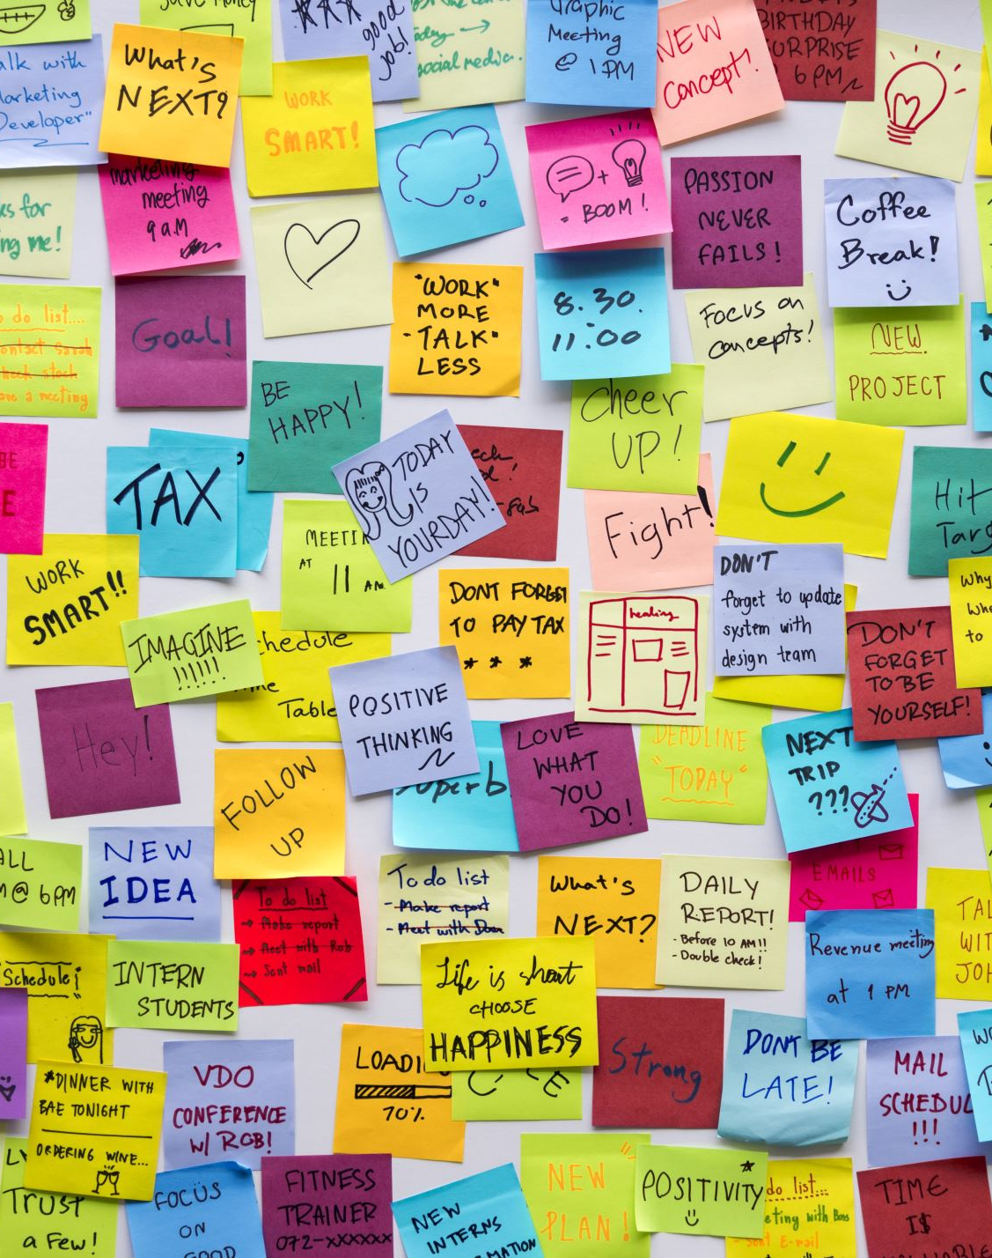
Additional Notes
FYP lectures will occur SOME Fridays 11-12
Other guides and notes available on Moodle.
Find a project.
Get started.
Do some targeted reading.
Do some work/programming.
Take guidance. Record your progress.

Slide 22

Questions / Q&A

