Slide 1
The 7 Friction Points Causing Developer Burnout
How Burnout-as-a-Service detects and mitigates each one

Slide 2
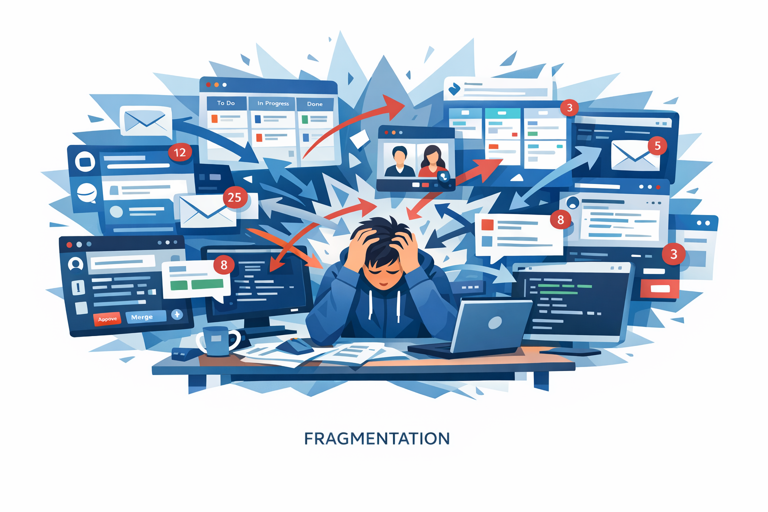
1. Fragmentation
Too many tools, tabs, models, prompts, and context switches

Slide 3
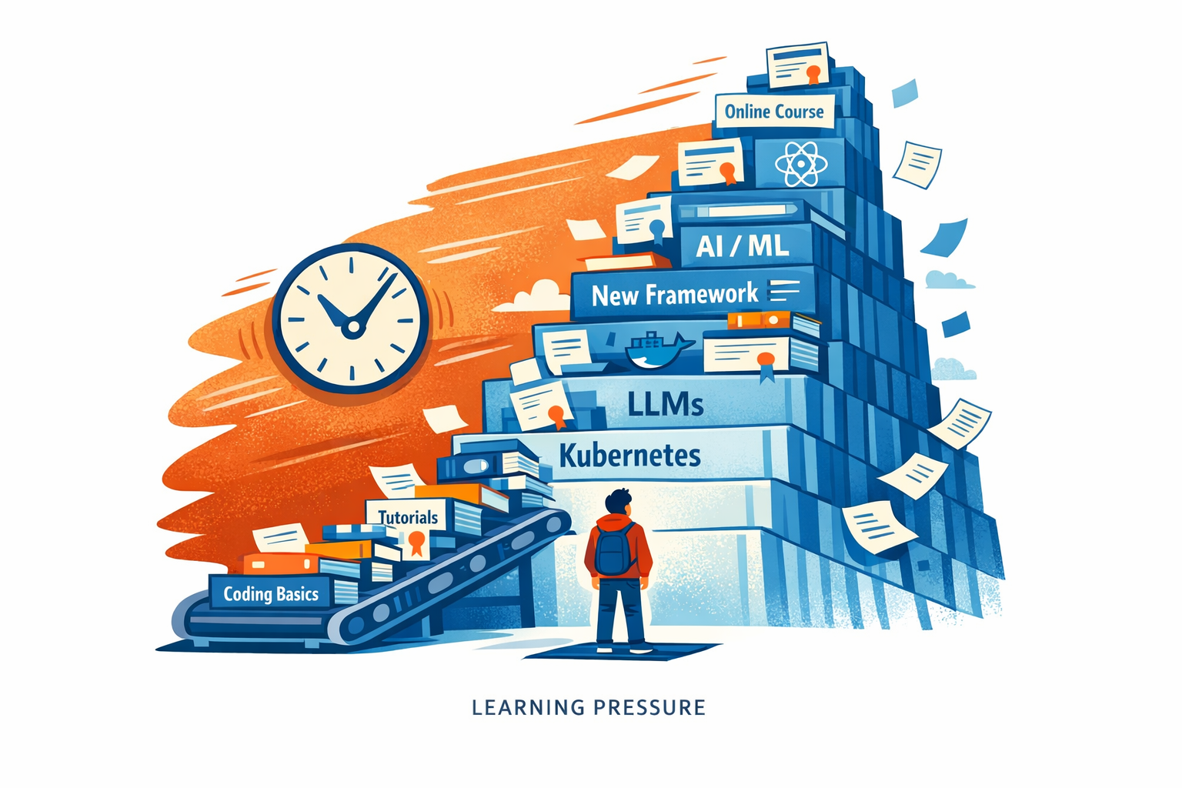
2. Learning Pressure
The constant feeling that you're already behind

Slide 4
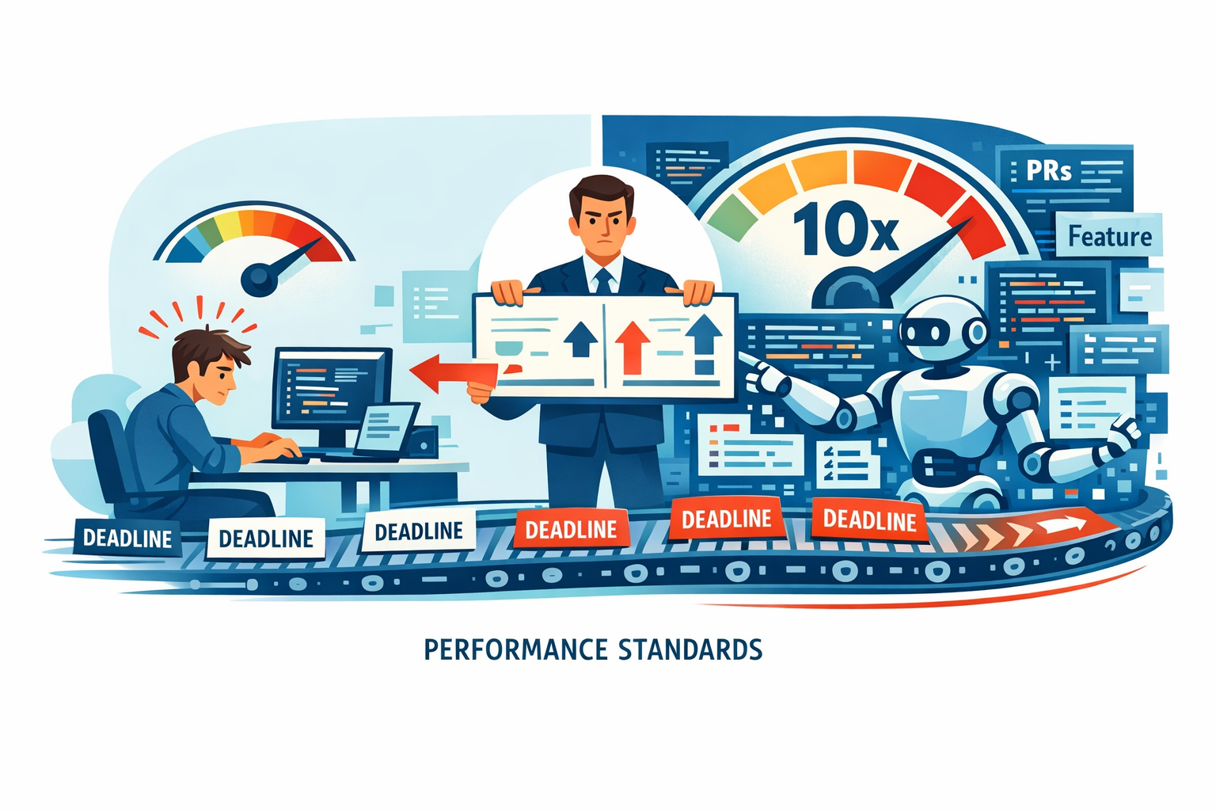
3. Performance Standards
Pressure to produce more, faster, because AI exists

Slide 5
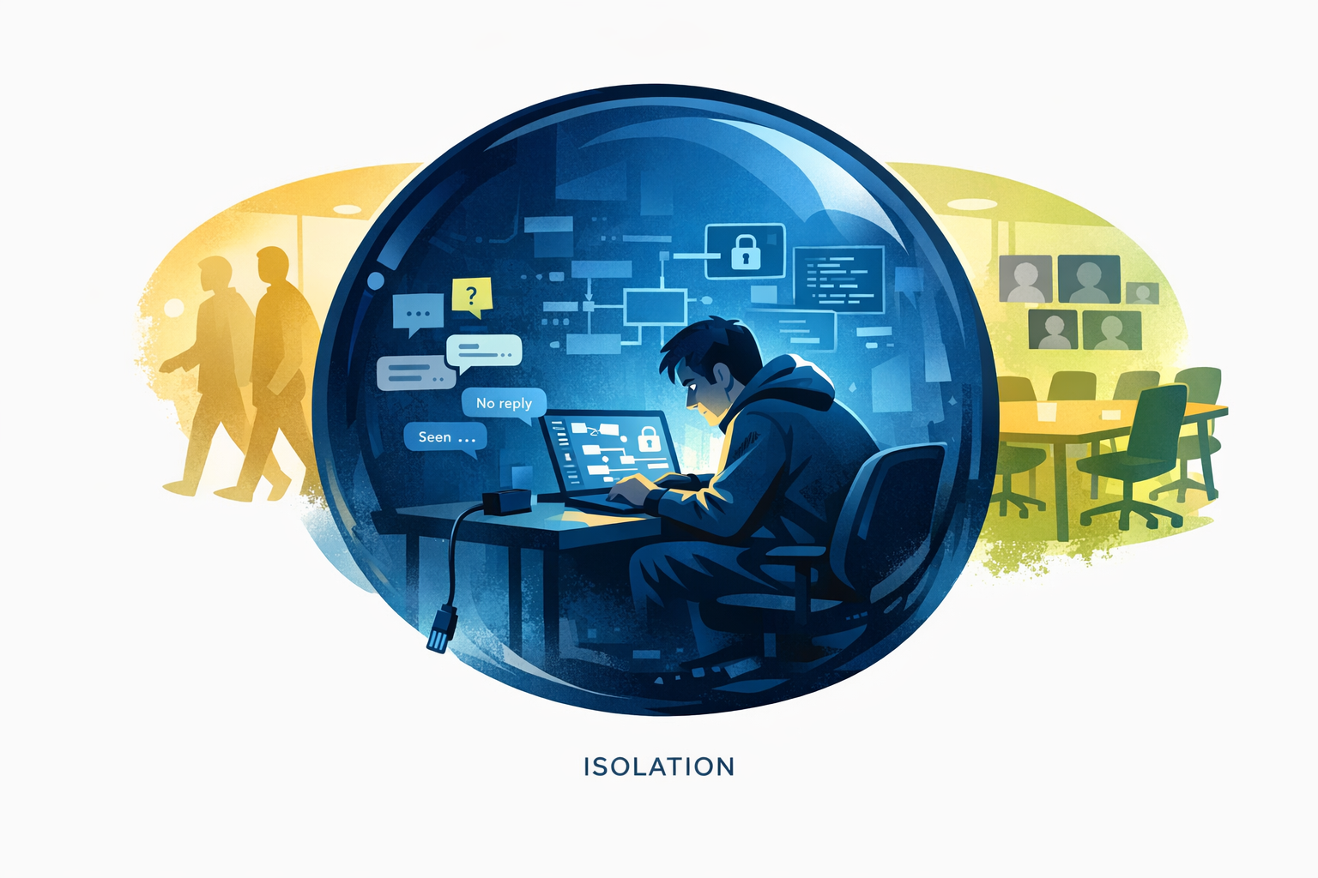
4. Isolation
Doing cognitively heavy work alone, with less human grounding

Slide 6
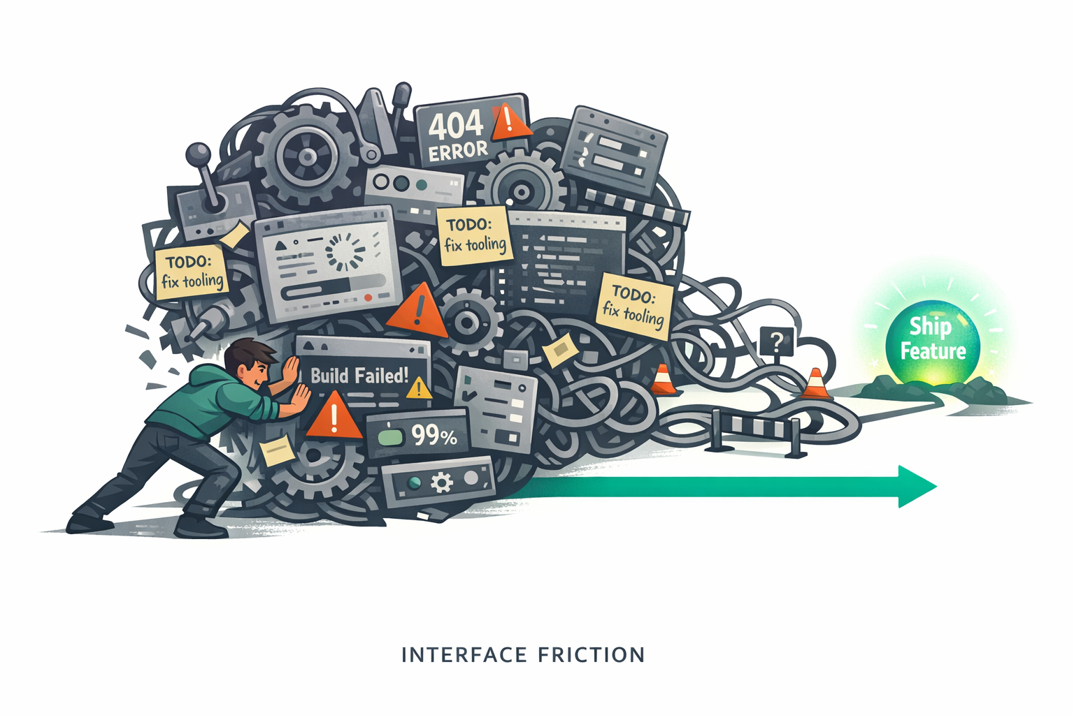
5. Interface Friction
Fighting clunky tools instead of flowing through the work

Slide 7

6. Altitude Sickness
Strategic thinking pulled into fine-grained review and execution

Slide 8
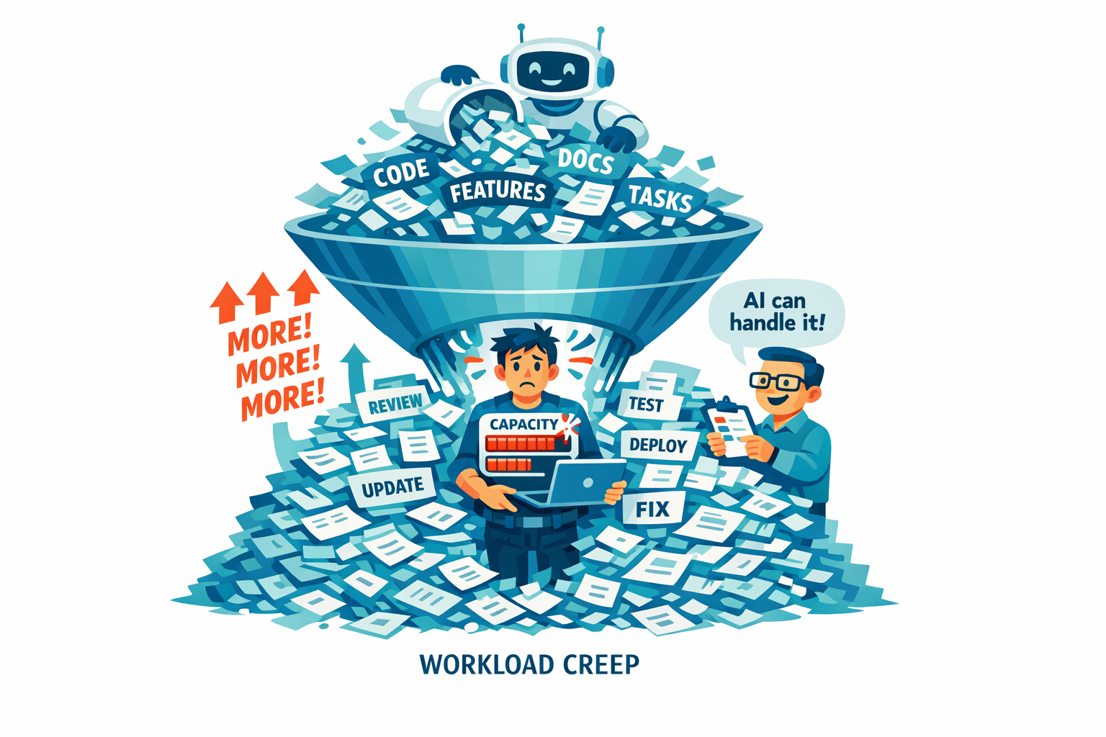
7. Workload Creep
AI makes more possible, so more gets expected

