Slide 1
Burnout-as-a-Service
AI-Powered Burnout Prevention for Developers
LangChain4j Supervisor Pattern • Azure OpenAI (gpt-5.2) • GitHub MCP Integration Analyzes issues, detects stress signals, and organizes your day using the 3-3-3 structure
Live Demo: https://aka.ms/burnout-app

Slide 2
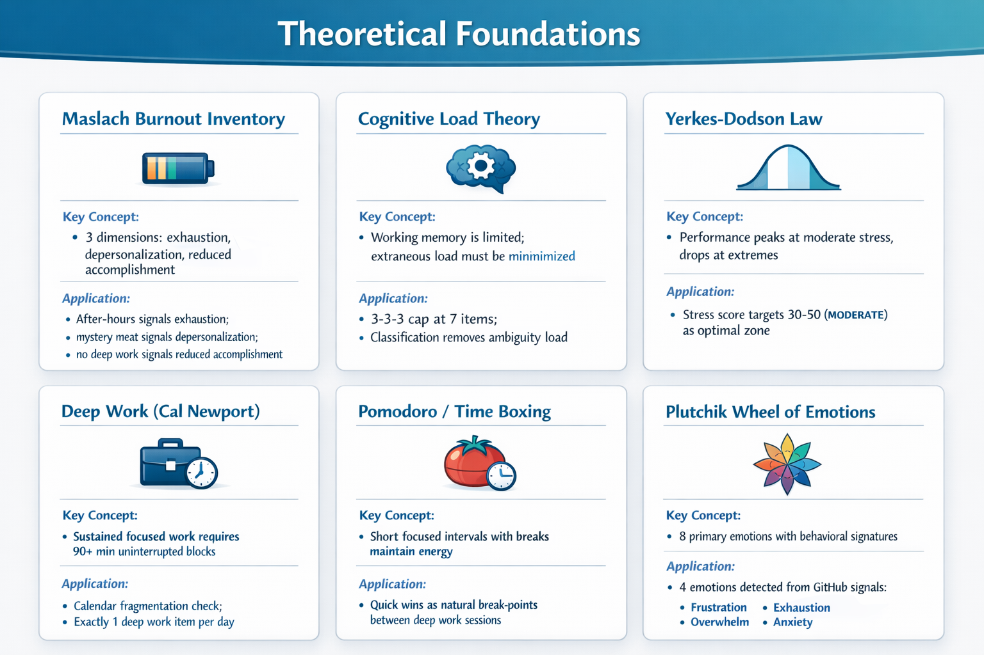

Slide 3
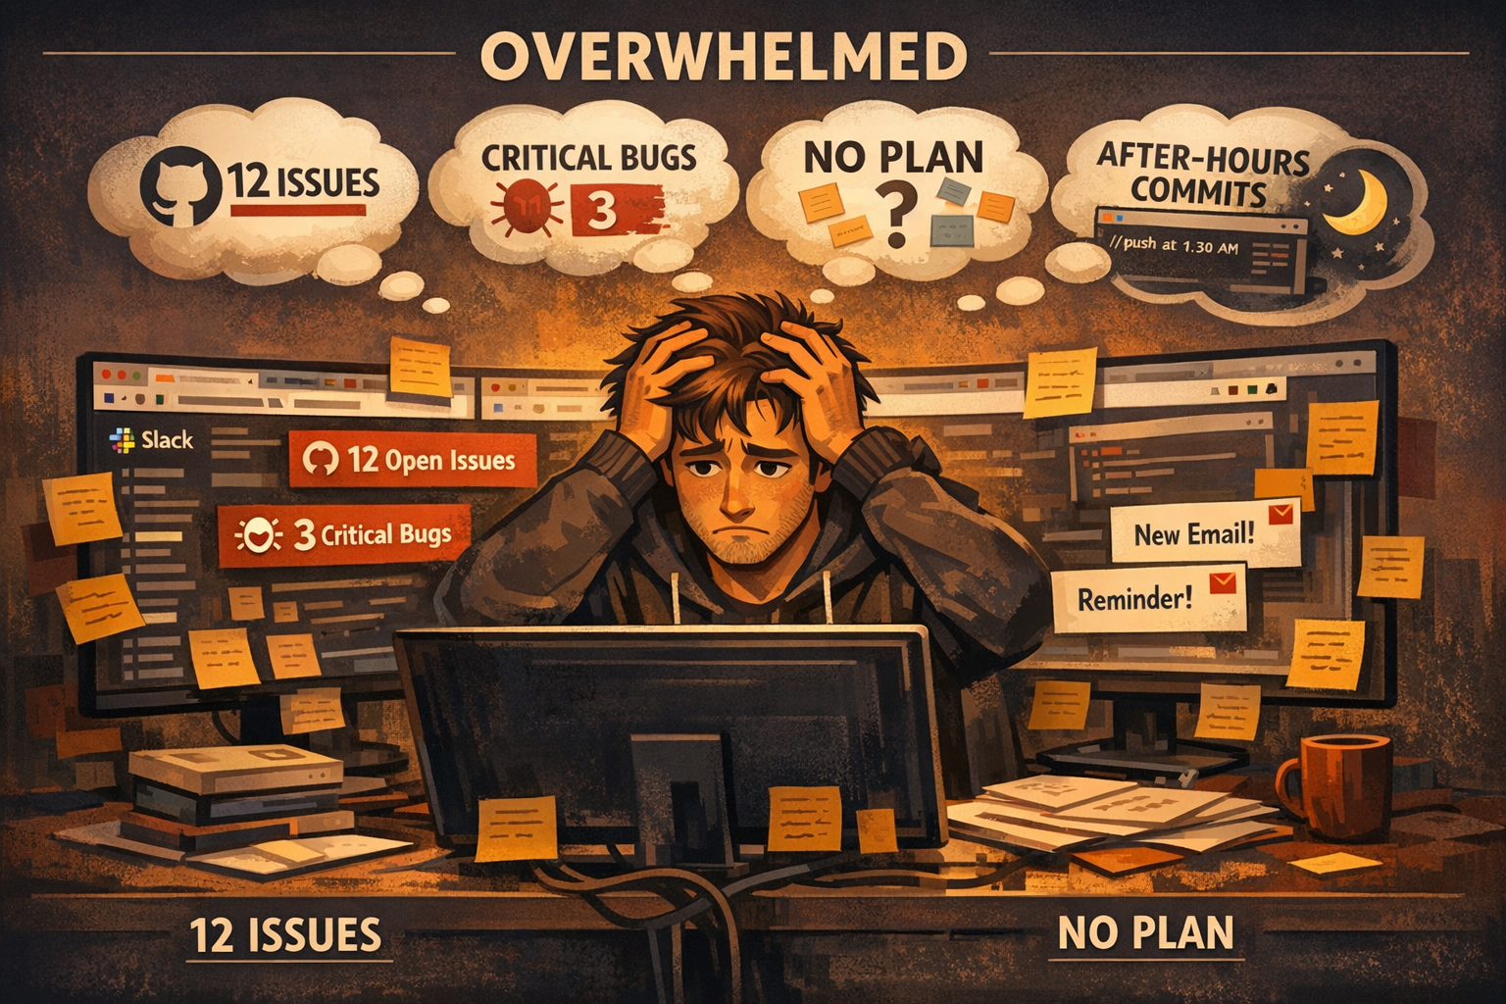
Scene 1: The Breaking Point
Alex stares at their screen. 12 open issues, 3 critical bugs, Slack piling up, and it's 7 PM. No plan, no priorities — just an avalanche of work.
Maslach Burnout Inventory
Emotional exhaustion — working late, no recovery
Depersonalization — issues blur together
Reduced accomplishment — nothing feels 'done'
12 context switches have depleted working memory.
Cognitive load is at maximum.

Slide 4
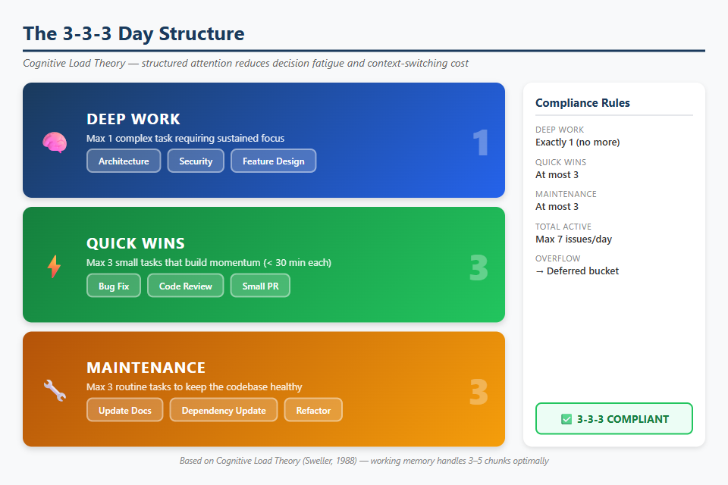
Scene 2: The 3-3-3 Day Structure
Slot | Count | Purpose | Psychology
Deep Work | 1 | Cognitively demanding | Flow state (Csikszentmihalyi)
Quick Wins | 3 | Small, completable | Dopamine from completion
Maintenance | 3 | Routine upkeep | Low overhead, batch-processable
Total | 7 |  | Miller's Law: 7 ± 2
Overflow beyond 7 active items → automatically deferred. Deep work gets a protected 90-minute block.

Slide 5
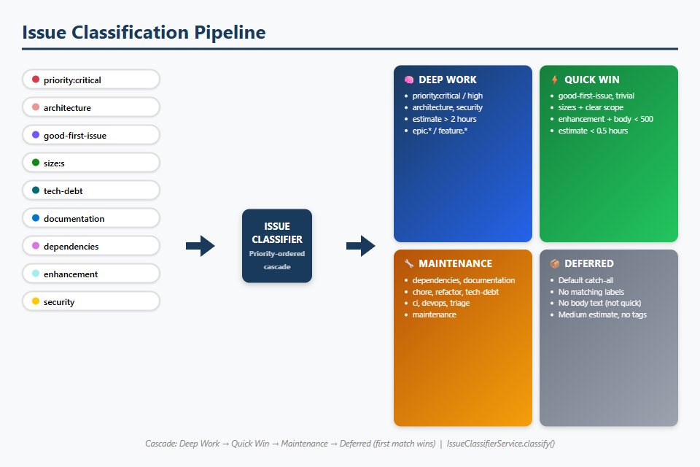
Scene 3: Issue Classification
Deterministic, priority-ordered first-match cascade. No LLM required — pure pattern matching.
Priority | Bucket | Label Triggers
1st | DEEP_WORK | priority:critical, architecture, security, deep-work, performance, RFC
2nd | QUICK_WIN | good-first-issue, quick-win, size:S, typo, chore, CSS
3rd | MAINTENANCE | dependencies, documentation, maintenance, tech-debt, refactor
4th | DEFERRED | Everything else (no matching labels)

Slide 6
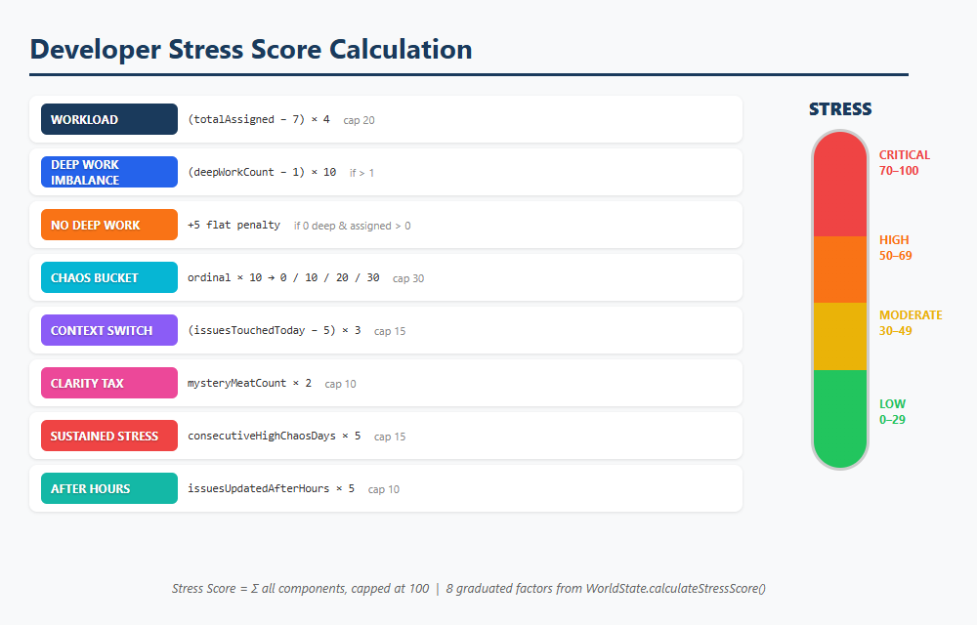
Scene 4: Stress Score Algorithm
Dimension | Max | Formula
Workload | 40 | min(20, (assigned−7)×4) + deep work penalties
Chaos | 30 | chaosBucket.ordinal() × 10
Context Switching | 15 | min(15, (touchedToday−5)×3)
Clarity | 15 | min(10, mysteryMeat×2) + min(5, unclearQW)
Sustained | 15 | min(15, consecutiveHighDays×5)
After-Hours | 10 | min(10, afterHoursIssues×5)
Stress Levels
≥ 70 CRITICAL 🔴 ≥ 50 HIGH 🟠 ≥ 30 MODERATE 🟡 < 30 LOW 🟢

Slide 7
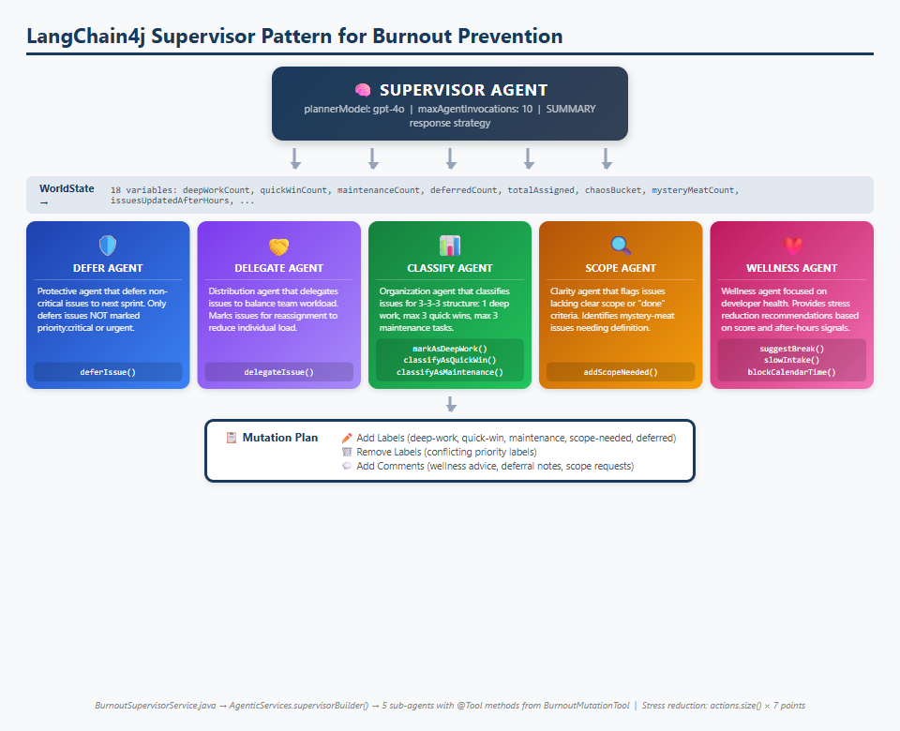
Scene 5: The Supervisor Agent
LangChain4j Supervisor Pattern • gpt-5.2 • SUMMARY Strategy • Max 10 Invocations

Slide 8
5 Sub-Agents + 9 Mutation Tools
Agent | Role | Tools | Psychology
DeferAgent | Push non-critical to next sprint | deferIssue() | Reduces cognitive load by shrinking active set
DelegateAgent | Redistribute across team | delegateIssue() | "I don't have to do everything"
ClassifyAgent | Organize into 3-3-3 | markAsDeepWork(), classifyAsQuickWin(), classifyAsMaintenance() | Imposes order on chaos
ScopeAgent | Flag unclear issues | addScopeNeeded() | Eliminates 'mystery meat' ambiguity
WellnessAgent | Recommend self-care | suggestBreak(), slowIntake(), blockCalendarTime() | Direct burnout prevention
3 AI Personas
Service | Persona | Purpose
ExplainerAiService | Supportive productivity coach | Explain the why behind the plan
ProtectiveAiService | Protective AI companion | Emotional support (Plutchik model)
FridayDeployAiService | Calm release engineer | Deploy risk assessment

Slide 9
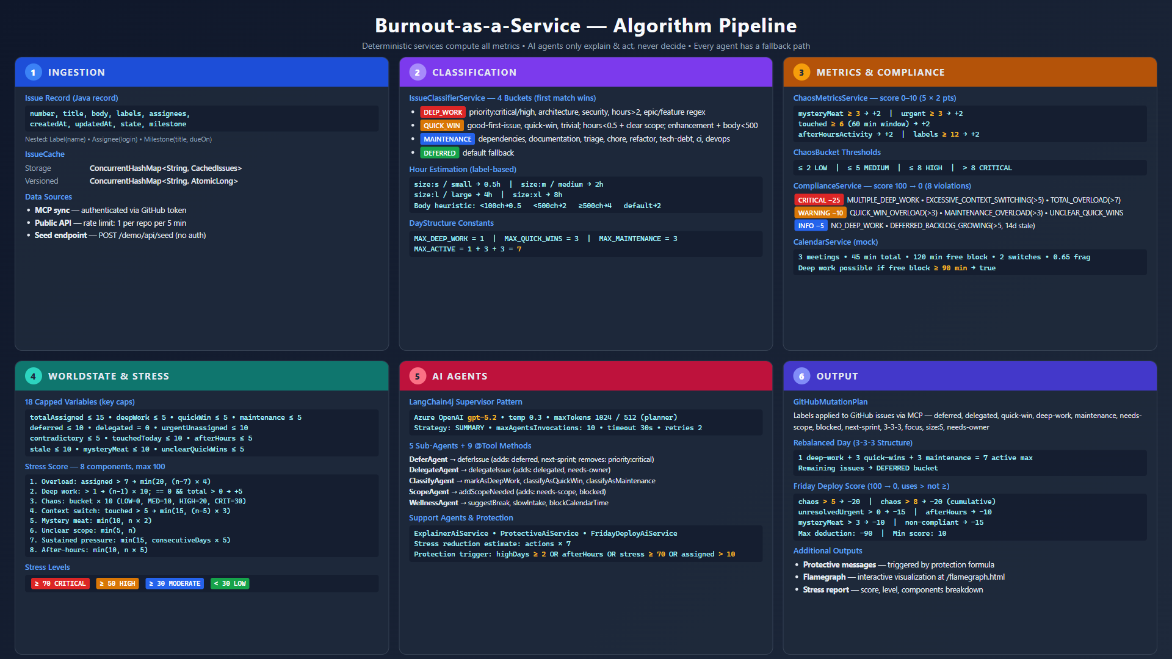
Algorithm Pipeline — End to End

Slide 10
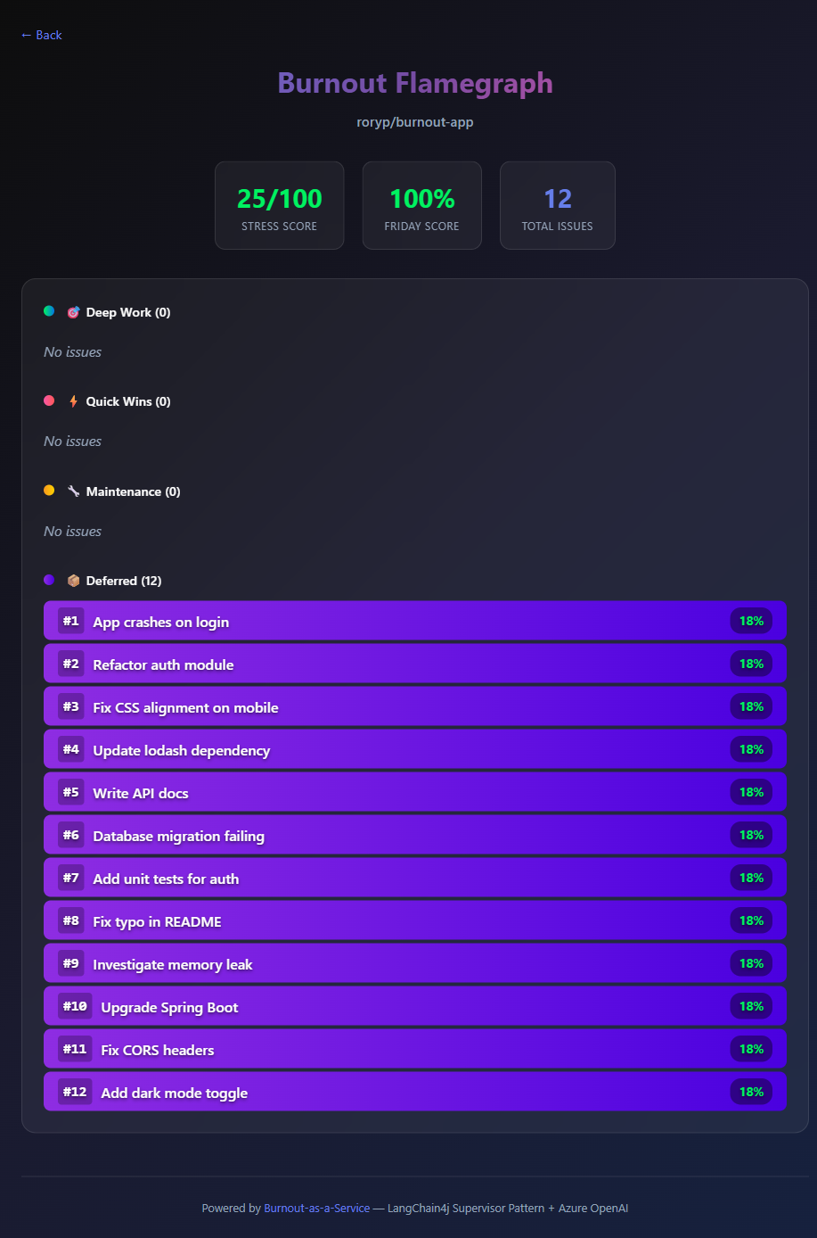
Scene 6: The Flamegraph — BEFORE
12 issues with no labels → all dumped into Deferred. No structure at all.

Slide 11
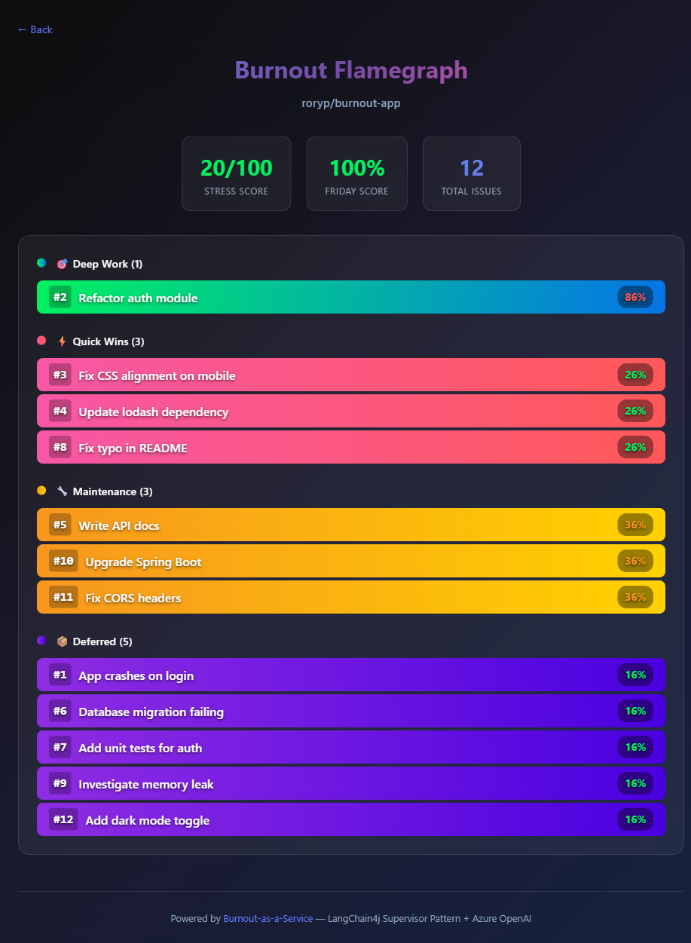
Scene 7: The Flamegraph — AFTER
Same 12 issues → now structured into 1 Deep Work, 3 Quick Wins, 3 Maintenance, 5 Deferred.

Slide 12
Scene 8: The Transformation
Same issues, same deadlines — but structured. That's the difference between burnout and balance.
Metric | Before (No Labels) | After (Reshaped)
Deep Work | 0 | 1
Quick Wins | 0 | 3
Maintenance | 0 | 3
Deferred | 12 (all) | 5 (intentional)
Stress Score | 25/100 | 20/100
3-3-3 Compliant | No ❌ | Yes ✅

Slide 13
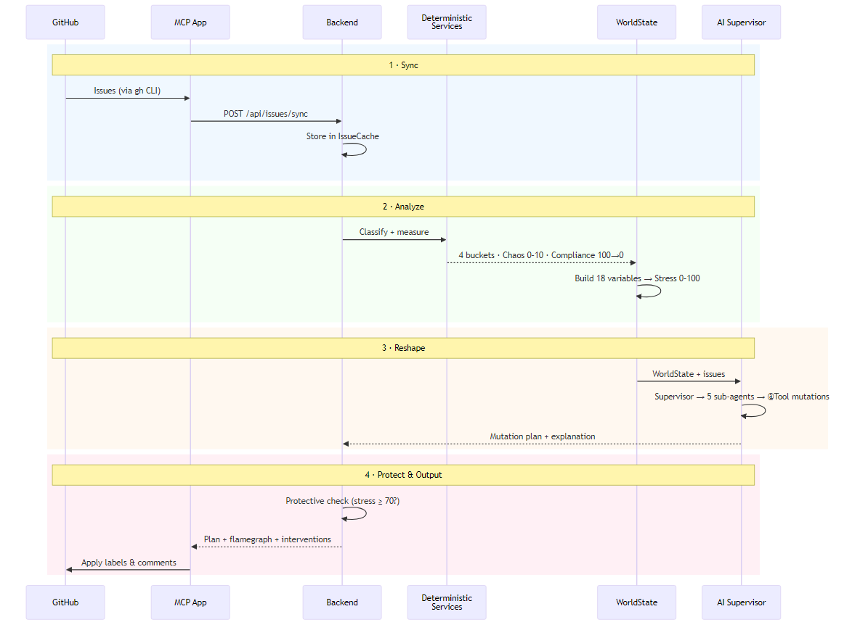

Slide 14
Graceful Degradation
Core principle: every AI feature must work without AI.
Level | State | Behavior
0 | Full LLM available | AI explanations, emotional support, supervisor active
1 | LLM call fails | Catch exception → fallback; all metrics still accurate
2 | LLM not configured | llmEnabled = false → full deterministic with pre-written messages
3 | Backend partial | Health returns UP; endpoints degrade independently
Why This Matters
If a burnout prevention tool fails when you need it most, it increases stress instead of reducing it. All metrics are deterministic — stress scores, chaos, compliance, classification, and day plans compute without any LLM. AI agents only add the how (mutation plan) and why (explanation).

Slide 15
Architecture & MCP Usage
End-to-End Flow
4 MCP Tools (VS Code Copilot Chat)
1. Sync — GitHub issues → IssueCache (ConcurrentHashMap)
2. Calculate — ChaosMetrics, Compliance, Classification
3. Build WorldState — 18 capped variables
4. Invoke Supervisor — planner coordinates 5 sub-agents
5. Accumulate Mutations — @Tool methods → pendingActions
6. Return Response — plan, scores, protective messages
Tool | Description
sync_issues | Fetch GitHub issues and sync to backend
show_burnout_wheel | Interactive flamegraph with 3-3-3 plan
reshape_day | AI-powered optimization — applies labels
get_stress_score | Stress score 0–100 (LOW → CRITICAL)
Usage in VS Code
Sync issues for owner/repo Show my burnout wheel for owner/repo Reshape my day for owner/repo What's my stress score for owner/repo

Slide 16
Quick Start
Option A: Deploy to Azure
Option B: Run Locally
Prerequisites:
• GitHub CLI — gh auth login
• VS Code with GitHub Copilot
• Node.js 18+
One command:
azd auth login
azd up
Provisions: Container Apps, Azure OpenAI,
ACR, managed identity (Bicep)
Requires: Java 21+, Maven
Backend:
cd backend
mvn clean package -DskipTests
java -jar target/burnout-backend-*.jar
MCP App:
cd mcp-app
npm install && npm run build
Reload VS Code — .vscode/mcp.json pre-configured

Slide 17
Burnout-as-a-Service
Not less work — structured work.
Live Demo: https://aka.ms/burnout-app GitHub: github.com/roryp/burnout-app Psychology Deep-Dive: docs/PSYCHOLOGY.md
Java 21 • Spring Boot 3 • LangChain4j • Azure OpenAI • MCP • GitHub Copilot

