Slide 1
AI Agents
LangChain4j Agentic Patterns Showcase
11 agentic patterns with real-time visualization using D3.js and WebSocket streaming
Quarkus 3.30 • LangChain4j 1.18 • React 18 • D3.js • Azure OpenAI

Slide 2
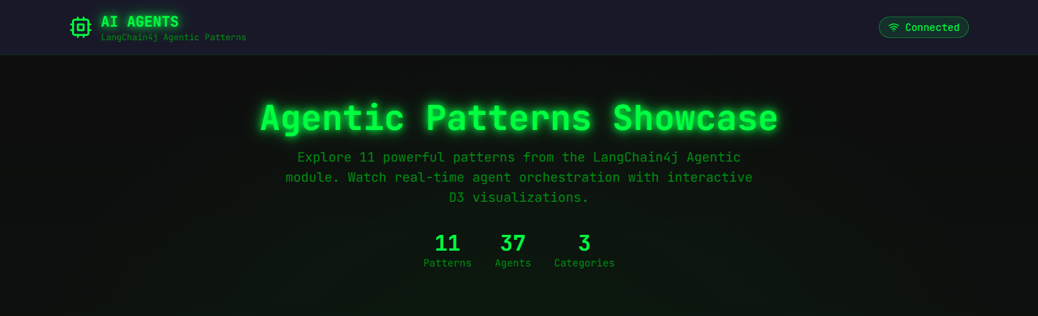
Live Dashboard
WORKFLOW · 5
AGENTIC · 2
PLANNING · 4
Sequential · Parallel · Mapper · Loop · Conditional
Supervisor · Human-in-the-Loop
GOAP · P2P · Debate · Voting

Slide 3
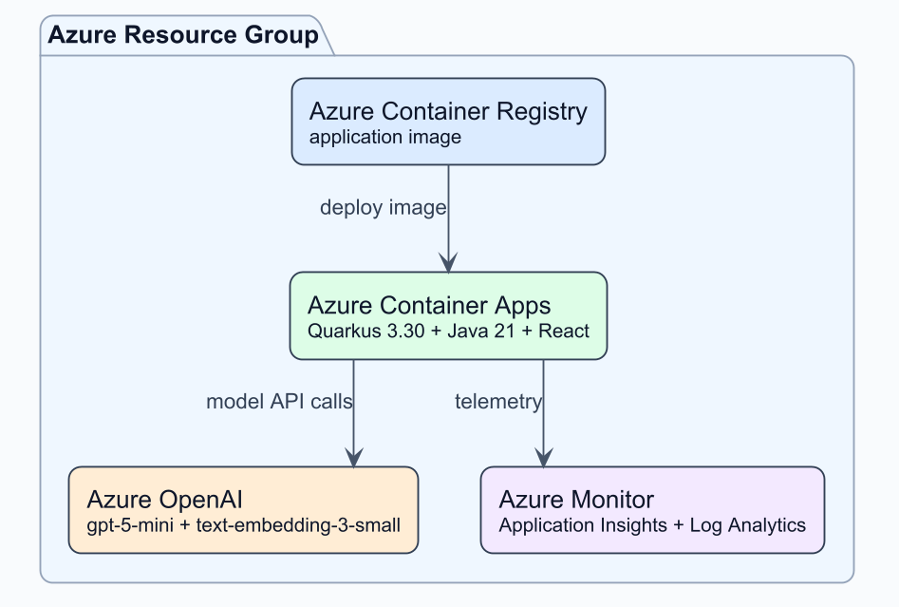
Azure Deployment Architecture

Slide 4
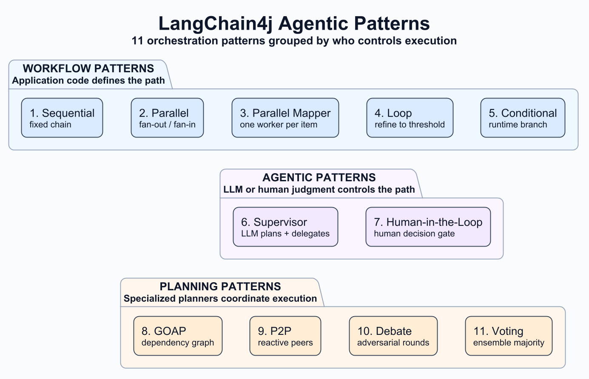
11 Agentic Patterns Overview

Slide 5
1. Sequential Workflow
Chain Orchestration
• Agents run one after another, like an assembly line • Each step depends on the previous step's output
• Example: CreativeWriter → AudienceEditor → StyleEditor • API: AgenticServices.sequenceBuilder()

Slide 6
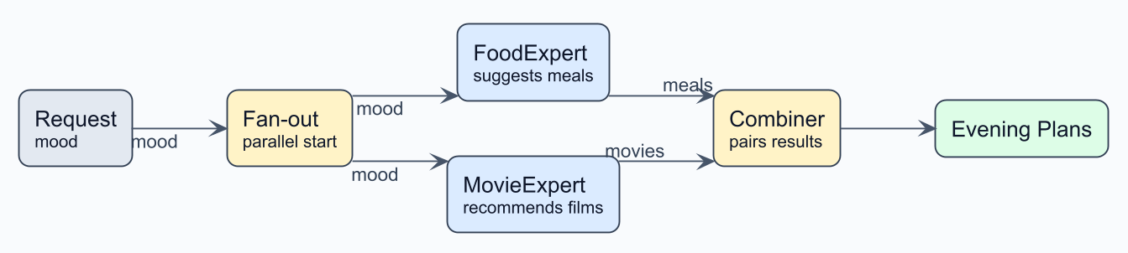
2. Parallel Workflow
Fan-out Orchestration
• Multiple agents run simultaneously, results combined • Get diverse perspectives quickly
• Example: FoodExpert + MovieExpert → Combiner • API: @Parallel annotation with createAgenticSystem()

Slide 7
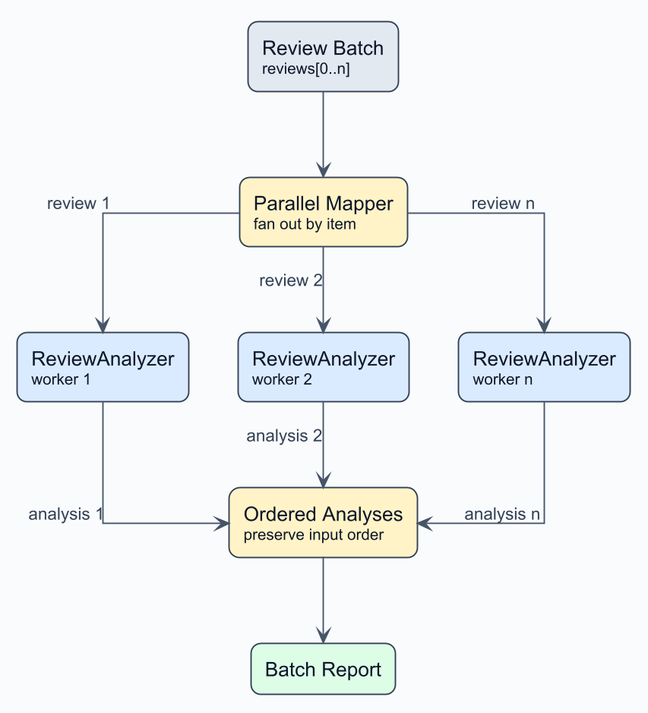
3. Parallel Mapper
Concurrent Map-Reduce
• Creates one worker instance per collection item • Processes the full batch concurrently while preserving order • Example: Review batch → ReviewAnalyzer workers → Report • API: AgenticServices.parallelMapperBuilder()

Slide 8
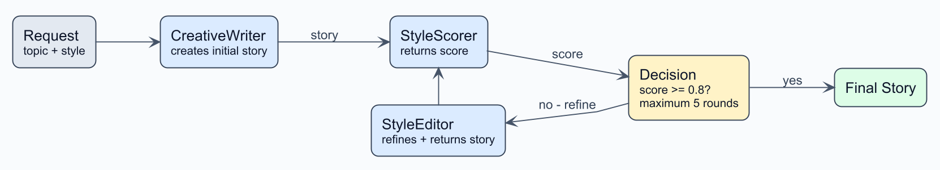
4. Loop Workflow
Cycle Orchestration
• Iterative refinement until quality threshold is met • Quality matters more than speed
• Example: Writer → Scorer → Editor (repeat until score ≥ 0.8) • API: AgenticServices.loopBuilder()

Slide 9
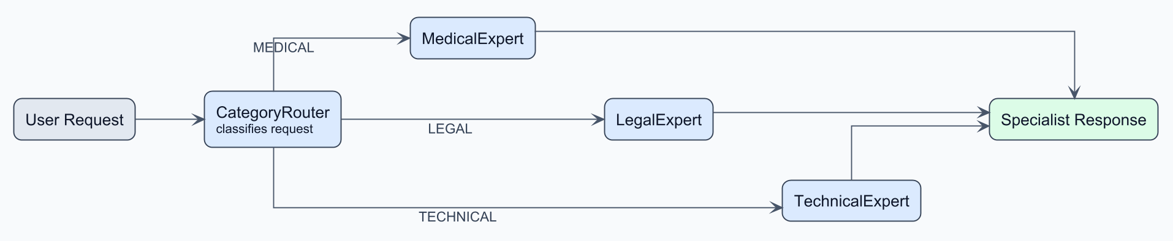
5. Conditional Routing
Branch Orchestration
• Routes to different specialist agents based on input • Different inputs need different expertise
• Example: CategoryRouter → Medical / Legal / Technical Expert • API: @Conditional annotation with createAgenticSystem()

Slide 10
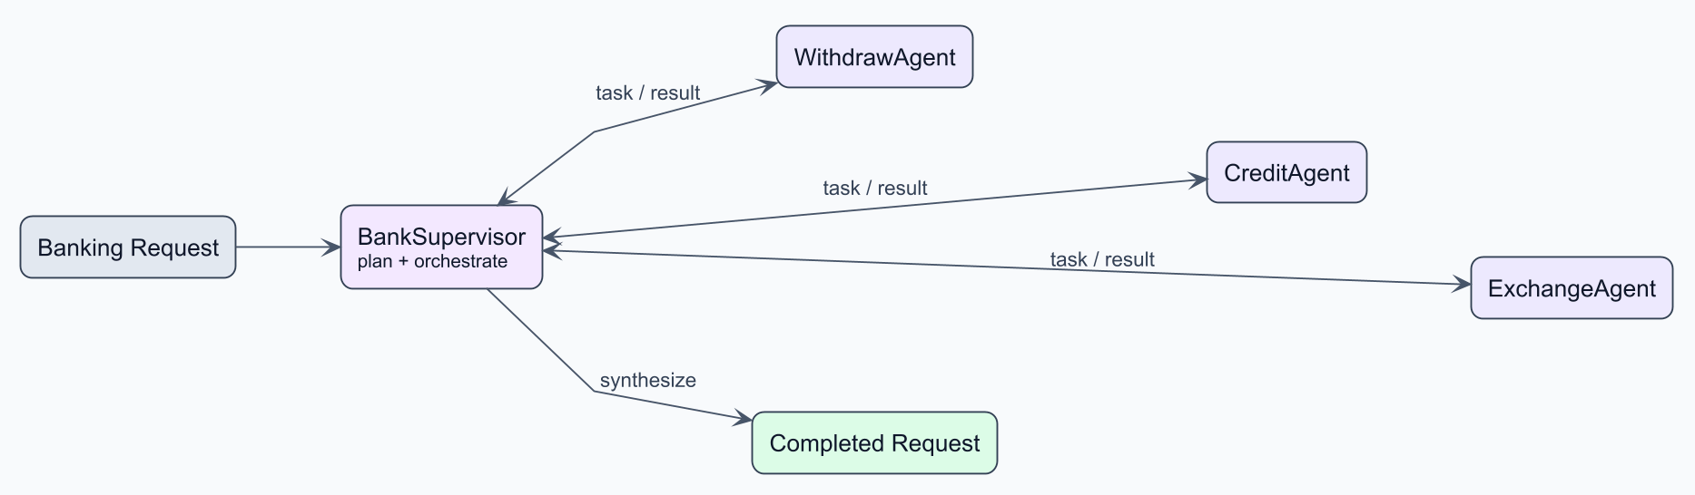
6. Supervisor Agent
Star Orchestration
• A 'boss' agent plans and delegates to worker agents • LLM intelligence decides task decomposition
• Example: BankSupervisor → Withdraw / Credit / Exchange Agent • API: AgenticServices.supervisorBuilder()

Slide 11
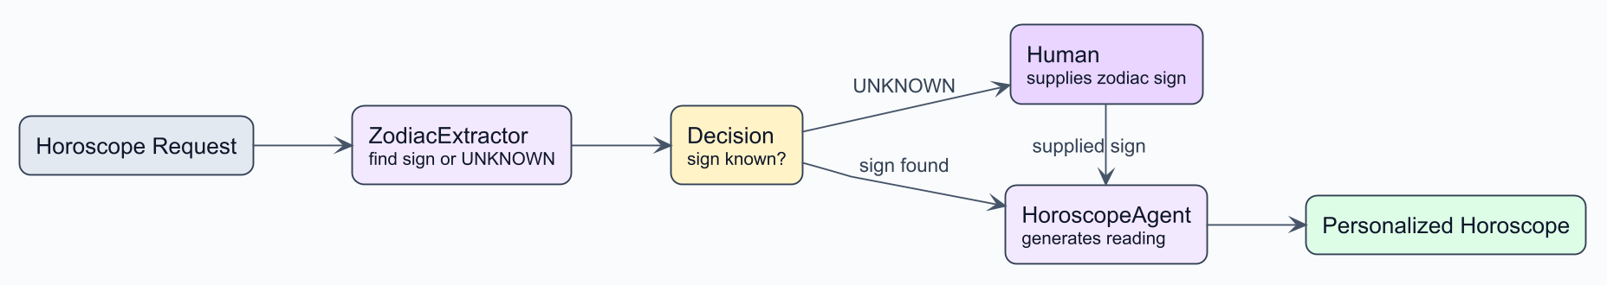
7. Human-in-the-Loop
Gated Orchestration
• Pauses execution for human input or approval • High-stakes decisions, compliance requirements
• Example: ZodiacExtractor → Human Input → HoroscopeAgent • API: AgenticServices.agentBuilder() with WebSocket events

Slide 12
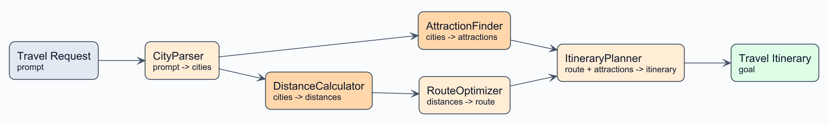
8. GOAP — Goal-Oriented Action Planning
DAG — Custom Planner
• Finds optimal sequence of agents to reach a goal • Like GPS finding the shortest route
• Example: CityParser → (Distances + Attractions) → Itinerary • API: plannerBuilder() + GoalOrientedPlanner

Slide 13
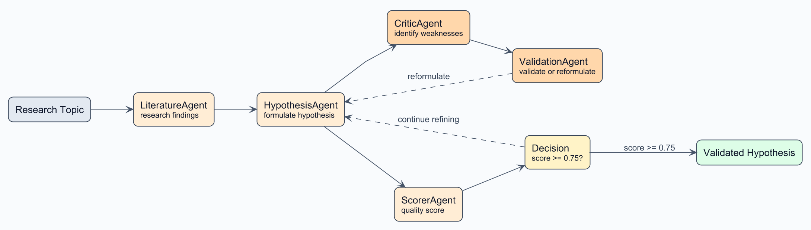
9. P2P — Peer-to-Peer
Mesh — Custom Planner
• Agents collaborate as equals without a central controller • Emergent collaboration for research & brainstorming
• Example: Literature → Hypothesis → Critic → Validation → Scorer • API: plannerBuilder() + P2PPlanner (threshold ≥ 0.75)

Slide 14
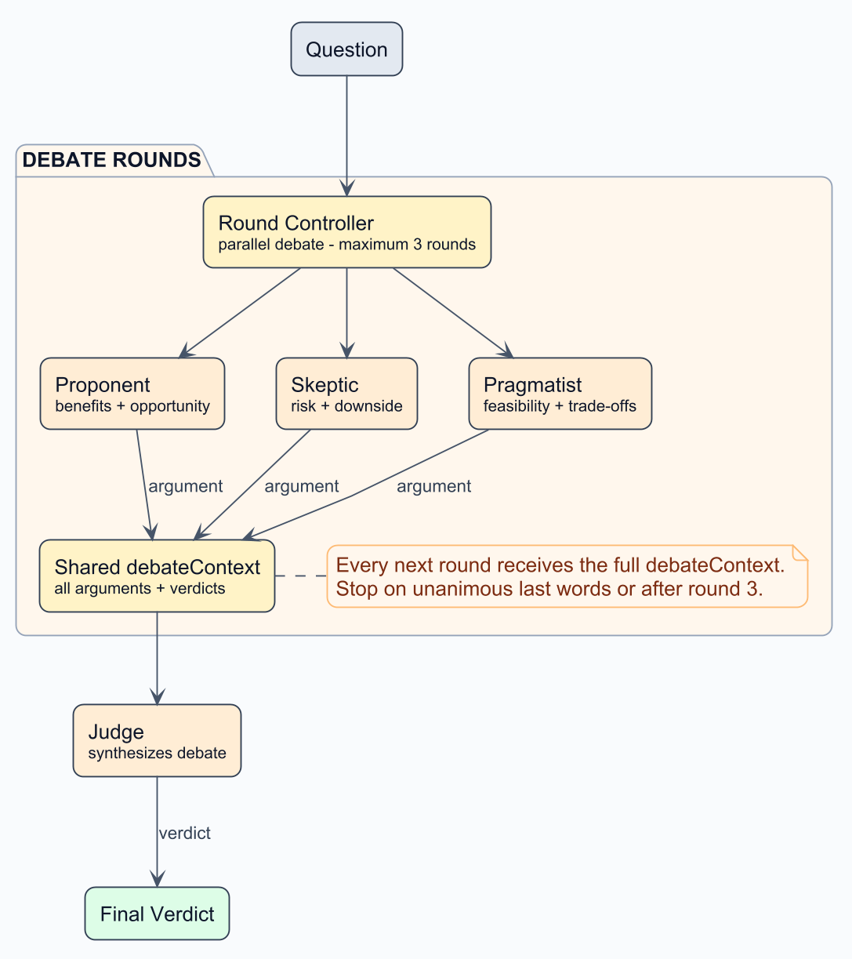
10. Debate
Multi-Round Panel — Custom Planner
• Opposing perspectives refine arguments in parallel rounds • Shared debate context lets agents respond to prior positions • Example: Proponent + Skeptic + Pragmatist → Judge • API: plannerBuilder() + DebatePlanner

Slide 15
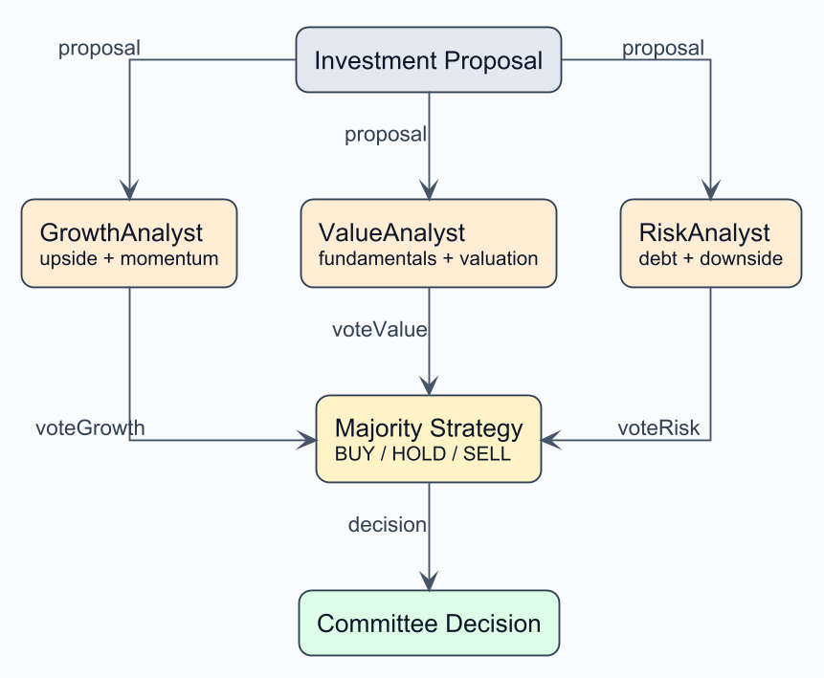
11. Voting
Ensemble Decision — Custom Planner
• Independent specialists cast comparable categorical ballots • A voting strategy aggregates one collective decision • Example: Growth + Value + Risk analysts → Majority • API: plannerBuilder() + VotingPlanner

Slide 16
Choosing the Right Pattern
Situation | Recommended Pattern
Simple pipeline with clear steps | Sequential
Need multiple perspectives fast | Parallel
Apply one operation to many items | Parallel Mapper
Quality is critical, time isn't | Loop
Different inputs need different handling | Conditional
Complex task, unclear how to break down | Supervisor
Need human approval or input | Human-in-the-Loop
Many dependencies, need optimal path | GOAP
Creative / brainstorming collaboration | P2P
Need competing arguments examined | Debate
Need a robust categorical decision | Voting

Slide 17
Tech Stack
Backend + AI
Frontend + Visualization
• Java 21 with Virtual Threads • Quarkus 3.30 • LangChain4j 1.18.0 (Core) • LangChain4j Agentic 1.18.0-beta28 • Agentic Patterns 1.18.0-beta28 • Azure OpenAI integration • Native Quarkus WebSockets
• React 18 with TypeScript • Vite 5 build tool • D3.js for visualizations • Tailwind CSS for styling • React Router for navigation
Azure OpenAI reasoning
Quarkus + LangChain4j orchestration
React + D3 live visualization

Slide 18
AgenticScope: Unified State Management
All 11 patterns coordinate through one shared AgenticScope
• Shared state via readState() / writeState() • Output mapping via @Agent(outputKey = ...) • Invocation tracking for debugging • AgentListener events for real-time visualization
PROGRAMMATIC
DECLARATIVE
Builder APIs such as sequenceBuilder() and loopBuilder() Best for dynamic workflows and runtime configuration
Annotations plus createAgenticSystem() Best for concise definitions with compile-time validation
Agent A writes output
AgenticScope shared state
Agent B reads input

