Slide 1


Slide 2
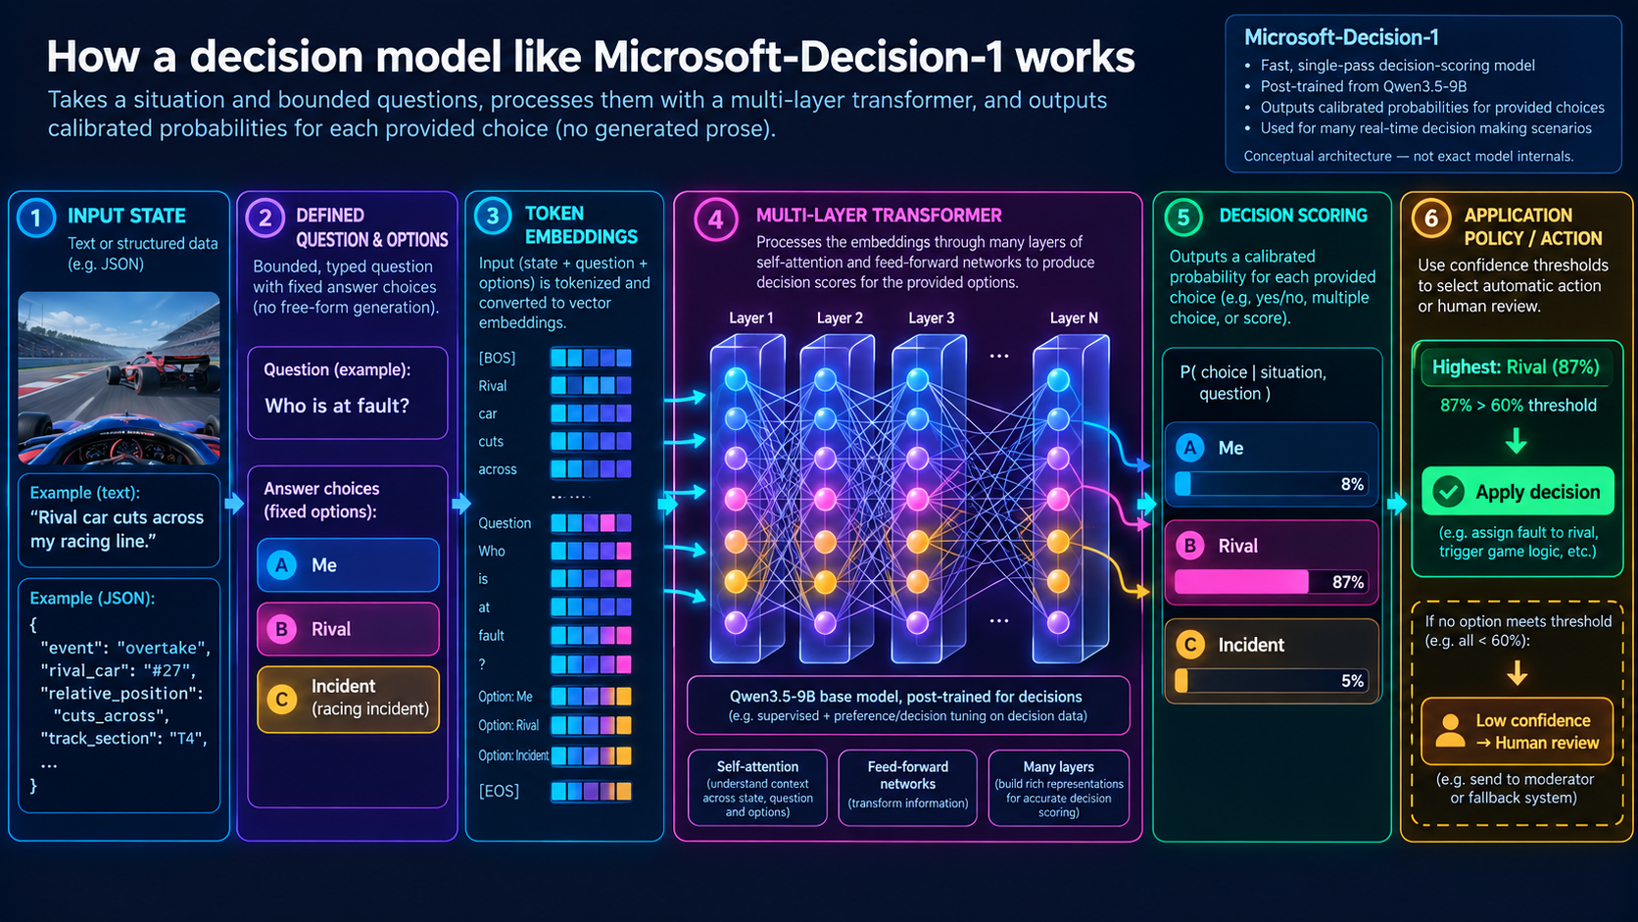

Slide 3
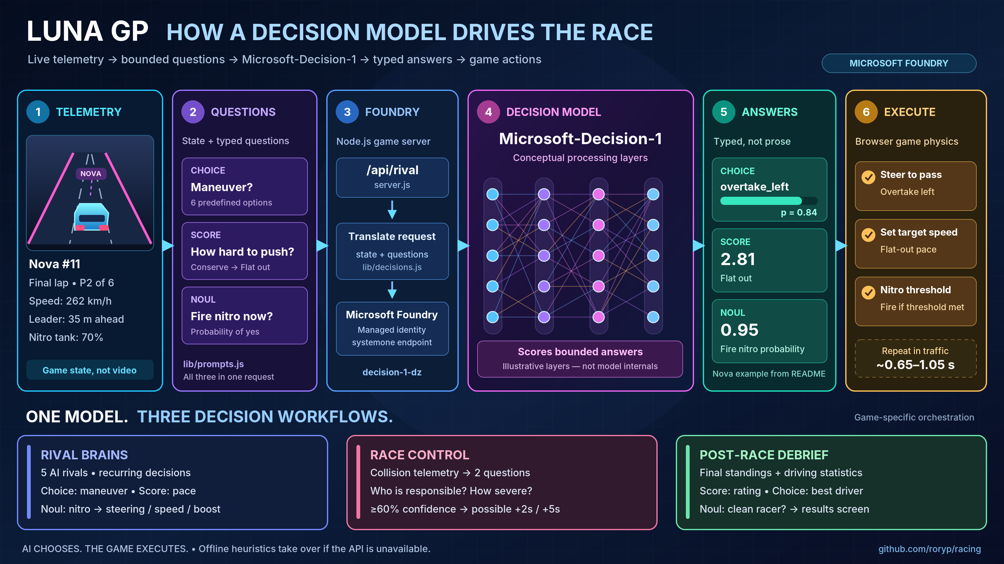

Slide 4
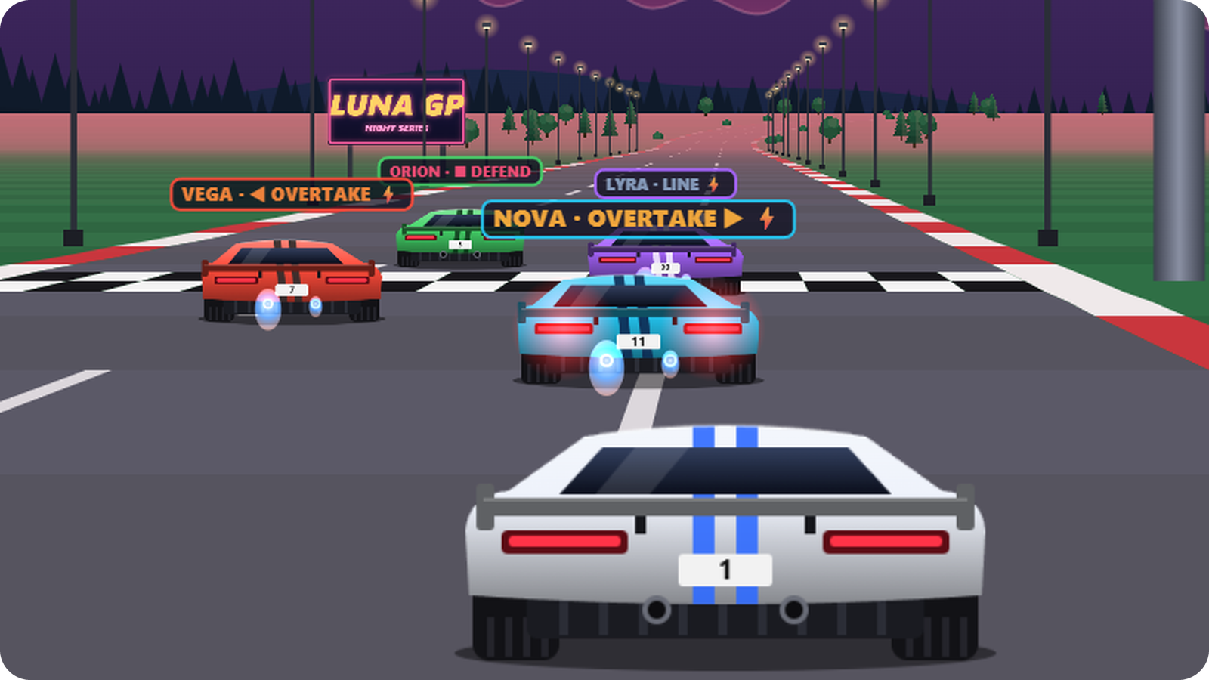



THE IDEA
02 / 14
You drive. The model decides.
The model never moves a car. It answers typed questions; game code acts on the answers.
You
Steer, brake and fire nitro,
on keyboard or touch.
The engine
Draws the pseudo-3D road
and runs the physics.
The model
Picks each rival's move;
the tags show it live.
Notes:
The split of work: the player drives, the game engine handles rendering and physics at a fixed 60 Hz step, and the model only makes decisions: the five rivals' tactics, Race Control rulings and the post-race debrief. The screenshot is a crop of the race canvas a few seconds after the start, with the game talking to Microsoft-Decision-1: the tag above each rival is its latest answer, and a lightning bolt means its nitro is firing. Press L in the game to toggle the tags.

Slide 5
THE MODEL
03 / 14
A decision model, not a chatbot
Give it a situation and closed questions; it returns a calibrated probability for every answer option. No prose, no rationale.
BASE MODEL
INPUT · TEXT OR JSON
OUTPUT
Qwen3.5-9B, post-trained
Up to 32K tokens
3 tokens per rival call
QUESTION TYPES
ENDPOINT
noul · choice · score
POST {endpoint}/providers/microsoft/v1/systemone
Notes:
From the model card and Microsoft Learn: Microsoft-Decision-1 is a decision-scoring model built on the open-weight Qwen3.5-9B and post-trained by Microsoft. It takes a state (text or JSON, up to 32K tokens) and typed questions, and returns a calibrated probability per answer option in a single pass. It is text-only and gives no explanations. A rival call's response reports 3 output tokens (it asks three questions) against about 630 input tokens. LUNA GP uses a deployment named decision-1-dz (DataZoneStandard, 500 requests per minute). The request's model field is the deployment name; the response names the underlying model.

Slide 6
QUESTION TYPES
04 / 14
Three ways to ask
One request carries one state and any mix of typed questions; a single pass answers them all.
noul
choice
score
Is this true?
Which option?
How much?
0.73
a
0.62
score = 1.90
b
0.21
c
0.12
0 false
true 1
d
0.05
0
1
2
3
"noul": p(true)
"choice" + p per option
"score" = Σ i · p(i)
Gates and filters
Classify and route
Rank and grade
Notes:
The three question types from the Microsoft Learn docs. noul asks 'is this true?' and returns one probability from 0 to 1; optional criteria can define what true and false mean. choice picks exactly one option from a fixed set and returns a probability for every option. score places the state on an ordered scale: the returned score is the probability-weighted average of the level indexes (here 0.15 + 1.0 + 0.75 = 1.90), so it can fall between levels.

Slide 7
NOUL
05 / 14
One probability, many policies
REQUEST
SAME ANSWER, FIVE DRIVERS
"nitro": {
"type": "noul",
"instructions":
"Should the driver fire the nitro …"
}
noul = 0.62
0.50
0.60
0.65
RESPONSE
≥ 0.50
Vega, Rigel aggressive · wildcard
FIRE
"nitro": { "type": "noul", "noul": 0.62 }
≥ 0.60
Orion defensive
FIRE
≥ 0.65
Nova, Lyra tactical · smooth
HOLD
Notes:
noul is the yes/no type: the request has only instructions (criteria with true/false definitions are optional; LUNA GP doesn't send them) and the answer is one probability. The probability does not fire nitro by itself: each rival compares it with its personality threshold (aggressive and wildcard 0.50, defensive 0.60, tactical and smooth 0.65). This slide compares a hypothetical result of 0.62 against all five thresholds; it is not one answer broadcast to every car. Each rival has its own request and can receive a different probability. A boost also needs at least 34% of the tank. The debrief's clean_racer question is a noul too.

Slide 8
THE QUESTIONS
06 / 14
Eight questions, three callers
CALLER | QUESTION | TYPE | ANSWER SPACE | GAME POLICY
Rivals ×5 every 0.65–1.8 s | maneuver | choice | 6 maneuvers | steer to the chosen line
 | pace | score | 0–3, Conserve → Flat out | target = 92–101% of top speed
 | nitro | noul | p(true) | fire if p ≥ 0.50–0.65
Race Control on contact | responsible | choice | player · rival · incident | blame needs p ≥ 0.60
 | severity | score | 0–2, Light touch → Dangerous | ≥ 0.8 → +2 s · ≥ 1.5 → +5 s
Debrief after the flag | rating | score | 0–3, Rookie → Champion | results screen
 | driver_of_the_day | choice | you or one of the 5 rivals | results screen
 | clean_racer | noul | p(true) | results screen
Notes:
Every model call the game makes. Each of the five rivals sends its own request containing maneuver, pace and nitro; these are not five drivers batched into one request. Requests from different rivals can overlap. Each rival asks again 0.65 to 1.05 s after its last answer in traffic and 1.4 to 1.8 s otherwise. Its personality is included in the model input and also selects the game's nitro threshold. The pace score sets the target speed: top speed × (0.92 + 0.03 × score), so Flat out (3) aims 1% past the car's nominal top speed; overtakes add 2%, nitro 22% and a slipstream 6%, and corners scale it down. Race Control asks two questions on each contact with the player (at most once every 4 s per rival) and penalizes the responsible driver when the model is at least 60% sure and severity is at least 0.8. The debrief's driver_of_the_day picks from the six cars in the race: you and the five rivals. All policies (thresholds, penalties, the speed formula) live in game code, not in the prompt.

Slide 9
RIVAL DECISIONS
07 / 14
A radio check, not a chat
Illustrative snapshot and reply; each request is about one driver.
GAME SENDS TO THE MODEL
MODEL RETURNS TO THE GAME
Vega (#7), aggressive
Three answers
Lap 2/3 · P2/6 · 260 km/h
Nitro tank 70% · 300 m of straight road
Player 18 m ahead, 12 km/h slower
Last move: slipstream, 1.2 s ago
maneuver
Overtake left
pace
2.4 / 3
nitro
0.78 (78%)
Ask: Which move? How hard? Nitro?
Game checks the boost threshold and tank.
No chat history: each repeat sends fresh data plus the previous move and its age.
Five independent drivers: requests can overlap; rivals do not exchange plans.
Notes:
Think of this as a repeated radio check, not a chat conversation. The snapshot and answers on this slide are illustrative, not a captured model reply. The actual exchange is JSON, shown on the next slide.
The browser posts telemetry for one rival to /api/rival. It includes driver name, number and personality; lap, position and gaps; speed, top speed, road position, nitro tank and whether the boost is active; upcoming track features and elevation; nearby cars ahead, behind or alongside and their relative speeds. The previous maneuver and its age are included when available. The server validates the data, writes the state as plain text, and adds the same three fixed questions: maneuver, pace and nitro. Personality is part of the model input, not just a rule applied after the answer.
The example reply selects overtake_left, scores pace at 2.4 on the 0-to-3 scale, and returns a nitro likelihood of 0.78. Game code steers and sets the speed target. It compares the nitro likelihood with the driver's personality threshold and checks the tank before boosting; aggressive Vega's threshold is 0.50 and a boost needs at least 34% of the tank. The model does not drive the physics directly.
There is no messages array, growing chat transcript or persistent model conversation per car. Each call supplies a fresh snapshot, including the last move and its age. Each of the five rivals has its own asynchronous decision loop and at most one outstanding request; requests from different rivals can overlap. After a reply, that rival waits 0.65 to 1.05 seconds in traffic or 1.4 to 1.8 seconds otherwise before asking again. Rivals observe traffic but do not exchange plans or coordinate as a swarm. A coordinated swarm remains a future project on the closing slide.

Slide 10
THE JSON EXCHANGE
08 / 14
One request, three answers
Abbreviated JSON: one driver's situation in, three named answers out.
REQUEST
RESPONSE
POST …/providers/microsoft/v1/systemone
{
"model": "<deployment-name>",
"state": "<Vega's snapshot>",
"questions": {
"maneuver": { "type": "choice", … },
"pace": { "type": "score", … },
"nitro": { "type": "noul", … }
}
}
200 OK
{
"model": "microsoft-decision-1",
"answers": {
"maneuver": {
"choice": "overtake_left", …
},
"pace": { "score": 2.4, … },
"nitro": { "noul": 0.78, … }
},
"usage": { "output_tokens": 3, … }
}
All three include instructions.
Choice and score add criteria (options).
Illustrative reply; extra fields omitted.
Notes:
This is an abbreviated JSON example, not a literal complete packet: the ellipses mark omitted fields. The request's model is the configured deployment name; the response's model names the underlying model. state is a few lines of plain text built from validated telemetry, including personality, race position, speed, nitro, road and nearby cars, and the previous maneuver and its age. There is no messages array or growing chat history. All three questions include instructions explaining what to decide. The maneuver question's criteria is an object mapping the six choices to descriptions: racing_line, overtake_left, overtake_right, slipstream, defend and back_off. The pace question's criteria is an ordered list of four descriptions: Conserve, Race, Push and Flat out, indexed 0 to 3. The nitro question uses type noul and instructions, without criteria. The sample answers match the previous slide and are illustrative, not a measured model response. Actual choice and score answers also contain type, confidence and probabilities; a noul answer contains its type and one probability. Usage also includes input tokens. The server compacts the answers and adds timing and token information before returning them to the browser, where game code applies them. A measured rival call used about 630 input tokens and 3 output tokens.

Slide 11
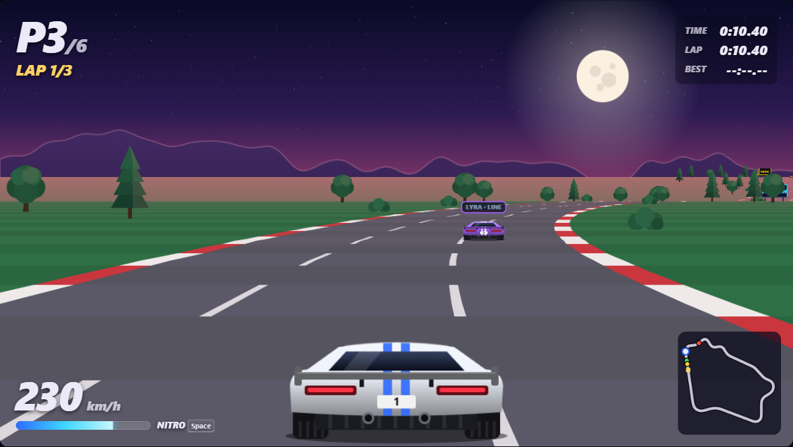
RACING LINE
09 / 14
How rivals follow the line
The model selects racing_line; game code computes the target and steers at 60 Hz.
YOU
AI REQUEST / STATE SUMMARY
Lyra #22 / smooth / lap 1/3 / P2
268 km/h / medium right / uphill
No car ahead within 150 m
LYRA #22 / P2 / 268 km/h
maneuver: choice
pace: score nitro: noul
LIVE RESULT / 358 ms
racing_line
choice: 99.24%
pace 1.46 / 3 nitro 0.095
Yellow: engine target. Controlled game capture; overlay added.
No boost: nitro 0.095 < Lyra's 0.65.
40-segment lookahead; inside bias, not a full apex line.
Notes:
A racing line is the path a driver aims to take to carry speed through a corner. A conventional racing line often uses outside entry, an inside apex and outside exit. LUNA GP does not compute that optimized route: racing_line is a simple curve-following heuristic. Positive curvature is a right-hand bend and produces a positive offset, so the target biases toward the INSIDE of the bend, not the opposite side.
Provenance: screenshot from the actual LUNA GP game at https://aka.ms/racing, captured on 2026-10-28. This is a controlled in-game setup using the existing debug hook, not a naturally occurring race moment. Lyra is positioned on a right-hand bend with clear road ahead and a slower player behind. The scene was held still while one real POST /api/rival request was made for that pictured car. The response is from Microsoft-Decision-1, not the local fallback. Request and result on the slide are condensed; displayed numbers are rounded. The HUD P3 and 230 km/h belong to the human player/camera, whereas the request's P2 and 268 km/h belong to Lyra (#22).
The editable yellow overlay was added only in PowerPoint. It projects the engine's target offset at sampled road positions using the game's own segment projection. It is a target line, not a model-generated polyline or a prediction of the exact vehicle trajectory. The line is interrupted where Lyra's car occludes it. The screenshot itself has no racing-line overlay in normal gameplay.
Implementation: Race.driveAi sets targetOffset = clamp(track.avgCurveAhead(car.progress, 40) * 0.12, -0.55, 0.55) for racing_line. Road offsets run from -1 (left edge) to +1 (right edge), with 0 at the centre. Here average curvature is +4, so the target is +0.48. The 40 segments cover about 55.6 metres in the game's distance scale. Each 60 Hz physics step moves the car toward that target by at most (0.25 + speed / MAX_SPEED) * dt. The model chooses the maneuver, pace and nitro probability; it does not steer frame by frame or supply path coordinates.
Traffic and pace: an alongside-car guard prevents steering into another car. Overtake, slipstream, defend and back_off temporarily choose different lateral targets. Pace sets topSpeed * (0.92 + 0.03 * score), then cornering, traffic, drafting and nitro modify the speed target. Rivals do not use the player's centrifugal-drift physics. The fixed-step AI controller directly adjusts their lateral offsets.
Exact server-built state for this request:
Arcade circuit race, 3 laps, 6 cars. Driver under review: Lyra (#22).
Personality: Smooth: clean and consistent, sticks to the racing line, only overtakes when it is easy.
Race situation: lap 1 of 3; running P2 of 6, 3.4 s behind the leader.
Car: 268 km/h (top speed 285 km/h), in the right lane, nitro tank 72%.
Track ahead: currently in a medium right-hand corner with 81 m to go, then a 47 m straight, then a gentle left-hand corner (97 m long). The road climbs.
Car ahead: none within 150 m.
Car behind: the human player, 24 m behind, slightly to the left, 37 km/h slower (dropping back).
Typed questions: maneuver (choice: racing_line, overtake_left, overtake_right, slipstream, defend, back_off); pace (score: Conserve, Race, Push, Flat out); nitro (noul). The exact fixed instructions and criteria are built by lib/prompts.js and converted to the Foundry request shape by lib/decisions.js. No conversation history or screenshot is sent with the rival request.
Captured result: model microsoft-decision-1; maneuver.choice racing_line; maneuver.probabilities.racing_line 0.9924292785227681 (99.24% on slide); maneuver.confidence 0.9909151342273217 (a different field, not the displayed choice probability). pace.score 1.4615374821905507; nitro.probability 0.09535027692543765; refusals []; latencyMs 358; inputTokens 594. Nitro is held because 0.09535 is below Lyra's 0.65 threshold even though her tank is 72%, above the 34% minimum cost.
Sources: public/js/race.js (driveAi, rivalPayload), public/js/track.js (avgCurveAhead), public/js/rivals.js (cadenceMs, apply), public/js/render.js (road projection), public/js/config.js (STEP and nitro thresholds), lib/prompts.js (buildRivalRequest), lib/decisions.js (toFoundryQuestions). Live game: https://aka.ms/racing.

Slide 12
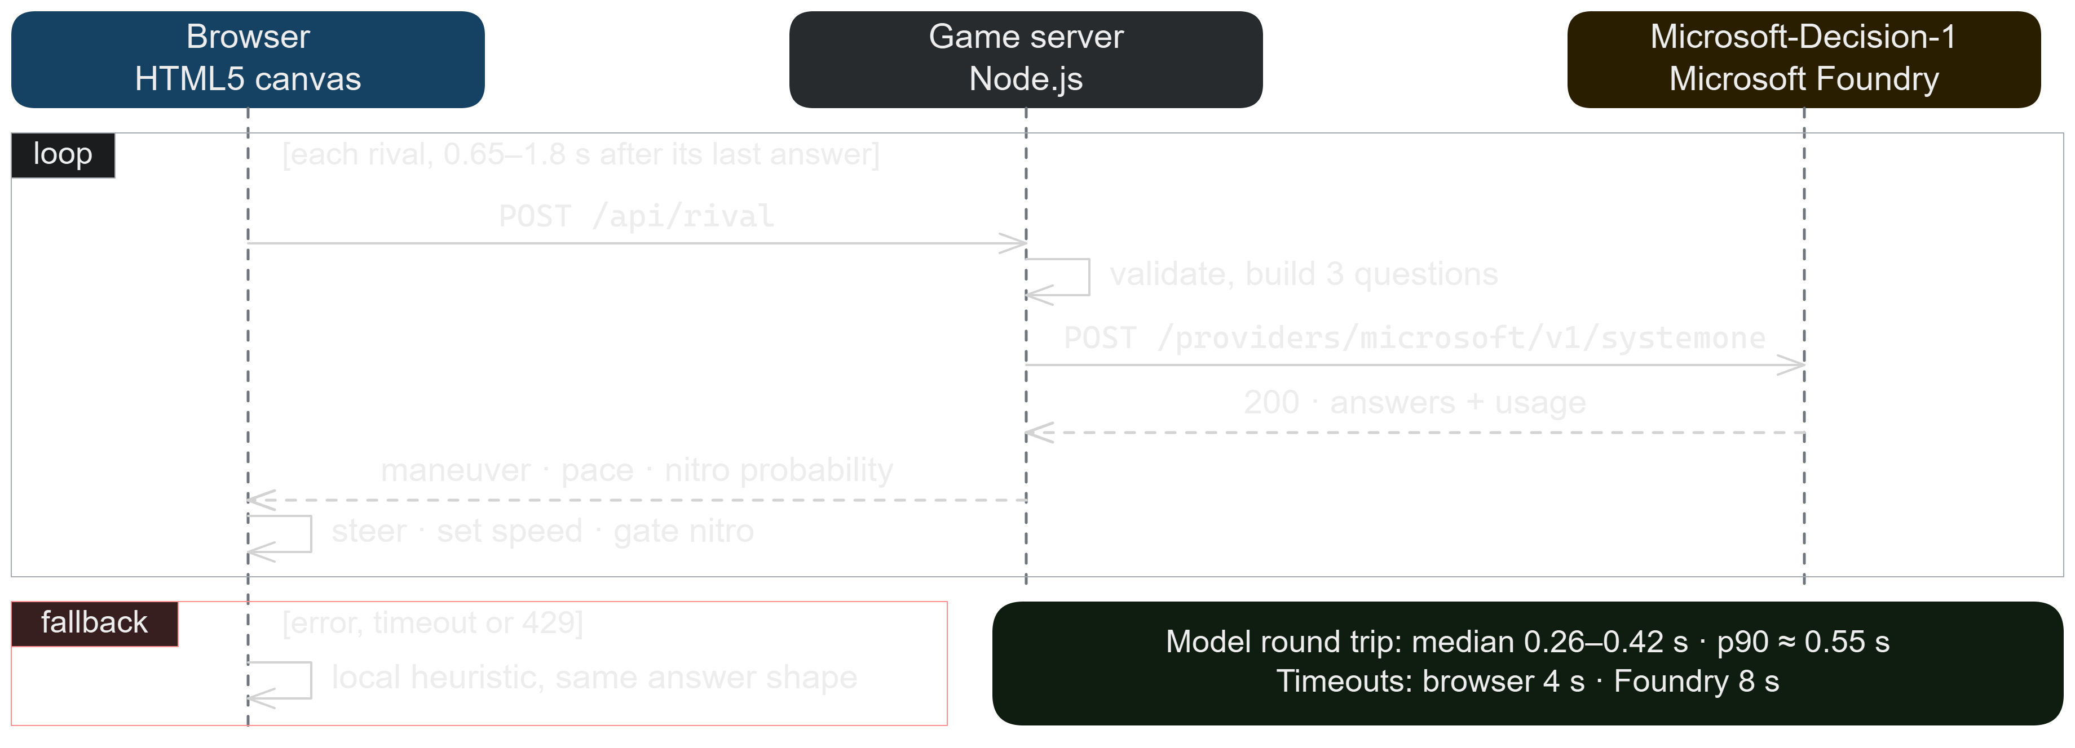
SEQUENCE
10 / 14
One rival decision, end to end
Notes:
One rival decision. The browser posts validated telemetry to /api/rival. The server builds the state and three questions, attaches a cached Entra ID bearer token and calls the systemone endpoint. It maps the answers, adds latency and token counts, and returns maneuver, pace and nitro p; the browser steers, sets speed and gates nitro. Each rival asks again 0.65 to 1.8 s after its last answer. Measured model round trips (server to Foundry): from the Azure app, median 260 ms and p90 550 ms over 37 calls; from a dev machine, median 415 ms and p90 530 ms over 186 calls. On an error, a timeout or a 429, that rival uses a local heuristic with the same answer shape. Source: docs/images/decision-sequence.excalidraw.

Slide 13


HOSTING
11 / 14
One web app, one Node process
The game runs in the browser. The server only serves files and asks the model.
BROWSER
APP SERVICE
FOUNDRY
The whole game
node server.js
Microsoft-Decision-1
Physics, rival driving, crashes, laps and drawing, 60 times a second.
Serves the game files. Its /api endpoints build the questions and call the model.
Answers rival, steward and debrief questions. Called with the app’s managed identity.
Not a container app: no image, background workers, queues or database. Deploy is a zip pushed to the web app.
Notes:
Where everything runs. The whole game runs in the player’s browser: physics at a fixed 60 Hz step, rival driving, crashes and the roadside recovery, laps, positions and canvas rendering. The browser calls the server only when a rival, Race Control or the debrief needs a decision. The server is one Node.js process (node server.js) on a Linux App Service web app (Node 22, P0v3, always on). It serves the static files in public/ and the /api/rival, /api/steward, /api/debrief and /api/duel endpoints: they validate the telemetry, build the state and questions, and call Microsoft-Decision-1 on Foundry with the app’s system-assigned managed identity, so no key ever reaches the browser. It is not a container app: there is no container image, background worker, queue, scheduled job or database. Apart from answering requests, the server only keeps an in-memory daily call counter and logs a usage summary every 30 s. Deploying is a zip of server.js, package.json, lib and public pushed with az webapp deploy.

Slide 14




GUARD RAILS
12 / 14
Safe to put on the internet
Auth
Input
API key → managed identity → Azure CLI login.
Tokens are cached and refreshed 5 min early;
the first one is fetched at startup.
Same-origin only. The browser sends telemetry,
never questions; every field is clamped.
Request bodies are capped at 16–32 KB.
Limits
Fallback
16 calls in flight, 20,000 a day, then 429.
Rival timeouts: 4 s in the browser, 8 s to Foundry.
Answers after 4 s are billed but go unused.
Errors fall back to a local heuristic.
A 503 or four failures in a row pause calls for 8 s;
then the next decision tries the model again.
Notes:
The web app is public, so the server protects the quota: it rejects cross-origin requests and unexpected Host headers, validates and clamps every field before writing the state text, and only ever sends its own fixed questions. It caps work at 16 decisions in flight and DAILY_CALL_LIMIT calls per UTC day (default 20,000). Auth order: FOUNDRY_API_KEY, then the App Service managed identity, then the local Azure CLI login; Entra ID tokens are cached, refreshed 5 minutes before expiry, and the first one is fetched at startup. The browser gives up on a rival decision after 4 s, but the server keeps waiting up to 8 s for Foundry, so an answer that lands in between is billed and then dropped. With a p90 round trip around 0.55 s that is rare. Race Control and the debrief get longer browser timeouts (9 s and 12 s). Answers are applied per question, so one refused or invalid answer only falls back for that question.

Slide 15

THROUGHPUT AND COST
13 / 14
About 1.5¢ a race
≈630
≈250
≈0.6¢
≈1.5¢
input tokens
per rival decision
rival calls
per race minute
model cost
per race minute
per 3-lap race
(about 2.5 minutes)
$0.04 per 1M tokens, one rate for input and output; a rival call returns 3 tokens.
Daily cap: 20,000 calls ≈ 80 minutes of racing ≈ $0.50. 500 RPM covers two races at once.
Notes:
Measured on the live game: a rival decision averaged about 630 input tokens and 3 output tokens over 186 calls. Azure's retail price list has a single meter for Microsoft-Decision-1, $0.04 per million tokens. Each rival asks again 0.65 to 1.8 s after its last answer, so the call rate depends on latency: with the Azure app's 260 ms median a race makes about 240 to 250 rival calls a minute, and about 210 from a dev machine (415 ms). That is about 0.6 cents per race minute. A 3-lap race takes about 2.5 minutes in the game's own simulation, so roughly 600 calls and 1.5 cents, plus one debrief call. The 20,000-call daily cap is about 80 minutes of racing, around 30 races, for about $0.50. A DataZoneStandard deployment with capacity 500 allows 500 requests a minute: two races at once. For more, add deployments in other quota pools or request more quota.

Slide 16






Start your engines
FUTURE PROJECT · Build a coordinated AI-driver swarm
PLAY IT NOW
Steer
aka.ms/racing
Throttle
Brake
OR RUN YOUR OWN
npm start → http://127.0.0.1:3000
Space
Nitro
Node.js 20+, no install step.
No FOUNDRY_ENDPOINT? Rivals use offline heuristics.
L
AI decision tags
github.com/roryp/racing
Phones and tablets get touch controls.
Notes:
Play the hosted game at aka.ms/racing: it runs on Azure App Service and reaches the model with its managed identity, and the server caps model calls at 20,000 a day. To run your own: Node.js 20+ and, for AI rivals, FOUNDRY_ENDPOINT plus an Azure CLI login with access to the Foundry resource. Without it the game still runs with offline heuristics. P or Esc pauses, M mutes. Future project: turn the independent rivals into a coordinated swarm that shares tactics and adapts together.

