Slide 1
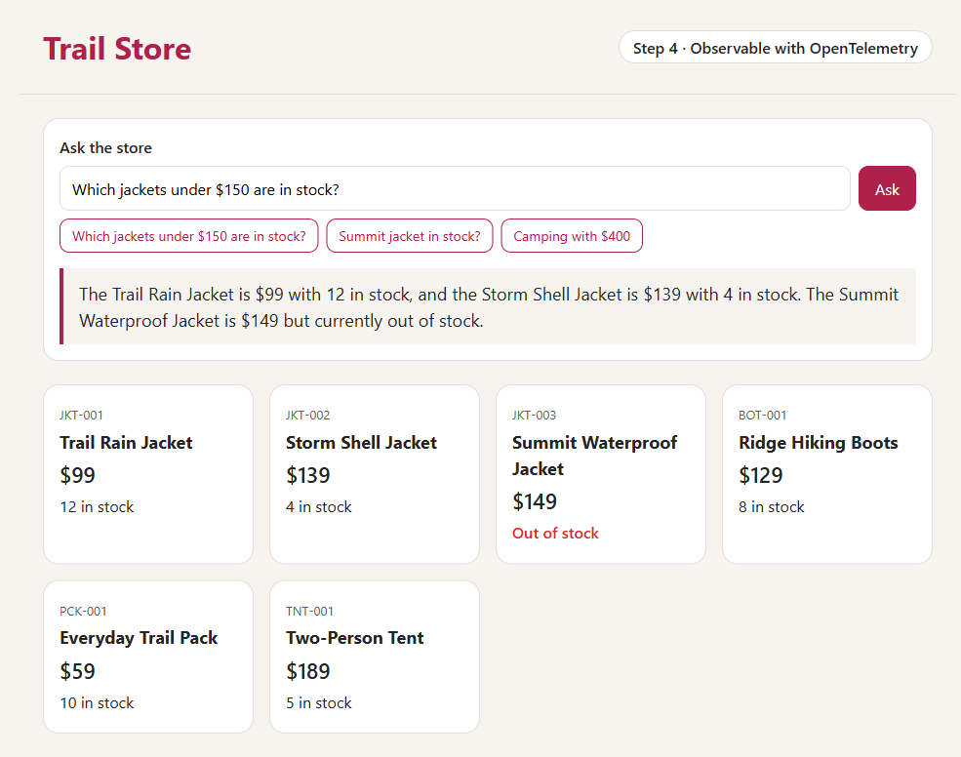
45-MINUTE WORKSHOP
Trail Store
From your laptop to an AI
you can see inside
Spring Boot · Azure Container Apps
Microsoft Foundry · OpenTelemetry
github.com/roryp/spring-ai-webstore
Notes:
Welcome. In 45 minutes we take one small Java web store from a laptop to Azure, add an AI assistant, and then look inside every answer. You only need a browser.

Slide 2
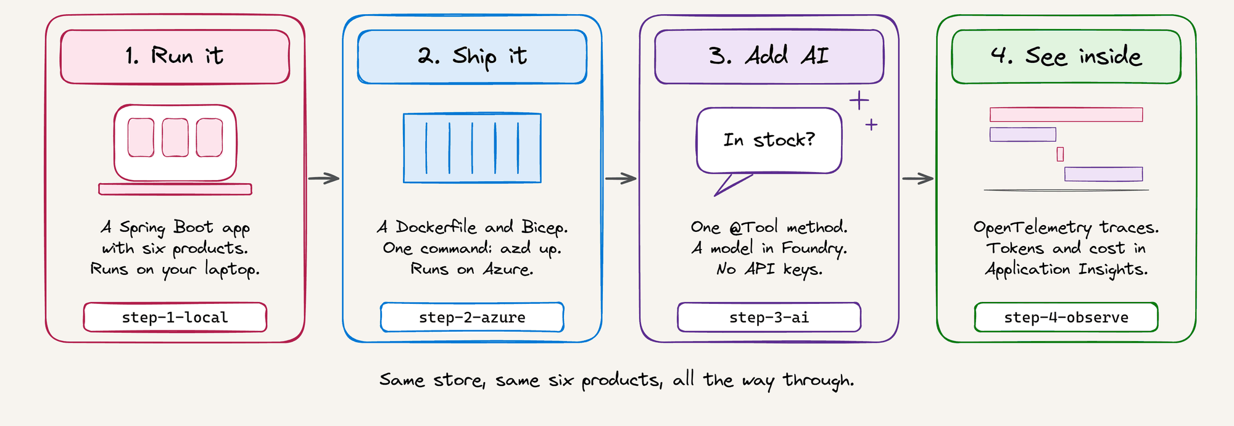
Four steps. One idea each.
Each step is a folder in the repo, and each adds one idea to the step before it.
Notes:
One store, four steps. Each step is a folder in the repo, and each adds one idea: run it, ship it, add AI, and see inside it. The six products stay the same all the way through.

Slide 3
Today: 45 minutes, only a browser
3 min
7 min
10 min
12 min
8 min
5 min
Plan
Step 1
Run it
Step 2
Ship it
Step 3
Add AI
Step 4
See inside
Wrap-up
YOU NEED
FOR EACH STEP
A browser. That's all.
1
Look at the diagram
2
Read the code on GitHub
Code
github.com/roryp/spring-ai-webstore
Live apps
Links from your presenter
3
Try the live app
4
Answer the Find questions
Notes:
Everything runs in your browser: read the code on GitHub and try the live apps. For each step: look at the diagram, read the code, try the app, then answer the Find questions. We check the answers at the end.

Slide 4
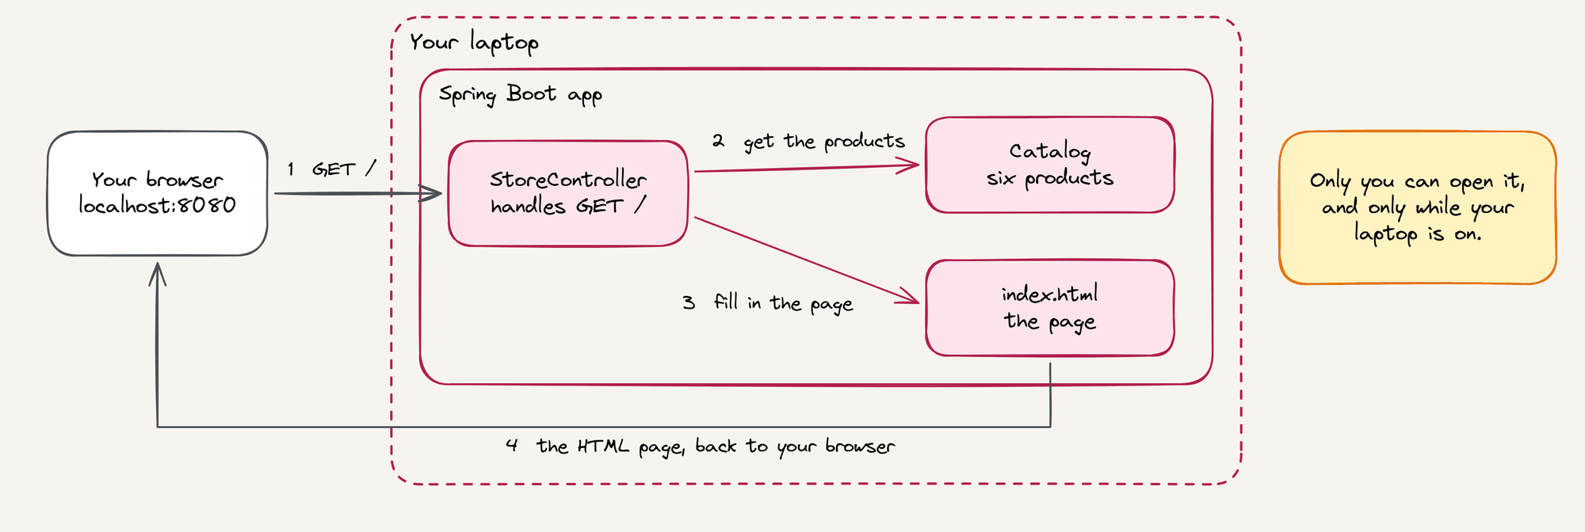
Step 1 One app on your laptop
READ
FIND
Product.java Catalog.java StoreController.java
How many products are there?
Which one is out of stock?
Notes:
Follow the numbers: the browser asks for the page, the controller gets six products from the catalog and fills in the page. It works, but only on my laptop. Nobody else can use it, and I start it by hand. Time: 7 minutes.

Slide 5
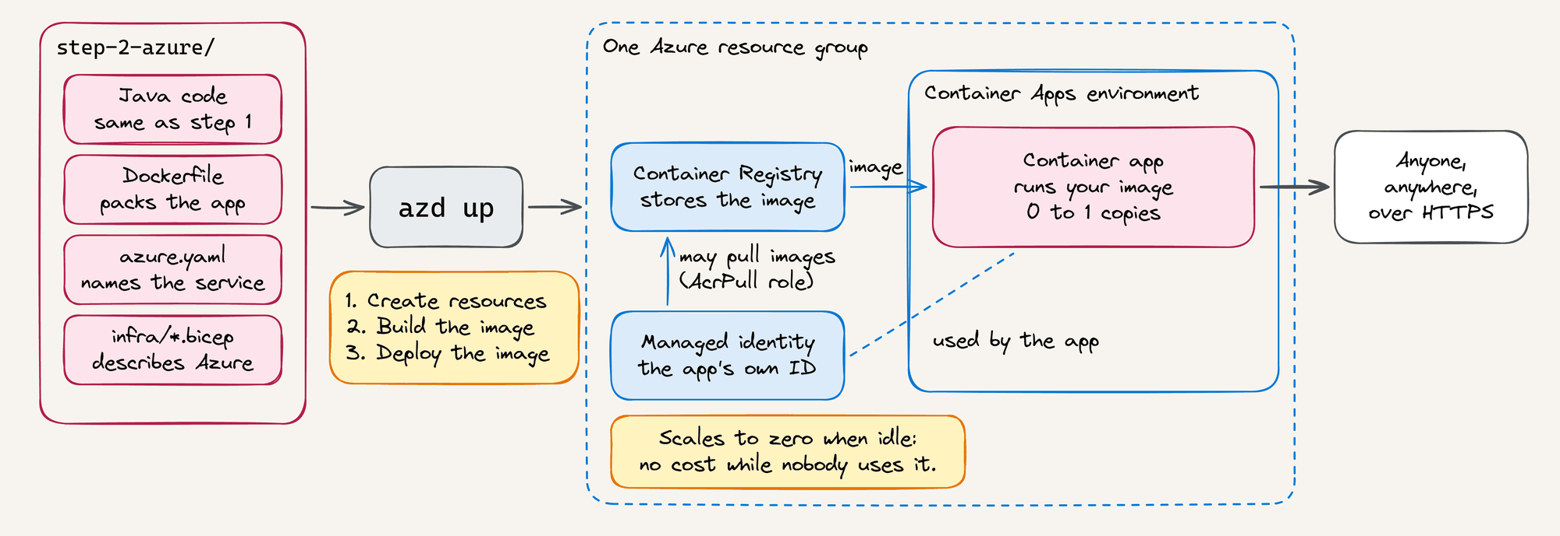
Step 2 One command puts the app on Azure
READ
FIND
Dockerfile azure.yaml infra/app.bicep
Which line in app.bicep lets the app scale to zero?
How does the app pull its image without a password?
Notes:
The Java code didn't change. We added a Dockerfile to pack the app, azure.yaml to name it, and Bicep to describe the Azure resources. One command, azd up, creates all of this in about 5 minutes. The app pulls its image with its managed identity, so there's no password, and it scales to zero when nobody uses it. Time: 10 minutes.

Slide 6
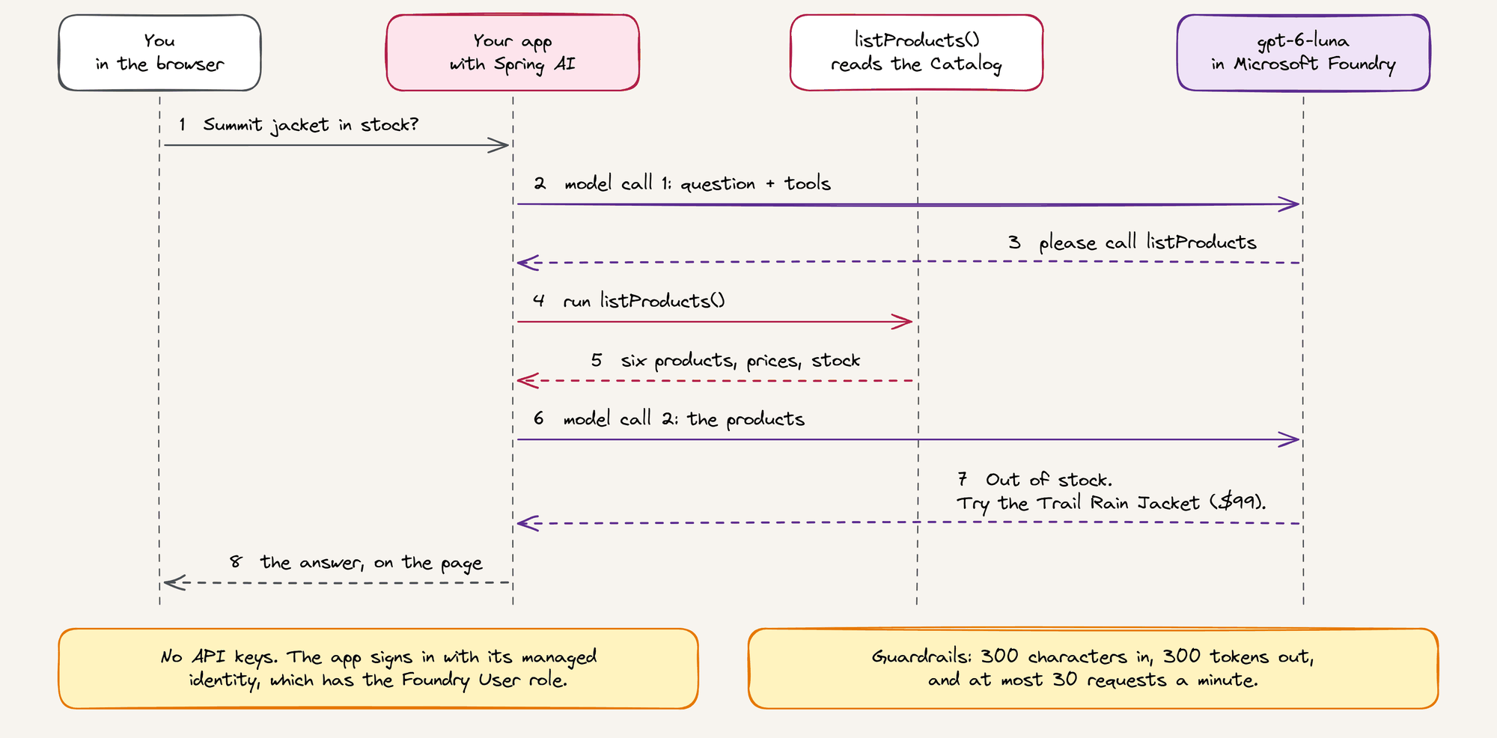
Step 3 How a question gets answered
Notes:
Follow the numbers: two calls to the model, and one call to our own Java code in between. The model can't see our catalog, so we give it a tool: one method with @Tool. There are no API keys: they're switched off in Foundry, and the app signs in with its managed identity. Time: 12 minutes for step 3, including the next two slides.

Slide 7
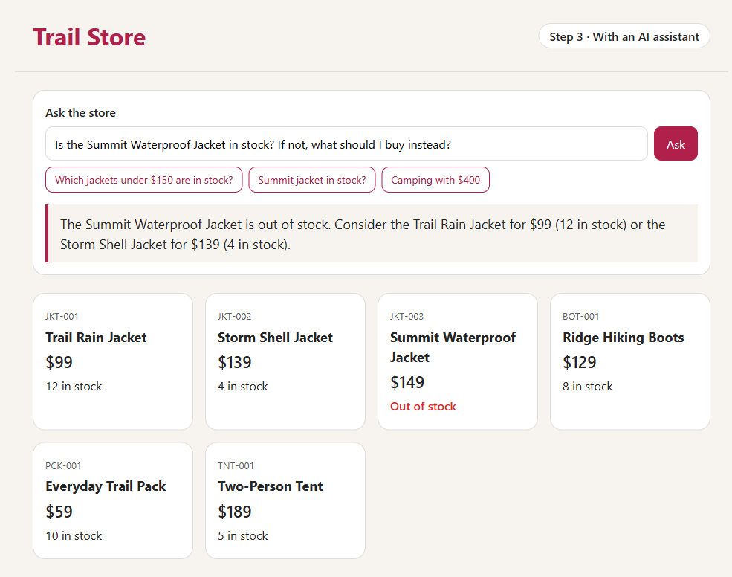
Your turn: read it, then ask the store
READ
InventoryTools.java ChatController.java
FIND
How does the app get permission to use the model?
Is there an API key anywhere?
Then ask the store one question:
“Do you sell kayaks?”
“What's the cheapest thing in stock?”
“Write me a poem about the weather.”
The whole room shares one model. If it can't answer, wait a few seconds and try again.
Notes:
Everyone: find the two files and answer the questions, then ask the store one question. The Summit jacket is out of stock, and the assistant says so, then suggests jackets that are in stock: real facts, not guesses. The poem question shows it stays on topic.

Slide 8
Step 3 Going further: the GitHub Copilot SDK
WHAT YOU JUST SAW
WITH THE COPILOT SDK
One question, one tool
One goal, many steps
In this app, the model asks to run your Java method, then answers your question.
Copilot's agent runs in your app. It plans and calls your Java tools until the job is done.
@Tool listProducts()
@CopilotTool listProducts()
MAVEN DEPENDENCY
WORKS WITH
com.github:copilot-sdk-java
A GitHub Copilot subscription, or your own Foundry model with managed identity. No keys.
See it working in the step-3-copilot-sdk folder. The SDK's Java releases are still labeled preview. Learn more at github.com/github/copilot-sdk
Notes:
Two minutes, and nothing for the room to do. In step 3, Spring AI sends one question to the model, and the model can ask for one Java method. The GitHub Copilot SDK goes further: it runs Copilot's agent inside your own app. You give it a goal, and it plans and calls your Java tools, step by step, until the job is done. You still write the tools as Java methods, with @CopilotTool instead of @Tool. The Maven dependency is com.github:copilot-sdk-java. It works with a GitHub Copilot subscription, or with your own model in Microsoft Foundry, where the app signs in with its managed identity, as in step 3. The bonus folder, step-3-copilot-sdk, builds this same assistant with the SDK: show Assistant.java and its live app if you have time. Copilot's agent can run commands and edit files, so the app switches all of that off and allows only the one tool. Be clear that the SDK's Java releases are still labeled preview, and @CopilotTool is still marked experimental.

Slide 9
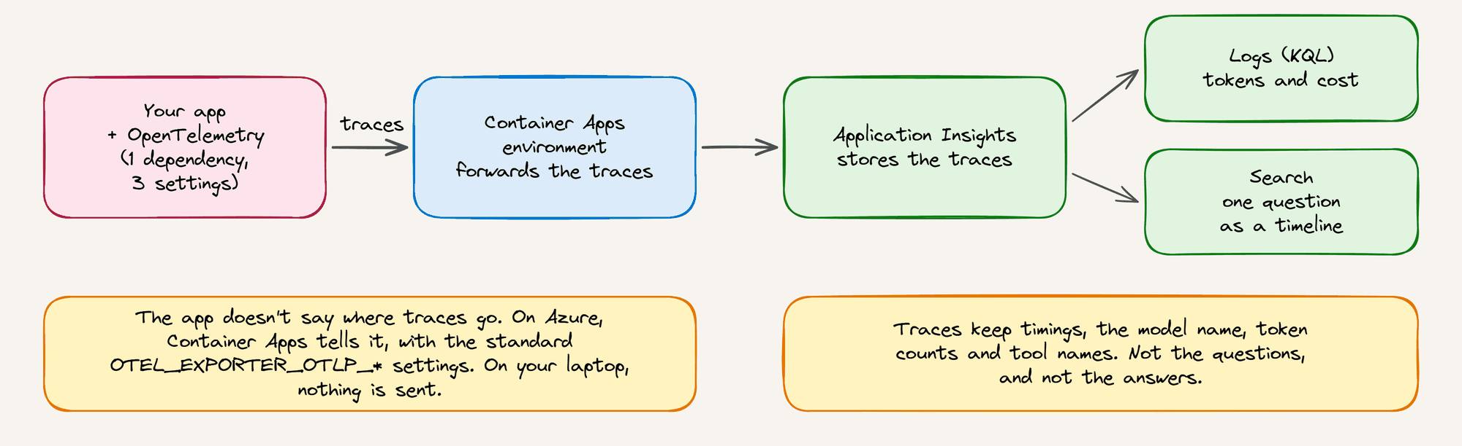
Step 4 How traces get to Application Insights
READ
FIND
pom.xml application.properties infra/app.bicep
How many model calls does one product question make, and why?
About how much does one question cost?
Notes:
The app's code didn't change: one dependency, three settings, and Application Insights in Bicep. Container Apps tells the app where to send traces. Time: 8 minutes for step 4, including the next slide.

Slide 10
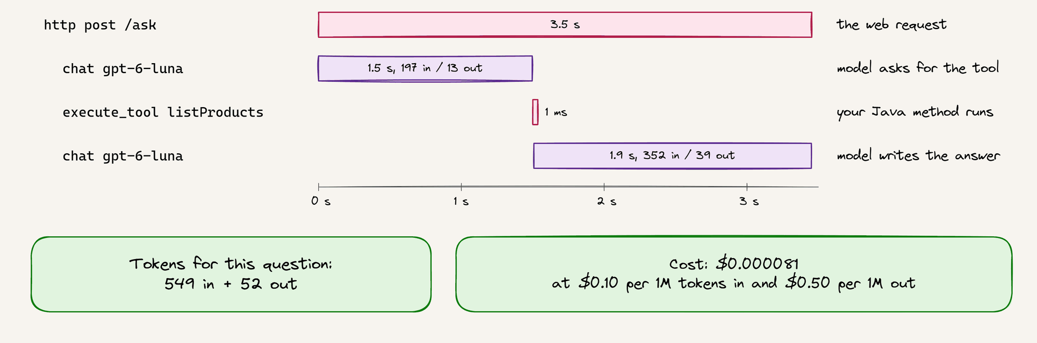
Step 4 One question, as a trace
“Is the Summit Waterproof Jacket in stock?” Real data from step 4.
Your Java method takes 1 ms. The model is where the time, and the cost, goes.
Notes:
This is a real trace from step 4. Two model calls and one tool call. Here are the tokens, and here's the cost: less than a hundredth of a cent. The traces keep timings and token counts, not the questions or the answers.

Slide 11
Cost-aware by design
$0.00008
$0.08
per question
per 1,000 questions
About 540 tokens in and 50 tokens out, on average
At $0.10 per 1M tokens in and $0.50 per 1M tokens out
$0
$5
while nobody uses it
a month per container registry
The apps scale to zero when they're idle
The main fixed cost for each step you deploy
Azure retail prices for Sweden Central, checked on 22 October 2026.
The model accepts at most 30 requests and 30,000 tokens a minute, so it costs at most about $0.90 an hour.
Notes:
The model is the cheap part: a question costs less than a hundredth of a cent. The main fixed cost is the container registry. The model's per-minute limit also caps the worst case.

Slide 12
Check your answers
STEP 1
How many products?
Which one is out of stock?
Six. The Summit Waterproof Jacket has 0 in stock.
STEP 2
Scale to zero?
Pull the image without a password?
minReplicas: 0. The managed identity has the AcrPull role.
STEP 3
Permission to use the model?
Any API key?
The managed identity has the Foundry User role. Keys are off: disableLocalAuth: true.
STEP 4
How many model calls?
What does a question cost?
Two: it asks for listProducts, then writes the answer. Off-topic questions usually need one. About $0.00008 each.
Notes:
Go through the answers together. The details are in docs/workshop.md.

Slide 13
Run it. Ship it. Add AI. See inside.
Try it on your own Azure subscription
git clone https://github.com/roryp/spring-ai-webstore
cd spring-ai-webstore/step-2-azure
azd auth login
azd up
azd down --purge # when you're done
Questions?
The code, diagrams and these slides are all in the repo.
github.com/roryp/spring-ai-webstore
Notes:
Run it, ship it, add AI, see inside it. To try it yourself, run azd up in any step folder, and azd down --purge when you're done.

