Slide 1
Design and Implementation of a joint communication and Radar System Optimized for Target Classification
By rory schram

Slide 2
The goals of the day
Chapter 1: What does a “Joint Communication and Radar System” mean?
Chapter 2: Why do I want to use a communication signal in my radar?
Chapter 3: What are Channel Estimations?
Chapter 4: How am I utilizing Channel Estimations?
Chapter 5: System design.
Chapter 6: Initial results.
Chapter 7: Takeaways and next steps.

Slide 3
Chapter 1
What does a “Joint Communication and Radar System” mean?

Slide 4
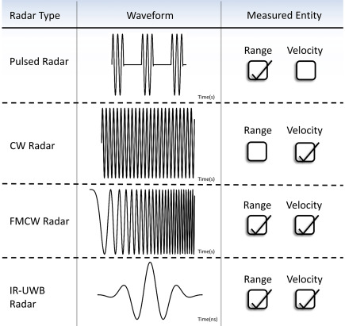
Chapter 1: What does a “Joint Communication and Radar System” mean?
”Classic” Radar Waveforms
Radar Waveforms. Source [1]
[1] Malikeh P. Ebrahim, Neil Tom, Duygu Nazan Gençoğlan, Şule Çolak, Mehmet R. Yuce, Radar and Non-Contact Sensing

Slide 5
Chapter 1: What does a “Joint Communication and Radar System” mean? digital data modulation schemes
Modulation Technique | Encodes Data Using
Amplitude Shift Keying (ASK) | Amplitude
Frequency Shift Keying (FSK) | Frequency
Binary Phase Shift Keying (BPSK) | Phase
Quadrature Phase Shift Keying (QPSK) | Phase
Multiple Phase Shift Keying (M-PSK) | Phase
Quadrature Amplitude Modulation (QAM) | Amplitude and Phase
Amplitude Phase Shift Keying (APSK) | Amplitude and Phase
Digital Modulation Schemes. Adapted from [2]
[2] Lou Frenzel, Understanding Modern Digital Modulation Techniques

Slide 6
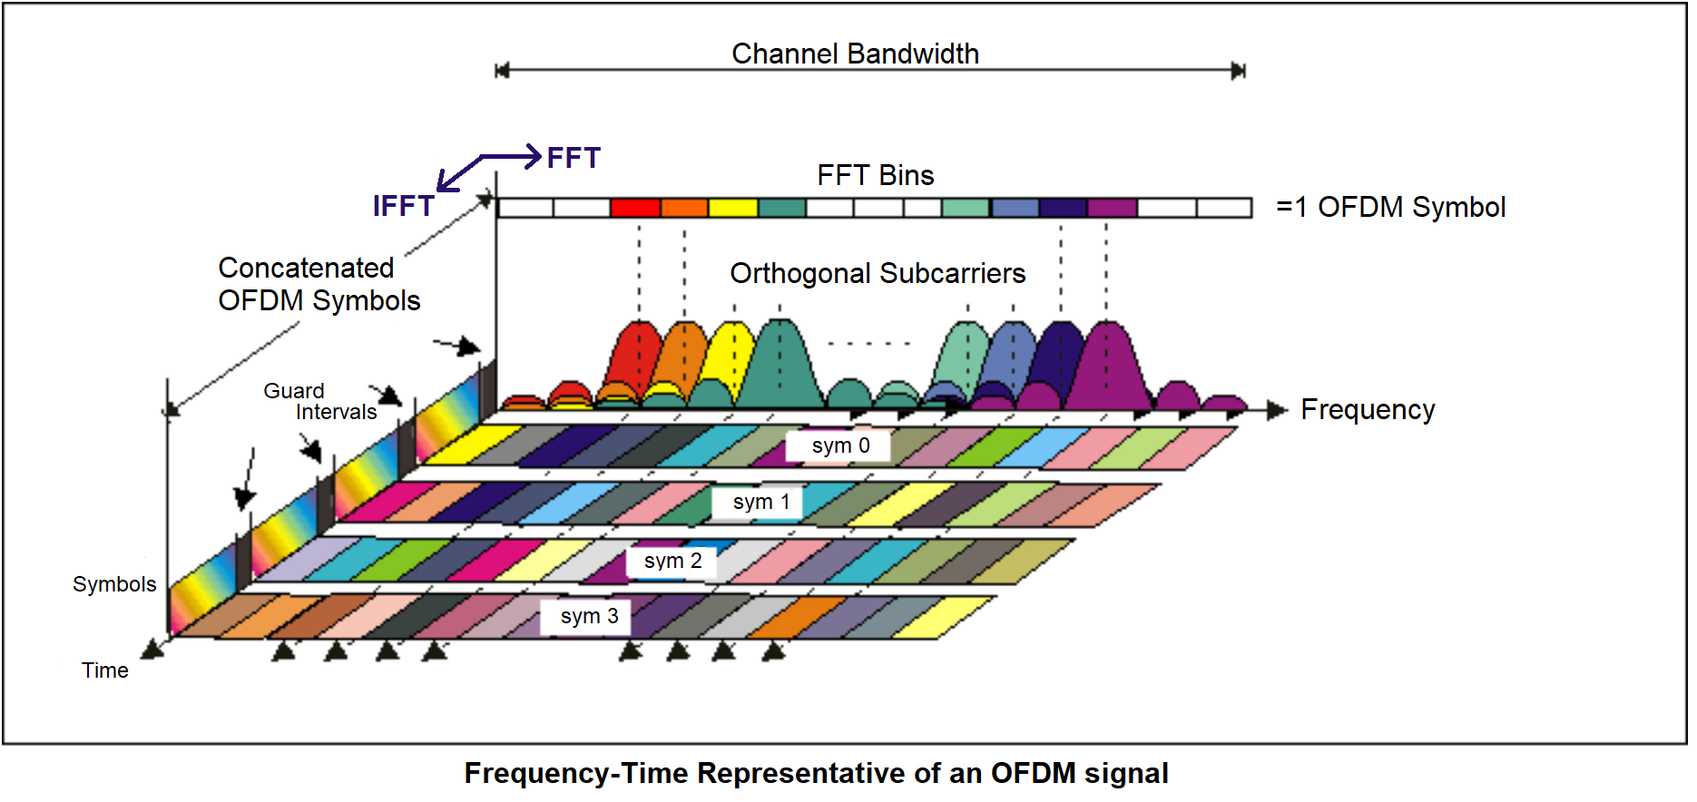
Chapter 1: What does a “Joint Communication and Radar System” mean?
The ”popular” digital data modulation scheme
OFDM. Source [3]
[3] Bob Witte, The Basics of 5G’s Modulation, OFDM

Slide 7
Chapter 2
Why do I want to use a communication signal in my radar?

Slide 8
Chapter 2: Why do I want to use a communication signal in my radar?
We want to investigate the following
The primary goal of my masters is to create a radar system that can classify targets based on returned waveforms and nothing else. This can prove difficult with traditional radar waveforms…
Therefore, we need to extract more information about the target to achieve the goal of classification.
A communication signal with the correct modulation and demodulation techniques has the potential to help extract more information about our targets in the form of CHANNEL ESTIMATIONS.
If this system can operate as a normal radar, detecting range of targets, that is a bonus.

Slide 9
Chapter 3
What are Channel Estimations?

Slide 10
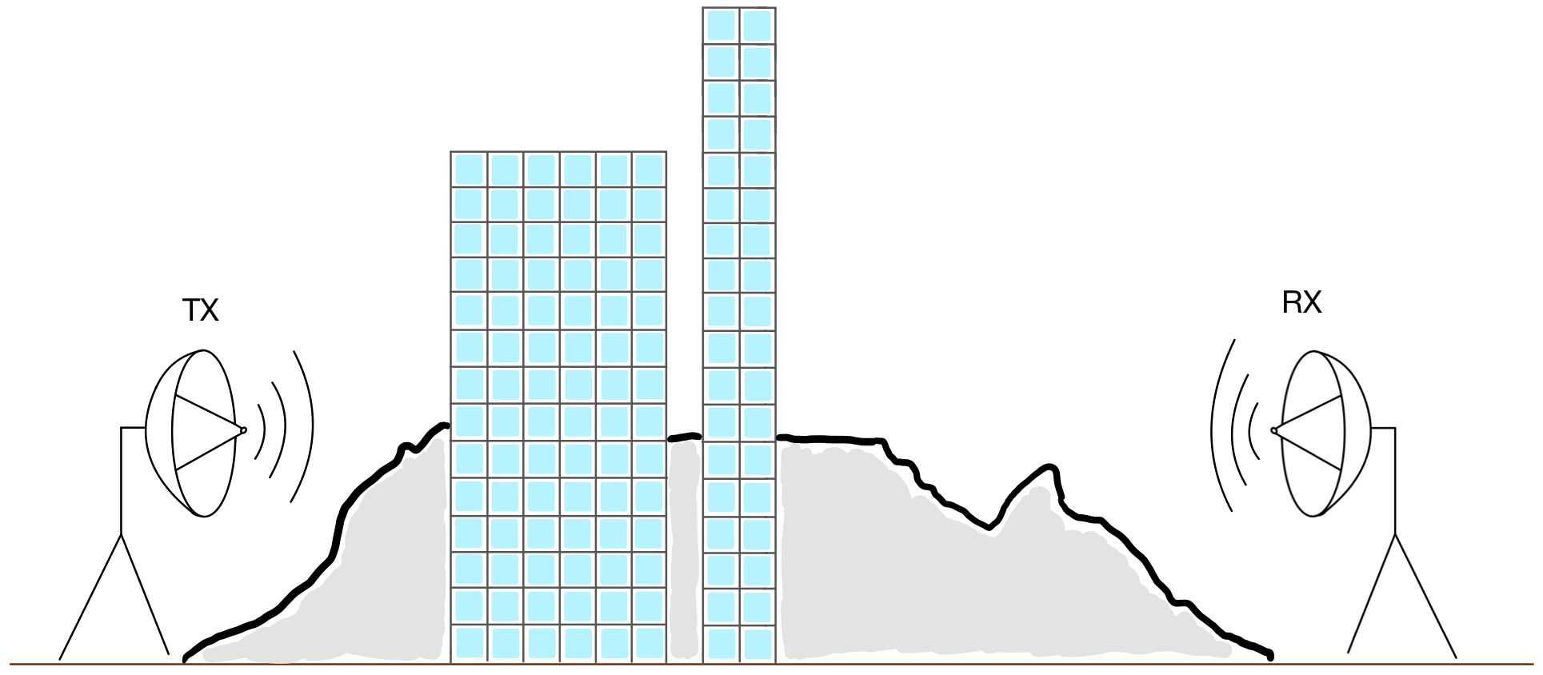
Chapter 3: What are Channel Estimations? the Traditional Communication Answer
“Channel estimation refers to the process of estimating the characteristics of the wireless channel between the transmitter and receiver, such as signal strength, delay, and Doppler shift.” [4]
A communication channel in a city.
[4] Dhinesh Kumar R, Rammohan A, Revolutionizing Intelligent Transportation Systems with Cellular Vehicle-to-Everything (C-V2X) technology

Slide 11
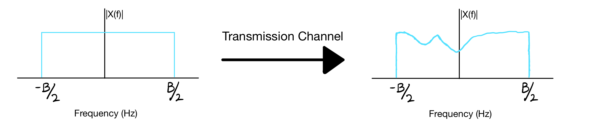
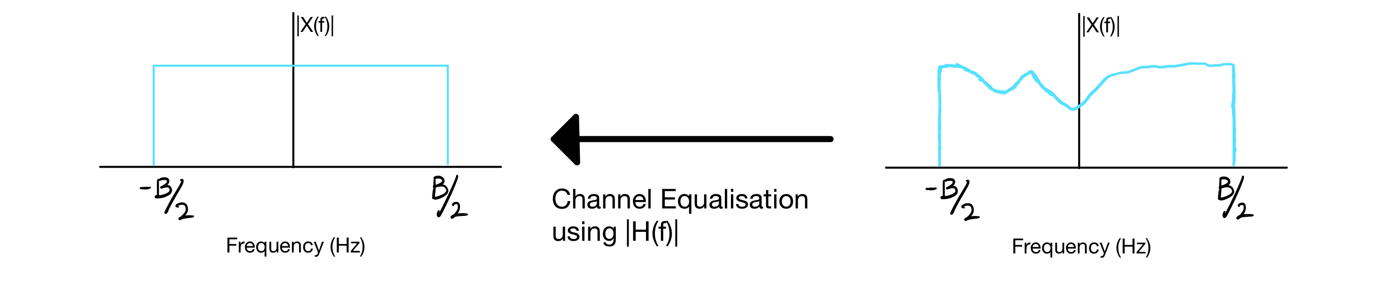
Chapter 3: What are Channel Estimations?
What does this look like in real life?
Effects of a channel on a perfect signal.
Channel equalization using a channel estimate.

Slide 12
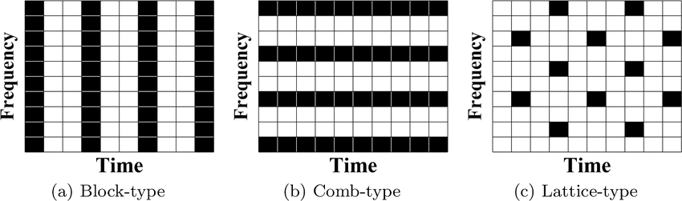
Chapter 3: What are Channel Estimations?
How does one get a channel estimation?
Pilot Symbol Patterns. Source [5]
OFDM. Source [3]
[3] Bob Witte, The Basics of 5G’s Modulation, OFDM
[5] Wang, Shuchen & Gao, Suixiang & Wenguo, Yang, Pilot pattern design scheme with branch and bound in PSA-OFDM system

Slide 13
Chapter 4
How am I utilizing Channel Estimations?

Slide 14
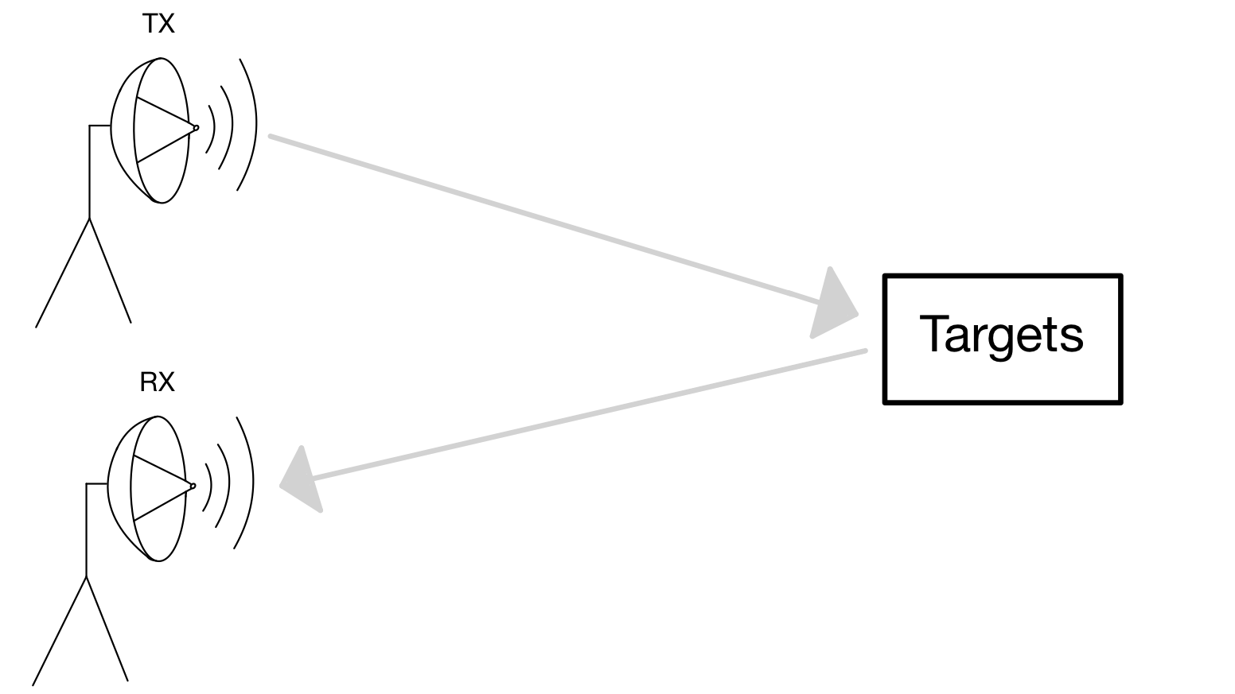
Chapter 4: How am I utilizing Channel Estimations? extracting channel Estimates from target reflections
H(f)

Slide 15
Chapter 5
System design.

Slide 16
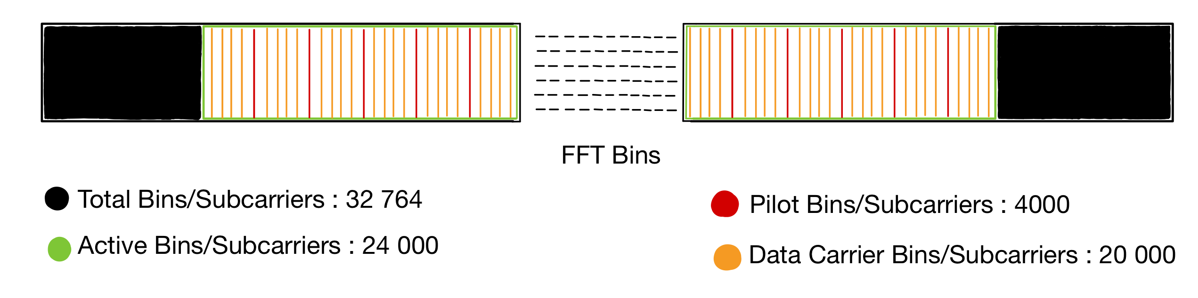
Chapter 5: system design
Step 1: Design the OFDM waveform layout
OFDM waveform active, pilot, and data carrier layout

Slide 17


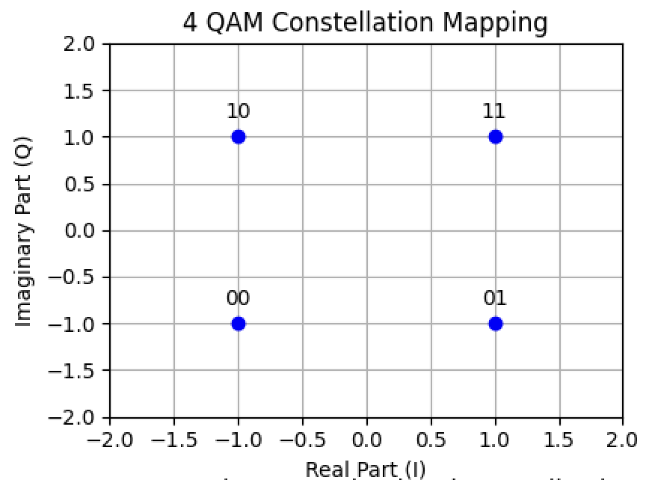
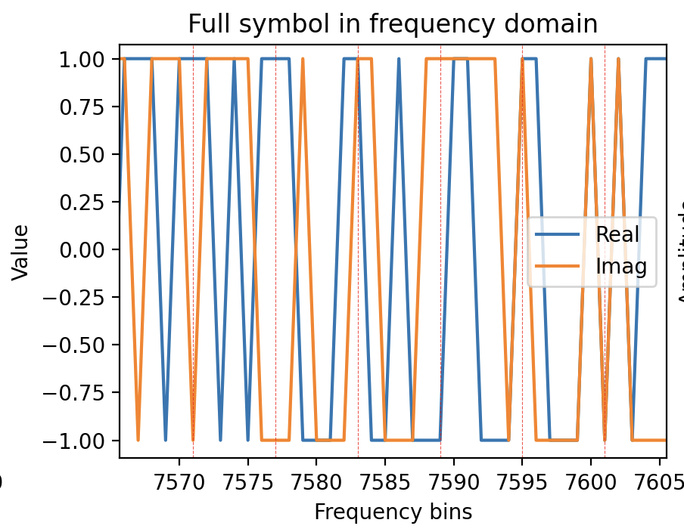
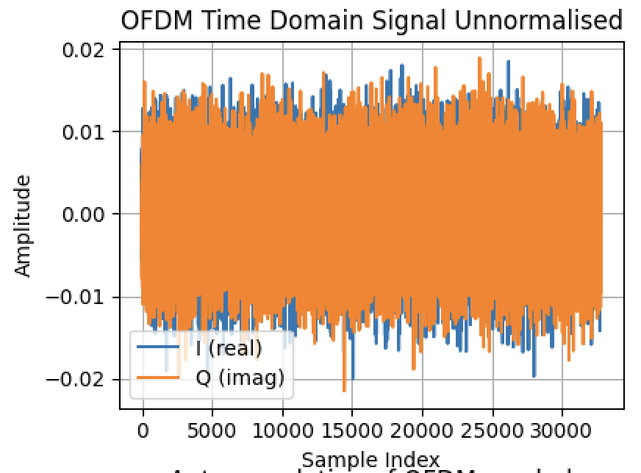
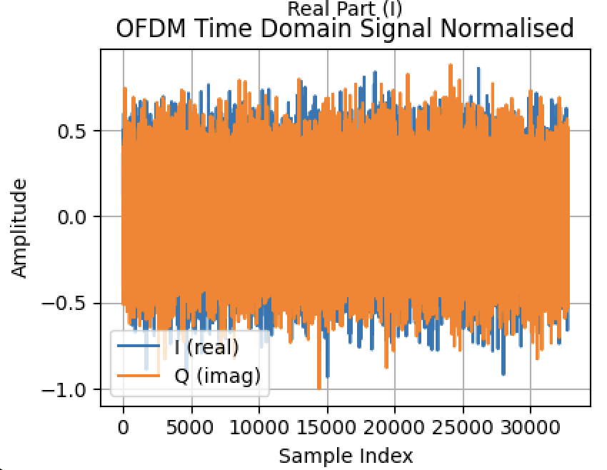
Chapter 5: system design
Step 2: implement in code

Slide 18
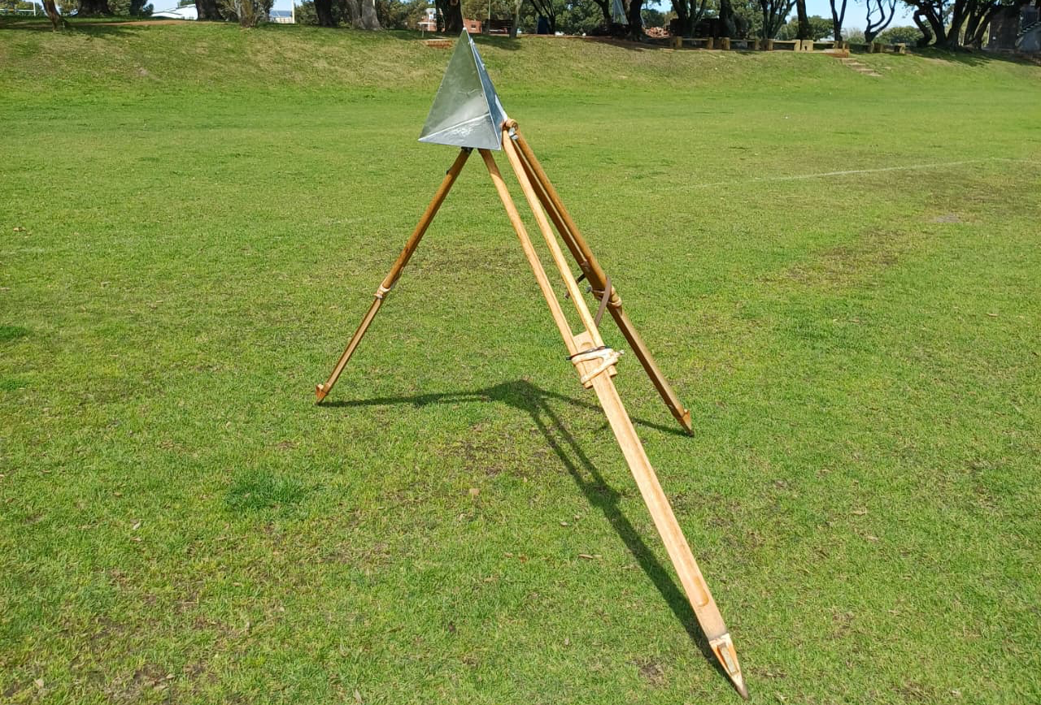
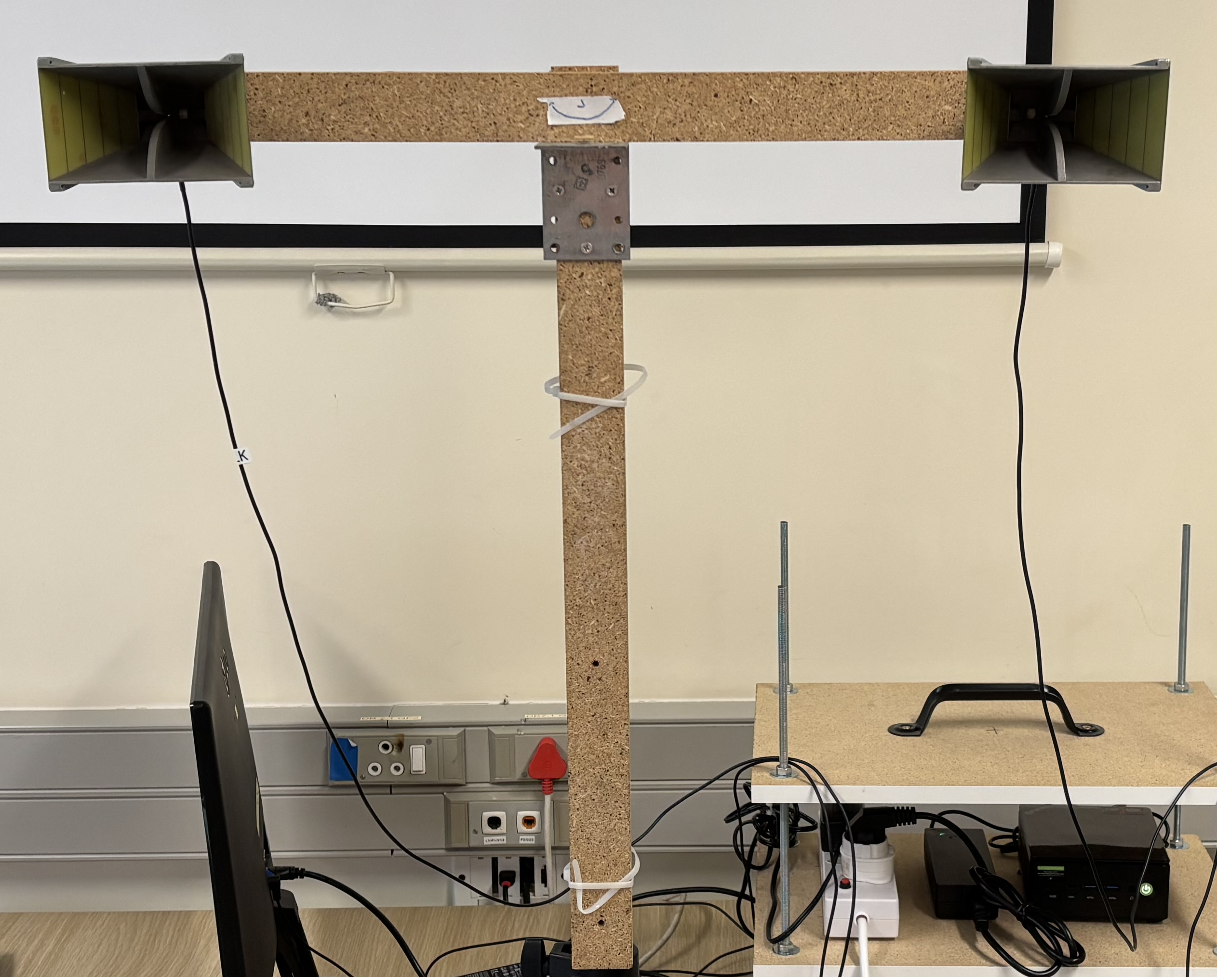
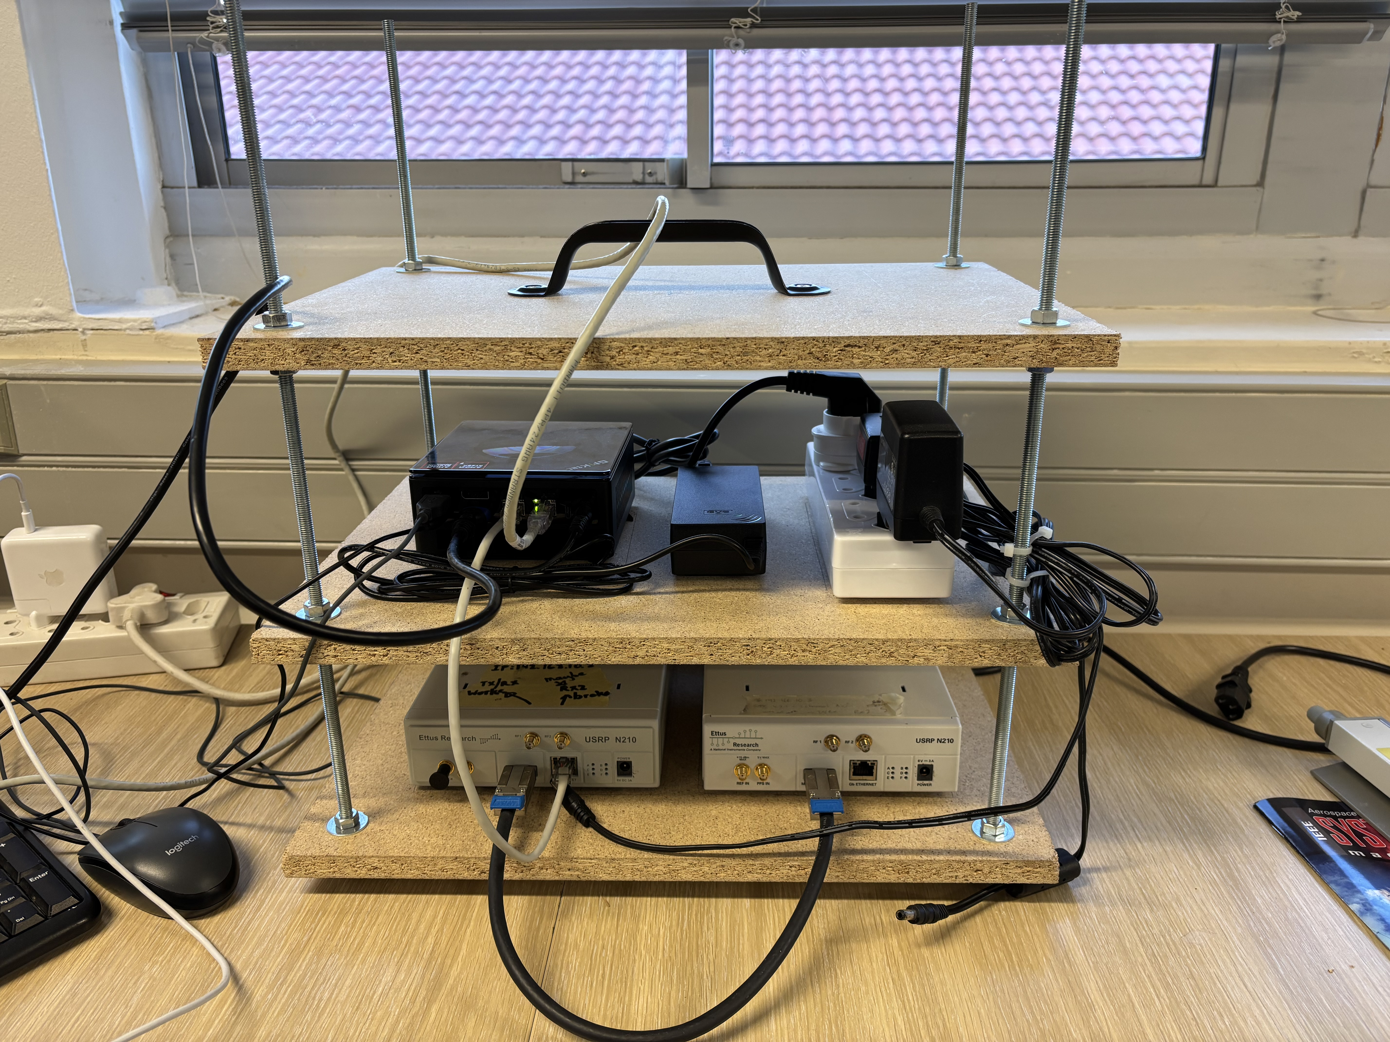
Chapter 5: system design
Step 3: Transmit and receive waveform
An example of a target
Antenna Setup
SDR and Ingest Rig

Slide 19
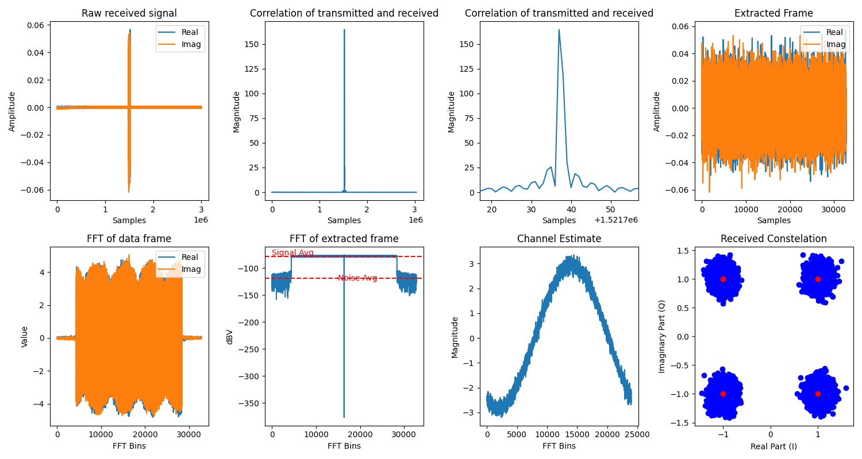
Chapter 5: system design
Step 4: Ingest Raw data
Ingestion process

Slide 20
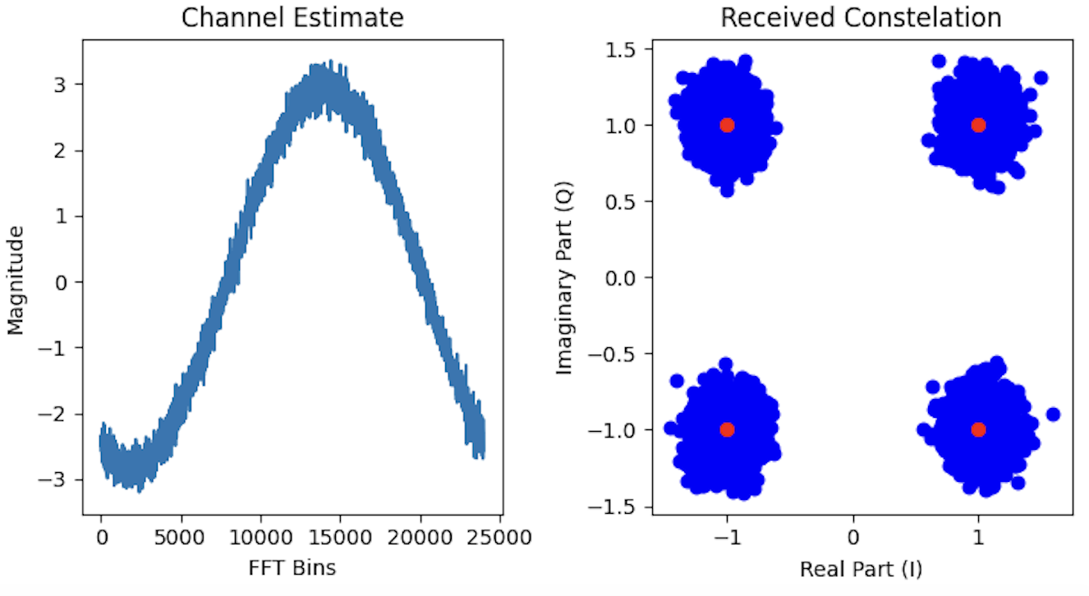
Chapter 5: system design
Step 4: Ingest Raw data
Received Constellation
Channel estimation and received QAM constellation map

Slide 21
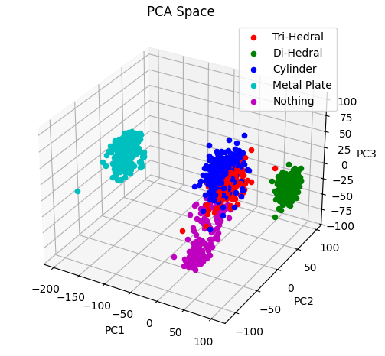
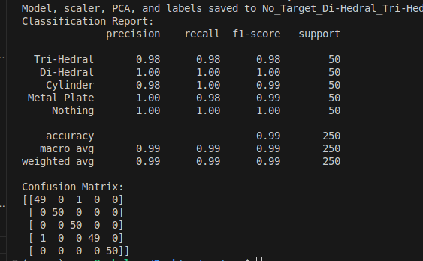
Chapter 5: system design
Step 5: Collect channel estimates and use PCA analysis with SVM to classify
PCA Space of 1250 data captures
SVM Performance on 80/20 train-test split

Slide 22
Chapter 6
Initial results.

Slide 23
Chapter 6: Initial Results
Testing Procedure
Test 1: Communication system characterization
Test 2: Range radar capabilities
Test 3: Classification abilities (indoor and outdoor)

Slide 24
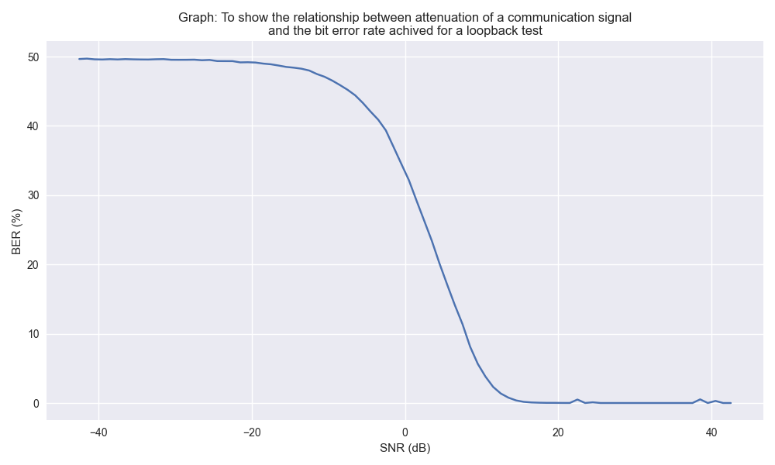
Chapter 6: Initial Results
Test 1: Communication system characterization
Graph showing initial results regarding characterization
of the communication ability of the system.

Slide 25
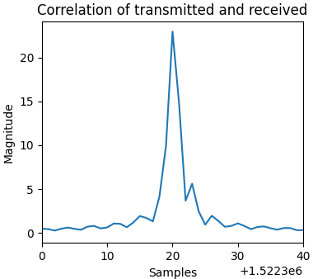
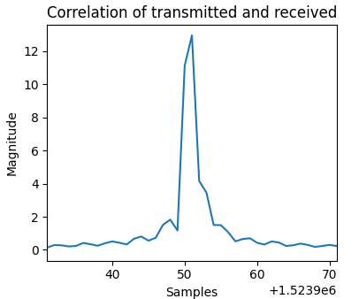
Chapter 6: Initial Results
Test 2: Range radar capabilities
Target at 9m
Target at 9m
(lumped into first range bin)

Slide 26
Chapter 6: Initial Results
Test 3: Classification abilities (indoor)
Testing Conditions | Prediction Accuracy of SVM Trained on PC 1-10 | Prediction Accuracy of SVM Trained on PC 2-10
6 targets at 3m | 0.99 | 0.99
6 targets at 6m | 0.99 | 0.98
6 targets rotating through 5 orientations at 3m | 0.89 | 0.97
6 targets in free movement at 3m | 0.53 | 0.63
Table showing results from initial indoor classification tests

Slide 27
Chapter 6: Initial Results
Test 3: Classification abilities (Outdoor)
Testing Conditions | Prediction Accuracy of SVM Trained on PC 1-10 | Prediction Accuracy of SVM Trained on PC 2-10
5 targets at 6m | 1.00 | 0.98
5 targets at 12m | 0.99 | 0.96
Table showing results from initial outdoor classification tests

Slide 28
Chapter 7
Takeaways and next steps.

Slide 29
Chapter 7: Takeaways and next steps.
Takeaways:
  Have a well-structured testing procedure before doing field tests, especially when you have lots of equipment to take to the field.
  I am happy with the data communication performance of the system.
  System’s range resolution of 6m is a hinderance.
  Target classification works well with stationary objects.
  Classification of targets that are moving through multiple axis at a fixed distance from the system shows promise.
  Haven’t been able to show classification of multiple object in single scene yet.
Next Steps:
  One more round of field testing.
  Write up.

Slide 30
Thank You and questions

