Slide 1
Implementation of a Single pulse ofdm Based classification radar
By Rory Schram

Slide 2
Recap of My project in FAQ form
What is a typical single pulse RADAR?
What is OFDM?
Why are we combining to two technologies?

Slide 3
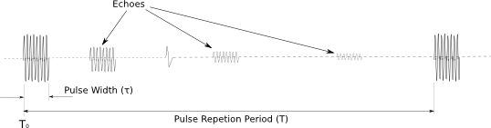
What is a typical single pulse RADAR?

Slide 4
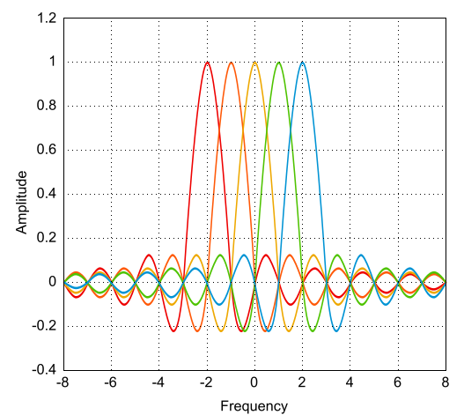
What is OFDM?

Slide 5
Ok that is cool, but like how is it useful?

Slide 6
Why are we combining to two technologies?

