Slide 1
Design and implementation of single pulse classification radar – an update
By rory schram

Slide 2
The goals of the day
Chapter 1:What the hell are you trying to achieve?
Chapter 2: What the heck have I done since last time?
Chapter 3: What my next steps may be?

Slide 3
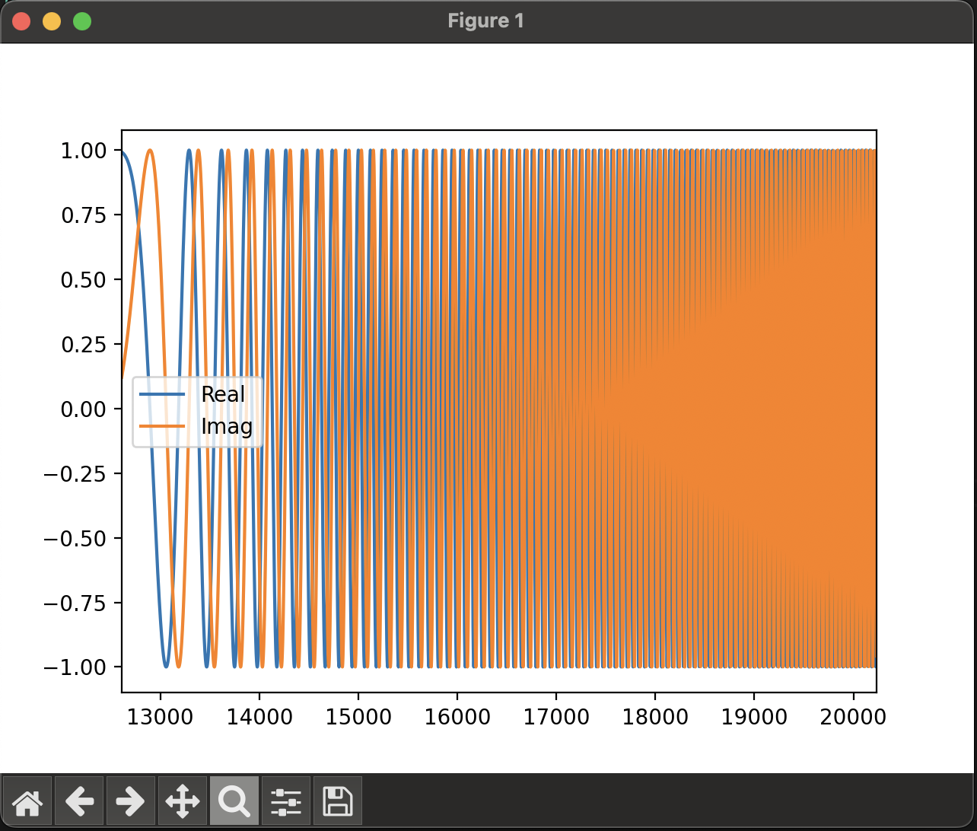
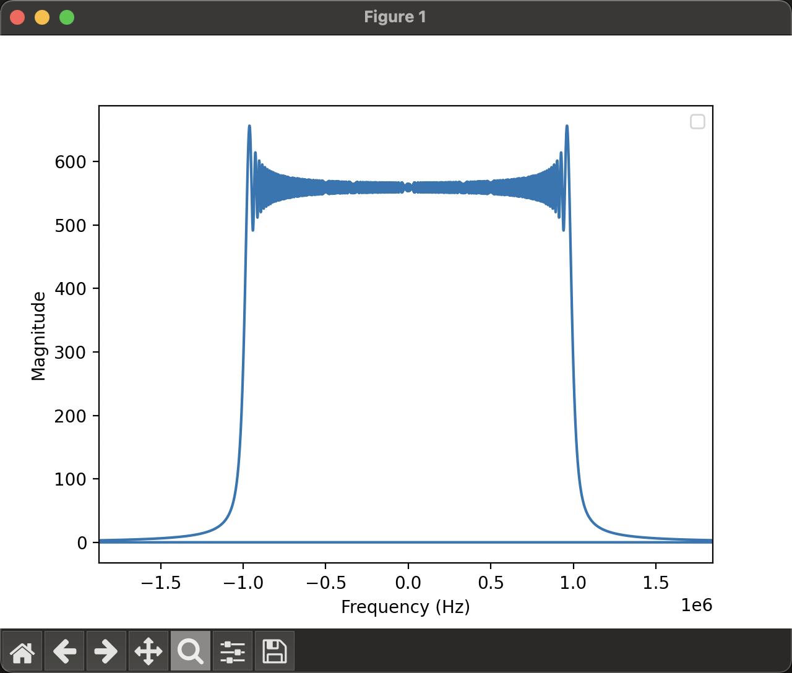
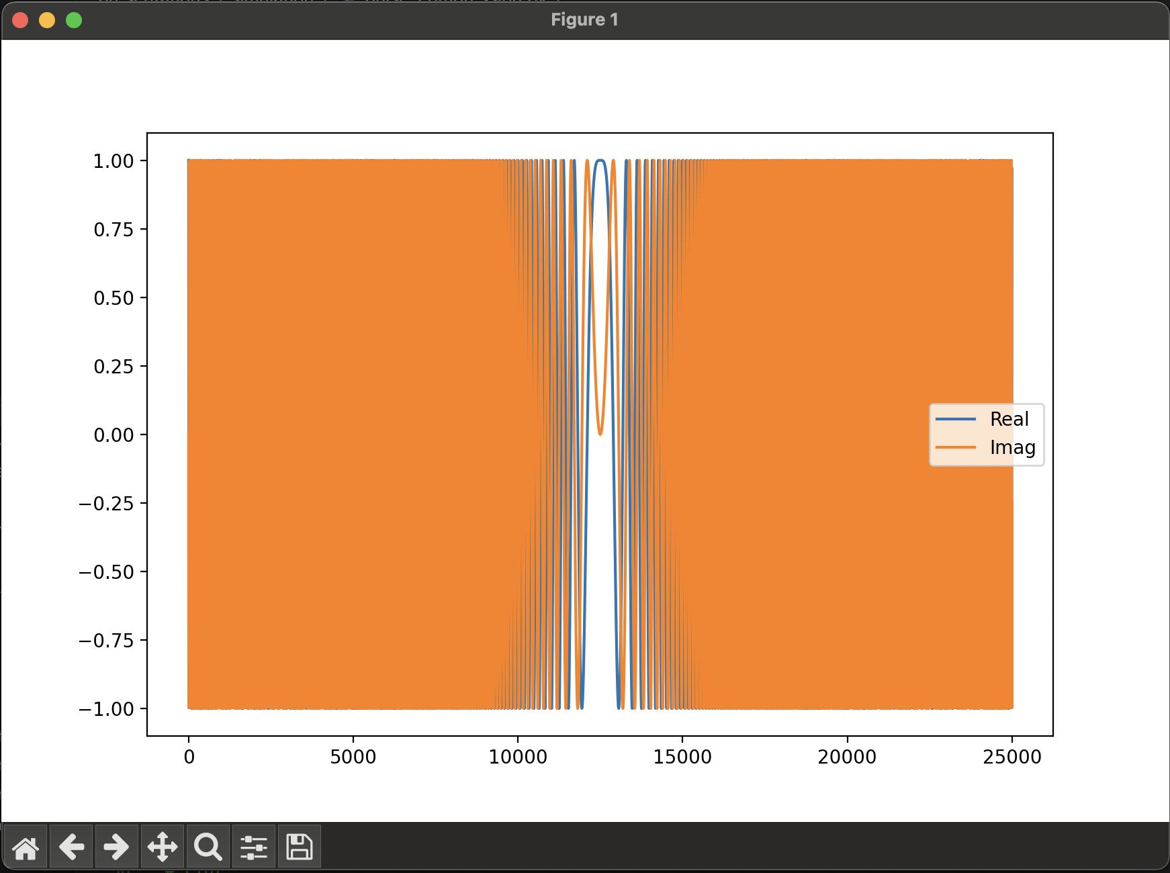
Chapter 1: What the heck am I trying to do
Simple pulse radar setup

Slide 4
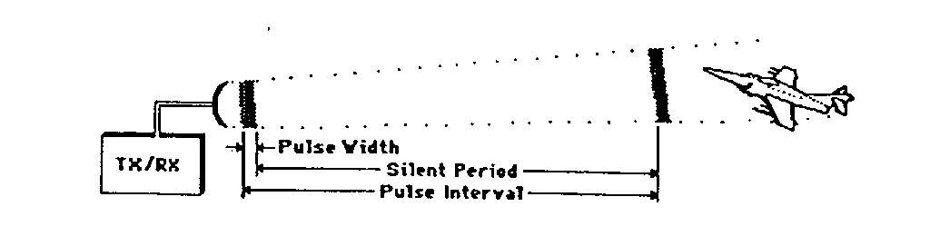
Chapter 1: What the heck am I trying to do
Simple pulse radar setup

Slide 5
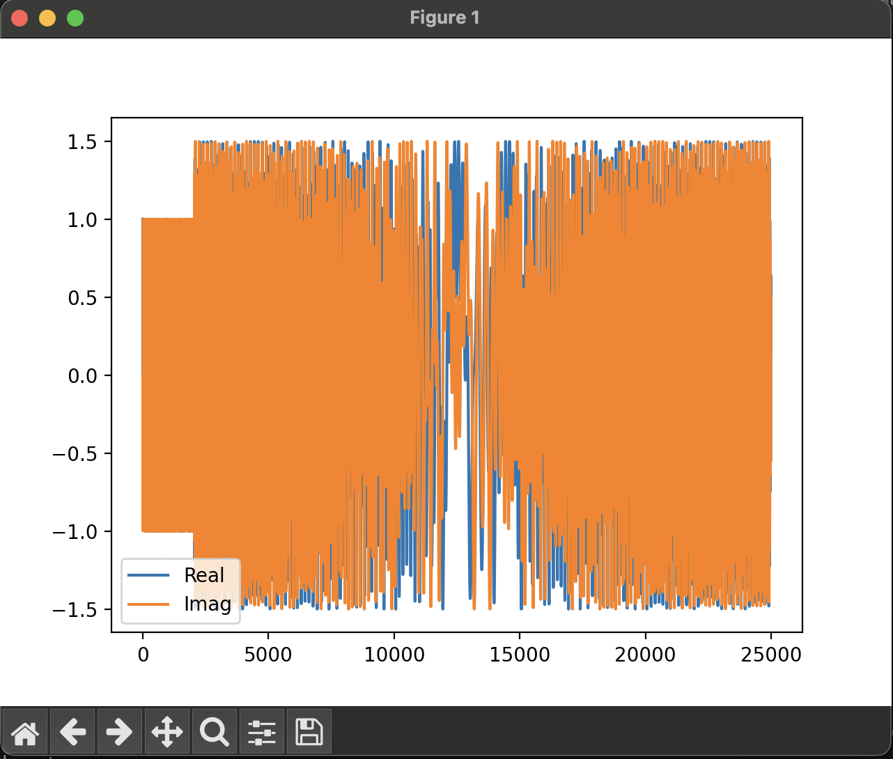
Chapter 1: What the heck am I trying to do
Simple pulse radar setup

Slide 6
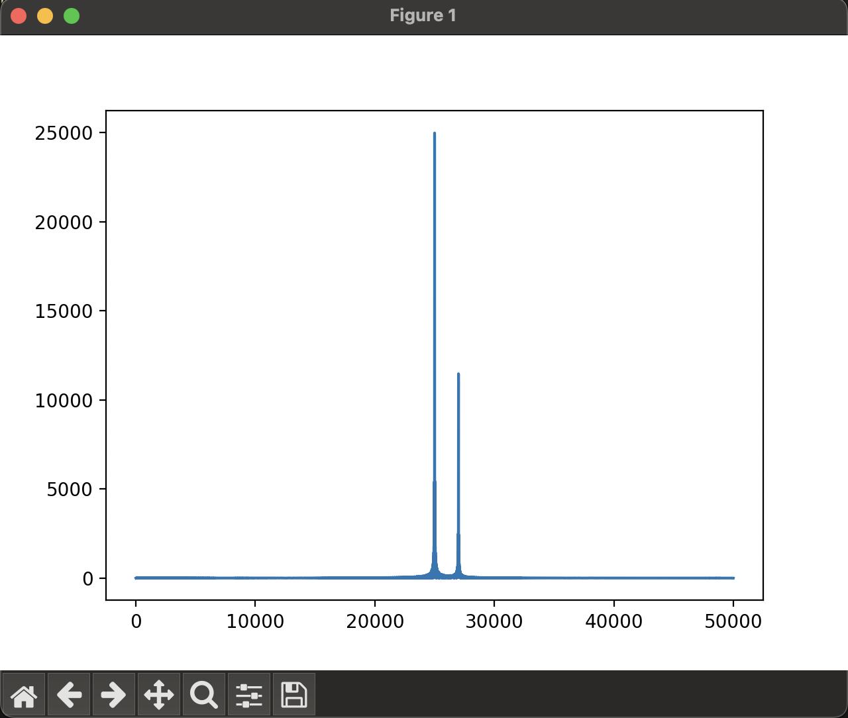
Chapter 1: What the heck am I trying to do
Simple pulse radar setup

Slide 7
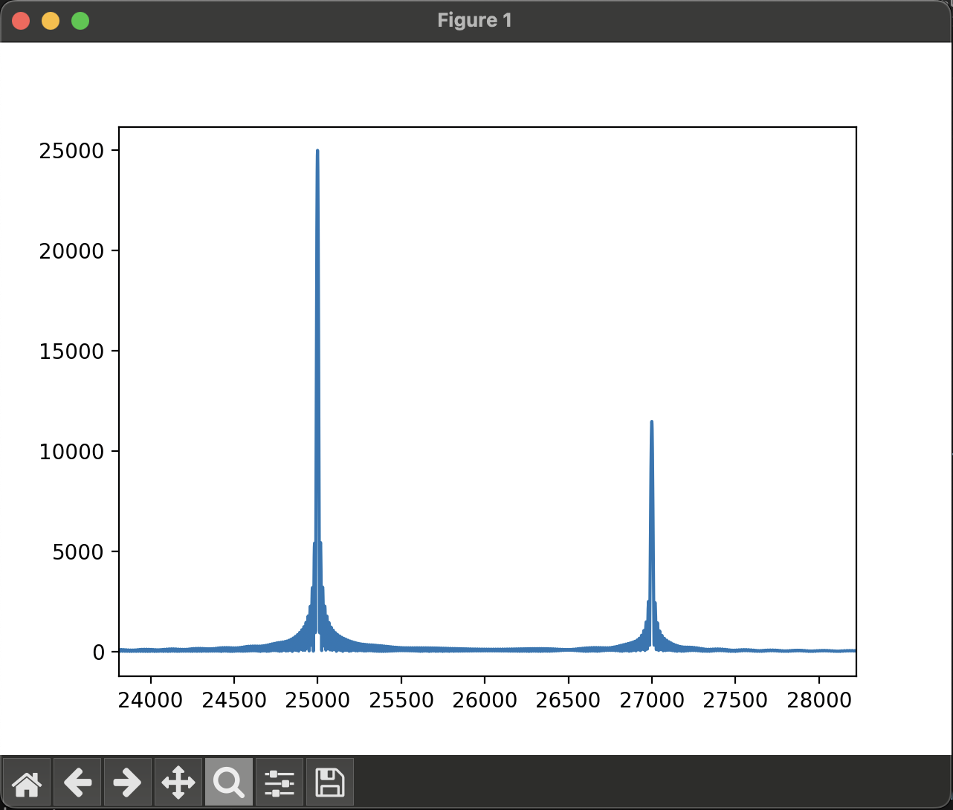
Chapter 1: What the heck am I trying to do
Simple pulse radar setup

Slide 8
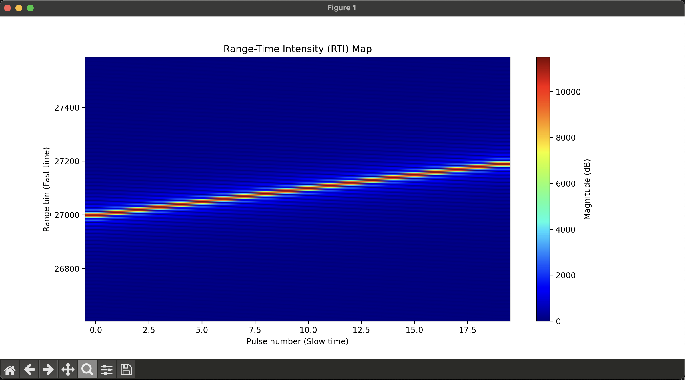
Chapter 1: What the heck am I trying to do
Simple pulse radar setup

Slide 9
Chapter 1: What the heck am I trying to do
Simple pulse radar setup

Slide 10

Chapter 1: What the heck am I trying to do
Simple pulse radar setup

Slide 11

Chapter 1: What the heck am I trying to do
Simple pulse radar setup

Slide 12

Chapter 1: What the heck am I trying to do
Simple pulse radar setup

Slide 13
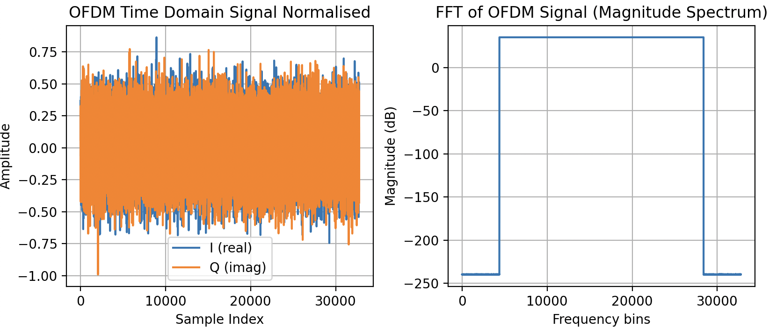
Chapter 1: What the heck am I trying to do
Classification via channel estimation

Slide 14
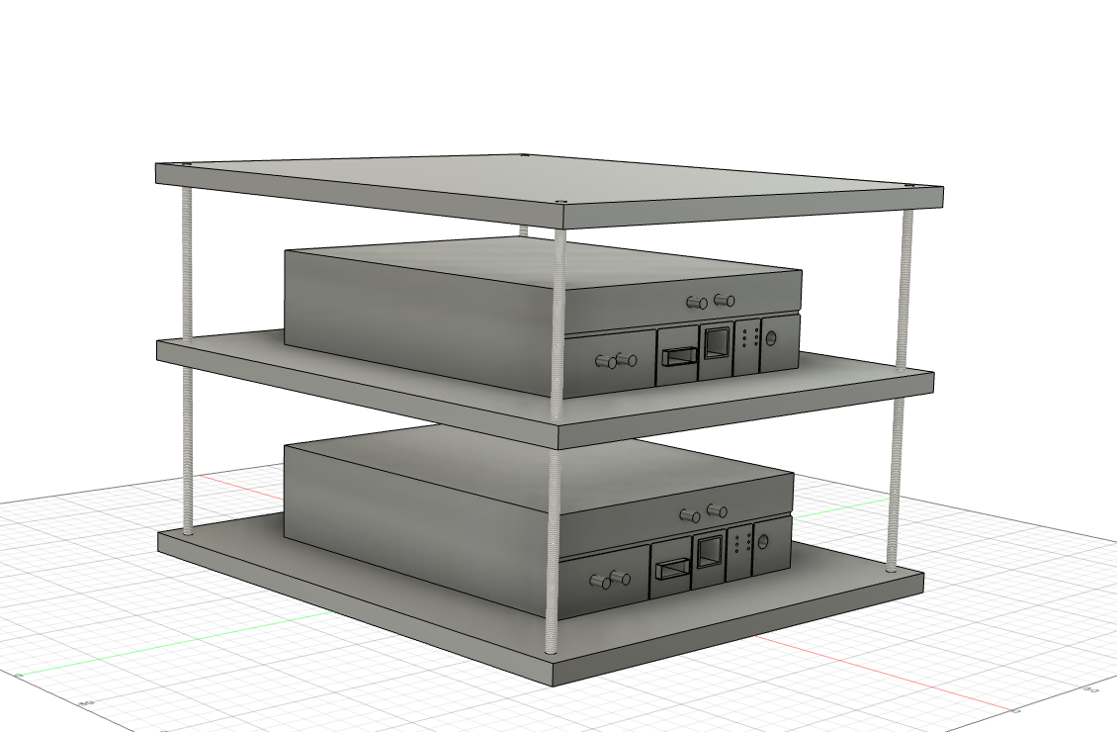
Last time we spoke I had done the following
Created a single pulse RADAR, very bare bones.
Embedded some data with pilots into the RADAR signal to try and get a channel estimation of a scene.
I also decided that I needed a rig for all my equipment, which could potentially look like this.

Slide 15
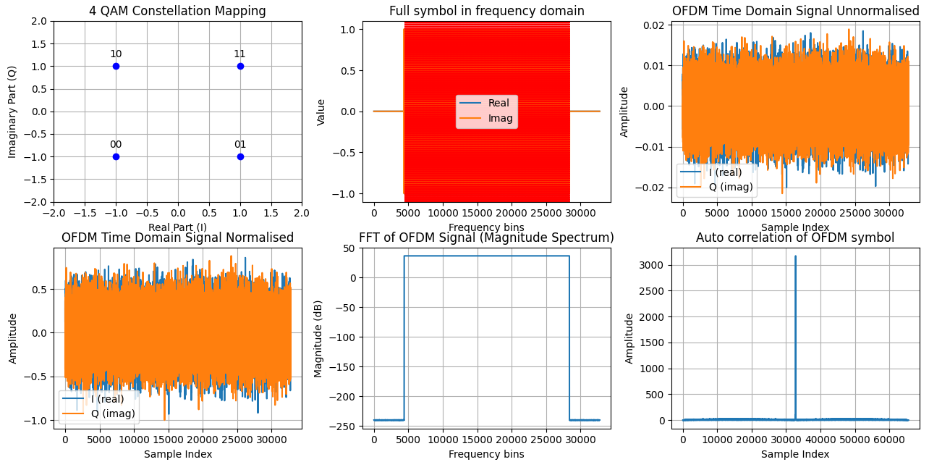
Chapter 2: What the heck have I done since last time?
Re-design of signal creation toolchain

Slide 16
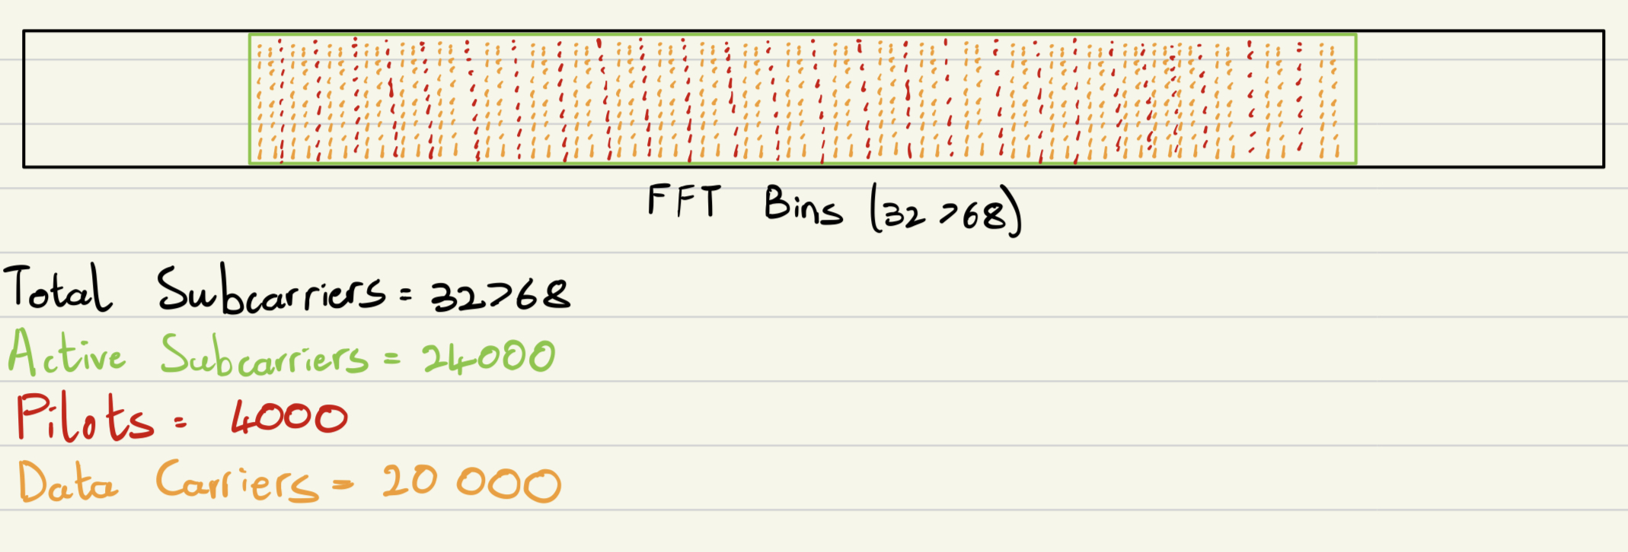
Chapter 2: What the heck have I done since last time?
Re-design of signal creation toolchain

Slide 17
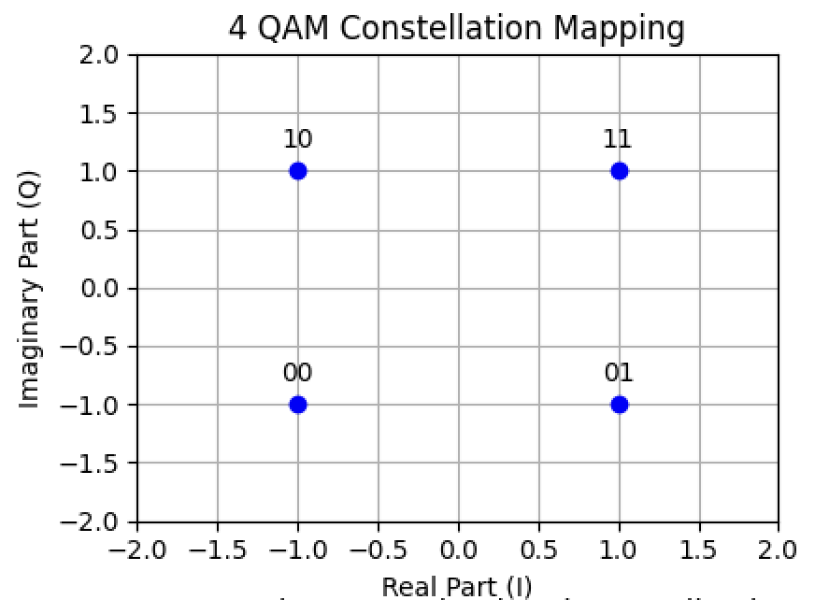
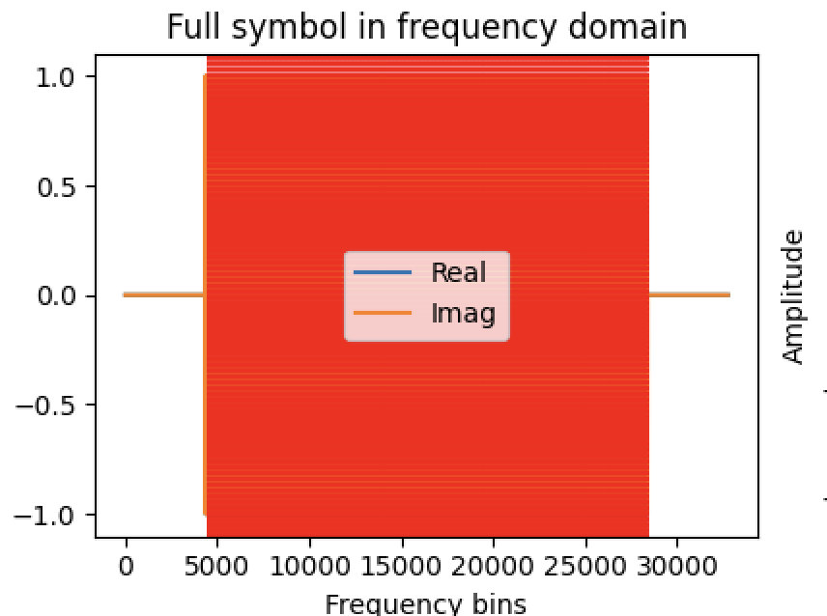
Chapter 2: What the heck have I done since last time?
Re-design of signal creation toolchain

Slide 18
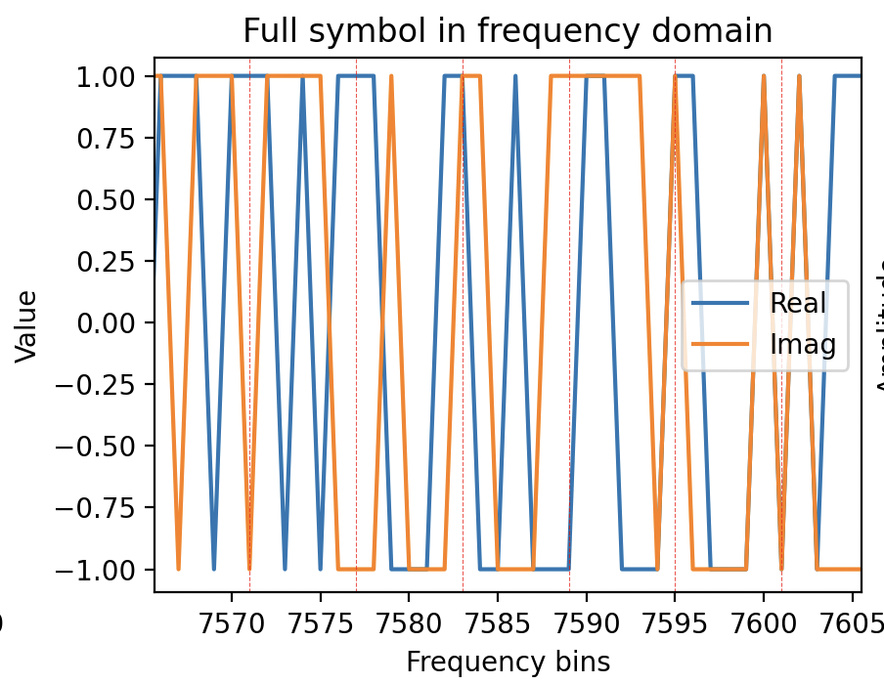
Chapter 2: What the heck have I done since last time?
Re-design of signal creation toolchain

Slide 19
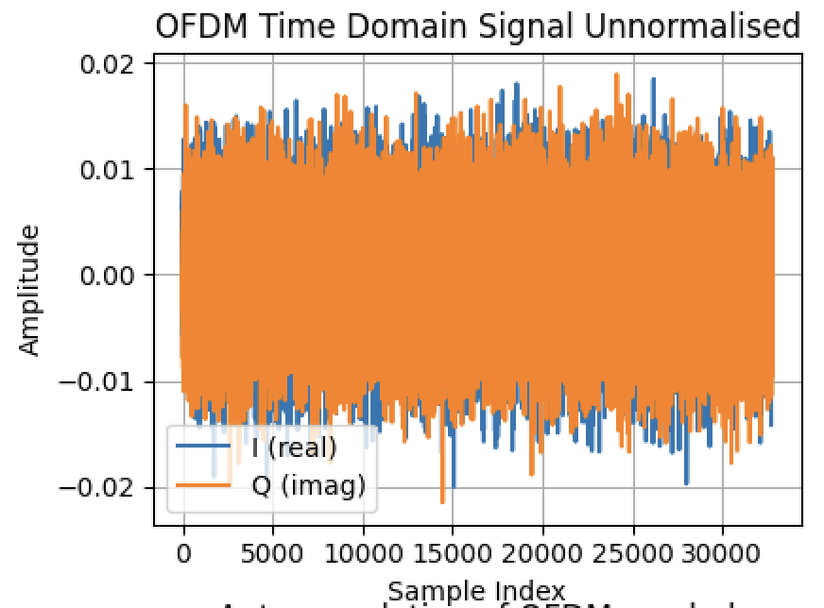
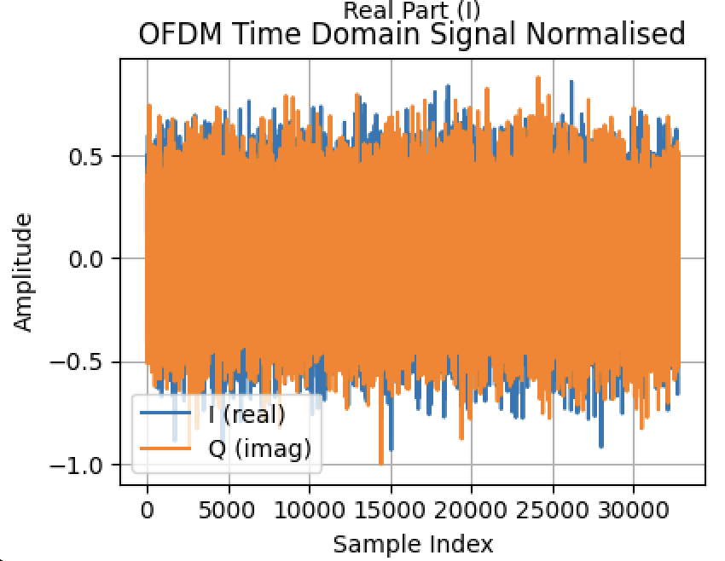
Chapter 2: What the heck have I done since last time?
Re-design of signal creation toolchain

Slide 20
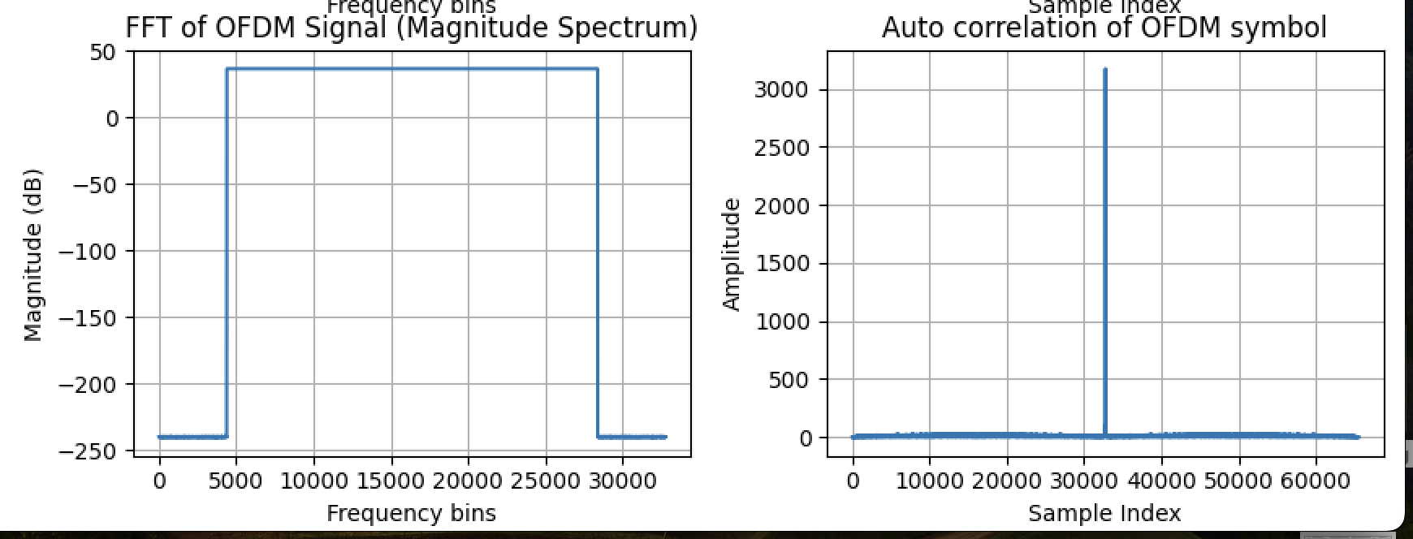
Chapter 2: What the heck have I done since last time?
Re-design of signal creation toolchain

Slide 21
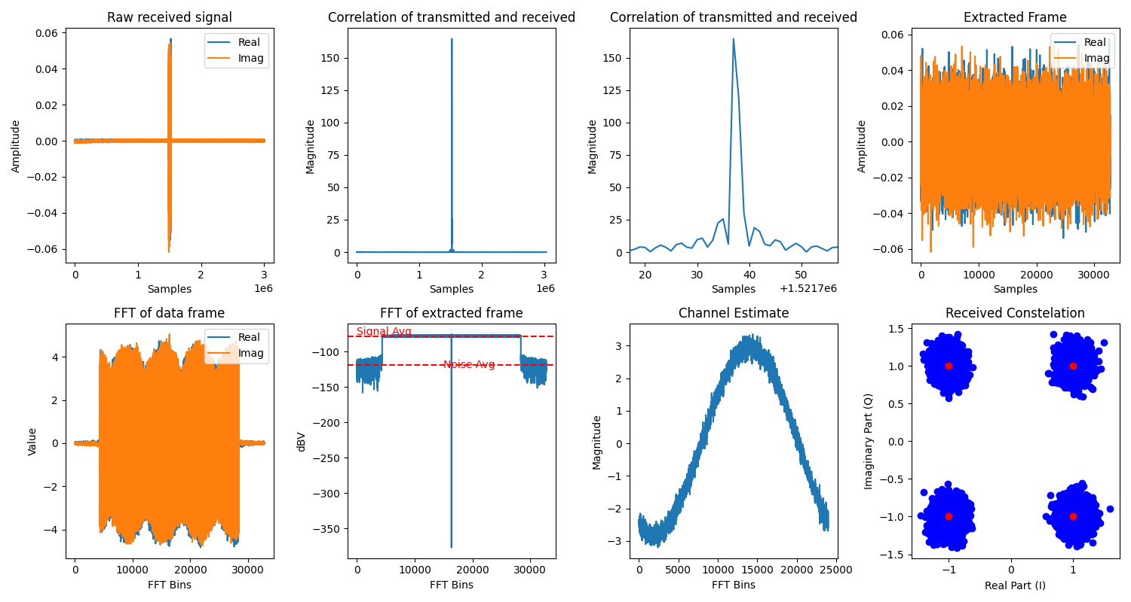
Chapter 2: What the heck have I done since last time?
Flow of Re-designed of signal demodulation toolchain

Slide 22
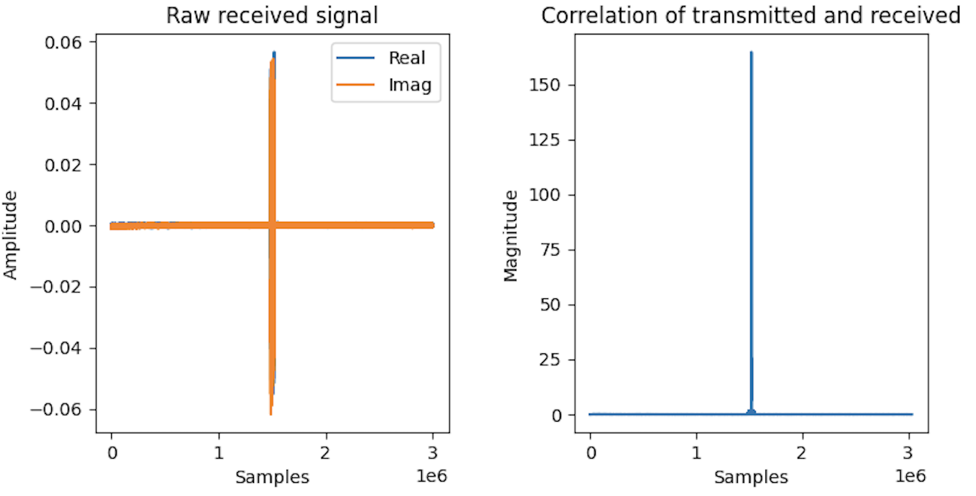
Chapter 2: What the heck have I done since last time?
Flow of Re-designed of signal demodulation toolchain

Slide 23
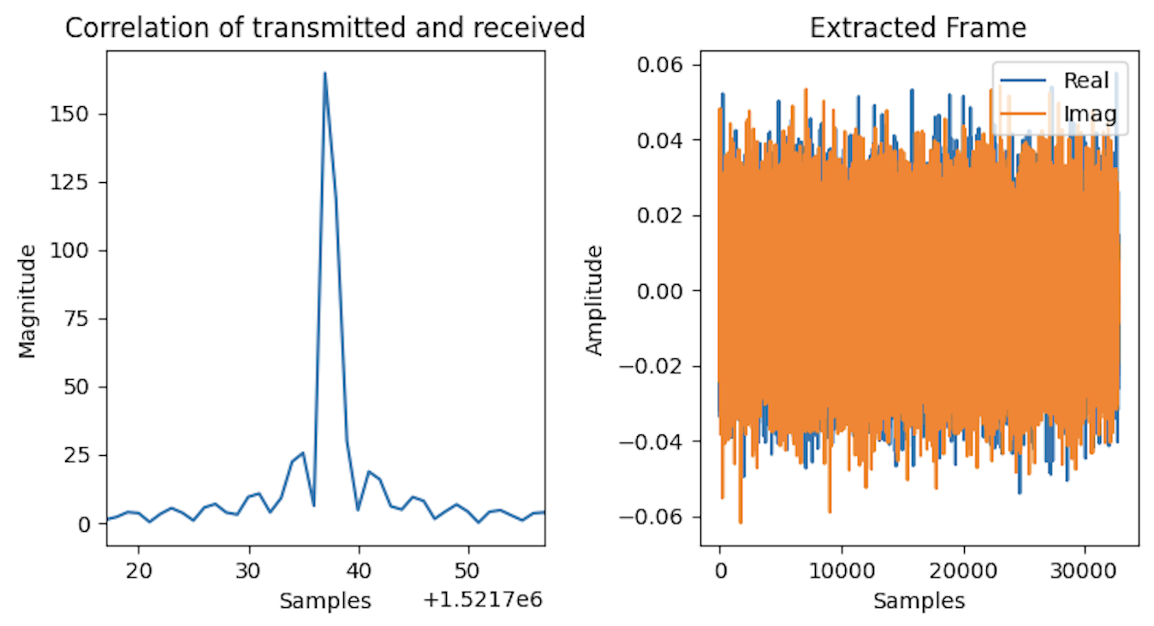
Chapter 2: What the heck have I done since last time?
Flow of Re-designed of signal demodulation toolchain

Slide 24
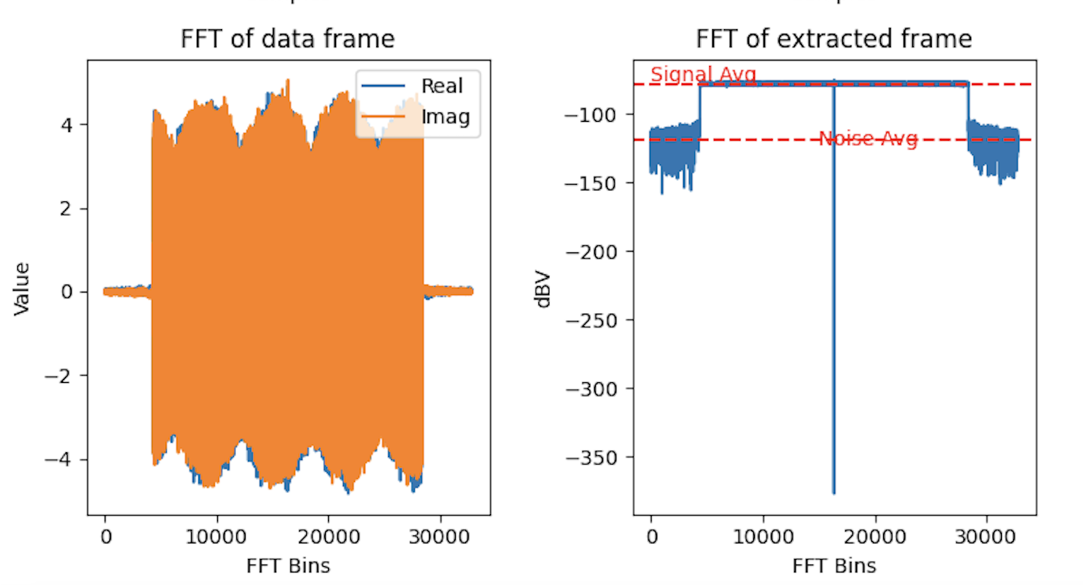
Chapter 2: What the heck have I done since last time?
Flow of Re-designed of signal demodulation toolchain

Slide 25
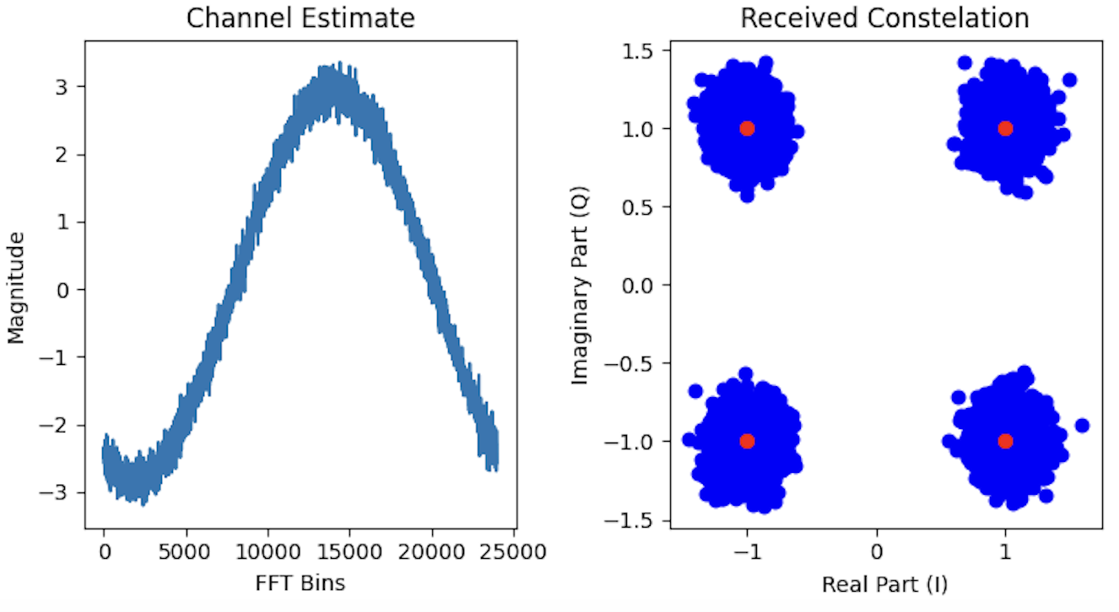
Chapter 2: What the heck have I done since last time?
Flow of Re-designed of signal demodulation toolchain

Slide 26
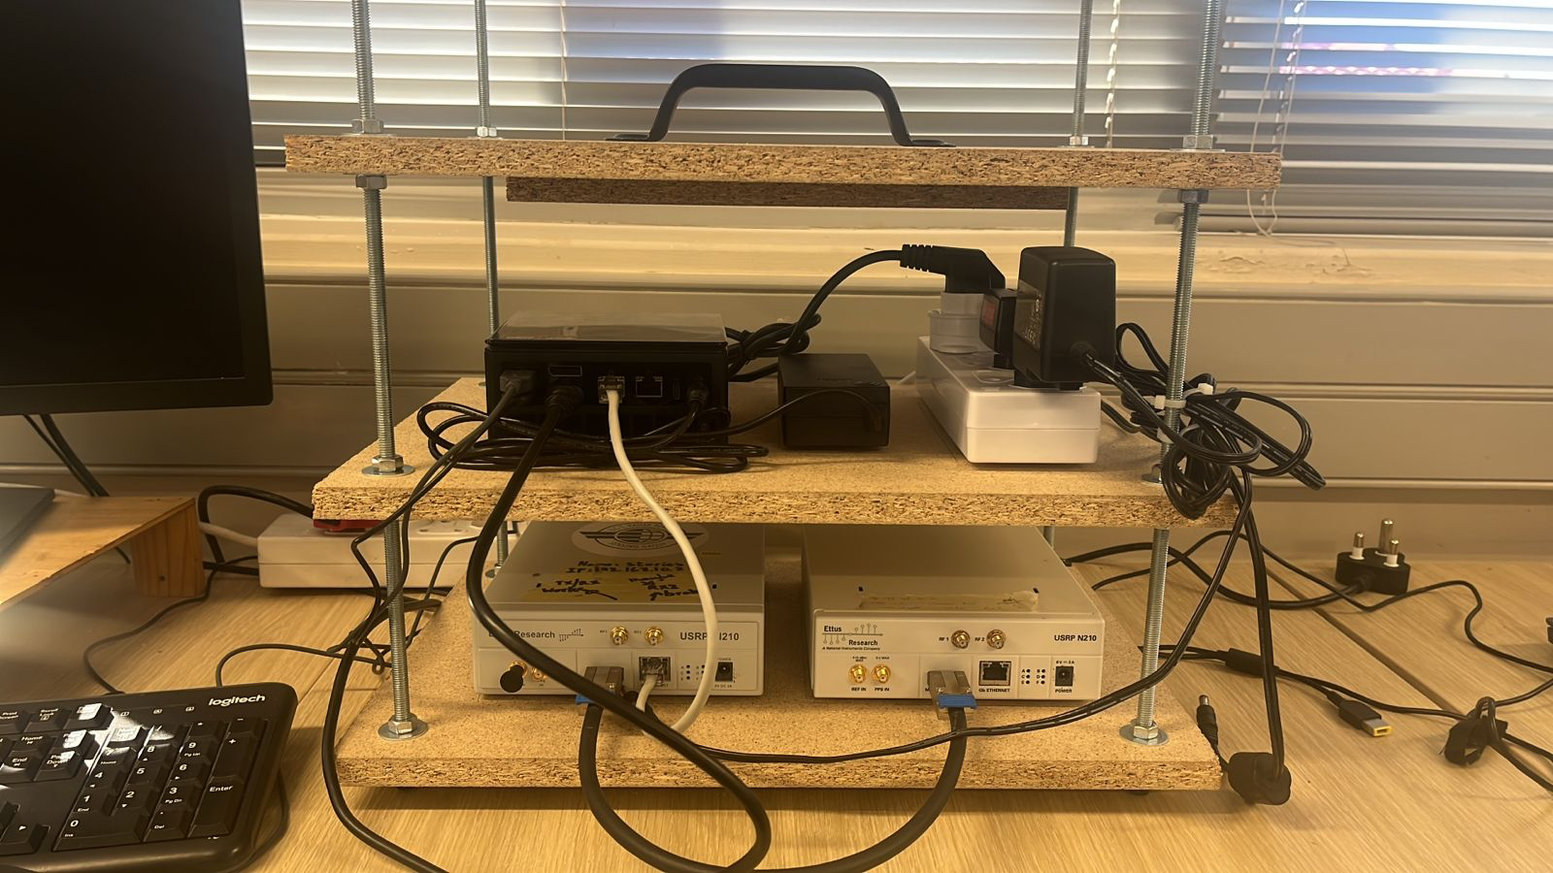
Chapter 2: What the heck have I done since last time?
Built a testing rig

Slide 27
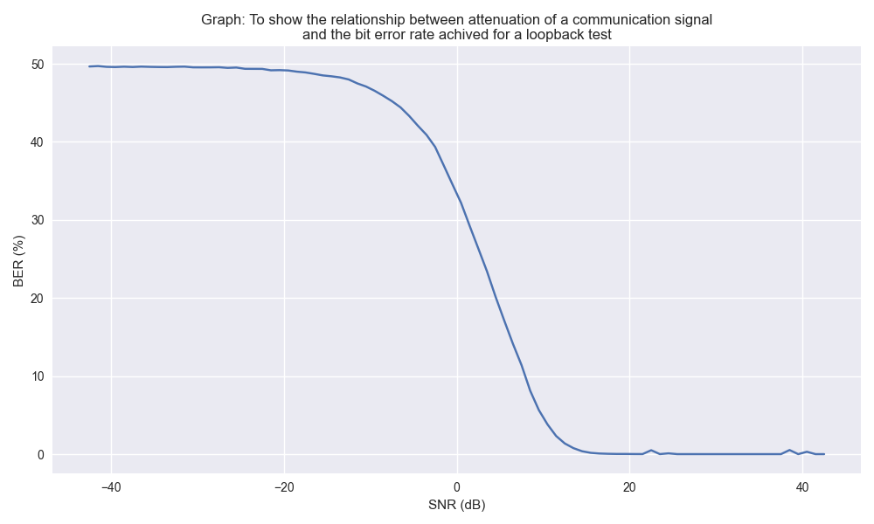
Chapter 2: What the heck have I done since last time?
Preliminary Communications testing

Slide 28
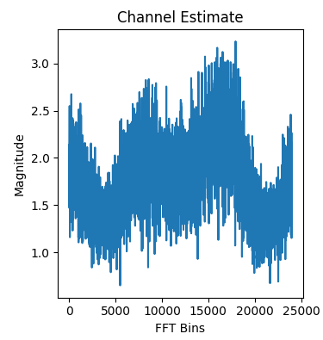
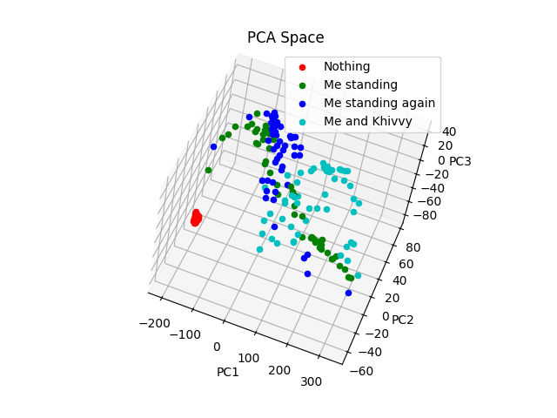
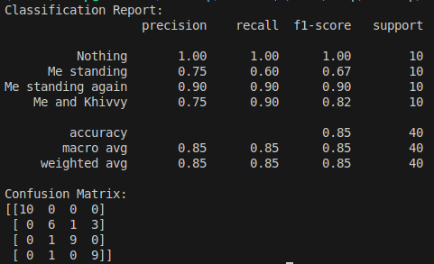
Chapter 2: What the heck have I done since last time?
Creating classification pipeline

Slide 29
Chapter 2: What the heck have I done since last time?
Creating classification pipeline

Slide 30
Chapter 3: What my next steps may be?
Communication Testing
  Communication system characterization
  Long cable loopback test
  Antenna test
Range Testing
  Characterize system performance when detecting objects at different distances
  Multiple targets in frame
Classification testing
  Keep scene background the same, then change targets and get multiple captures of each object
  Asses classification performance

