Slide 1
ALTO Low Power Mode
V1.1
Soundec, 26 Feb 2020

Slide 2
Version | Date | Description | Owner
V1.0 | 2020/02/08 | Document creation | Simon Wang
V1.1 | 2020/02/26 | Add USB power up structure and calculation | Hongdong Song

Slide 3
Power structure plan for MP version
One power control pin use 2.6V power as IO power.
USB PHY share same power with other digital IO
USB PMU is in Always-on power domain, and USB core is in power down domain.

Slide 4
Power status in pin control power down mode
OPM is in low power mode, RAR-eSR-qLR is in retention mode.
2x iLR-Victoria , eSR-Tugela are shutdown.
Click is shutdown

Slide 5
Power status in USB control power down mode
OPM is in low power mode, RAR-eSR-qLR is in retention mode.
One iLR-Victoria , eSR-Tugela are shutdown.
Click is shutdown
One iLR-Victoria is active to enable USB PHY and Digital IO

Slide 6
Power Consumption of Major Blocks
 | Normal mode | LP Mode | Note
OPM | 10uA | 0.3uA
RAR-eSR-qLR | 70uA + TBD | 0.365uA + TBD | DC/DC + LDO, Output current limited to 1 mA in LP mode
iLR-Victoria | 40uA | 0.15uA | LDO
eSR-Tugela | 187uA | 0.35uA | 95%, 90%, 70% efficiency
PORBOR | 13uA | 0.05nA
Click | TBD | 1uA
IO | 4 uA | 4 uA | 0.2 uA leakage per IO cell in typical case.
32K OSC | 70nA | 70nA | ???
Standard Cell Leakage | 1.25mA | 0 | Cut down power in low power mode
Standard Cell Dynamic | 80.9mA | 0 | Cut down power in low power mode

Slide 7
Chip Power Consumption in Power Down mode

Slide 8
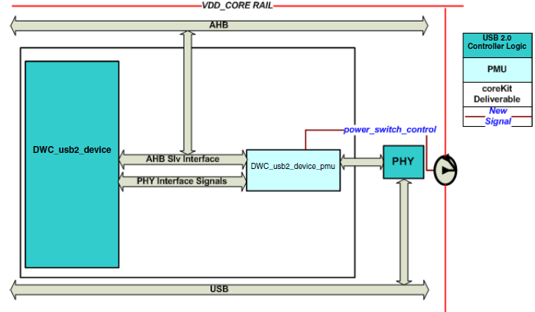
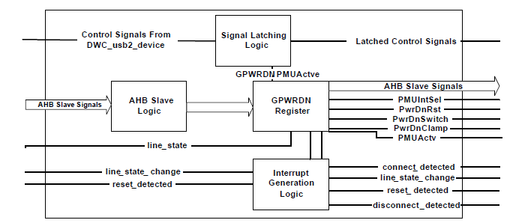
USB IP Hibernation Feature
PMU block signal

Slide 9
Power Down IO Structure

Slide 10
END

Slide 11
Power Consumption in Low Power Mode
OPM → active in LP mode
Low-power mode: 300 nA
PORBOR → active in LP mode
Low-power mode: 5nA
eSR → OFF
Shutdown mode on AVDPWR: 111 nA
Shutdown mode on AVD: 26 nA
iLRs → OFF
Shutdown mode: 150*2 = 300 nA
RAR → qLR active
Retention mode: 365 nA
Click (power switch):
Leakage: 1000nA
OSC32K:
70 nA
Only one IO is active (supply by OPM)
Always-ON for sleep and wakeup
leakage, 0.2uA
Block | Current (Typical) | unit
OPM | 300 | nA
PORBOR | 5 | nA
eSR | 137 | nA
Two iLR | 300 | nA
RAR | 365 | nA
Click | 1000 | nA
32K OSC | 70 | nA
One IO | 200 | nA
Total in LP | 2.372 | uA

