Slide 1
SNC8600 产品介绍

Slide 2
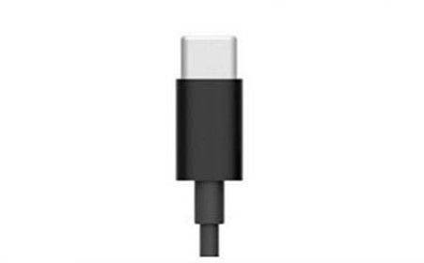


耳机的顺势发展
智能耳机将在无线连接、智能降噪、语音交互和生物监测等领域发挥重要的作用， 在用户体验和功能方面正在成为智能手机的重要组成部分。
耳机正在摆脱从属性质的地位，从一个单一的听音拾音设备，变成一个独立的智能化设备。众多传感器和人工智能技术让耳机成为独立计算设备的可能，配合互联网和云计算，音频正在形成一个完整的智能产业链。
连接方式
支持本地SPK ANC（下行）和MIC ANC（上行）的降噪耳机的市场份额正在迅速增长
2

Slide 3
耳机多样化的市场机会及九音的优势
九音科技的技术优势：
噪音环境拾音的技术：为语音识别、翻译、物联网控制提供核心的前端拾音方案；
生理特征监测技术：不需要额外增加传感器，依靠耳内声呐技术来实现；（针对耳机产品）
音频信号处理技术：在100dB强噪音环境中可以无障碍语音通话；
音频信号放大技术：在普通环境中，可以实现喃喃细语般的“腹语”通话；
本地隔离噪音技术：把低频噪音2KHz以下的噪音消除或抑制；
音效还原补偿技术：使用普通的耳机、低品质音乐内容，聆听到HiFi的音响效果。
音频播放
互联网语音
语音识别
翻译
智能家居控制
助听器
增强听力
人与人交流
主动保护
降噪
隔离噪音
监测（生理特征）
运动
医疗
3

Slide 4
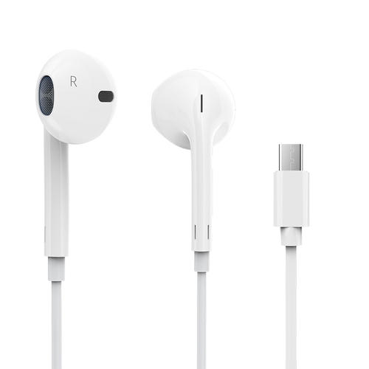
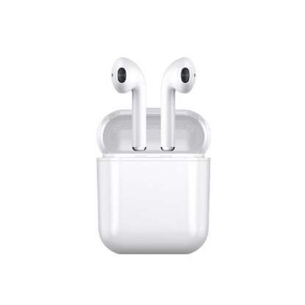
产品线路图
耳机
Type-C
蓝牙（TWS）
耳道内拾音
Hybrid ANC和ENC
Beamforming
语音唤醒VAD
风噪Filter
24bit/192KHz
耳道内拾音
Hybrid ANC和ENC
Beamforming
语音唤醒VAD
风噪Filter
24bit/768KHz
IoT（）物联网）
MIC阵列
6MIC
Beamforming
语音唤醒VAD
远场拾音和降噪
助听器
健康
人声拾音
Beamforming
声音还原和放大
智能环境音降噪
DSP声音处理
特殊行业
耳道内拾音
120dB噪音降噪
Beamforming
风噪Filter
Q3
Q4
Q1
Q2
Q3
Q4
Q1
Q2
Q3
Q4
Q1
Q2
Q3
Q4
CY2019
CY2020
CY2021
CY2022
11

Slide 5
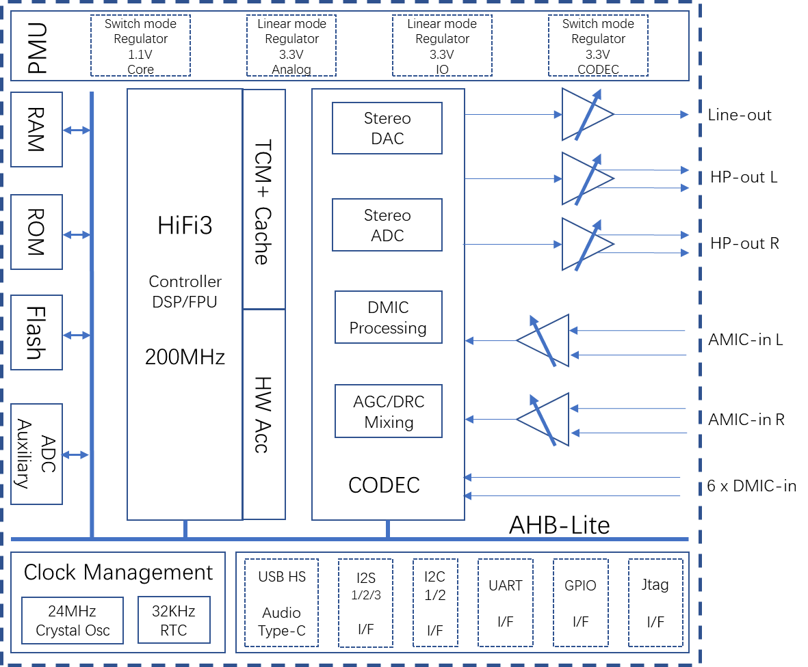
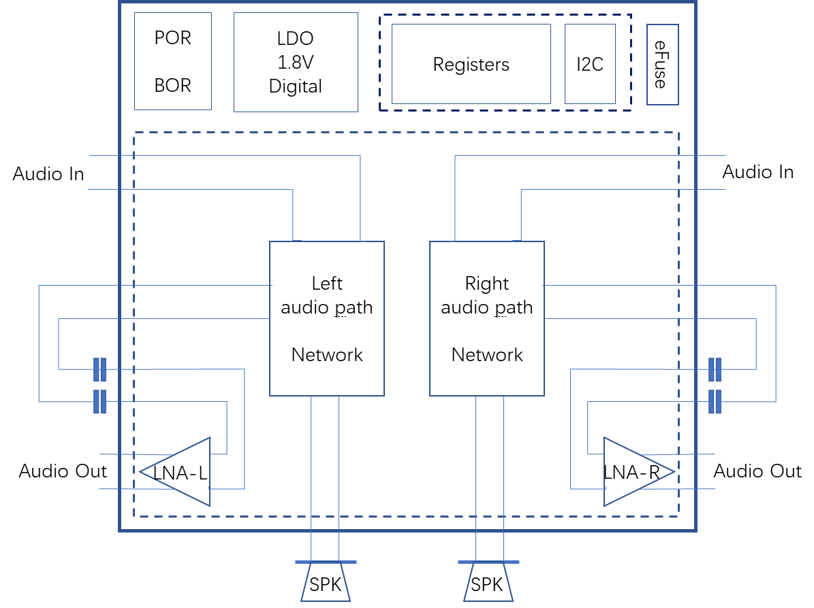
第一代音频套片芯片架构图
SNC1600: Audio Front-end
(Optional)
SNC8600: CODEC SOC
4

Slide 6
产品主要功能
Core
CODEC
Audio DSP, up to 200MHz
Single cycle MAC, vector FPU, SIMD
Proprietary hardware accelerators
384KB zero-wait RAM
32KB zero-wait cache RAM
On-chip 1MB NOR flash memory
One unique power supply from 3.3V to 5.5V
DC-DC regulators and LDOs for all on-chip supply voltages
Stereo 24-bit ADC and DAC, with 106 dBA and 110dBA dynamic range respectively
DAC: SNR 100dB, THD+N: 89dB
ADC: SNR 95dB, THD+N: 88dB
Support sampling rate: 8k, 16k, 32k, 48k, 96k, 192k
Up to 8 DMIC inputs
Low power voice detection
Wind noise suppression
Audio local DSP: AGC, DRC, mixing
DSP
CODEC
Noise cancellation
软件功能
Noise cancellation for both near-end and far-end
Active echo cancellation (AEC)
Microphone Active noise cancellation (MIC ANC)
Beam forming (BF)
Speaker Active noise cancellation (SPK ANC)
Automatic Gain Control (AGC)
Wind noise suppression （WNS）
接口功能
Type-C USB2.0 HS device, compliant with Audio Class Specification Rev1.0
Three I2S for data transfer
Two I2C for system setting
One UART for firmware update and system setting
16 GPIO multiplexing with other interfaces
Auxiliary ADC for button detection, battery monitor, other analog sensors
One effuse OTP with 256 bits
Interface
5

Slide 7
SNC8600 CODEC Performance
Headphone DAC performance, measured with 1kHz sinewave signal and differential-output @typical condition
Load (ohms) | Dynamic range (dB) | SNR (dB) | THD+N (dB) | Crosstalk (dB) | Idle noise (uV)
600 | 110 | 101 | -89 | 124 | 5.70
32 | 106 | 99 | -80 | 123 | 5.65
ADC performance, measured with 1kHz sinewave signal and differential-input @typical condition
ADC Input | Dynamic range (dB) | SNR (dB) | THD+N (dB) | Channel Separation (dB) | Input noise (uV)
Analog | 106 | 95 | -88 | 108 | 3.60
6

Slide 8
SNC8600外围器件清单
10

Slide 9
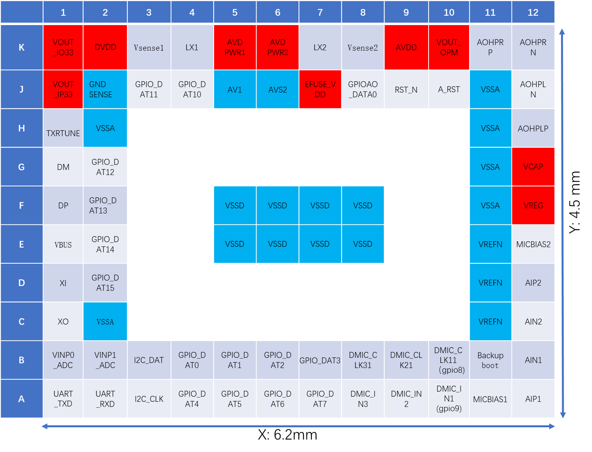
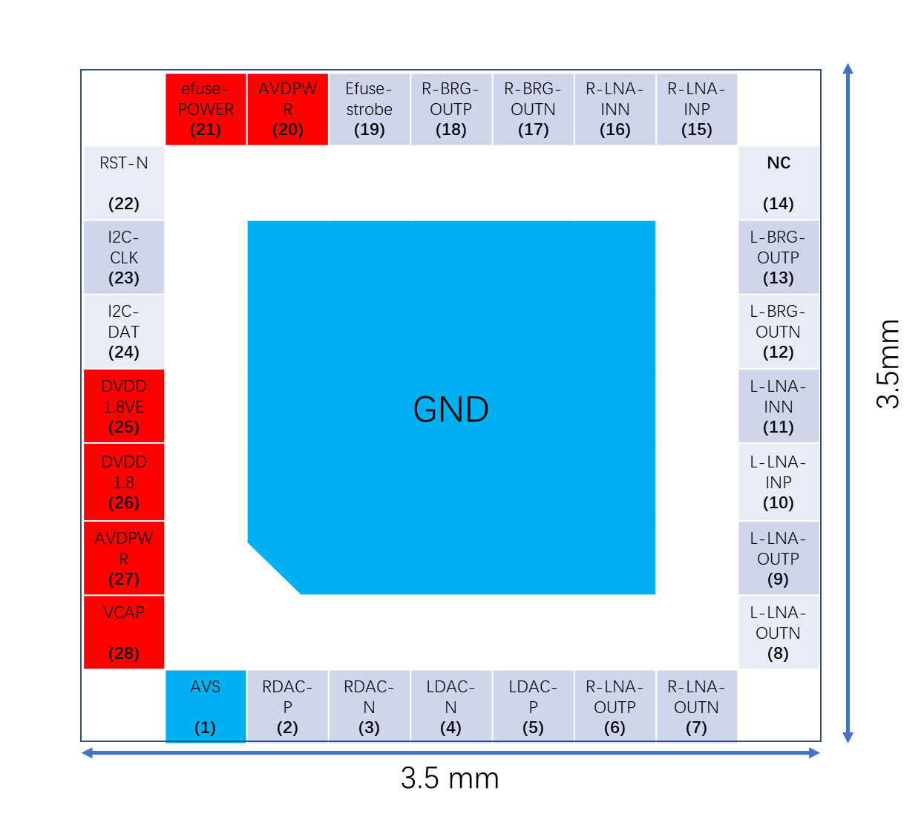
SNC8600 封装信息
SNC1600: QFN28
(top view)
SNC8600: BGA80
(top view)
*MPW样片尺寸，量产尺寸在3.xmm*4.xmm
9

Slide 10
Playback Power Comparison
Test Case | SNC 8600 Full Speed(5V) | CX21888 Full Speed | BES3001 Full Speed
Suspend w/ remote wake enabled | 1.47mA | 1.5mA | NA
Idle Current ADC/DAC/USB power down /processing disenabled | 3.7mA | 10.0mA | NA
Headphone Active Stereo Playback: 1.0mW | 23.3mA | 21.0mA | NA
Record Path Active stereo | 16.6mA | 14.0mA | NA
Record Path Active stereo Headphone Active stereo Playback: 1.0mW | 25.1mA | 24.0mA | NA
Type-application case: Vbus=5V,Stereo playback, 32Ohm load, 16bit/48KHz
* ES1版本的数据，量产版本数据会优化
12

Slide 11
Features Comparison
Test Case | Soundec SNC 8600 | Synaptics CX31988 | BES BES3001
USB Speed | Full Speed or High Speed | Full Speed or High Speed | Full Speed or High Speed
LPM | Yes | Yes | No
VPD-V conn power support | ??? | Yes | No
Audio Bit/Sample Rates | 24bit/192KHz | 32bit/384KHz | 24bit/192KHz
DSD Audio support (44.1x) | No | Yes | No
In-field FW update support | Yes | Yes | Yes
Multiband EQ | 10 Bands playback and record | 26 bands playback, 5 band record | TBD
Audio Round trip Latency | 2ms | 4ms | 25ms
Beam forming | Yes | No | No
MIC ANC | Yes | No | No
SPK ANC | Yes | No | No
AEC | Yes | No | No
WNS | Yes | No | No
13

Slide 12
BOM Comparison
Test Case | Soundec SNC 8600 | Synaptics CX31988 | BES BES3001
Integrated Crystal | No | Yes | No(Full Speed) Yes（High Speed）
Integrated Memory | Yes (SRAM 384KB) | Yes (TBD) | Yes(SRAM 160KB)
Integrated DC-DC | Yes | Yes | Yes
Passives | 41 | 41 | 61
Footprint | 4.5 x 6.2 mm/ 3.5 x 5.0 mm (MP) | 2.6 x 4.3 mm | 2.7 x 4.4 mm
Passives: 拆解产品分析得到的数据
14

Slide 13
Record and Playback Performance Comparison
Parameter | Soundec SNC 8600 | Synaptics CX31988 | BES BES3001
SNR, silence（DAC） | 101dB | 130 dB | 120dB（Noise Gate） 102dB
DR, -60 dBFS（DAC） | 110dB | 120 dB | 98dB
THD+N, 0 dBFS（DAC） | -86dB | -102dB | -86dB
Crosstalk（DAC） | -123dB | -110dB | -99dB
DR, -60 dBFS（ADC） （48K/24-bit/ 0dB MIC） | 106dB | 115dB | 96dB
THD+N，-1 dBFS（ADC） | -88dB | -90dB | -78dB
15

Slide 14

SOUNDEC
谢谢！

Slide 15
Power Consumption
Type-C Headset, power sink from one external supply at 5V, in unit of mA
Mode | No load | 22 ohm load |  | 32 ohm load |  | 64 ohm load
 | Mute | 0.1mW | 1.0mW | 0.1mW | 1.0mW | 0.1mW | 1.0mW
Music | 17.50 | 20.31 | 26.40 | 19.83 | 24.88 | 19.15 | 22.72
Call | 18.99 | 21.80 | 27.89 | 21.32 | 26.37 | 20.64 | 24.21
Music ANC | 25.20 | 28.01 | 34.10 | 27.53 | 32.58 | 26.85 | 30.42
Call ANC | 26.69 | 29.50 | 35.59 | 29.02 | 34.07 | 28.34 | 31.91
BT Headset, power sink from one external supply at 3.3V, in unit of mA
Mode | No load | 22 ohm load |  | 32 ohm load |  | 64 ohm load
 | Mute | 0.1mW | 1.0mW | 0.1mW | 1.0mW | 0.1mW | 1.0mW
Music | 7.74 | 9.87 | 14.48 | 9.51 | 13.33 | 8.99 | 11.69
Call | 9.51 | 11.64 | 16.25 | 11.28 | 15.10 | 10.76 | 13.46
Music ANC | 15.44 | 17.57 | 22.18 | 17.21 | 21.03 | 16.69 | 19.39
Call ANC | 17.21 | 19.34 | 23.95 | 18.98 | 22.80 | 18.46 | 21.16
Power figures are estimated basing on basic power measurement data.
Stereo DAC and mono ADC, 24bit/48KHz, power including digital and analog part, referred to one external power supply
For reference: ADAU1787 Call ANC mode, 3.305mA from DVDD, 4.49mA from AVDD
* ES1版本的数据，量产版本数据会优化
12

Slide 16
SNC8600 DAC frequency response measurement
32 ohms
Frequency | LEFT Vout-dif |  |  |  | RIGHT Vout-dif
 | Amplitude |  | THD_+N |  | Amplitude |  | THD_+N
20HZ | 872.30 | mV rms | -97.9 | dB | 860.7 | mV rms | -97.8 | dB
50HZ | 874.90 | mV rms | -96.6 | dB | 872.2 | mV rms | -96.7 | dB
100HZ | 875.20 | mV rms | -93.6 | dB | 872.5 | mV rms | -93.4 | dB
500HZ | 874.20 | mV rms | -83.9 | dB | 871.5 | mV rms | -83.5 | dB
1KHZ | 871.70 | mV rms | -79.8 | dB | 869.1 | mV rms | -79.2 | dB
2KHZ | 870.60 | mV rms | -75.7 | dB | 867.9 | mV rms | -74.9 | dB
3KHZ | 872.50 | mV rms | -73.7 | dB | 869.8 | mV rms | -72.9 | dB
4KHZ | 867.80 | mV rms | -72.5 | dB | 865.2 | mV rms | -71.6 | dB
5KHZ | 866.10 | mV rms | -72.1 | dB | 863.4 | mV rms | -71.2 | dB
6KHZ | 868.90 | mV rms | -71.3 | dB | 866.3 | mV rms | -70.4 | dB
7KHZ | 865.80 | mV rms | -72.2 | dB | 863.2 | mV rms | -71.2 | dB
8KHZ | 867.90 | mV rms | -71.8 | dB | 865.3 | mV rms | -70.8 | dB
9KHZ | 870.30 | mV rms | -71.3 | dB | 867.8 | mV rms | -70.3 | dB
10KHZ | 868.90 | mV rms | -70.6 | dB | 866.4 | mV rms | -69.6 | dB
11KHZ | 868.70 | mV rms | -75.1 | dB | 866.2 | mV rms | -73.7 | dB
12KHZ | 873.20 | mV rms | -76.2 | dB | 870.8 | mV rms | -74.5 | dB
13KHZ | 870.90 | mV rms | -75.4 | dB | 868.5 | mV rms | -73.7 | dB
14KHZ | 869.10 | mV rms | -74.6 | dB | 866.8 | mV rms | -73 | dB
15KHZ | 872.40 | mV rms | -73.8 | dB | 870.1 | mV rms | -72.3 | dB
16KHZ | 869.70 | mV rms | -74.8 | dB | 867.5 | mV rms | -73.3 | dB
17KHZ | 869.10 | mV rms | -82.4 | dB | 866.9 | mV rms | -82 | dB
18KHZ | 874.60 | mV rms | -82.2 | dB | 872.4 | mV rms | -81.9 | dB
19KHZ | 874.10 | mV rms | -81.8 | dB | 872.1 | mV rms | -81.7 | dB
20KHZ | 880.80 | mV rms | -81.5 | dB | 878.8 | mV rms | -81.3 | dB
21KHZ | 874.20 | mV rms | -81.1 | dB | 872.2 | mV rms | -80.8 | dB
22KHZ | 585.60 | mV rms | -61.1 | dB | 484.8 | mV rms | -61.1 | dB
Average | 871.24 | mV rms | -78.37 | dB | 868.39 | mV rms | -77.54 | dB
32 ohms load, 0.871V rms
Frequency (KHz) | Response (dB) |  | 32 ohms load
20 | 0.01 |  | -97.9
50 | 0.04 |  | -96.6
100 | 0.04 |  | -93.6
500 | 0.03 |  | -83.9
1000 | 0.00 |  | -79.8
2000 | -0.01 |  | -75.7
3000 | 0.01 |  | -73.7
4000 | -0.03 |  | -72.5
5000 | -0.05 |  | -72.1
6000 | -0.02 |  | -71.3
7000 | -0.05 |  | -72.2
8000 | -0.03 |  | -71.8
9000 | -0.01 |  | -71.3
10000 | -0.02 |  | -70.6
11000 | -0.03 |  | -75.1
12000 | 0.02 |  | -76.2
13000 | 0.00 |  | -75.4
14000 | -0.02 |  | -74.6
15000 | 0.01 |  | -73.8
16000 | -0.02 |  | -74.8
17000 | -0.02 |  | -82.4
18000 | 0.03 |  | -82.2
19000 | 0.03 |  | -81.8
20000 | 0.09 |  | -81.5
21000 | 0.03
22000 | -3.45
7

Slide 17
Playback Power Comparison
Test Case | SNC 8600 Full Speed | CX31988 Full Speed | BES3001 Full Speed
Suspend w/ remote wake enabled | 7.4mW | 2.24mW | 2.05mW
Playback: Silence | 87.5mW | 46.90mW | 83.50mW
Playback: 0.5mW | 108.5mW | 69.45mW | 102.50mW
Playback: 1.0mW | 116.5mW | 77.14mW | 117.00mW
Playback: 5.0mW | 154.5mW | 109.40mW | 137.50mW
Playback: 10mW | 182.5mW | 133.18mW | 178.85mW
Playback: 24.5mW | 238.0mW | 179.50mW | 224.50mW
Type-application case: Vbus=5V,Stereo playback, 32Ohm load, 16bit/48KHz
* ES1版本的数据，量产版本数据会优化
12

