Slide 1
Examples of Data Wrangling
Rosa Filgueira

Slide 2
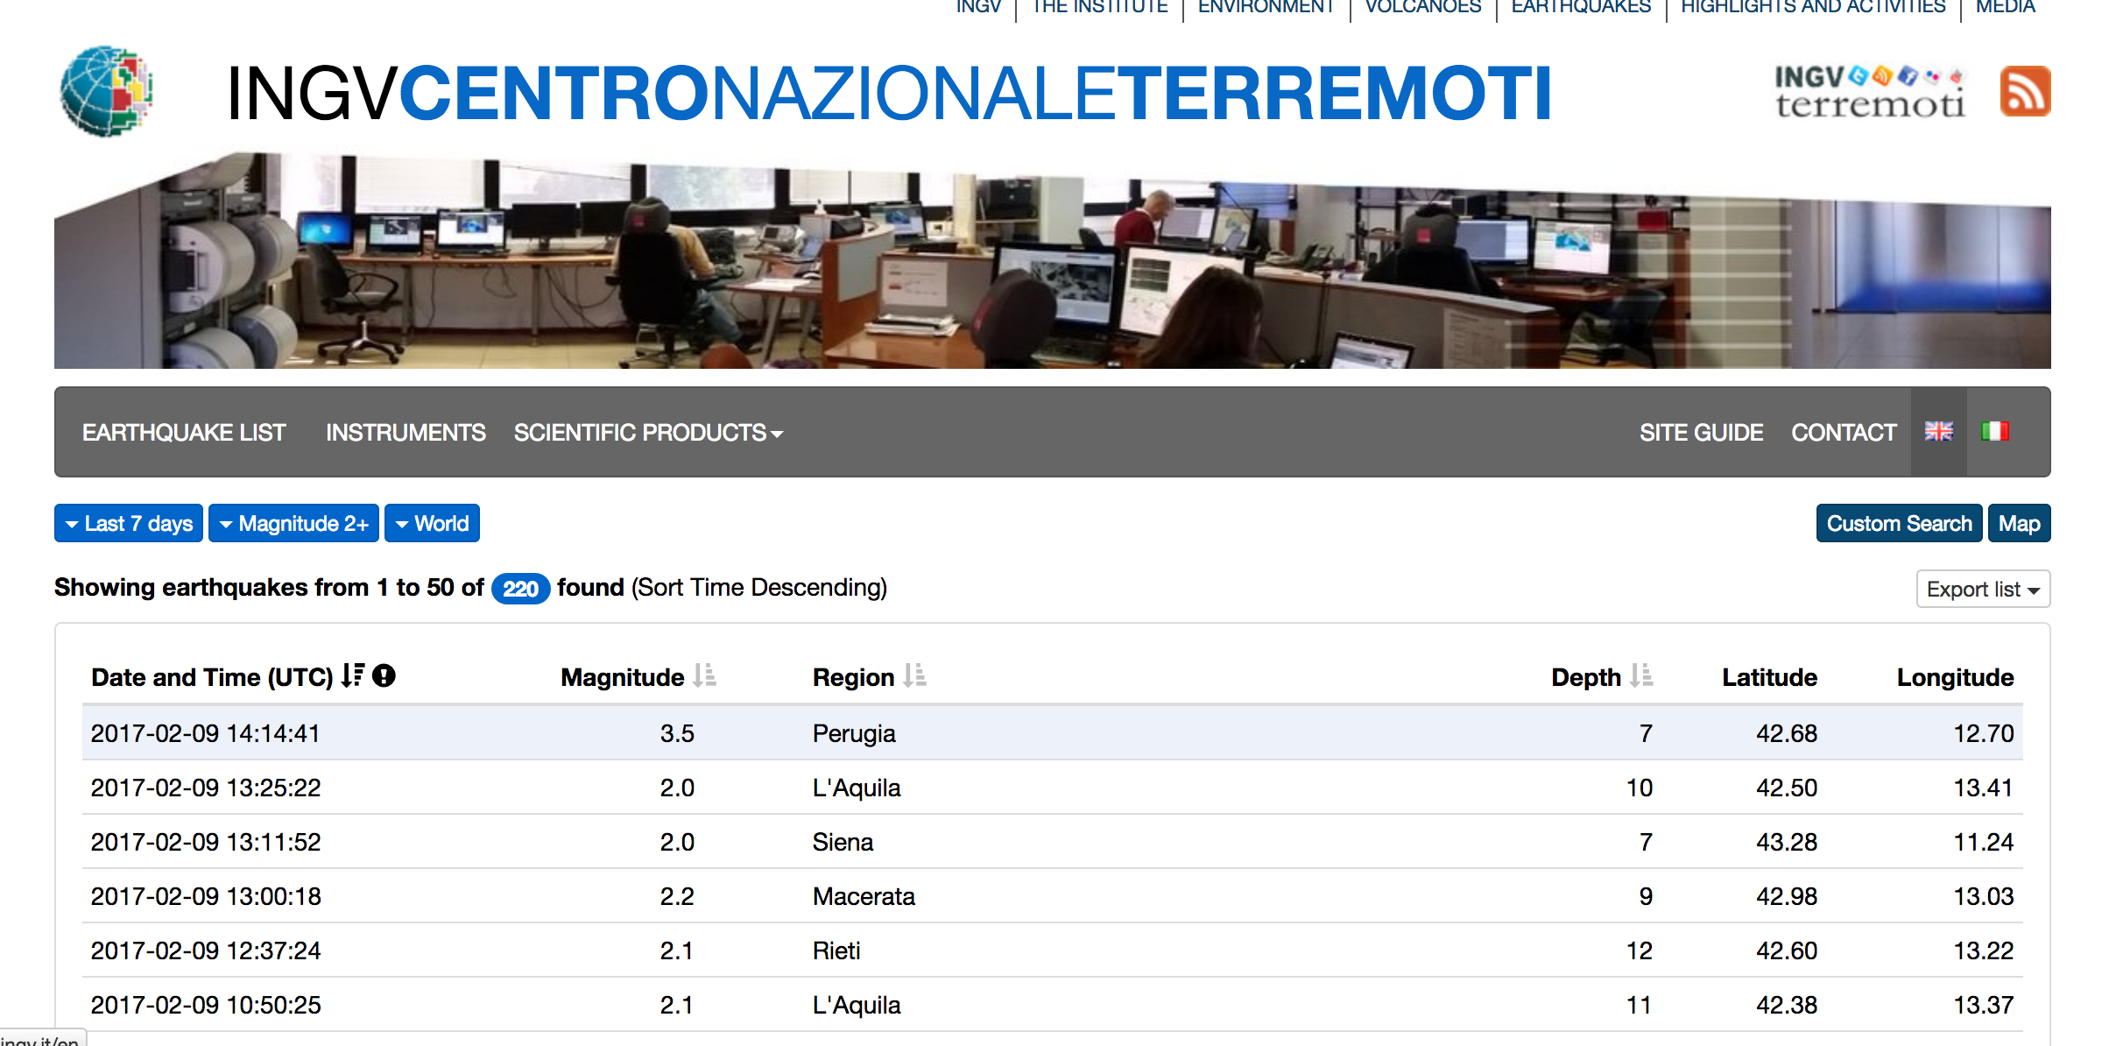
Seismology
INGV- CENTRO​NAZIONALE - ​TERREMOTI http://cnt.rm.ingv.it/en

Slide 3
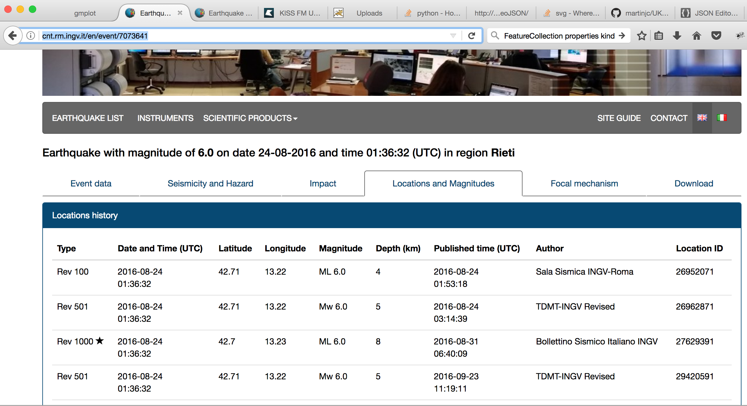
Seismology
INGV- CENTRO​NAZIONALE - ​TERREMOTI http://cnt.rm.ingv.it/en

Slide 4
Seismology
INGV- CENTRO​NAZIONALE - ​TERREMOTI http://cnt.rm.ingv.it/en

Slide 5
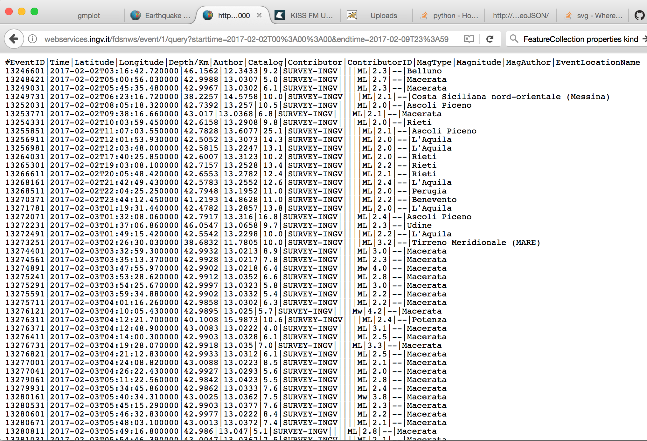
Seismology
Starttime
Endtime
Magnitude
webservices
Area
event IDs

Slide 6
Seismology
event IDs
HTML

Slide 7
Code - GitHub
Simple python code for downloading data in memory – I used some html libraries for parsing HTML – Everything is streamed – Not intermediate files
It could be easily be transformed into a data-pipeline workflow to download/parser several events in parallel – not need for this now –
https://github.com/rosafilgueira/Data_Wrangling/blob/master/Seismology_Example/download_cnt.py

Slide 8
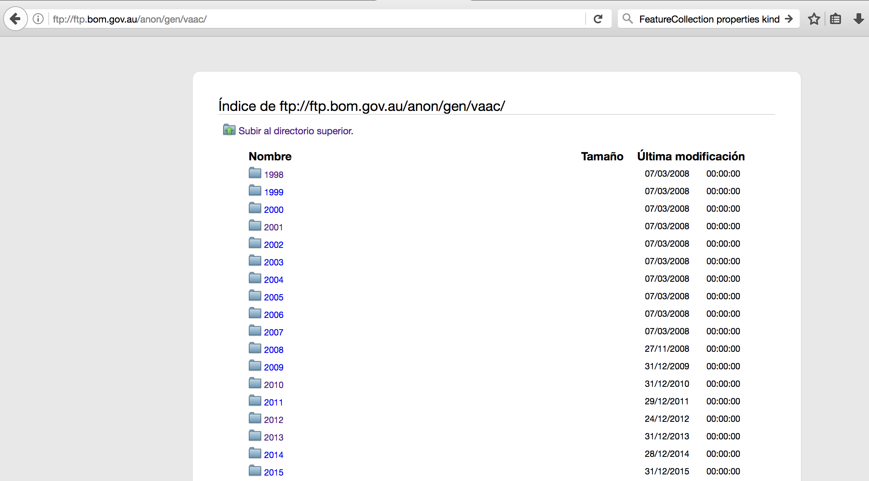
Volcanology
ftp://ftp.bom.gov.au/anon/gen/vaac/

Slide 9
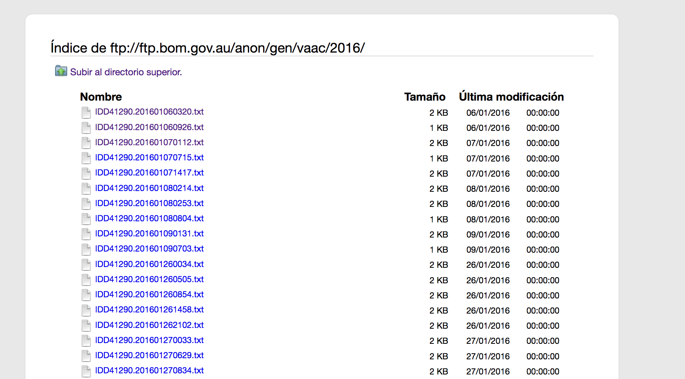
Volcanology
ftp://ftp.bom.gov.au/anon/gen/vaac/2016

Slide 10
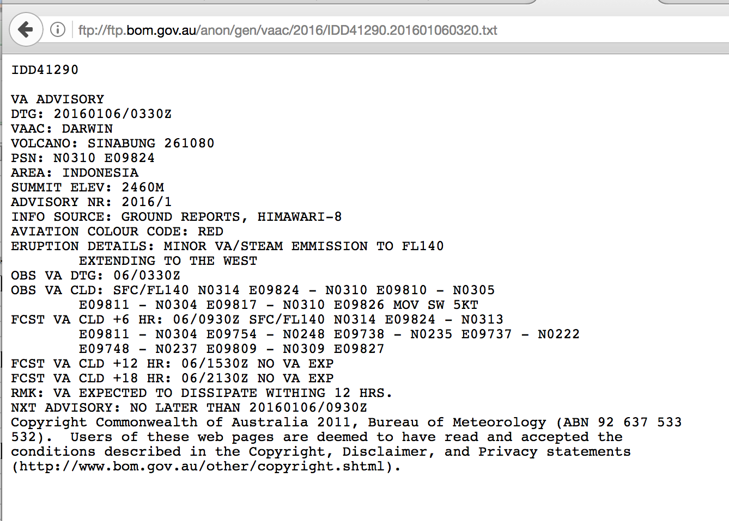
Volcanology
ftp://ftp.bom.gov.au/anon/gen/vaac/2016/IDD41290.201601060320.txt
volcano_name
colour_code
advice_date,
advice_time
time, date, fl,

Slide 11
Volcanology- Code - GitHub
- Data-pipeline workflow to download and to extract the selected data from different URLs in parallel - (new version soon -total streaming) - dispel4py + python
https://github.com/rosafilgueira/Data_Wrangling/blob/master/Volcanology_Example/vaac_preprocess.py
Python program to interpolate FLs values per volcano/year – Statistics - Pandas & Python
https://github.com/rosafilgueira/Data_Wrangling/blob/master/Volcanology_Example/vaac_process.py

Slide 12
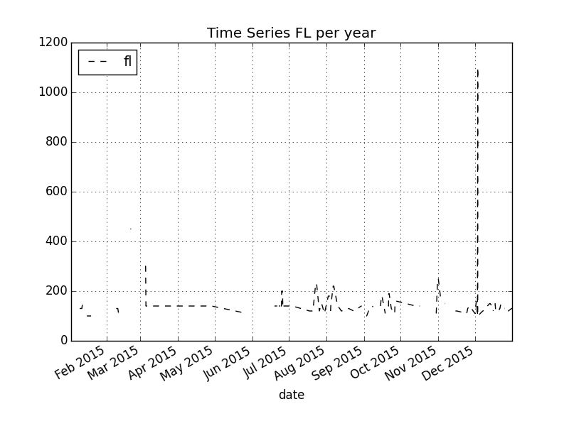

Slide 13
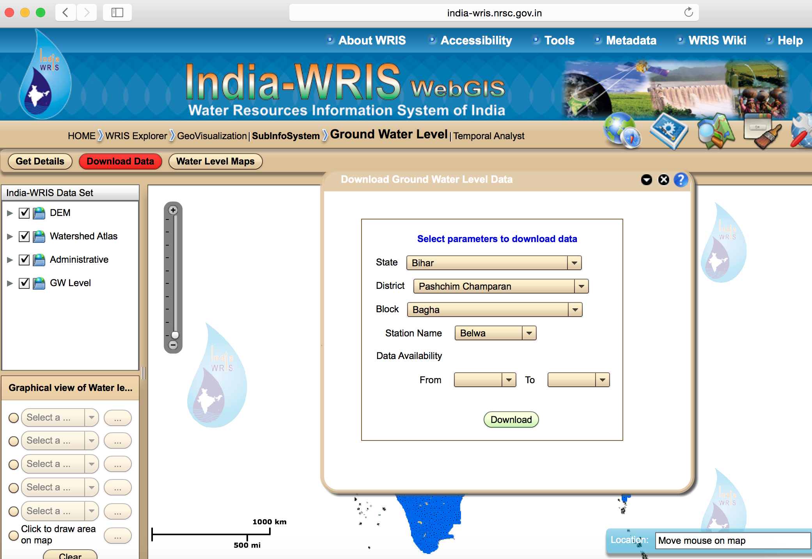
Hydrology http://www.india-wris.nrsc.gov.in/GWLevelApp.html?UType=R2VuZXJhbA==?UName=

Slide 14
Hydrology
The data is ordered into State, District, Block, Station name, and the user interface lets you select the times for which they should be downloaded. However, it only lets you download one file at a time.
Would you be able to write something clever so all the GW level data in the sates Bihar and Uttar Pradesh are downloaded for all districts, blocks, and stations? I won’t need all of them, but it might be easier to download them all and then see which ones are within our catchment.
Example of parameters:
State: Bihar
District: Pashchim Champaran
Block: Bagha
Station Name: Belwa
The range of time we need is whatever is available,

Slide 15
Social-Computing- Code - GitHub
Tweets classification – Supervised Method – Logistic Regression
Labeling tweets - Python
Create and Training a classifier– ScikitLearn ML python
Applying the classifier – Data-pipeline workflow –
For labeling automatically more tweets in parallel
For creating statistics with the tweets labeled
https://github.com/rosafilgueira/Data_Wrangling/tree/master/SocialComputing_Example

