Slide 1
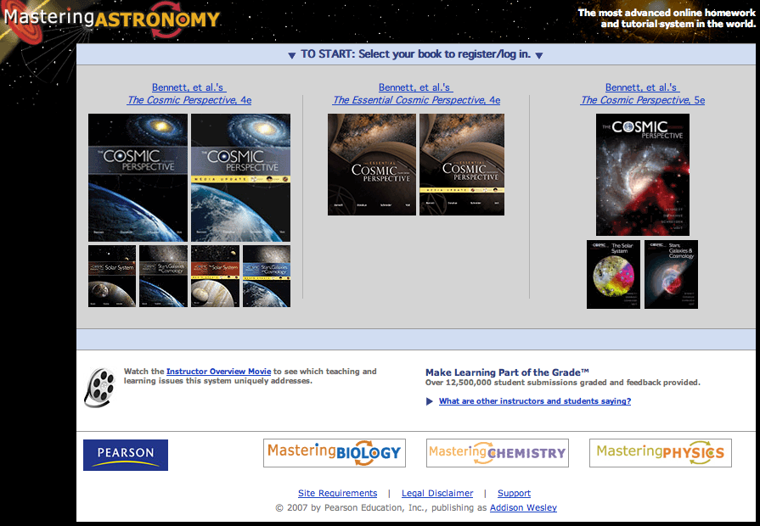
Go to www.masteringastronomy.com - and you get this
Click on our book

Slide 2
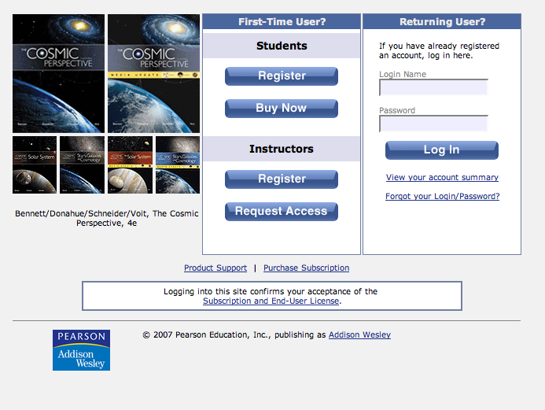
If you did not buy a new textbook then you need to buy access to Mastering Astronomy

Slide 3
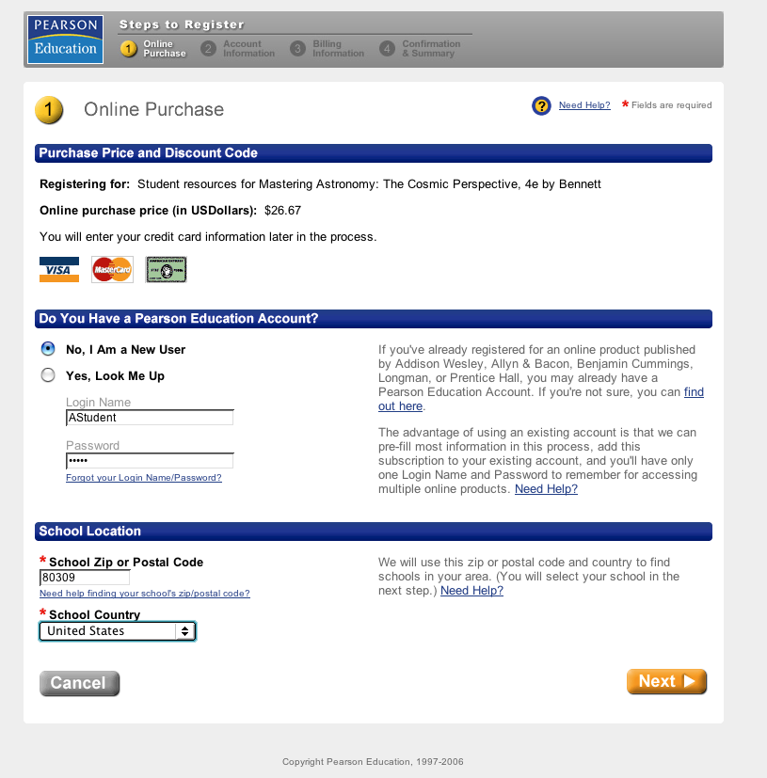
Register as a new student

Slide 4
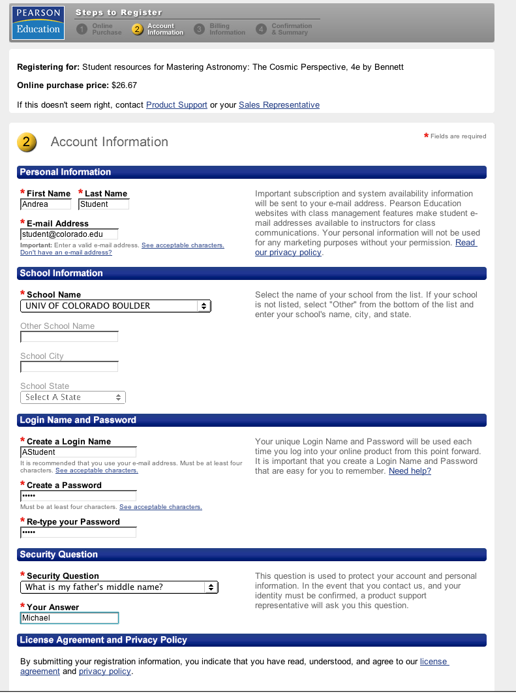
Register with a login name and password you can remember. (Your login can be whatever you want.)
And write your login down somewhere!

Slide 5
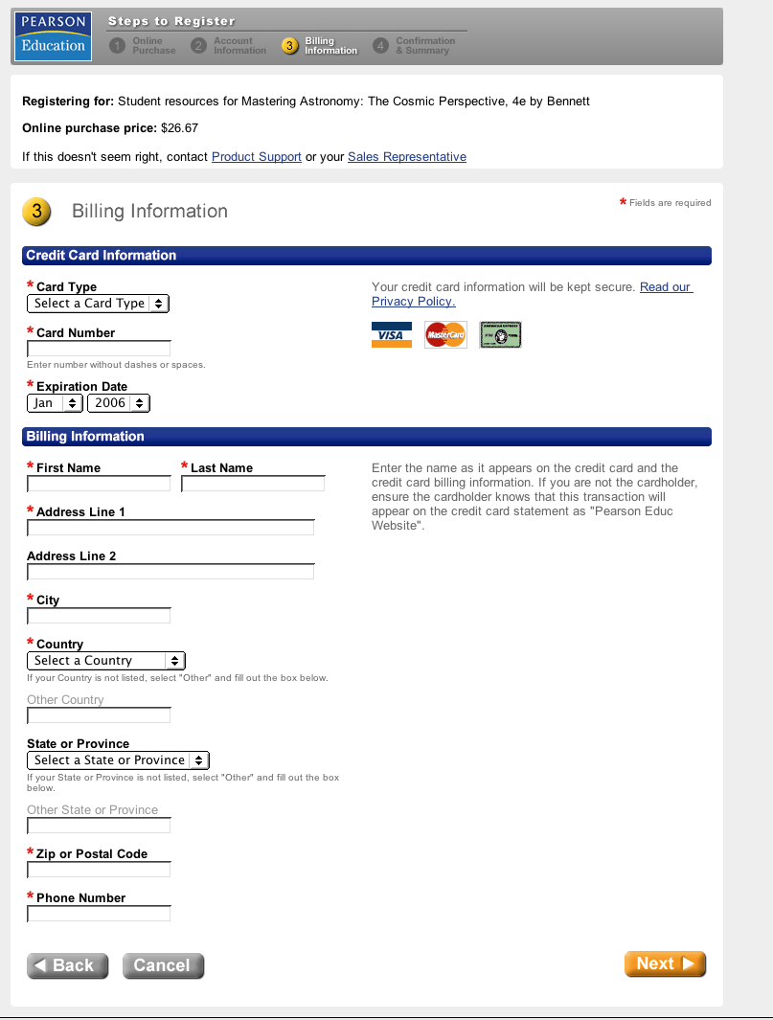
Yup - they need payment

Slide 6
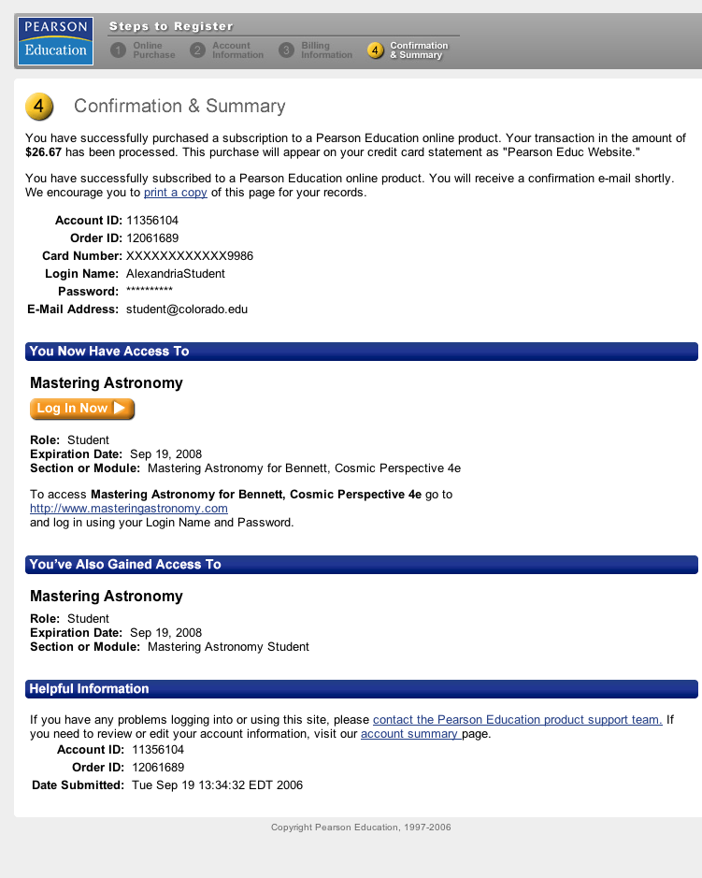
Your confirmation
NOW DO THIS

Slide 7
Log in here when you next want to go to Mastering Astronomy
AStudent
********

Slide 8
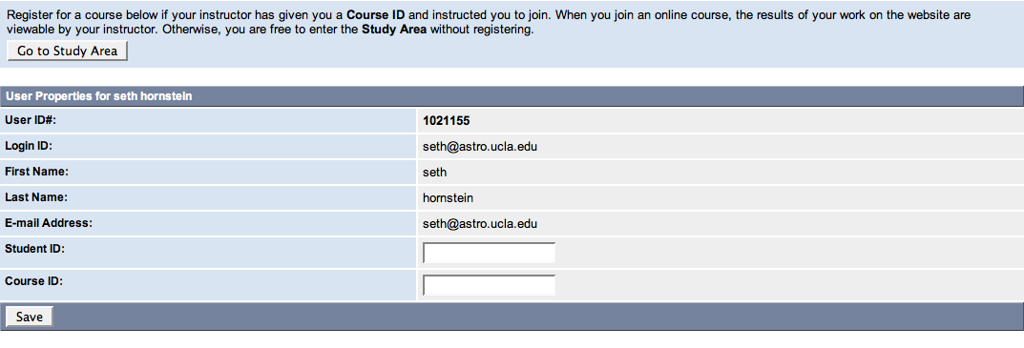
Now you need to join our class!
Andrea Student
1234567
astudent@colorado.edu
Use your CULearn logon ID (not your student number)
Andrea
Student
astudent@colorado.edu
Use the Course ID given in class (or on the syllabus)
Be SURE to click Save!!!

Slide 9
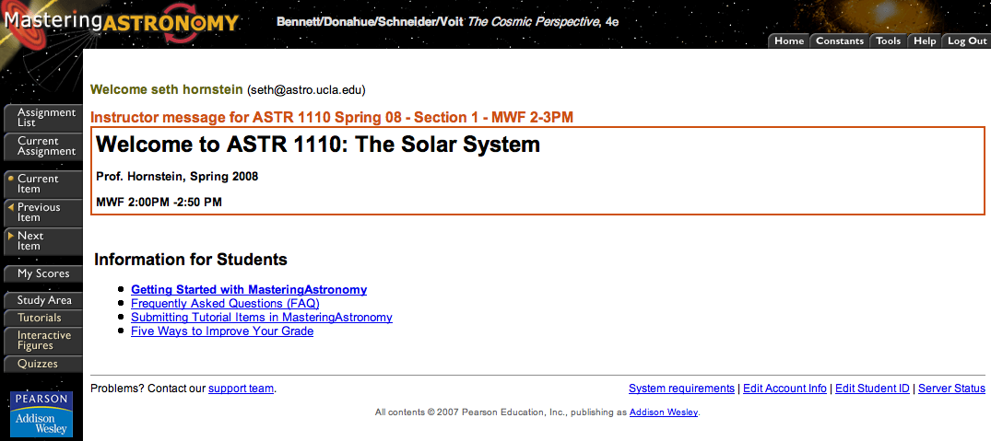
Ta-da! You're in!
Andrea Student (AStudent)

