Slide 1
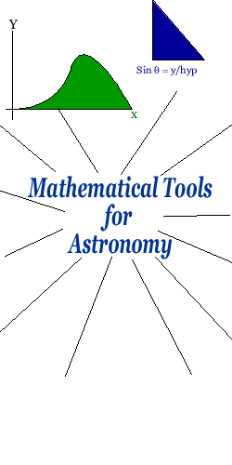
Math Reminder
Reference
Fran Bagenal
http://lasp.colorado.edu/~bagenal/MATH/main.html

Slide 2
Contents
0 General Problem Solving Tips
1 Scientific Notation
2 Units - how to use them, how to convert
3 Triangles, Circles, Squares and More
4 3-D objects: Spheres and More
5 Trigonometry
6 Powers and Roots
7 Graphing Functions

Slide 3
Tips for Solving Quantitative Problems:
Understand the concept behind what is being asked, and what information is given.
Find the appropriate formula or formulas to use.
Apply the formula, using algebra if necessary to solve for the unknown variable that is being asked for.
Plug in the given numbers, including units.
Make sure resulting units make sense, after cancelling any units that appear in both the numerator and denominator. Perform a unit conversion if necessary, using the ratio method discussed today.
Calculate the numerical result. Do it in your head before you plug it into your calculator, to make sure you didn’t have typos in obtaining your calculator result.
Check the credibility of your final result. Is it what you expect, to an order of magnitude? Do the units make sense?
Think about the concept behind your result. What physical insight does the result give you? Why is it relevant?

Slide 4
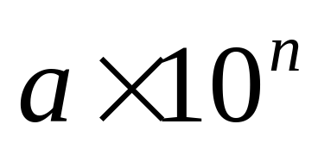
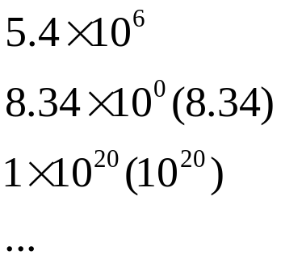
Scientific Notation
a: between 1 and 10
n: integer

Slide 5
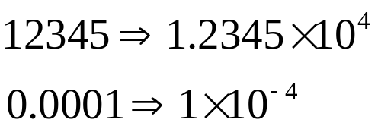
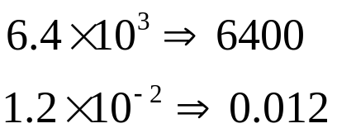
Scientific Notation
Converting from "Normal" to Scientific Notation
Place the decimal point after the first non-zero digit, and count the number of places the decimal point has moved. If the decimal place has moved to the left then multiply by a positive power of 10; to the right will result in a negative power of 10.
Converting from Scientific Notation to "Normal"
If the power of 10 is positive, then move the decimal point to the right; if it is negative, then move it to the left.

Slide 6
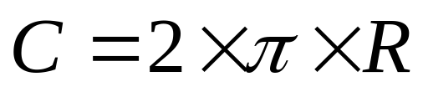
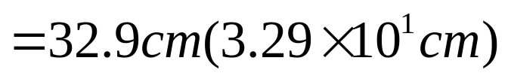
Scientific Notation
Significant Figures
If numbers are given to the greatest accuracy that they are known, then the result of a multiplication or division with those numbers can't be determined any better than to the number of digits in the least accurate number.
Example: Find the circumference of a circle measured to have a radius of
5.23 cm using the formula:
Exact
5.23 cm
3.141592654

Slide 7
Units
Basic units: length, time, mass…
Different systems:
  SI(Systeme International d'Unites), or metric system, or MKS(meters, kilograms, seconds) system.
  ‘American’ system
Units Conversion Table
American to SI |  |  | SI to American
1 inch | = | 2.54 cm | 1 m | = | 39.37 inches
1 mile | = | 1.609 km | 1 km | = | 0.6214 mile
1 lb | = | 0.4536 kg | 1 kg | = | 2.205 pound
1 gal | = | 3.785 liters | 1 liter | = | 0.2642 gal

Slide 8

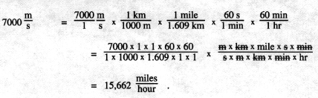
Units
Conversions: Using the "Well-Chosen 1"
Magic “1”
Well-chosen 1
Poorly-chosen 1
Example:

Slide 9
Temperature Scales
Fahrenheit (F) system (°F)
Celsius system (°C )
Kelvin temperature scale (K)
K = °C + 273
°C = 5/9 (°F - 32)
°F = 9/5 K - 459
Water freezes at 32 °F , 0 °C , 273 K .
Water boils at 212 °F , 100 °C , 373 K .

Slide 10
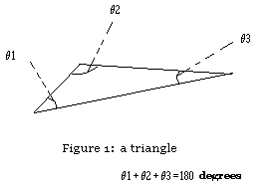
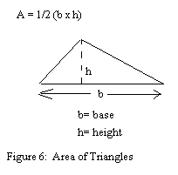
Geometry
Triangles

Slide 11
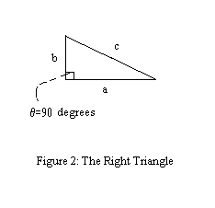
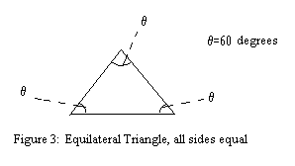
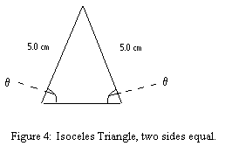
Geometry
  Right triangle
  Equilateral Triangle
  Isoceles Triangle

Slide 12
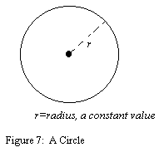


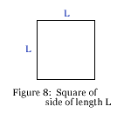
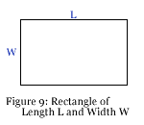
Geometry
Circles
Circumference
Area
Squares and Rectangles
Perimeter?
Area?

Slide 13
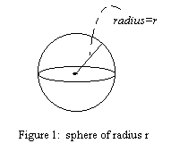
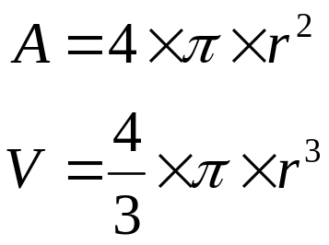
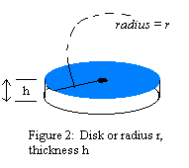

Geometry
Spheres
Surface area
Volume
Discs
Volume

Slide 14
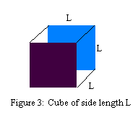

Geometry
Cubes
Volume

Slide 15
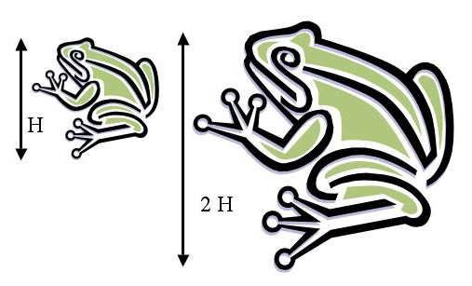


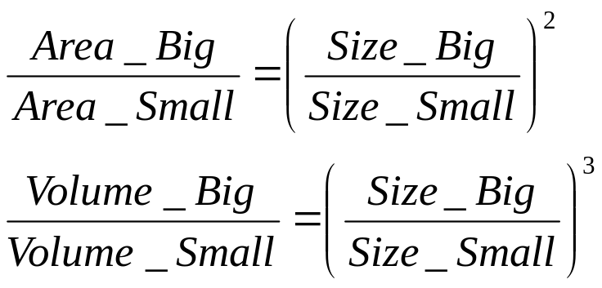


Geometry
What do we conclude from above?
Area of a frog = "something" x
Volume of a frog = "something else" x
Area is proportional to
Volume is proportional to

Slide 16
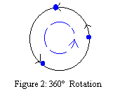
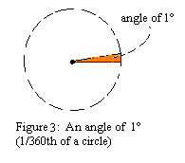
Trigonometry
Measuring Angles - Degrees
  There are 60 minutes of arc in one degree. (The shorthand for arcminute is the single prime ('): we can write 3 arcminutes as 3'.) Therefore there are 360 × 60 = 21,600 arcminutes in a full circle.
  There are 60 seconds of arc in one arcminute. (The shorthand for arcsecond is the double prime ("): we can write 3 arcseconds as 3".) Therefore there are 21,600 × 60 = 1,296,000 arcseconds in a full circle.

Slide 17


Trigonometry
Measuring Angles – Radians
  If we were to take the radius (length R) of a circle and bend it so that it conformed to a portion of the circumference of the same circle, the angle subtended by that radius is defined to be an angle of one radian.
  Since the circumference of a circle has a total length of , we can fit exactly radii along the circumference; thus, a full 360° circle is equal to an angle of radians.
1 radian = 360°/ = 57.3°
1° = radians /360° = 0.017453 radian

Slide 18
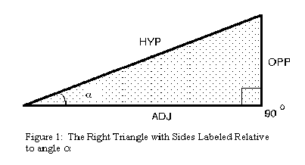






Trigonometry
The Basic Trigonometric Functions
= (opp)/(hyp) , ratio of the side opposite to the hypotenuse
= (adj)/(hyp) , ratio of the side adjacent to the hypotenuse
= (opp)/(adj) , ratio of the side opposite to the side adjacent

Slide 19
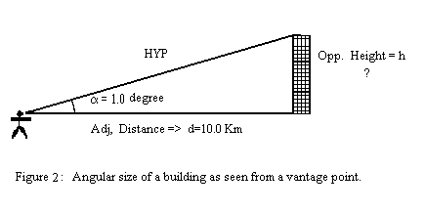
Trigonometry
Angular Size, Physics Size, and Distance
  The angular size of an object (the angle it subtends, or appears to occupy, from our vantage point) depends on both its true physical size and its distance from us. For example,

Slide 20
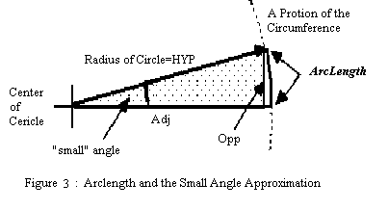
The Small Angle Approximation for Distant Objects
h = d × = d × (opp/adj)
Opp~ArcLength, Adj~HYP=Radius of Circle
h = d × (arclength/radius) = d ×(angular size in radians)

Slide 21
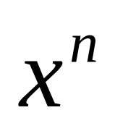
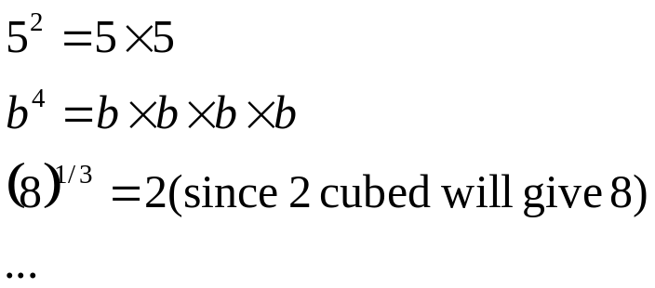
Powers and Roots
x: base
n: either integer or fraction
Recall scientific notation,

Slide 22


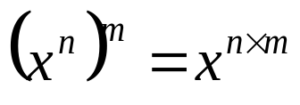
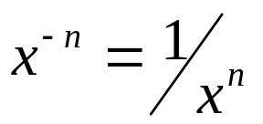

Powers and Roots
Algebraic Rules for Powers
  Rule for Multiplication:
  Rule for Division:
  Rule for Raising a Power to a Power:
  Negative Exponents: A negative exponent indicates that the power is in the denominator:
  Identity Rule: Any nonzero number raised to the power of zero is equal to 1, (x not zero).

Slide 23
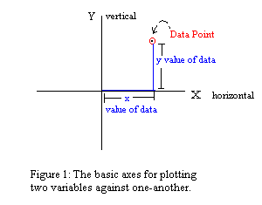
Graphing Functions
The Basic Graph: Y vs. X

Slide 24
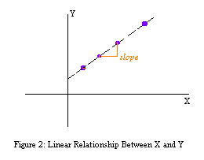
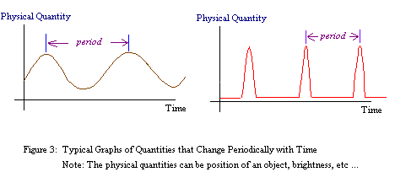
Graphing Functions
Simple Graphs: Lines, Periodic Functions

