Slide 1
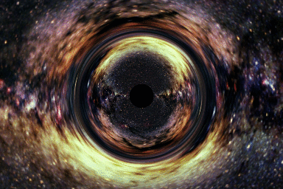
Overview/Preview
[Image by A.
Hamilton]
ASTR 2030 - BLACK HOLES
Rosalba Perna - Fall 2010

Slide 2
WHAT IS A BLACK HOLE?
A few definitions from the dictionary:
Region of space resulting from the collapse of a star
Region of space with strong gravitational field
Dungeon or dark cell in a prison
Project that requires large effort with no return
Concentration of mass with a gravitational field
so strong that not even light can escape its grip
(closer to what this course will be about…)

Slide 3
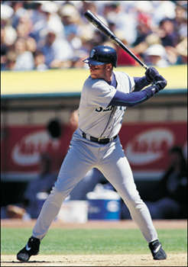
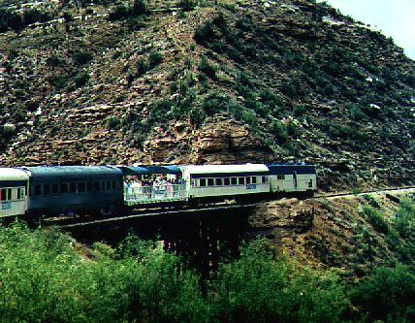
Starting point: our familiar world of
“slow” human beings
Slow compared to what???
…. the velocity of light, “c”

Slide 4


In our everyday, “slow” world,
everybody agrees on measurements of time and space
independently of the motion
This constitutes our
“common sense”

Slide 5
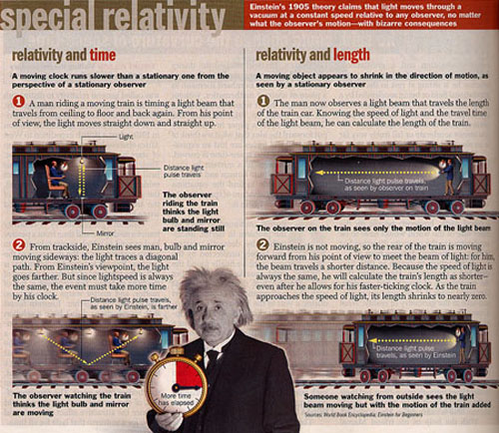
What happens when V c ?
Special Relativity - Einstein 1905

Slide 6
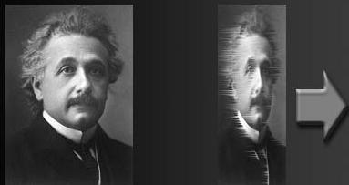
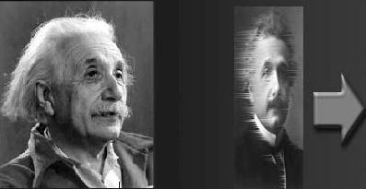
Relativity of…..
Space
and …
Time

Slide 7
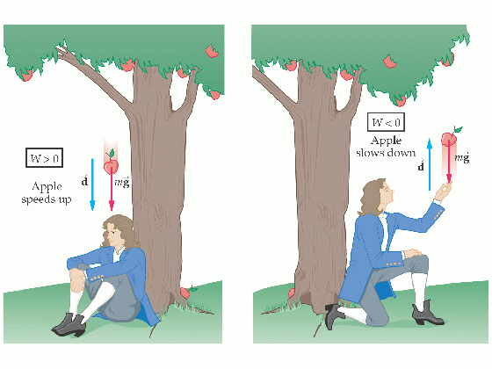
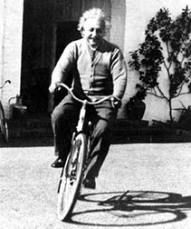
Then GRAVITY comes into play…..
+ relativity
of space and
time
General Relativity
Einstein 1915

Slide 8
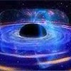
BLACK HOLES are predicted….
Schwarzschild discovers that General Relativity
predicts the presence of “singularities”, regions where
gravity is so strong that not even light can escape…
Einstein refutes… “too bizarre to be true”….
… but research continues….

Slide 9

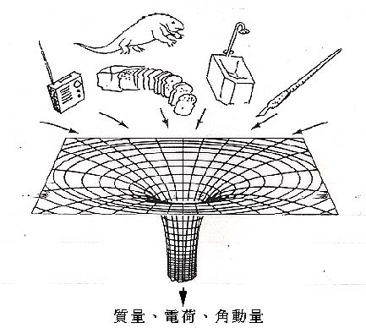
Properties of Black Holes… e.g.
From inside
this region
no information
can escape
Time dilation, gravitational redshift,
“spaghettification”
red-shifted
red-shifted into
oblivion
“No hair theorem”
…. Hawking radiation…. Kerr black Holes….

Slide 10
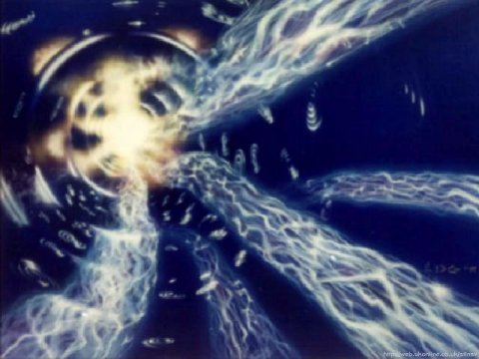

“Exotic” phenomena connected to Black Holes….
Wormholes
Time machines

Slide 11
Do Black Holes exist in the
"real" Universe???

Slide 12
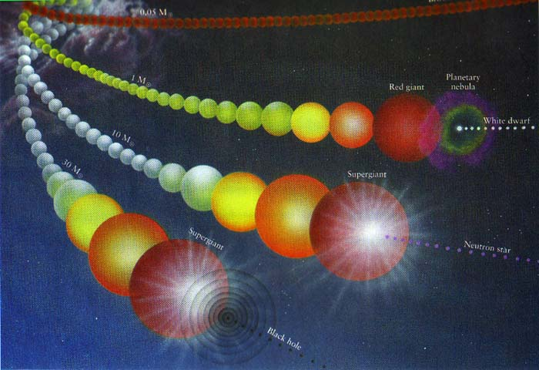
Theoretically: Black holes believed to be associated with the “death” of massive stars

Slide 13

Observationally: several pieces of evidence
(astrophysicists like to classify by the mass of the Sun) )
Small-mass BHs in X-ray binaries
a few
Supermassive BHs in galaxy centers and Quasars
10⁶-10¹⁰

Slide 14
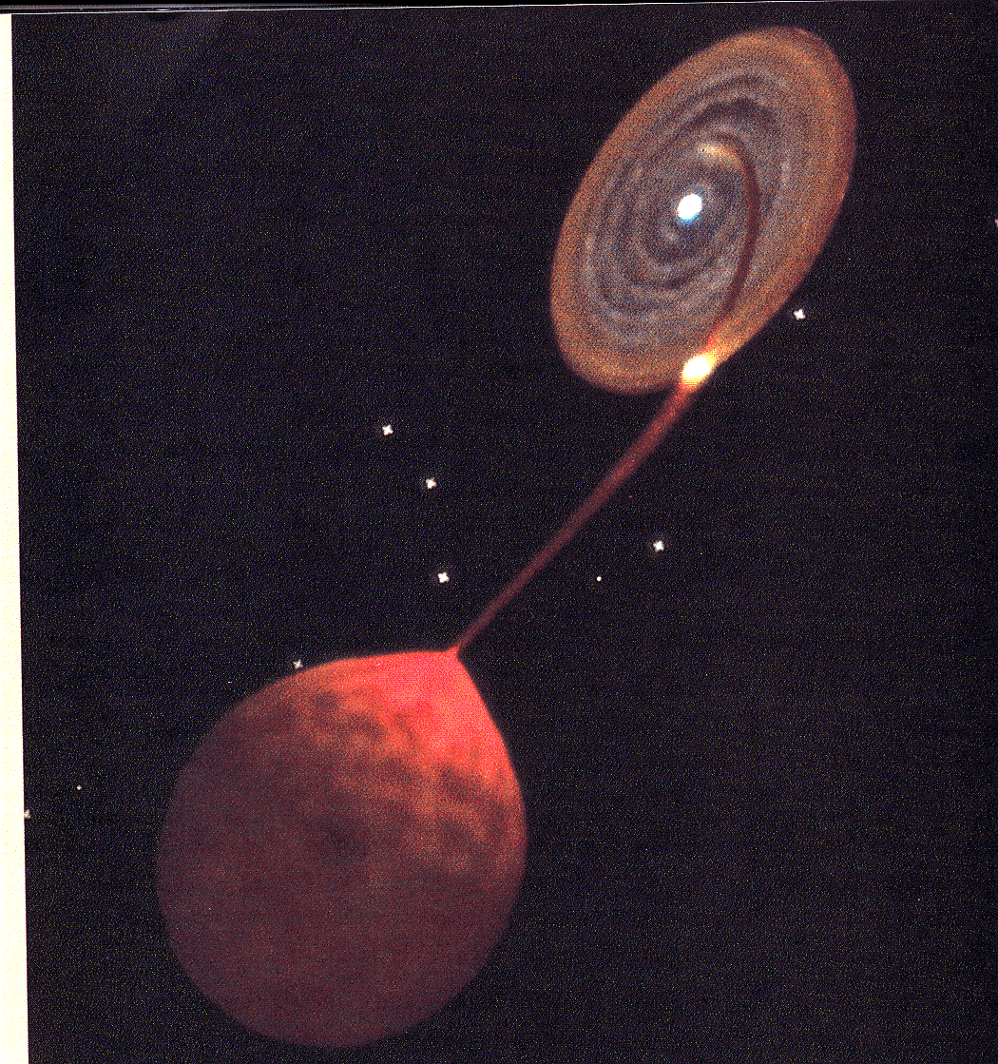
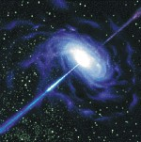
X-RAY BINARIES
Star “feeding” Black Hole
QUASARS
L~10⁴⁶erg/s
~ 10000000000000 L_{sun}!!

Slide 15
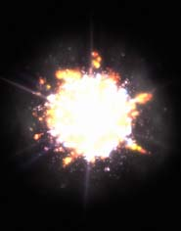
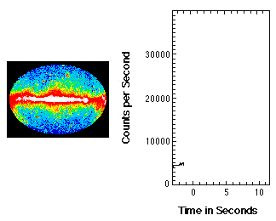
Do we ever “witness” the birth of a NEW Black Hole?
We probably do when we “see” a…. GAMMA-RAY BURST

Slide 16
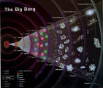
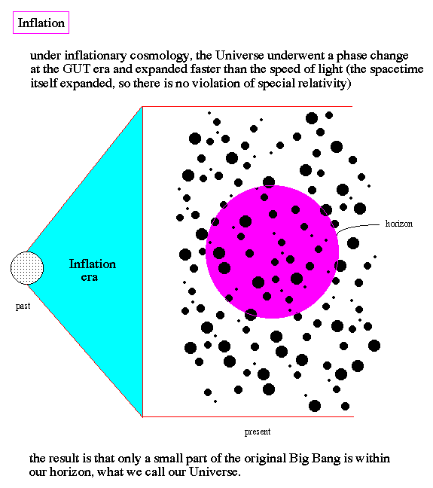
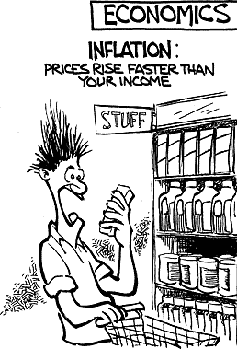
We will also discuss…
The BIG BANG theory
.. and…
The theory of INFLATION

Slide 17

A class will also be on Black Holes and Popular Culture
Excerpts from popular movies will be watched and discussed.

Slide 18
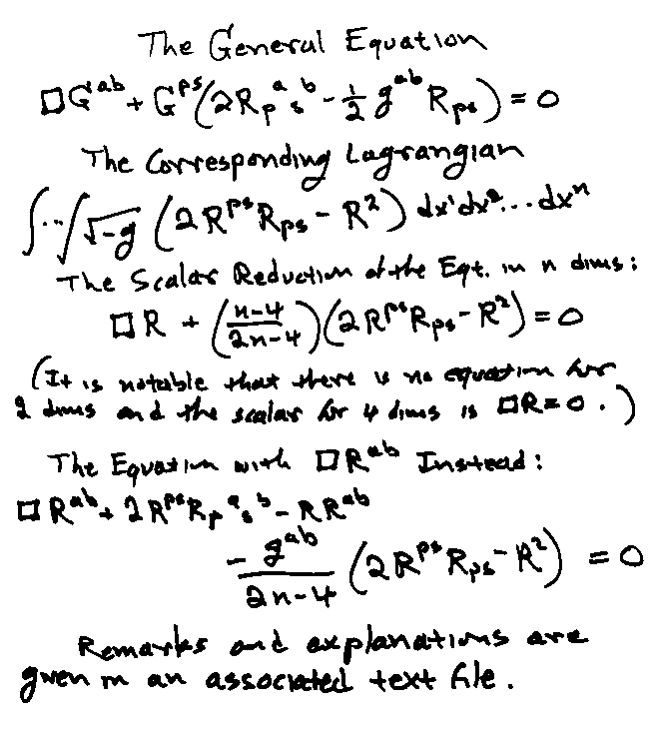
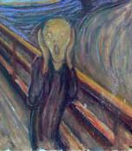
Focus of course: CONCEPTS, IDEAS
Required math background: high school-level algebra
But if you see something you don’t like…
DO LET ME KNOW!

Slide 19
If you find some of these concepts and ideas mind bogglers….

Slide 20
DO NOT DESPAIR !!!
YOU ARE NOT ALONE!
Some concepts defy our “everyday” intuition

Slide 21
GOALS of the course:
Understand where concept of Black Hole
comes from within context of General Relativity
Become familiar with physical properties of
Black Holes
Gain a knowledge of the current status of
the astrophysical evidence for the presence
of black holes in the Universe

Slide 22
Hopefully by the end of the course YOU WILL:
Be able to evaluate critically the things you read
in the popular press and science fiction literature
Have a glimpse of the process by which scientific
theories are conceived, advanced and tested
Understand enough to be able to offer correct
explanations of black holes and related phenomena
to friends and family and have an idea of “how
science works”
….and all this while…

Slide 23
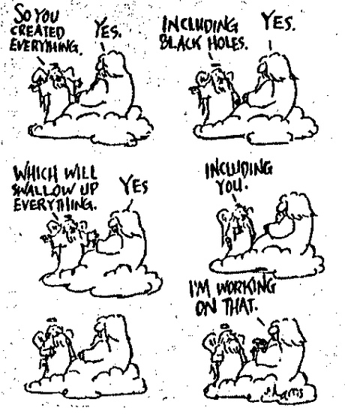
….having FUN !

Slide 24
However, BE AWARE that:
FUN EASY!!!
You will need to have a good understanding of
the material discussed in class in order to get
the grade you aim at.

Slide 25
CLASS ATTENDANCE IS VERY IM PORTANT!!
Questions on tests that count towards grade
will always be on topics discussed in class.
Clicker questions will yield minimum gain for
no answer (more on this later).
90% of success is showing up.
Woody Allen

Slide 26
“Practicalities”….
This is a “multi-media” class.
Lectures will be a mixture of:
Demonstrations/explanations on the blackboard;
Powerpoint presentations (images/clips)
Videos and movies with discussions
Practice problems
Clicker questions followed by discussion

Slide 27

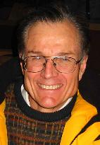
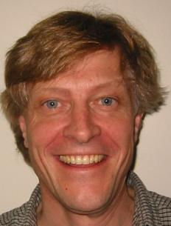

“Field” Trips to the Fiske Planetarium
Prof. Dick McCray will host a show on Supernovae
Prof. Andrew Hamilton will host a show on Black Holes

Slide 28
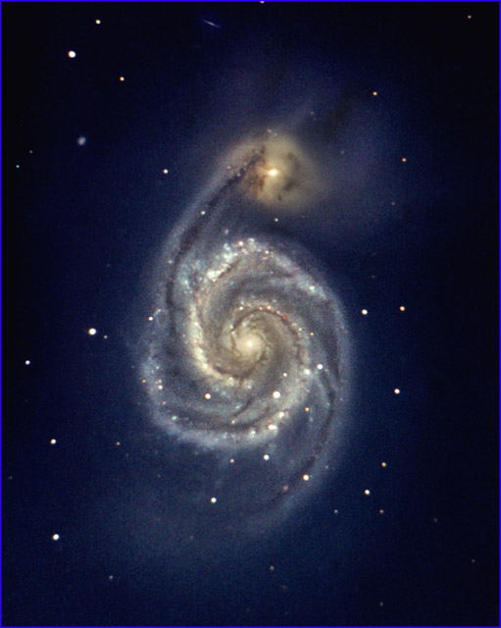
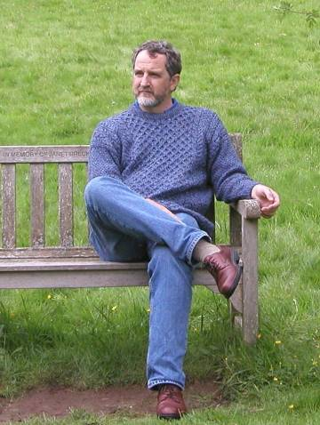
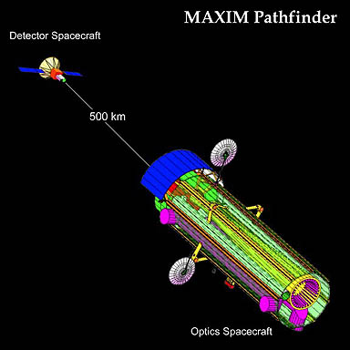
The Fiske planetarium team will host a show on
The Milky Way, a City of Stars
Guest Lecture:
Prof. Webster Cash on MAXIM
on
Galaxies

Slide 29

Textbooks:
Begelman & Rees “Gravity final attraction”
Thorne: “Black Holes and Time Warps”
NOTES from class
If you do happen to miss a class, make sure to get a copy
of the class lecture notes.

Slide 30
What YOU will need to do and GRADING policy
40% : 4 in class projects (3 people) - the best 3 count
counts for 13.33% each. The worst will be neglected.
20%: paper (on a topic of your choice related to class)
30%: final (December 13)
10% clicker questions (on most days)

Slide 31
More on Clicker Questions:
3 Types of questions:
On the material from the previous or recent classes
(graded);
On issues that arise in class and that are related to the
material being discussed (graded);
On background material not previously discussed- for me to
know whether to make a digression (not graded)
Assessment:
Right answer: 2 points
Wrong answer: 1 point
No answer: 0 points
4 days “bonus” (i.e. 4 days of absence will discounted)

Slide 32
Office hours and contact info:
PROF:
Tue: 12:45pm-2:00pm
Thu: 12:45pm-2:00pm
506A in JILA tower
Rosalba.Perna@Colorado.EDU
Tel: 492-0389
TA:
Mon: 12:00-1:00pm
Wed: 12:00-1:00pm
Duane 122
Tyler.Redick@Colorado.EDU
Tel: 492-5010
Course web site:
http://amalfi.colorado.edu/~rosalba/astro2030/astro2030.html

