Slide 1


Slide 2
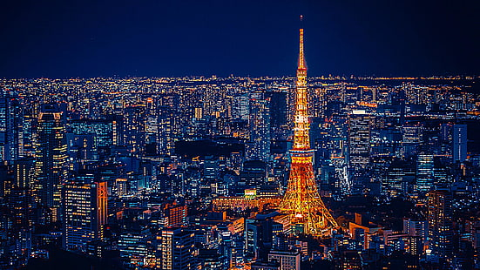
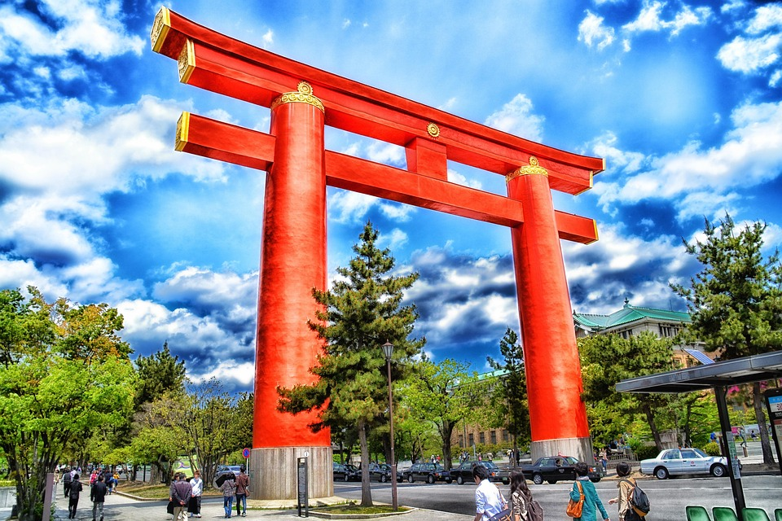
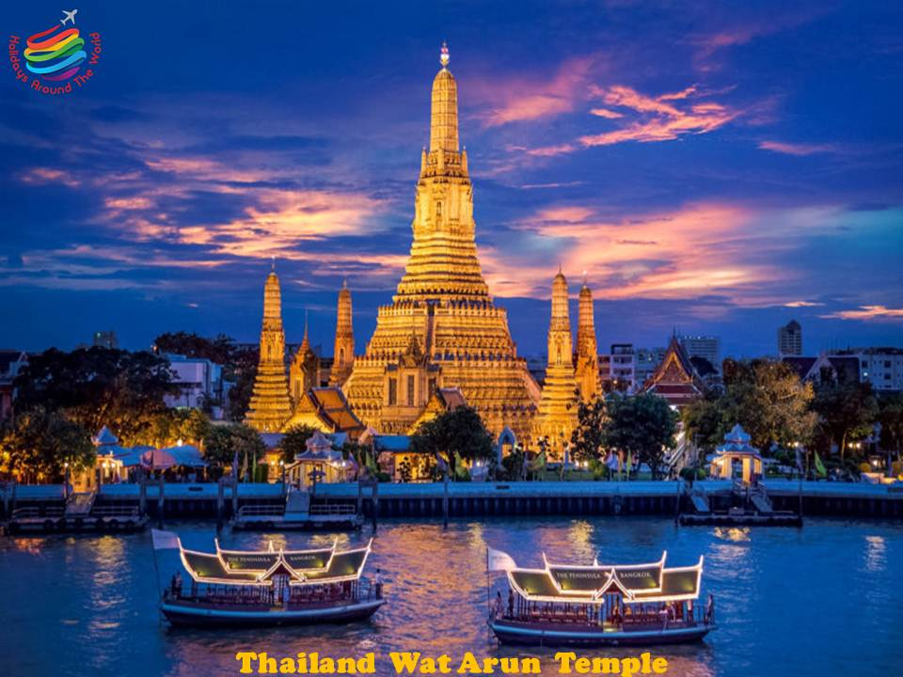
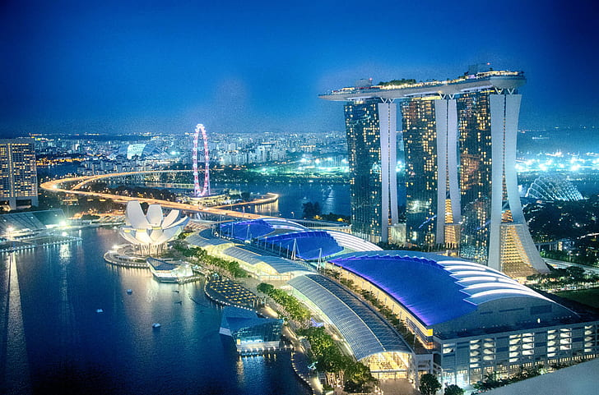
🗼 Tokyo – The City of the Future
A thrilling mix of tradition and technology, Tokyo dazzles visitors with its neon lights, historic temples, and vibrant neighborhoods like Shibuya and Akihabara.

Slide 3
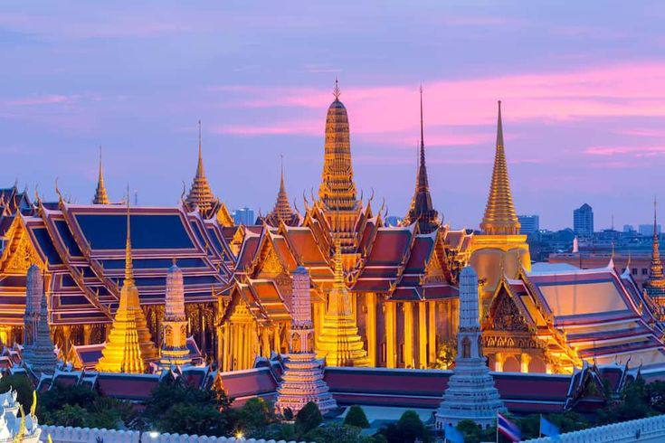
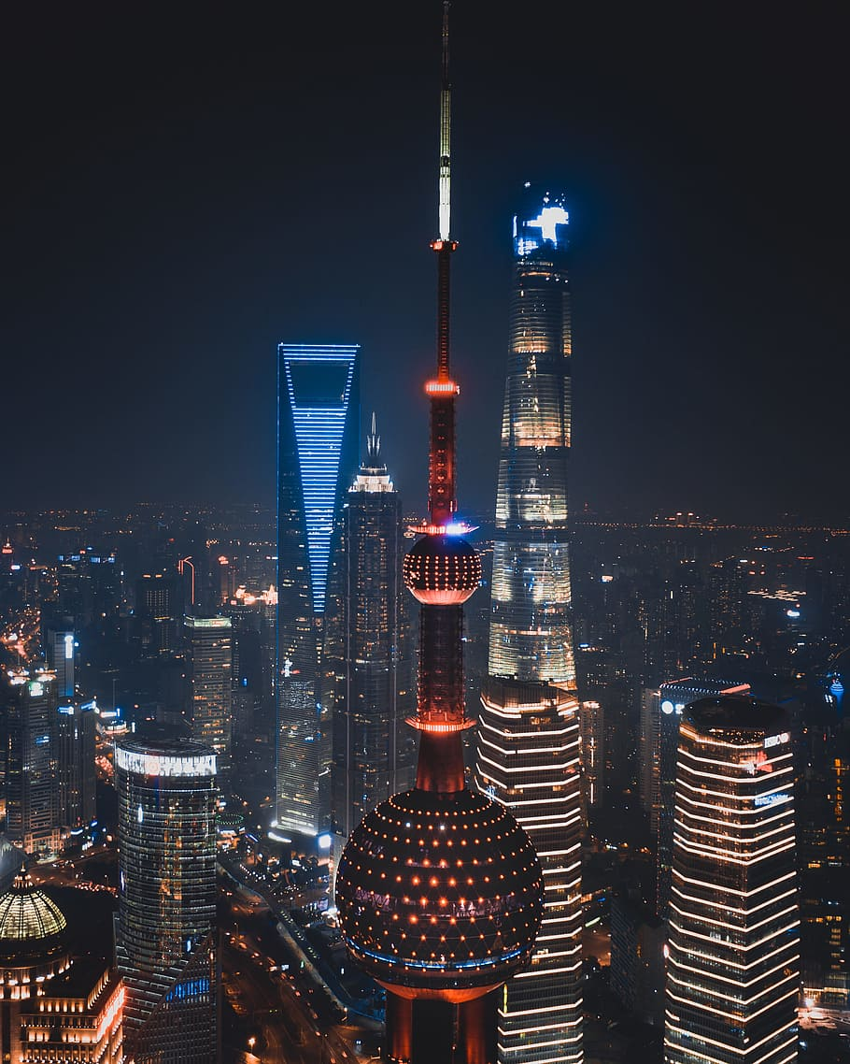
🏯THAILAND-Land of free
Grand Palace
The Grand Palace in Bangkok is a dazzling architectural masterpiece and the heart of Thailand's royal heritage. Built in 1782, it served as the official residence of the Kings of Siam. Visitors are captivated by the intricate golden spires, stunning murals, and the sacred Emerald Buddha housed within Wat Phra Kaew.THAI

Slide 4
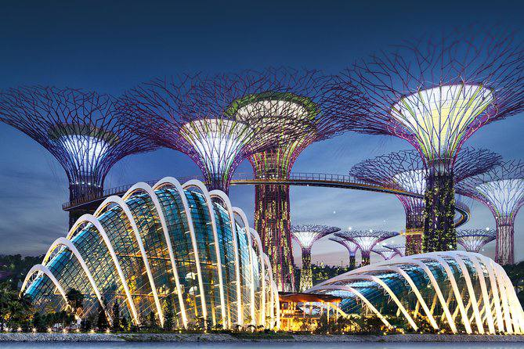
Singpore-ion City
Iconic Landmark
Marina Bay Sands is one of Singapore's most recognizable buildings. This integrated resort features a hotel, casino, shopping mall, museum, and the world-famous SkyPark Infinity Pool. It offers spectacular panoramic views of the city skyline and a luxury experience like no other.

Slide 5
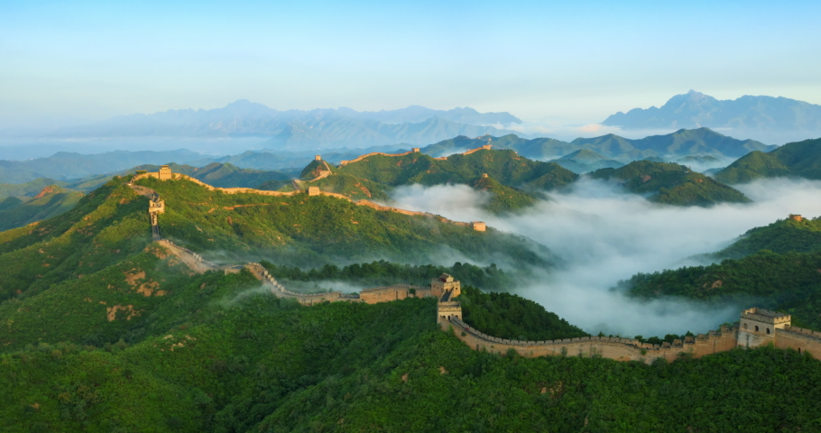
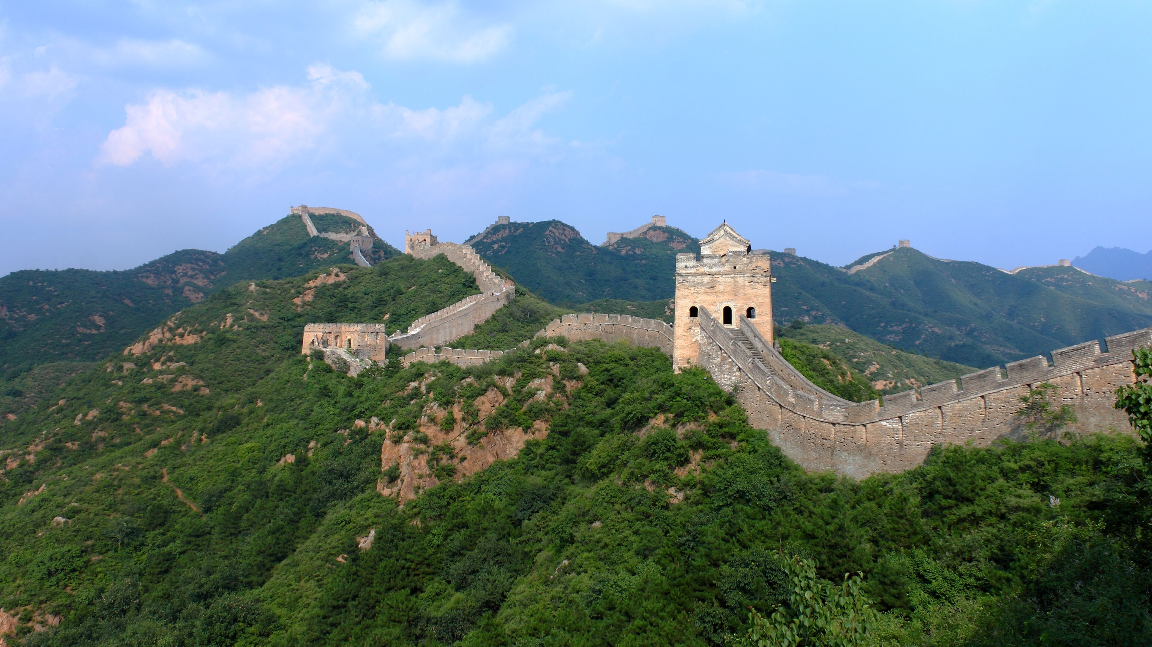
China-Qin Dynasty
Great Wall of China
Wonder of the World
The Great Wall of China stretches over 13,000 miles and is one of the most iconic structures in the world. Walking along its ancient stones offers breathtaking views and a profound sense of history and endurance.

