Slide 1
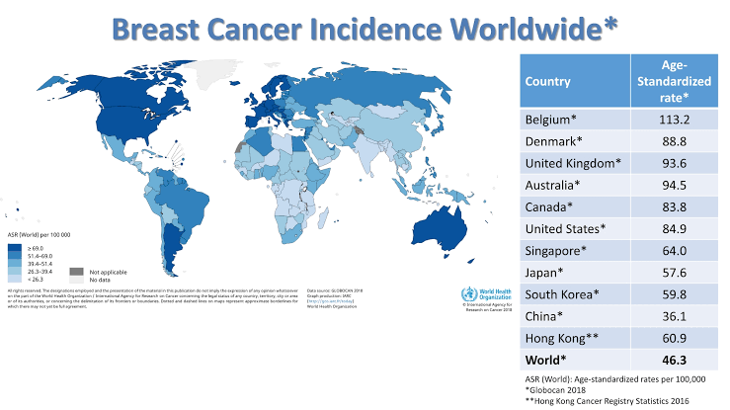
Problem
Breast Cancer is one of the leading killer disease among women
Breast cancer test includes:
Screening test
Diagnostic test – Benign or Malignant
Clump Thickness
Uniformity of Cell Size
Uniformity of Cell Shape
Marginal Adhesion
Single Epithelial
Cell Size
Bare Nuclei
Bland Chromatin
Normal
Nucleoli Mitoses
Monitoring tests
Can Machine Learning Model be used for determining a breast tumour is malignant or not??

Slide 2
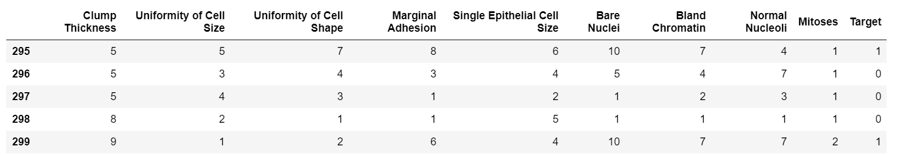
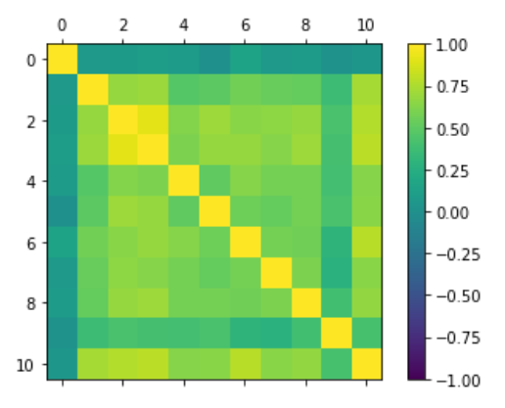
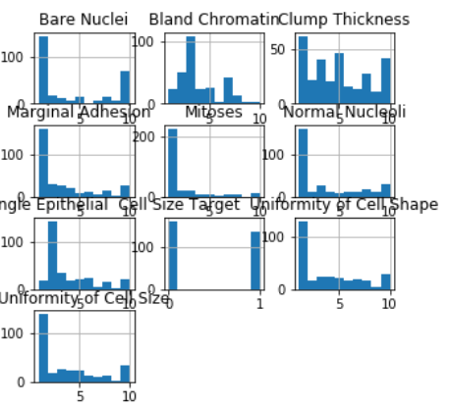
Data Understanding

Slide 3
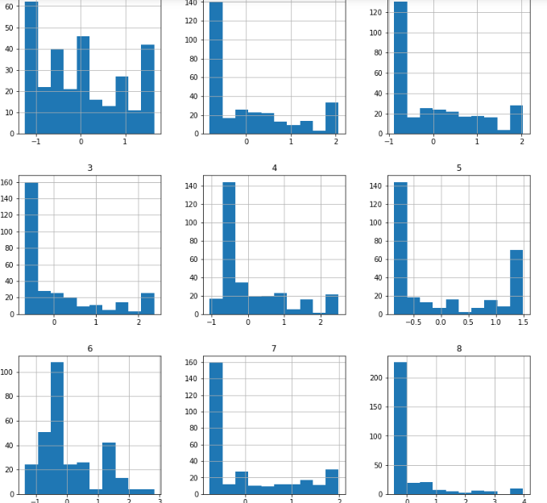
Data Pre processing
Pre processed data using Standard Scaler
Original dataset

Slide 4
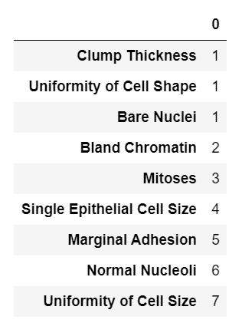
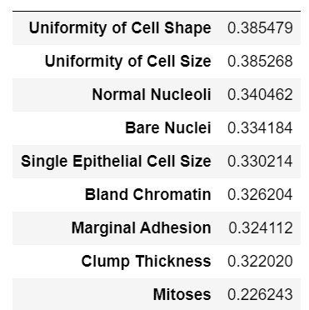
Feature Selection
Top features using PCA
Top features using RFE

Slide 5
Model
Proposed model
Using Standard Scaler, PCA, n=20
KNN: 0.9600000000000002 AUC: 0.984 (0.029)
SVM: 0.9600000000000002 AUC: 0.971 (0.049)
C0 = benign “0” : 163
C1 = malignant “1” : 139
Baseline accuracy = 0.63 using PCC

Slide 6
Testing different models
USING NORMALIZER | Using rescaled | Using rescaled, PCA, n=30 | Using Standard Scaler, PCA, n=20
LR: 0.866667 (0.080277) LDA: 0.853333 (0.081921) KNN: 0.893333 (0.074237) CART: 0.873333 (0.067987) NB: 0.890000 (0.063333) SVM: 0.876667 (0.078951) | LR: 0.943333 (0.039581) LDA: 0.930000 (0.056667) KNN: 0.960000 (0.032660) CART: 0.920000 (0.045216) NB: 0.940000 (0.041633) SVM: 0.953333 (0.033993) | LR: 0.9499999999999998 LDA: 0.9333333333333332 KNN: 0.9533333333333333 CART: 0.9166666666666667 NB: 0.9433333333333332 SVM: 0.9566666666666667 | LR: 0.95 KNN: 0.9600000000000002 AUC: 0.984 (0.029) SVM: 0.9600000000000002 AUC: 0.971 (0.049)

