Slide 1
TOPIC MODELING OF CLINICAL AND TRANSLATIONAL RESEARCH PUBLICATIONS USING LDA
An exploratory analysis
Rosalina Das, November 16, 2021, ECE677 Course Project2

Slide 2
BACKGROUND
MOTIVATION
Miami Clinical and Translational Institute is funded by a five-year $20M grant from the National Institute of Health resulting in several hundred publications
Clinical and Translational Science research is broad ranging from therapeutics in diseases (cancer, HIV) to cellular/ molecular research and community and public health topics
Use topic modeling to identify prominent research themes and trends for Miami CTSI to guide research strategy and highlight program strengths

Slide 3
BACKGROUND
INTRODUCTION TO TOPIC MODELING
Unsupervised classification approach in Natural Language Processing for organization and understanding of text data
Mixed member models
each document is a mixture of topics, and
each topic is a collection of words (terms)
Probabilistic Latent Semantic Allocation, Latent Dirichlet Allocation, Correlated Topic Model , Structured Topic Model
CTM, STM

Slide 4
BACKGROUND
LATENT DIRICHLET ALLOCATION
Generative probability model that attempts to provide a model for the distribution of outputs and inputs based on latent variables.
Defined by two parameters:
α - A prior estimate on topic probability (the average frequency that each topic within a given document occurs).
β - a collection of k topics where each topic is given a probability distribution over the vocabulary used in a document corpus, also called a "topic-word distribution."
Assumptions
Ordering of terms in documents is unimportant
Documents are exchangeable: document sequencing is unimportant
Topics are independent (uncorrelated)
Model evaluation
Perplexity Score
Topic Coherence

Slide 5
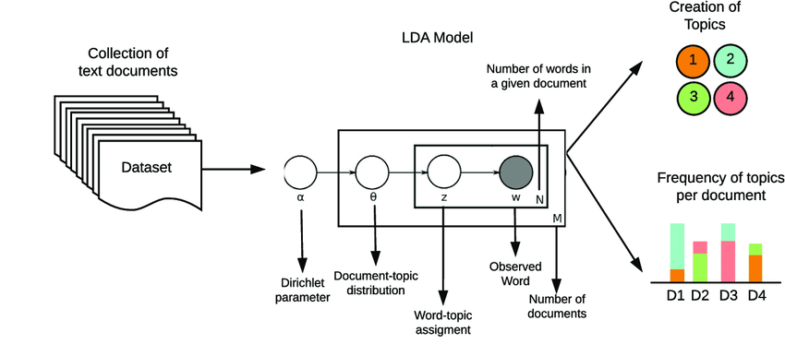
BACKGROUND
LATENT DIRICHLET ALLOCATION
β controls the distribution of words per topic. Lower the β, topics will likely have less words & vice versa
β
α controls the mixture of topics for any given document. Low α will likely have less of a mixture of topics & vice versa.
Buenaño-Fernández, Diego et. Al. (2020). Text Mining of Open-Ended Questions in Self-Assessment of University Teachers: An LDA Topic Modeling Approach. IEEE Access. PP. 1-1. 10.1109/ACCESS.2020.2974983.

Slide 6
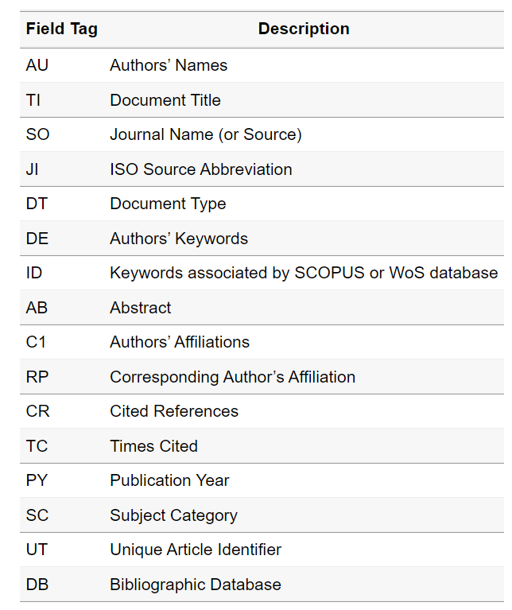
METHODS
DATASET
Web of Science search of Miami CTSI grant numbers
341 publications from 2013-2021 exported with 71 field tags
Abstract and author-assigned keywords used in this analysis

Slide 7
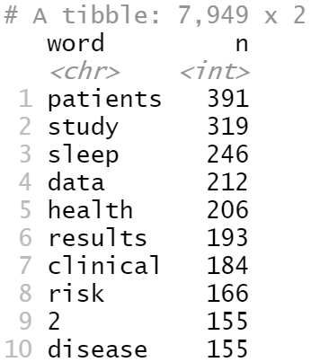
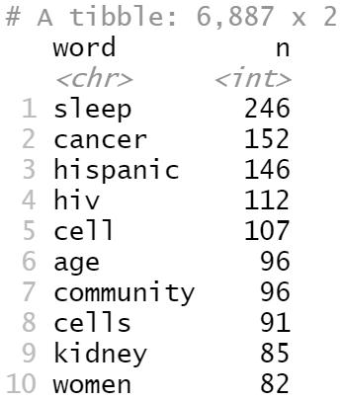
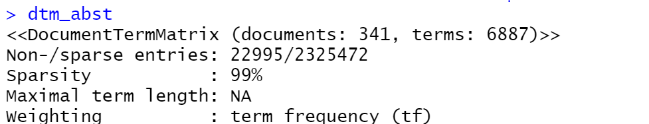
METHODS
DATA CLEAN UP AND PREPARATION
Split publications into train and test sets for evaluating best ‘k’
Tokenization and Removing stop words: punctuation, custom stop words - numbers; sub-titles such as “background”, “introduction”, common words such as “data”, “study”, “results”
Create Document Term Matrix
341 documents, 6887 terms

Slide 8
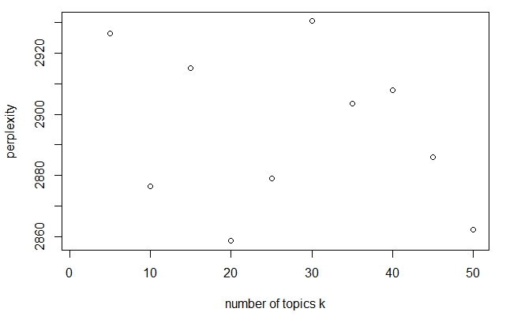
METHODS
LDA MODEL
LDA algorithm from ‘topicmodels’ package, method = “VEM”
“k” value selected using Perplexity on held-out data – measure of how well a model predicts a sample, lower the value, better the performance
LDA model run for k = 5 to 50 and perplexity score calculated

Slide 9
METHODS
LDA MODEL ON FULL DATASET
R topicmodels package
Outputs
β (beta): Probability of that term (word) belonging to that topic.
γ (gamma): Probability that each document belongs in each topic. The higher the γ value is for a document, the more likely that the topic dominates the document.

Slide 10
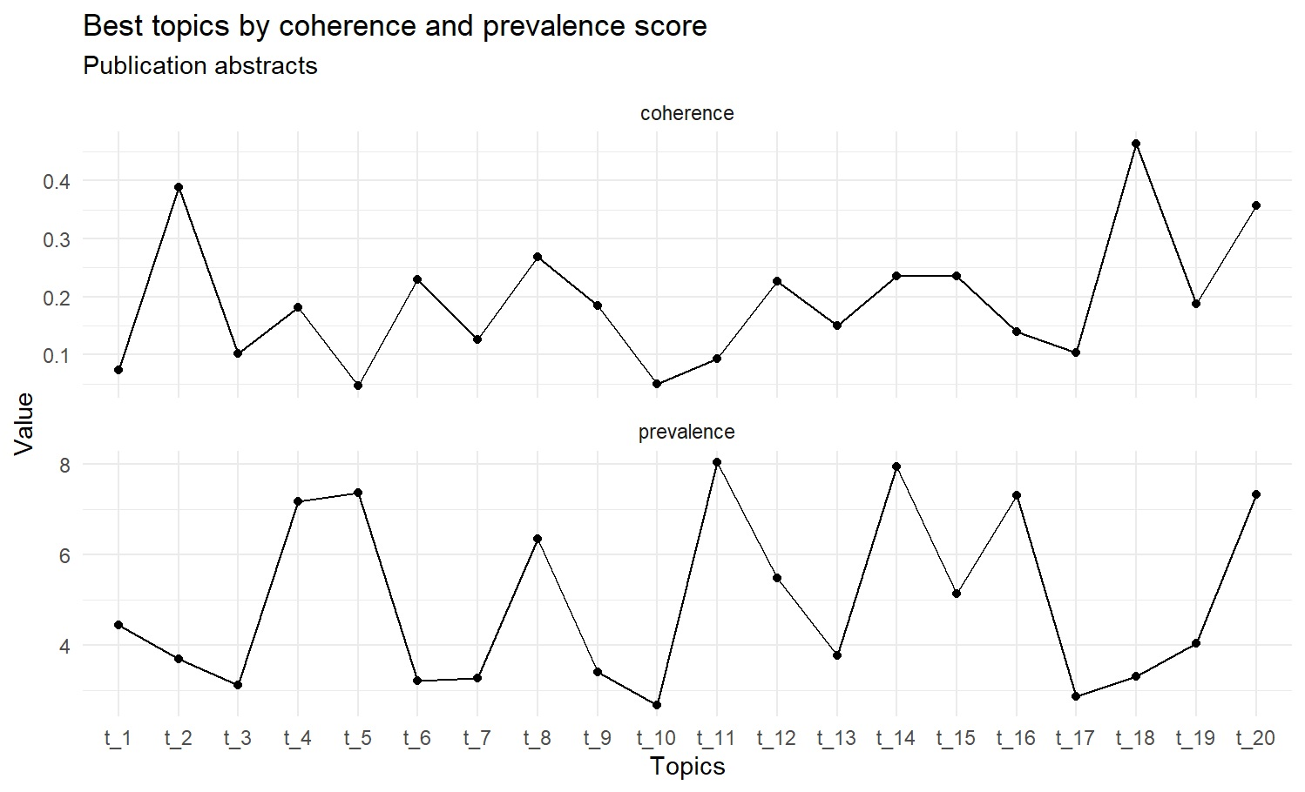
METHODS
TOPIC COHERENCE
Topic Coherence scores a single topic by measuring the degree of semantic similarity between high scoring words in the topic. Generally, higher the coherence score, the better the topic quality

Slide 11
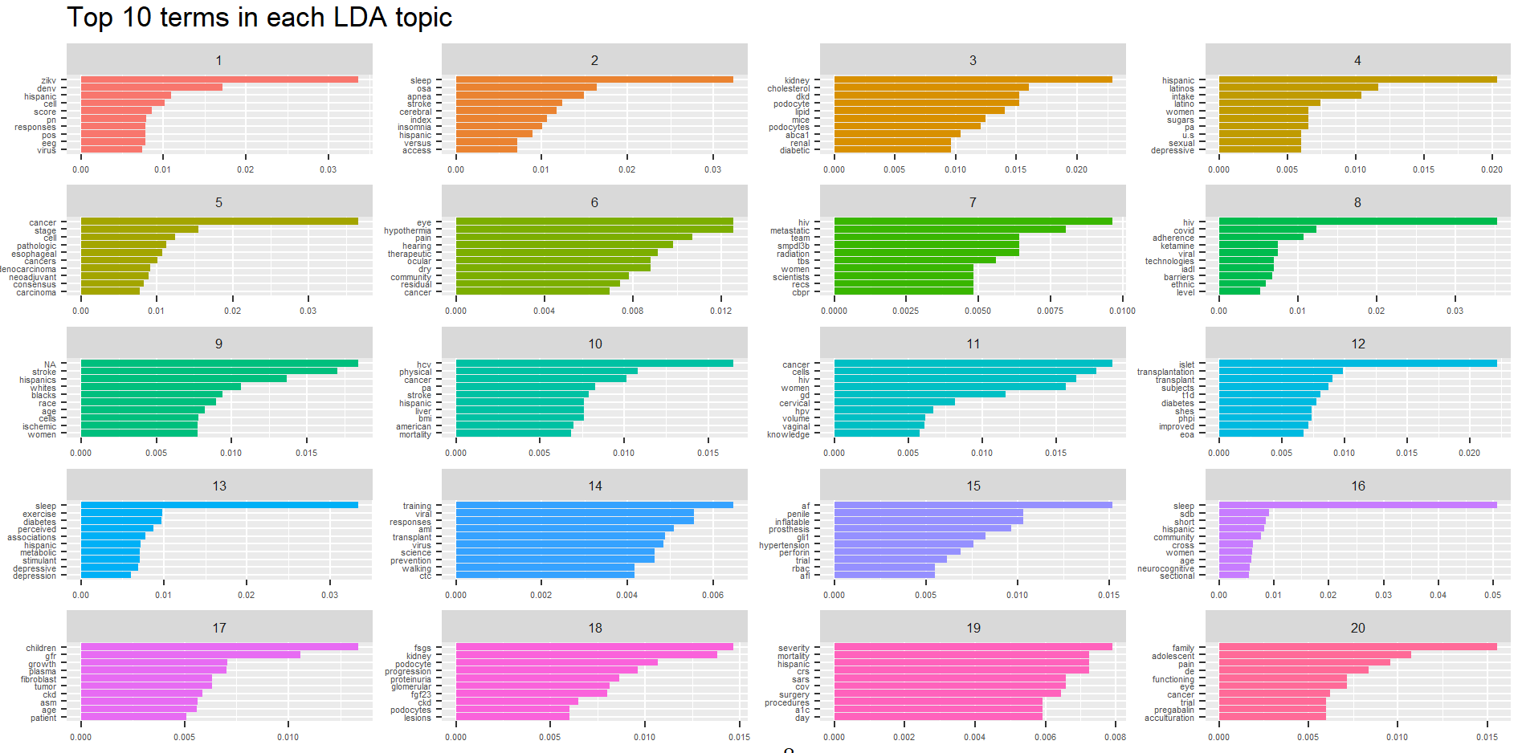
RESULTS
TOP 10 TERMS IN EACH LDA TOPIC
β

Slide 12
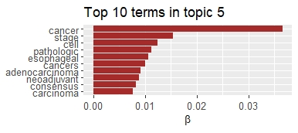
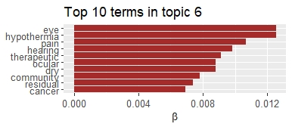
RESULTS

Slide 13
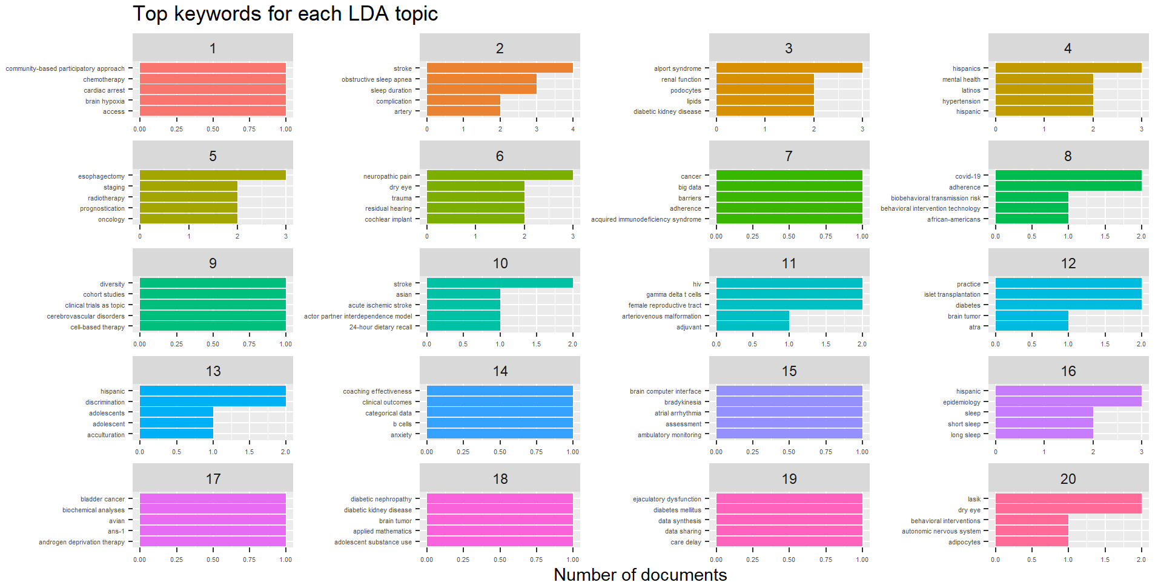
RESULTS
TOP KEYWORDS FOR EACH LDA TOPIC
Most common author-assigned keywords for documents with a high probability of belonging to a topic
Number of documents

Slide 14
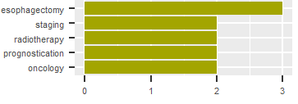
RESULTS
COMPARING TERMS AND KEYWORDS
Most frequent keywords in topic 5
Number of documents

Slide 15
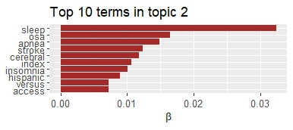
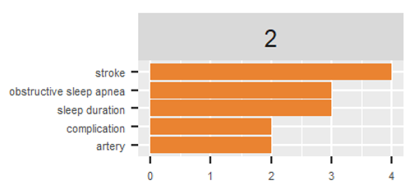
RESULTS
COMPARING TERMS AND KEYWORDS
Most frequent keywords in topic 2
Number of documents

Slide 16
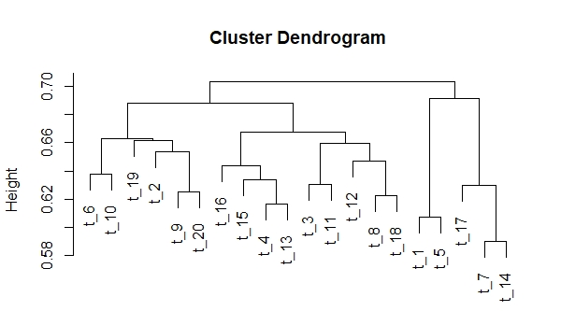
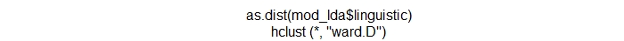
RESULTS
CLUSTER TOPICS USING DENODROGRAM

Slide 17
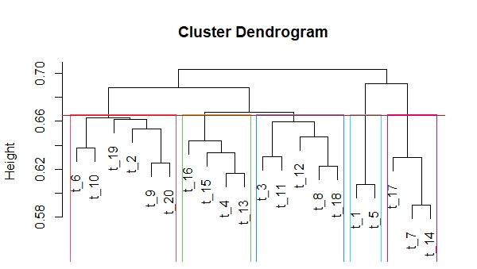
RESULTS
GROUPING TOPICS FURTHER

Slide 18
RESULTS
RESEARCH THEMES
Cluster | Topics in Cluster | Research themes identified *
1 | Topics 6, 10, 19, 2, 9, 20 | Neuroscience
2 | Topics 16, 15, 4, 13 | Community & Public Health
3 | Topics 3, 11, 12, 8, 18 | Metabolics/Proteomics
4 | Topics 1, 5 | Cancer (cellular mechanisms)
5 | Topics 17, 7, 14 | HIV / infectious diseases
* Minority health and cancer terms occur in all the research themes.

Slide 19
CONCLUSION
CONCLUSIONS
Topic modeling of Miami CTSI publications identified topics within the broad clinical and translational research field publications
LDA tuning can be used to find optimal number of topics – computation time intensive; other metrics such as coherence and prevalence can also be used
Other topic models such as STM incorporate meta data such as author names and can be useful especially for scientific publications

