Slide 1
Don’t have to be a designer to know when something just ain’t right…

Slide 2
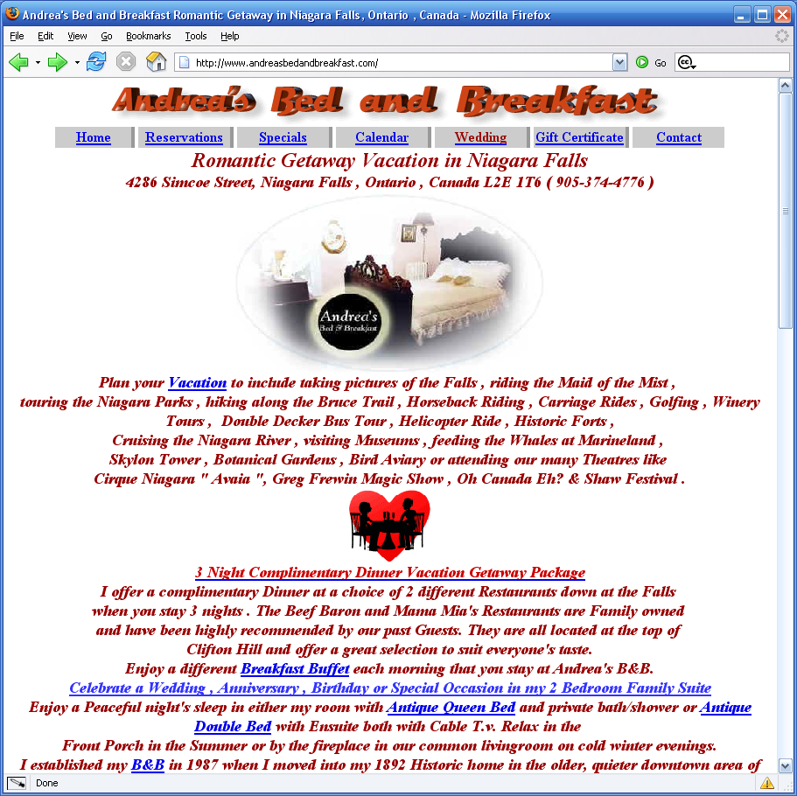
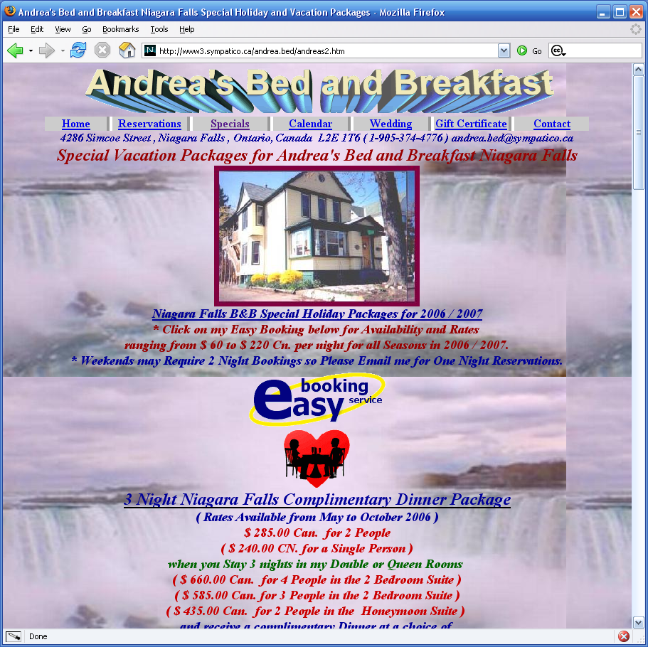
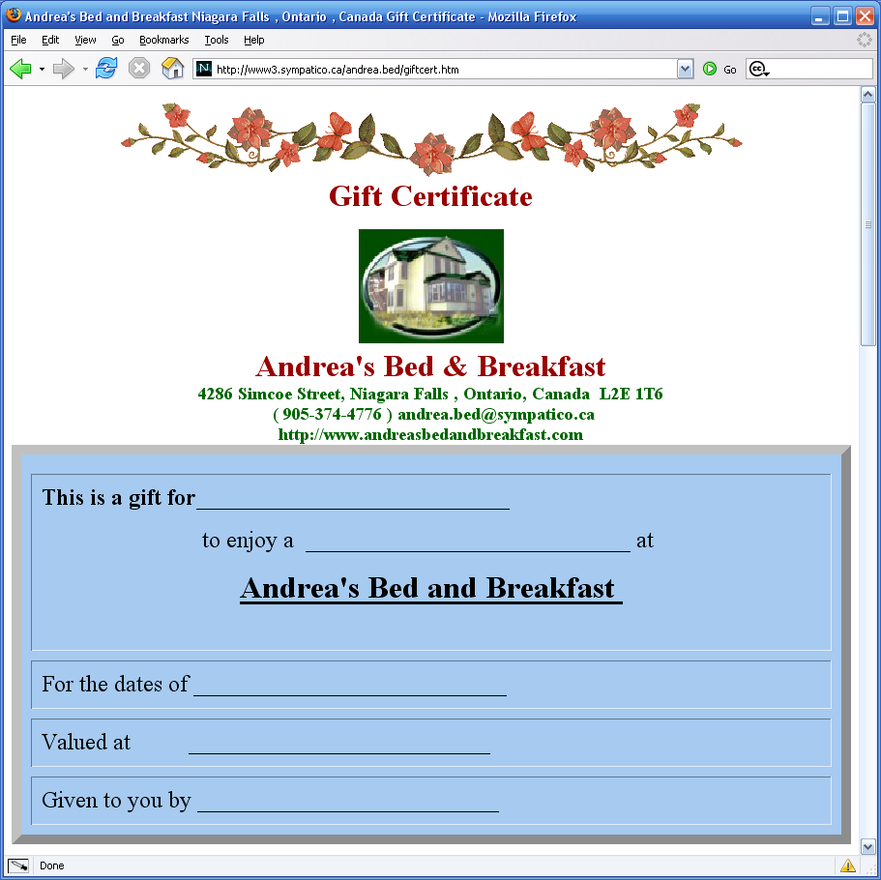

Slide 3
what are the principles?
Contrast - for visual attraction
Repetition - for organization and unity
Alignment - for a clean look and feel
Proximity - to organize info and reduce clutter
use the acronym CRAP to help you out...

Slide 4
contrast
Usage:
When you want things to stand out
Colours
Shapes
Size
Fonts

Slide 5
optional exercise
What’s being contrasted here:
http://commons.bcit.ca/biginfo/
Or here:
http://www.bcit.ca/admission/requirements/
Or here:
http://www.designtaxi.com/

Slide 6
repetition
Usage:
Unify pages and sites
Colours
Shapes
Fonts
Layout

Slide 7
optional exercise
What’s being repeated here:
http://commons.bcit.ca/biginfo/
Or here:
http://www.bcit.ca/admission/requirements/
Or here:
http://www.designtaxi.com/

Slide 8
alignment
Usage:
Tie page together
Horizontally
Vertically
Use an edge
Rarely center

Slide 9
optional exercise
Where is the alignment here:
http://commons.bcit.ca/biginfo/
Or here:
http://www.bcit.ca/admission/requirements/
Or here:
http://www.designtaxi.com/

Slide 10
proximity
Usage:
Organize info and suggest relationships
Similar elements
Use white space for breathing room

Slide 11
optional exercise
What is adhering to the principle of proximity here:
http://commons.bcit.ca/biginfo/
Or here:
http://www.bcit.ca/admission/requirements/
Or here:
http://www.designtaxi.com/

Slide 12
just remember…
Use CRAP to avoid creating crap
  Contrast
  Repetition
  Alignment
  Proximity

Slide 13
layout & typography

Slide 14
information design
The art of presenting information so people can use it and understand it easily
This is important if we are trying to help people find or do things
How are elements arranged on the page?
How is text used to guide our eyes?

Slide 15
Visual hierarchy
If it’s important, let the user know
Is there a place on the page where they should start?
Use proximity and repetition to imply relationships:
  Different types of navigation
  Special promotions or announcements
Nest things visually to show a relationship if there is one

Slide 16
1. Site [Site ID] 2. [Site-level navigation and functions]
3. Section [Site ID] 4. [Section navigation (1st level navigation)]
5. This section
6. [Section Nav (2nd level)]
7. Page title
8. Page contents

Slide 17
optional exercise
Where is the hierarchy here:
http://commons.bcit.ca/biginfo/
Or here:
http://www.bcit.ca/admission/requirements/
Or here:
http://www.designtaxi.com/

Slide 18
define areas clearly
A good visual hierarchy helps us to pre-process pages
  “Things I can do on this page!”
  “Things you want me to buy!”
  “Links to related information!
  “Navigation to the rest of the site!”

Slide 19
Use conventions
Navigation bars commonly on left
Highlight current location in navigation
Logo is a link to the home page
Make it obvious what is clickable

Slide 20
Use white space
You don’t need to fill up every last inch of space
Give elements some breathing room
Keeping things spaced accordingly helps reinforce relationships
White space gives the eye a break as it moves from element to element

Slide 22
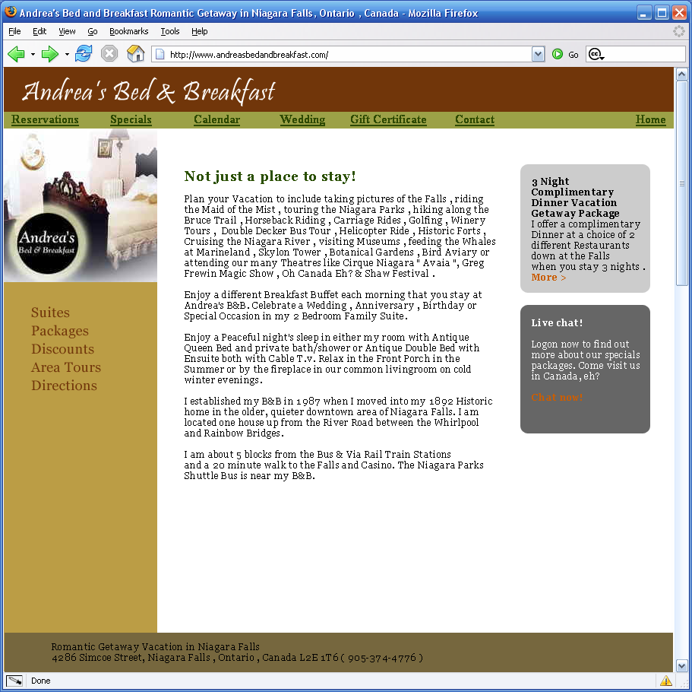

Slide 23
Text alignment
Used centred text sparingly – the occasional headline is okay
Never centre large blocks of text
Do not justify text!
  Browsers do not deal with the spacing well
  Will render you text largely illegible
Left-aligned titles and text makes for the easiest on-screen reading

Slide 24
uppercase/lowercase
Uppercase lettering is hard to read on-screen
People read by recognizing the overall shape of words
UPPERCASE HEADLINES OR BODY COPY TURNS YOUR TEXT INTO A SERIES OF MONOTONOUS RECTANGLES

Slide 25
headings
Use headings throughout a document to facilitate scanning
Recommend that headings and sub-heads use sentence case (capitalize first word and proper nouns only)
Mixed case can slow scanning as we try to interpret the shape of words

Slide 26
typefaces
Not all typefaces are legible on-screen
Avoid using several typefaces
Sans-serif actually works better
  Verdana, Arial, Tahoma, Helvetica
Serif works well at larger sizes – avoid for smaller text
  Times New Roman, Georgia, Courier

Slide 27
bold, italics & underlines
Use bold text sparingly
Never use bold text for headings – use a proper heading tag/style (semantic mark-up)
Use italics for conventional citation purposes, but avoid using excessively or for emphasis
Never use underlining on the web – I’ll give you one guess why…

Slide 28
using graphics

Slide 29
should you use graphics?
Does it support the content or add information for the user?
Does it support the visual hierarchy?
Does add aesthetic value to the page?
Does it compliment the colour scheme and page layout?

Slide 30
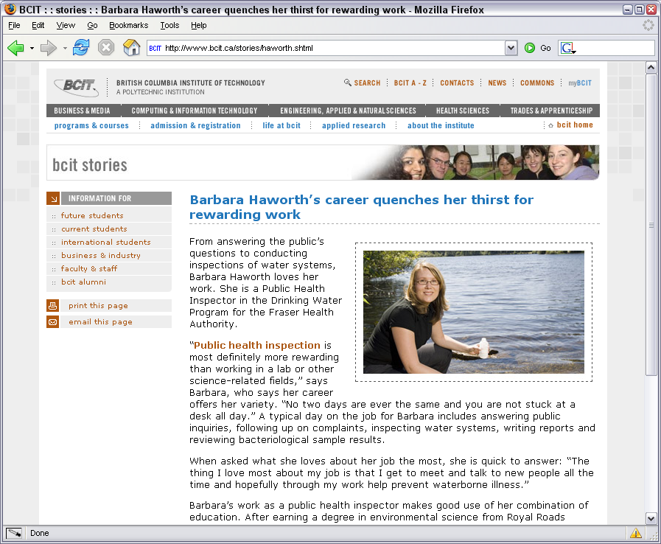
Good!

Slide 31

Bad!

Slide 32
economy & elegance
Economy: graphics should relay meaning in minimal space using minimal storage (file size)
Elegance: should fit with overall design – colour scheme, shapes, theme

Slide 33



formats: GIF
Graphic Interchange Format (GIF)
Best for graphics with areas of flat colour
Reduces file size by limiting colours readable in file
Permits transparency

Slide 34
Formats: JPG
Joint Photographic Experts Group (JPG)
Best for photographs or complex illustrations
“Lossy” compression means some information is discarded to make the image smaller
Images have a blurred or softened look
Discards some data every time you save the file so quality is increasingly reduced

Slide 35
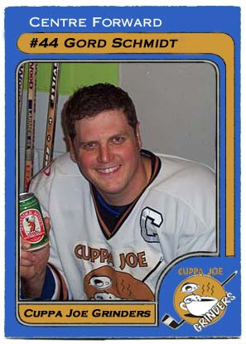

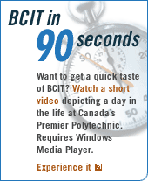
JPG examples

Slide 36
Formats: PNG
Portable Network Graphic (PNG)
Designed to replace the GIF format and to some extent the more compelx TIFF format
Alpha channels (variable transparency)
Compresses better than GIF
JPG still best choice for photographs

Slide 37
backgrounds
You can add backgrounds to pages, or to page elements, e.g., divs, headings, etc.
In all cases, you shouldn’t use background images that detract from the foreground
Experiment with non-tiling images

Slide 38
