Slide 1
COMP1911
JAVASCRIPT WORKSHOP:
DAY 1

Slide 2
Me
Web developer
Software engineer
Instructor, Computer Systems Technology
Jason_Harrison@bcit.ca
twitter.com/bcitjason
COMP1911 - JavaScript Workshop - Day 1

Slide 3
You
Have taken COMP1850
Will check your @my.bcit.ca email daily throughout this workshop (or autoforward it)
May have no previous programming experience
Will work hard
Will ask questions
COMP1911 - JavaScript Workshop - Day 1

Slide 4
The Course
Day 1
  9:00 – 10:30 lesson
  10:30 – 10:40 break
  10:40 – 12:00 lesson
  Day 2
  9:00 – 9:15 quiz 1
  10:15 – 10:30 lesson
  10:30 – 10:40 break
  10:40 – 12:00 lesson
Day 3
  9:00 assign 1 due
  9:00 – 9:15 quiz 2
  9:15 – 10:30 lesson
  10:30 – 10:40 break
  10:40 – 12:00 lesson
  Day 4
  9:00 – 9:15 quiz 3
  9:15 – 10:30 lesson
  10:30 – 10:40 break
  10:40 – 11:20 closed-book paper exam
  11:20 – 12:00 open-book computer exam
COMP1911 - JavaScript Workshop - Day 1

Slide 5
What is JavaScript?
JavaScript was originally called LiveScript
JavaScript has nothing to do with Java
JavaScript was invented by Netscape in 1995
JavaScript was the first client-side scripting language
JavaScript runs in the browser
There are essentially millions of types of browsers
Each browser has a different way of running JavaScript
One of our most difficult challenges is getting our scripts to run “the same” in every browser
COMP1911 - JavaScript Workshop - Day 1

Slide 6
Standards
The official standards for client-side web-scripting languages are set by the European Computer Manufacturers Association (ECMA)
JavaScript is by far the most common ECMAScript
JavaScript interacts with the browser’s Document Object Model (DOM)
DOM standards are set by the World Wide Web Consortium (W3C)
Therefore, JavaScript follows the ECMA standards (directly) and the W3C standards (indirectly)
COMP1911 - JavaScript Workshop - Day 1

Slide 7
Not Allowed
Some things ECMAScripts (JavaScript) are not allowed to do:
  Read (or write to) the client’s file system
  Send emails without the client’s knowledge/consent
  Close browser windows it did not open
  Execute programs on the client’s computer
  Open tiny windows (less than 100px x 100px)
  Establish connections to other computers
  Set file-upload inputs
  Read the browser’s history (links, yes; read, no)
COMP1911 - JavaScript Workshop - Day 1

Slide 8
Privacy and Concerns
If a web page uses JavaScript, then you can read (and copy) it
Therefore never put anything private or secret in your JavaScript pages
Some users intentionally disable JavaScript (e.g. in Firefox: Tools → Options… → Content → uncheck the “Enable JavaScript” checkbox)
Also, some browsers (very rare now) do not support JavaScript; others were invented before JavaScript was invented, so they do not support JavaScript either
COMP1911 - JavaScript Workshop - Day 1

Slide 9
DOM
JavaScript has access to the browser’s Document Object Model
The browser itself actually does most of the work; JavaScript “tells the browser what to do” (this is how scripting languages work)
Each browser has its own DOM, but the trend has been that browser DOMs are becoming increasingly similar, increasingly conforming to the W3C’s standards
Life is getting easier for JavaScript developers
COMP1911 - JavaScript Workshop - Day 1

Slide 10
How JavaScript Works
In general, JavaScript works with the following:
  The DOM and other objects
  Events and event handlers
  Timers
  CSS and HTML
For example, an event is done on some object (e.g., a user mouses over an image), and an event handler performs some action (a function changes the image’s source by accessing its CSS or HTML properties).
COMP1911 - JavaScript Workshop - Day 1

Slide 11
Where
JavaScript can be written in different places:
  The body section (not good at all)
  The head section (better)
  An external .js JavaScript file (best)
COMP1911 - JavaScript Workshop - Day 1

Slide 12
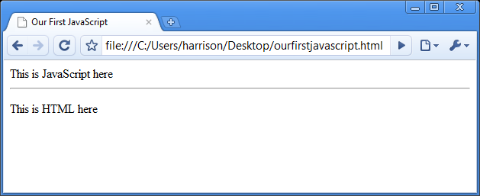
Our First JavaScript
<html><head><title>Our First JavaScript</title></head>
<body>
<script type='text/javascript'>
document.write('This is JavaScript here<hr />');
</script>
<p>This is HTML here</p>
</body>
</html>
COMP1911 - JavaScript Workshop - Day 1

Slide 13
Problems with Previous Script
Older browsers did not use type attribute (type=“text/javascript”)
Older browsers used language attribute (language=“javascript”)
So older browsers may not recognize this as JavaScript
However, using the language=“javascript” attribute, the page will not validate
Also, do not put JavaScript into the body of your web page
COMP1911 - JavaScript Workshop - Day 1

Slide 14
Problems with Previous Script
Some browsers do not support JavaScript
The code on the next slide comments out the JavaScript
Browsers that do not understand JavaScript will ignore the <script> tag, will ignore the </script> tag, and will now ignore all of the JavaScript code in between.
COMP1911 - JavaScript Workshop - Day 1

Slide 15
Older Browsers are Happier
<html><head><title>Our First JavaScript</title></head>
<body>
<script type='text/javascript' language='javascript'>
<!--
document.write('This is JavaScript here<hr />');
// -->
</script>
<p>This is HTML here</p>
</body>
</html>
COMP1911 - JavaScript Workshop - Day 1

Slide 16
The JavaScript
document is an object
The document object is the web page itself
write() is a method (‘behavior’) of the document object
Different objects have different methods
Please note that it is very rare to use document.write()
COMP1911 - JavaScript Workshop - Day 1

Slide 17
The JavaScript
document.write() is an instruction to the browser
It is the only instruction in our script
There are two other lines of JavaScript in the script too, but they are not instructions; they are comments
Comments are ignored by the browser
Comments are usually written as notes for other humans to read
There are three ways to write comments in JavaScript
COMP1911 - JavaScript Workshop - Day 1

Slide 18
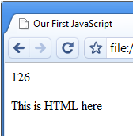
Comments
<html><head><title>Our First JavaScript</title></head><body>
<script type='text/javascript' language='javascript'>
<!–
document.write('1'); // this is ignored
document.write('2'); <!-- this is ignored
/*
all of these are ignored too:
document.write('3');
document.write('4');
document.write('5');
*/
document.write('6');
// -->
</script>
<p>This is HTML here</p></body></html>
COMP1911 - JavaScript Workshop - Day 1

Slide 19
Head Section is Better than the Body
<html><head><title>Our First JavaScript</title>
<script type='text/javascript' language='javascript'>
<!–
document.write('1'); // this is ignored
document.write('2'); <!-- this is ignored
/*
all of these are ignored too:
document.write('3');
document.write('4');
document.write('5');
*/
document.write('6');
// -->
</script> </head><body>
<p>This is HTML here</p></body></html>
COMP1911 - JavaScript Workshop - Day 1

Slide 20
View Source
You can view the source code of any JavaScript
Type in the code from the preceding page
Use Firefox to run the script
If something is wrong, Firefox’s error console may help you:
Tools → Error Console
Once it runs without errors, view the source code
Make sure it runs in Internet Explorer too, and Opera, and Chrome
COMP1911 - JavaScript Workshop - Day 1

Slide 21
Browsers and Standards
Download and install Chrome and Opera
In each of the four browsers we have in the lab (Chrome, Opera, Firefox, Internet Explorer), visit the following web site and see how they compare:
http://acid3.acidtests.org
Another useful site to compare web browsers:
http://quirksmode.org/compatibility.html
Official JavaScript documentation:
https://developer.mozilla.org/en/JavaScript
Better JavaScript style:
http://www.javascriptlint.com
COMP1911 - JavaScript Workshop - Day 1

Slide 22
Useful Firefox Add-ons
Firebug
Web developer
x-ray
yslow
COMP1911 - JavaScript Workshop - Day 1

Slide 23
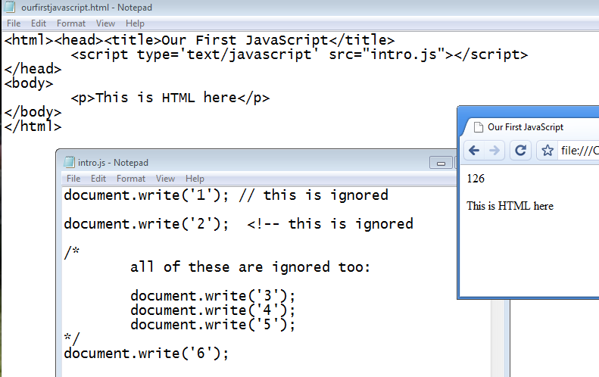
External Files
Let’s move our JavaScript into its own .js file
Link to it in the head section
COMP1911 - JavaScript Workshop - Day 1

Slide 24
Older / Disabled Browsers
In the <body> section, we can include a <noscript> section of code
This is ignored by all browsers that understand JavaScript
But this is executed by all browsers that do not understand JavaScript
COMP1911 - JavaScript Workshop - Day 1

Slide 25
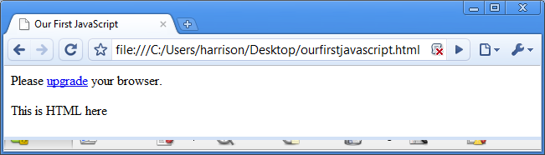
Older / Disabled Browsers
Disable JavaScript in Chrome:
Options
Under the Hood
Content settings...
COMP1911 - JavaScript Workshop - Day 1

Slide 26
DOM
The DOM is the interface to the browser
The DOM is the set of objects that JavaScript uses to access the browser and the web page
E.g. The window object, the document object (the HTML page), the navigator object (the browser), the style object (CSS).
COMP1911 - JavaScript Workshop - Day 1

Slide 27
DOMs
Browsers have changed their Document Object Models substantially, a few times. In chronological order, they are:
DOM 0 No rules. Limited abilities.
2 DOMs Two separate DOMs: IE versus Netscape
DOM 1 W3C cleaned it up: ONE standard
DOM 2 We are using this now; more convergence
DOM 3 We are on the verge of this; even more convergence
COMP1911 - JavaScript Workshop - Day 1

Slide 28
DOM 0
No formal specification
Offered by Netscape Navigator 2 and IE3
Still supported by modern browsers
Very limited capabilities
Very clunky code
Widely supported by most browsers new and old
Long strings of code
Position-dependent elements
Works similarly for all browsers (IE copied Netscape)
http://www.quirksmode.org/js/dom0.html
COMP1911 - JavaScript Workshop - Day 1

Slide 29
DOM 0
<html><head><title>Our First JavaScript</title>
<script type='text/javascript'>
<!—
window.onload=function(){
document.images[0].src="chicken.jpg";
document.forms[0].t.focus();
}
// -->
</script></head><body>
<form action="#" name="f">
<input type="text" name="t" />
</form>
<img src="cat.jpg" name="img1" /><br />
<img src="dog.jpg" name="img2" /><br />
</body></html>
COMP1911 - JavaScript Workshop - Day 1

Slide 30
Browser-war DOMs
Netscape 4: document.layers
IE4: document.all
IE still supports document.all
Other browsers may support it too, with a warning though
document.layers is no longer supported; ignore it
COMP1911 - JavaScript Workshop - Day 1

Slide 31
DOM 1, 2, 3
Official specification exists, by the W3C:
w3.org/TR/REC-DOM-Level-1/level-one-html.html
Much more powerful than DOM 0
http://www.quirksmode.org/dom/intro.html
document.getElementById
Level 2 HTML applies to both HTML 4.01 as
well as XHTML 1.0 documents while DOM Level 1 HTML applies only to HTML 4.01 documents.
Level 3 has more features
COMP1911 - JavaScript Workshop - Day 1

Slide 32
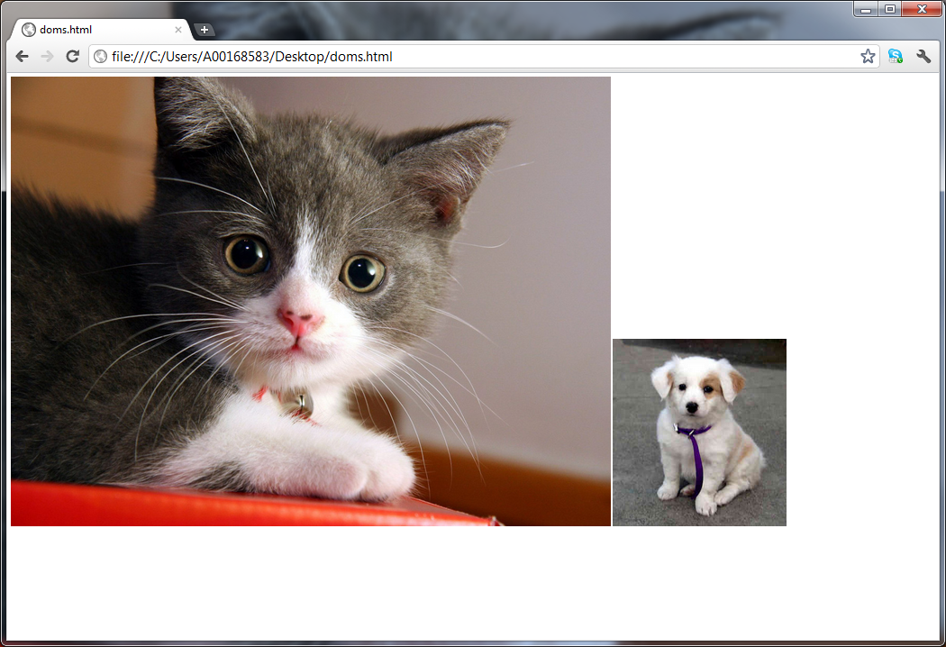
No JavaScript
<html>
<body>
<img src="cat.jpg"/>
<img src="dog.jpg"/>
</body>
</html>
COMP1911 - JavaScript Workshop - Day 1

Slide 33
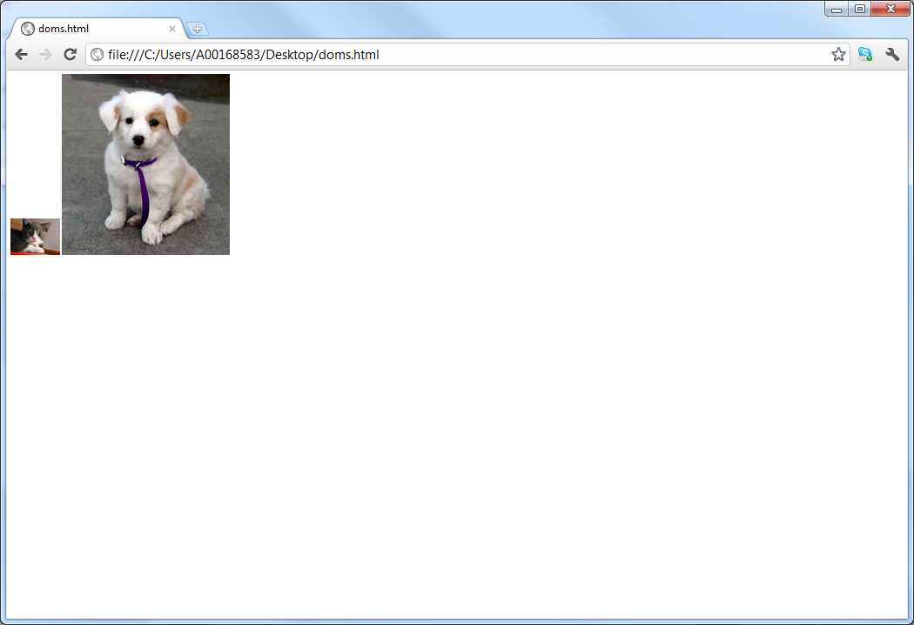
DOM 0
<html>
<body>
<img src="cat.jpg"/>
<img src="dog.jpg"/>
<script type="text/javascript">
document.images[0].width=100;
</script>
</body>
</html>
COMP1911 - JavaScript Workshop - Day 1

Slide 34

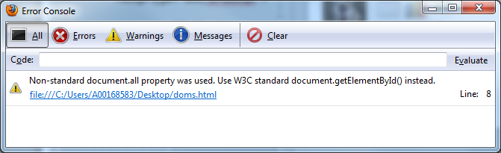
Browser Wars: IE
<html>
<body>
<img src="cat.jpg" name="c"/>
<img src="dog.jpg"/>
<script type="text/javascript">
document.all["c"].width=100;
</script>
</body>
</html>
COMP1911 - JavaScript Workshop - Day 1

Slide 35
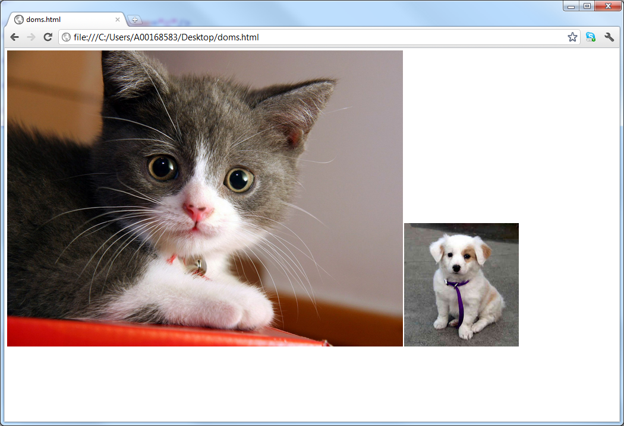
Browser Wars: Netscape
<html>
<body>
<img src="cat.jpg" name="c"/>
<img src="dog.jpg"/>
<script type="text/javascript">
document.layers["c"].width=100;
</script>
</body>
</html>
COMP1911 - JavaScript Workshop - Day 1

Slide 36

DOM1+
<html>
<body>
<img src="cat.jpg" id="c"/>
<img src="dog.jpg"/>
<script type="text/javascript">
document.getElementById("c").width=100;
</script>
</body>
</html>
COMP1911 - JavaScript Workshop - Day 1

Slide 37
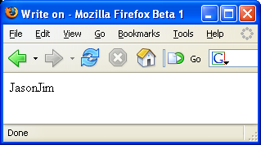
Variables
A variable is a piece of data that is used to store changing information. A variable has a name and a value and a data type. A real life non-computer example can demonstrate:
We could create a variable called “firstname” that stores a person’s first name. I would set the value to “Jason”, Jim would set the value to “Jim”, Julie would set the value to “Julie”, etc.... The same variable (firstname) can have different values.
In a Web script, variables are used to keep track of all kinds of data. Here is a simple example:
  <script type = “text/javascript”>
  <!--
  var firstname = “Jason”;
  document.write(firstname);
  firstname = “Jim”;
  document.write(firstname);
  // -->
  </script>
Javascript Workshop COMP 1911

Slide 38
Variables
global variables are declared (created) with var (optional but good style)
writing to screen: no quotation marks: document.write(variable)
= sign assigns values to a variable
first character can be underscore or letter
the rest of the characters can be digits, underscores, or letters
no spaces in the name
You cannot use JavaScript keywords (parts of the language, itself) for variable names.
JavaScript variable names are case-sensitive (firstname is a different variable than Firstname)
value is “undefined” if not set with an equals sign var firstname;
use meaningful names for variables
use quotation marks around strings assigned to variables (e.g. var name = “jason”)
a variable name can be very long (no official limit) but must fit on a single line
global variables are created when they are created, and die when the page is closed.
Javascript Workshop COMP 1911

Slide 39
Data Types
Variables can contain different types of data:
strings quoted words
e.g. “Shania”, ‘hello everyone’, “6 and 7 and 8”, “”
numbers no quotation marks
e.g. 7.4, 5, 10000, 0, -5
booleans true or false (only)
e.g. true, false
null means “no value”
e.g. null
A variable can hold any type of data and can change at any time. A variable containing a number can be changed to hold a string, a boolean, null, etc.... This is why JavaScript is called “weakly typed”.
Javascript Workshop COMP 1911

Slide 40
Quotes, escaping
There is virtually no difference between using single and double quotation marks in javascript.
var hisname = ‘jack’;
var hername = “jill”;
Alternate to avoid conflicts within a string
var “Jill’s plans include fetching water.”;
OR use the escape \ character to include a quote within a string.
var ‘Jack\’s plans are the same as Jill\’s.’;
Javascript Workshop COMP 1911

Slide 41
Quotes, escaping
<html><head><title>javascript</title>
<script type="text/javascript">
var firstName = "jason";
firstName = 'john';
firstName = 5;
firstName = true;
var quotation = "My son is 3' 7\" tall";
document.write(quotation);
var quotation2 = "here are 2 backslashes: \\\\";
document.write(quotation2);
</script>
</body>
</html>
Javascript Workshop COMP 1911

Slide 42
Concatentation
To join together two strings use the plus sign + operator like this:
var variableName = “Coltrane”;
document.write(“My last name is “ + variableName);
var age = 50;
document.write(“My age is “ + age);
var firstname = “John”;
var fullname; // current value is null
fullname = firstname + “ “ + variableName;
Javascript Workshop COMP 1911

Slide 43
variables
<style type="text/css">
.red{ color: red }
</style>
<script type="text/javascript">
var firstName = "jason";
var lastName = 'harrison';
alert("full name is " + firstName + " " + lastName);
var currentYear = 2010;
var birthYear = 1990;
var ageInYears = currentYear - birthYear;
alert("you are " + ageInYears + " years old");
var browserType = navigator.appName;
alert(browserType);
document.write('<span class="red">\'hi!\'</span>');
</script>
Javascript Workshop COMP 1911

Slide 44
Control Statement: if
Very often, a programmer writes pieces of code which should only be executed if some certain conditions apply. Real-life examples could include:
if the distance to the store is two miles or less, I will walk
if it is not snowing, I will walk to the store
if the car is broken down and I have no bus fare, I will walk to the store
if it is sunny or cloudy, I will walk to the store
if (distance <= 2.0){
walk_to_store = true;
}
if (!snowing){
walk_to_store = true;
}
if (snowing == false){
walk_to_store = true;
}
if ((car_is_broken == true) && (have_bus-fare == false)){
walk_to_store = true;
}
if ((sunny == true) || (cloudy == true)){
walk_to_store = true;
}
Javascript Workshop COMP 1911

Slide 45
Logical and Relational Operators
! not
|| or
&& and
== equal
!= not equal
> greater than
>= greater than/equal
< less than
<= less than/equal
Javascript Workshop COMP 1911

Slide 46
If statement, logical operators
/* at the time of writing the code, we don’t know the value. Maybe the value comes from user input, or from ajax, or from a math calculation */
var salary;
if (salary > 50000.00)
{
document.write(“You make a good salary”);
}
else if (salary == 50000.00)
{
document.write(“You make 50 grand”);
}
else // it must be under 50 000
{
document.write(“You need a raise”);
}
Javascript Workshop COMP 1911

Slide 47
Mathematical Operators
Mathematical operators available in JavaScript:
var x = 20;
var y = 7;
* multiplication e.g. x * y = 140
/ division e.g. x / y = 2.85714...
% modulus e.g. x % y = 6 (x and y must be integers)
+ addition e.g. x + y = 27
- subtraction e.g. x - y = 13
++ increment e.g. x++ (x equals 21 now)
-- decrement e.g. y-- (y equals 6 now)
Javascript Workshop COMP 1911

Slide 48
Control structures: Loops
Loops are used to repeat sections of code. Any section of code in a script can be executed zero times (for example, skip the code because it fails an “if” condition), one time, or many times (using a loop). To repeat one or more statements 100 times, a web author could simply write out the statement(s) 100 times in a row, like this:
document.write(“Hi, my name is Jason<br>”);
document.write(“Hi, my name is Jason<br>”);
document.write(“Hi, my name is Jason<br>”);
document.write(“Hi, my name is Jason<br>”);
etc…
Javascript Workshop COMP 1911

Slide 49
while
var counter = 1;
while(counter <= 1000)
{
if(counter == 300)
{
break; // kills the loop
}
document.write(counter + "<br />");
counter = counter + 1;
if(counter == 100)
{
continue;
}
document.write("this is the end of the loop<br>");
}
document.write("the <hr />end");
Javascript Workshop COMP 1911

Slide 50
Control Structures: For Loop
The “for” loop repeats a section of code a number of times. The number of times to repeat is specified like this:
for ( var counter = 0;
counter < num_repetitions; counter++)
  {
  all of this code
  is repeated
  }
Javascript Workshop COMP 1911

Slide 51
Control Structures: For Loop
for (var counter = 0; counter < 100; counter++)
{
document.write(“Hi, my name is Jason<br>”);
}
Javascript Workshop COMP 1911

Slide 52
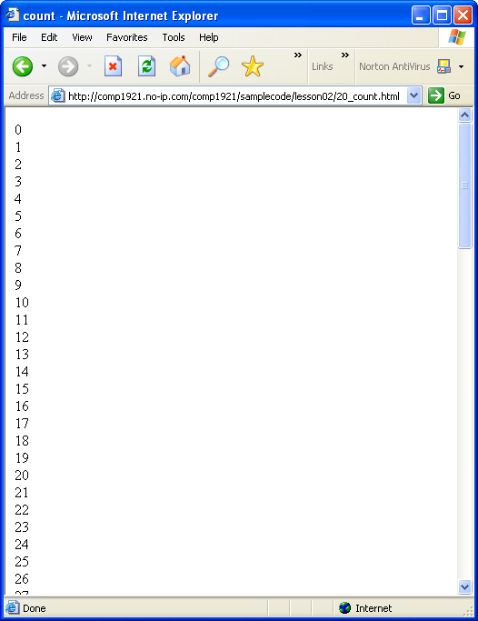
Control Structures: For Loop
We can use the same loop to print out 100 numbers:
for ( var counter = 0;
counter < 100;
counter++)
{
document.write(counter + “<br>\n”);
}
Javascript Workshop COMP 1911

Slide 53
Break
At any time inside a loop, you can stop the loop and continue with the instructions after the end of the loop by using the break instruction, like this:
  for (var counter = 0; counter < 100; counter++)
  {
  document.write(counter + “<br>”);
  if (counter == 30)
  {
  break;
  }
  }
document.write("end of loop");
This example would print the numbers from 0 to 30, then STOP the loop and continue with the document.write("end of loop"); instruction
Javascript Workshop COMP 1911

Slide 54
Self test
Write and test a script that has the following behaviour:
  Contains a variable named numberToBeginCountingFrom
  Assigns a large positive integer value to it.
  Prints the value of the variable, and counts down from that value by 2s, printing each time.
  If the number 13 is ever about to be printed, instead of printing 13 print ‘BOOM!’ and stop the countdown
  Stops counting down when the value reaches zero or less
  Prints ‘finished counting down’ when finished
Javascript Workshop COMP 1911

Slide 55
“while” versus “for”
//these next two loops (while and for) are IDENTICAL
var i = 1;
while(i < 10)
{
alert(i);
i++;
}
for(var j = 1; j < 10; j++)
{
alert(j);
}
Javascript Workshop COMP 1911

Slide 56
Objects
JavaScript is an object-based language.
The interactions that JavaScript makes with the Web page are done through objects.
JavaScript has access to many built-in objects on a Web page, depending upon the browser type and version.
Each object has different properties and behaviours.
http://devguru.com is a good resource.
https://developer.mozilla.org/en/JavaScript is the official JavaScript site
Javascript Workshop COMP 1911

Slide 57
Objects
Three of the most useful objects we use with JavaScript:
  navigator (browser)
  window (often implied; current window is default)
  document (the HTML page and all its contents)
Javascript Workshop COMP 1911

Slide 58
Homework
Lab 1 is due to BCIT’s SHARE/IN server before the start of next class
Please check your @my.bcit.ca email periodically
The next lesson begins with a quiz worth 10% of your overall grade.
COMP1911 - JavaScript Workshop - Day 1

Slide 59
Quiz Topics
invented js:
netscape
infinity browsers
standards for js:
ecma
standards for dom:
w3c
COMP1911 - JavaScript Workshop - Day 1

Slide 60
Quiz Topics
dom:
code that lets js interact with browser
Popular dom objects:
- navigator // browser
- window // often implied; current window default
- document // the html document
COMP1911 - JavaScript Workshop - Day 1

Slide 61
Quiz Topics
history of js:
- no js
- dom 0 (document.images)
- no common standards
- simple
- awkward
- browser wars
- netscape (document.layers)
- ie (document.all)
- w3c dom 1 (document.getElementById)
dom 2, dom 3
a single dom standard
- jQuery (toolkits / frameworks)
- DART / HTML5
COMP1911 - JavaScript Workshop - Day 1

Slide 62
Quiz Topics
<html>
<head>
<script type="text/javascript">
<!--
document.write("bad");
window.document.write("bad");
var schoolName = ‘BCIT’;
alert(schoolName); // alerts BCIT in a dialog box
alert("ok");
window.alert("ok");
COMP1911 - JavaScript Workshop - Day 1

Slide 63
Quiz Topics
var name = navigator.appName;
if(name == 'Microsoft Internet Explorer')
{
alert("you need a new browser");
}
for(var j = 1; j <= 200; j = j + 1)
{
alert(j);
}
// -->
</script>
COMP1911 - JavaScript Workshop - Day 1

Slide 64
Quiz Topics
<script type="text/javascript" src='x.js'></script>
</head>
<body>
<noscript><p>enable js!</p></noscript>
</body>
</html>
COMP1911 - JavaScript Workshop - Day 1

Slide 65
Quiz Topics
things js cannot do:
- close windows it didn't open
- execute programs on browser's machine
- connect your machine to another
- READ the history
- open invisible windows
- fill in file-upload contents
- invisibly send emails
COMP1911 - JavaScript Workshop - Day 1

