Slide 1
COMP1911
JAVASCRIPT WORKSHOP:
DAY 2

Slide 2
Learning Outcomes – Day 2
Math operators
Dates and times
Arrays
While loop
For loop
Objects and methods
parseInt
indexOf
Events and handling
window.onload
COMP1911 - JavaScript Workshop - Day 1

Slide 3
Mathematical Operators
Mathematical operators available in JavaScript:
var x = 20;
var y = 7;
* multiplication e.g. x * y = 140
/ division e.g. x / y = 2.85714...
% modulus e.g. x % y = 6 (x and y must be integers)
+ addition e.g. x + y = 27
- subtraction e.g. x - y = 13
++ increment e.g. x++ (x equals 21 now)
-- decrement e.g. y-- (y equals 6 now)
Javascript Workshop COMP 1911

Slide 4
Dates and Times
javascript can determine the date and time on the client’s (browser’s) computer
Javascript can also create dates and times
This can be used for display purposes, or to calculate spans of time
e.g.:
  “5 more days until January 1”,
  “you are 777600000 seconds old”
Javascript Workshop COMP 1911

Slide 5
Dates and Times
JavaScript’s Date object and its methods are very useful for working with dates and times.
This is the technique to get the current date stored into a Date variable:
var today = new Date( );
You can reference all of the Date object methods available for the today variable. On the next slide is a list of the most common Date object methods. Here is a simple example of how to use the Date object and its methods:
  function writeDate()
  {
  var today = new Date();
  document.write(today);
  }
Javascript Workshop COMP 1911

Slide 6
Date Methods
var today = new Date();
document.write("<br />DAY = " + today.getDay());
document.write("<br />MONTH = " + today.getMonth());
document.write("<br />DATE = " + today.getDate());
document.write("<br />YEAR = " + today.getFullYear());
document.write("<br />HOURS = " + today.getHours());
document.write("<br />MINUTES = " + today.getMinutes());
document.write("<br />SECONDS = " + today.getSeconds());
A full listing of Date methods can be found here
http://devguru.com/technologies/javascript/10585.asp
Javascript Workshop COMP 1911

Slide 7
Date Methods
You can create your own Date objects, not dependent on the current date
var newYearsEve = new Date();
//e.g. set to December 31, 2010
newYearsEve.setFullYear(2010,11,31);
//note month count begins at 0 for January
Javascript Workshop COMP 1911

Slide 8
Date Methods
The getTime() method returns an integer representing the number of milliseconds since midnight, January 1, 1970
Use this to determine the number of days between two dates…
Javascript Workshop COMP 1911

Slide 9
Date Methods
Create a Date variable for the July 5, 1990. Use the getTime( ) method to determine the number of milliseconds from midnight January 01, 1970 to July 5, 1990.
Create a Date variable for the July 5, 1991. Use the getTime( ) method to determine the number of milliseconds from midnight January 01, 1970 to July 5, 1991.
Subtract the 1990 getTime( ) value from the 1991 getTime( ) value to get the number of milliseconds between the two dates.
Convert this milliseconds value to a days value.
Javascript Workshop COMP 1911

Slide 10
Date Methods
var newYearsEve = new Date();
newYearsEve.setFullYear(2010,11,31);
var today = new Date();
var difference = newYearsEve.getTime() - today.getTime();
var minutes = 1000*60; //1000 millisec per sec; 60 sec/hr
var hours = minutes*60; //60 minutes per hour
var days = hours*24; //24 hours per day
document.write(difference/days+" days until new years eve!");
Javascript Workshop COMP 1911

Slide 11
Self test
The 2012 Chinese new year will be on January 23rd
Write a script which calculates and displays the number of weeks we have to prepare for it.
Investigate the toFixed() function of numeric variables if you want to format the number of decimal places displayed.
Javascript Workshop COMP 1911

Slide 12
var today = new Date();
var christmas = new Date();
christmas.setFullYear(2010, 11, 25);
var milliseconds = christmas - today;
var seconds = milliseconds / 1000;
var minutes = seconds / 60;
var hours = minutes / 60;
var days = Math.round(hours / 24);
document.write(days + " days until christmas");
var dayOfTheWeek = christmas.getDay();
if(dayOfTheWeek == 0){
document.write("*****Sunday");
}else if(dayOfTheWeek == 1){
document.write("*****Monday");
}else if(dayOfTheWeek == 2){
document.write("*****Tuesday");
}else if(dayOfTheWeek == 3){
document.write("*****Wednesday");
}else if(dayOfTheWeek == 4){
document.write("*****Thursday");
}else if(dayOfTheWeek == 5){
document.write("*****Friday");
}else if(dayOfTheWeek == 6){
document.write("*****Saturday");
}else{ // error. should be a number 0 – 6}
Javascript Workshop COMP 1911

Slide 13
More Objects, Methods, Properties
When you create new objects such as new Date() or new Array(), that object will have properties and methods available for us to use
window.alert()
document.write()
navigator.appName
style.backgroundColor
Date.setFullYear()
Math.round()
COMP1911 - JavaScript Workshop - Day 1

Slide 14
JavaScript References
devguru.com
…shows which objects exist, and which methods and properties each one has
COMP1911 - JavaScript Workshop - Day 1

Slide 15
Arrays
Arrays are special data types. They are a single variable which can contain multiple values
Use arrays to store information about a collection of related data
Eg: a list of products
Eg: a series of images for an animation
Javascript Workshop COMP 1911

Slide 16
Arrays
var days = new Array();
days[0] = "sunday";
days[1] = "monday";
days[2] = "tuesday";
days[3] = "wednesday";
days[4] = "thursday";
days[5] = "friday";
days[6] = "saturday";
alert(days.length); // 7
Javascript Workshop COMP 1911

Slide 17
Arrays
index value
0 | “Sonny”
1 | “Billie”
2 | “Thelonius”
3 | “Miles”
Arrays use an integer index (starting with 0 ‘zero’) to keep track of where particular values are stored
Javascript Workshop COMP 1911

Slide 18
Arrays
An array is an Object.
Use the ‘new’ keyword to create an array
Use [ num ] to describe the index you wish to access
var myArray = new Array();//create array
myArray[1] = “Holiday”; //change a value
var name = myArray[2];//access a value
Javascript Workshop COMP 1911

Slide 19
Control structures: Loops
Loops are used to repeat sections of code. Any section of code in a script can be executed zero times (for example, skip the code because it fails an “if” condition), one time, or many times (using a loop). To repeat one or more statements 100 times, a web author could simply write out the statement(s) 100 times in a row, like this:
document.write(“Hi, my name is Jason<br>”);
document.write(“Hi, my name is Jason<br>”);
document.write(“Hi, my name is Jason<br>”);
document.write(“Hi, my name is Jason<br>”);
etc…
Javascript Workshop COMP 1911

Slide 20
while
var counter = 1;
while(counter <= 1000)
{
if(counter == 300)
{
break; // kills the loop
}
document.write(counter + "<br />");
counter = counter + 1;
if(counter == 100)
{
continue;
}
document.write("this is the end of the loop<br>");
}
document.write("the <hr />end");
Javascript Workshop COMP 1911

Slide 21
Arrays
var provinces = new Array();
provinces[0] = "bc";
provinces[1] = "ab";
provinces[2] = "sk";
// provinces[3]=“mb”;
provinces[4] = "on";
provinces[5] = "qc";
provinces[6] = "newfoundland";
var index = 0;
while(index < provinces.length){
if(typeof(provinces[index]) != 'undefined'){
document.write(provinces[index] + "<br />");
}
index++;
}

Slide 22
Control Structures: For Loop
The “for” loop repeats a section of code a number of times. The number of times to repeat is specified like this:
for ( var counter = 0;
counter < num_repetitions; counter++)
  {
  all of this code
  is repeated
  }
Javascript Workshop COMP 1911

Slide 23
Control Structures: For Loop
for (var counter = 0; counter < 100; counter++)
{
document.write(“Hi, my name is Jason<br>”);
}
Javascript Workshop COMP 1911

Slide 24
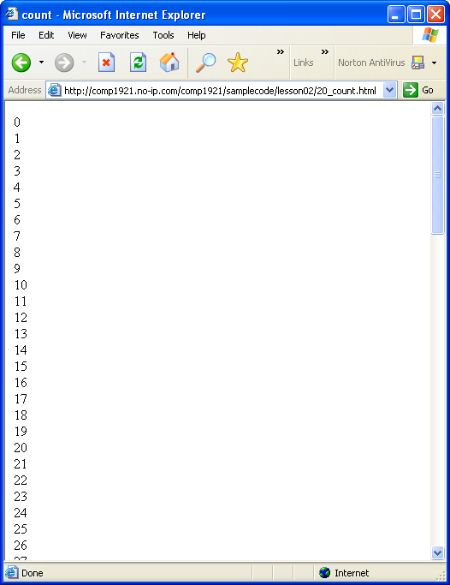
Control Structures: For Loop
We can use the same loop to print out 100 numbers:
for ( var counter = 0;
counter < 100;
counter++)
{
document.write(counter + “<br>\n”);
}
Javascript Workshop COMP 1911

Slide 25
Break
At any time inside a loop, you can stop the loop and continue with the instructions after the end of the loop by using the break instruction, like this:
  for (var counter = 0; counter < 100; counter++)
  {
  document.write(counter + “<br>”);
  if (counter == 30)
  {
  break;
  }
  }
document.write("end of loop");
This example would print the numbers from 0 to 30, then STOP the loop and continue with the document.write("end of loop"); instruction
Javascript Workshop COMP 1911

Slide 26
Self test
Write and test a script that has the following behaviour:
  Contains a variable named numberToBeginCountingFrom
  Assigns a large positive integer value to it.
  Prints the value of the variable, and counts down from that value by 2s, printing each time.
  If the number 13 is ever about to be printed, instead of printing 13 print ‘BOOM!’ and stop the countdown
  Stops counting down when the value reaches zero or less
  Prints ‘finished counting down’ when finished
Javascript Workshop COMP 1911

Slide 27
“while” versus “for”
//these next two loops (while and for) are essentially identical
var i = 1;
while(i < 10)
{
alert(i);
i++;
}
for(var i = 1; i < 10; i++)
{
alert(i);
}
Javascript Workshop COMP 1911

Slide 28
Arrays
The for loop is useful for iterating over an array
Use the length property to determine how many elements are in an array:
for(var index = 0; index < myArray.length; index++){
document.write(myArray[index]);
}
Javascript Workshop COMP 1911

Slide 29
Arrays
You can put any datatype into an array:
  numbers
  booleans
  Strings
  Objects
  other arrays (multi-dimensional array)
Usually best to use the same data type for all elements of a particular array
Javascript Workshop COMP 1911

Slide 30
Self test
Create an array with the names of at least five Canadian provinces.
Write a for loop that iterates through the entire array and prints both the contents and their associated index number to the screen.
Javascript Workshop COMP 1911

Slide 31
Loop through Images
<html><head></head><body>
<img src="dog.jpg"/> <br/>
<img src="cat.jpg"/> <br/>
<img src="bird.jpg"/> <br/>
<img src="fish.jpg"/> <br/>
<script type="text/javascript">
for(var i = 0; i < document.images.length; i++){ // DOM 0
alert(document.images[i].src);
document.images[i].width=100;
}
</script>
</body></html>
COMP1911 - JavaScript Workshop - Day 1

Slide 32
Objects
JavaScript is an object-based language.
The interactions that JavaScript makes with the Web page are done through objects.
JavaScript has access to many built-in objects on a Web page, depending upon the browser type and version.
Each object has different properties and behaviours.
http://devguru.com is a good resource.
https://developer.mozilla.org/en/JavaScript is the official JavaScript site
Javascript Workshop COMP 1911

Slide 33
OOP
Objects have properties and behaviours.
  Properties define the state of an object. accessed via the . operator
    document.bgColor = ‘blue’;
  Behaviors are the things an object can do, accessed via the . operator and () parenthesis
    document.write(‘Write this!’);
Javascript Workshop COMP 1911

Slide 34
OOP
For example, the “document” is a built-in object, which can be accessed and modified like this:
<script type = "text/javascript">
<!--
alert(document.bgColor);
document.bgColor = "#00ff00";
// -->
</script>
Javascript Workshop COMP 1911

Slide 35
OOP – Document properties
property description
alinkColor color of active links.
bgColor background color of the web page, set in the HTML <body> tag
cookie value of a cookie.
defaultCharset default character set
domain domain name of the document server (e.g. “http://signalflare.ca”
embeds array of document plugins
fgColor text color of the web page, set in the HTML <body> tag
fileCreatedDate date when the loaded HTML file was created
fileModifiedDate date of the most recent change to the loaded HTML file
fileSize size of the file, in bytes
fileUpdatedDate date of the most recent update to the loaded HTML file
lastModified date the file was last modified
linkColor color of links in the document, specified in the HTML <body> tag
Javascript Workshop COMP 1911

Slide 36
OOP – Document properties
location full web address of the loaded HTML file
mimeType array of mime types
protocol HTTP, FTP, etc....
readyState state of the document: loaded, loading...
security security certificate status
title from the head section’s <title> tag
URL location of the current document.
vlinkColor color of visited links, as specified in the HTML <body> tag
Javascript Workshop COMP 1911

Slide 37
OOP - Methods
Methods allow us to interact with objects.
Methods are used to change objects.
With this example...
document.write(“hello”);
...write is a method of the document object. It is used to write content to a new document. (However, once a page has been written, there are other ways to add content to it.)
Javascript Workshop COMP 1911

Slide 38
OOP - Methods
Each type of object has a different set of methods available to it, just like each type of object has a different set of properties available to it.
For instance, a “title” has no “src”, but an image does. To use a method to change an object, specify the method like this:
document.method( )
...sometimes there are contents inside the parentheses, (brackets) and sometimes the parentheses are empty.
Javascript Workshop COMP 1911

Slide 39
Self test
Write a script that uses the write() method of the document to print out the following information:
  When the document was last modified
  The title of the document
Alter the color of the text on the page using the DOM
Use the following list or find another resource
http://devguru.com/technologies/javascript
Javascript Workshop COMP 1911

Slide 40
OOP
So far we have only been concentrating on the document object.
There are many other useful objects that can be referenced by JavaScript.
Anchor | Checkbox | Frame | Link | Option | Select
Applet | Date | Function | Location | Password | String
Area | Document | Hidden | Math | Radio | Submit
Array | Event | History | Navigator | RegExp | Text
Boolean | FileUpload | Image | Number | Reset | Textarea
Button | Form | Layer | Object | Screen | Window
Javascript Workshop COMP 1911

Slide 41
Objects, properties, methods, events
Objects: document, window, navigator, Date, Array, Math, style, Image
Properties: src, width, length, color, backgroundColor, all the CSS properties, all the HTML attributes
Methods: document.write(), window.alert(), date.setFullYear(), etc…
Event handlers: onclick, ondblclick, onload, onmouseover, onmouseout…
COMP1911 - JavaScript Workshop - Day 1

Slide 42
Window Methods
Some javascript functions are built in, meaning you don’t need an object to use them. e.g dialog boxes
alert()
confirm()
prompt()
Actually, these are methods of the window object, but very often the “window” is assumed and not written. For instance, we could write window.alert() instead of simply alert()
Javascript Workshop COMP 1911

Slide 43
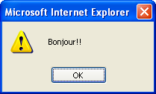
alert
<script type = "text/javascript">
<!--
alert("Bonjour!!");
// -->
</script>
Until the user presses the OK button, the script is “frozen”...when the OK button is pressed, the box disappears and the rest of the code can be run.
Javascript Workshop COMP 1911

Slide 44
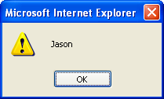
alert
You can use variables with alert dialogs:
<script type = "text/javascript">
<!--
var firstname = “Jason”;
alert(firstname); // no quotes
// -->
</script>
Javascript Workshop COMP 1911

Slide 45
confirm
var userInput = confirm("Are you sure you want to learn js?");
if (userInput){
document.write(“You clicked OK”);
}
else{
document.write(“You clicked Cancel”);
}
Javascript Workshop COMP 1911

Slide 46
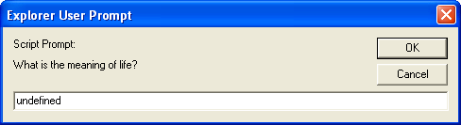
prompt
The prompt dialog allows you to get text input from your visitors
<script type = "text/javascript">
<!--
prompt("What is the meaning of life?");
// -->
</script>
Javascript Workshop COMP 1911

Slide 47

prompt
You can also specify a default “answer” in the textbox.
Change the instruction from this:
prompt("What is the meaning of life?");
to this
prompt("What is the meaning of life?", “to be happy”);
Javascript Workshop COMP 1911

Slide 48
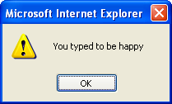
prompt
You can store the user’s prompt text in a variable like we did with the confirm dialog.
var userInput = prompt("What is the meaning of life?", “to be happy”);
alert(“You typed “ + userInput);
Javascript Workshop COMP 1911

Slide 49
What did the user do?
var userInput = prompt("What is the meaning of life?", "to be happy");
if (userInput == null)
{
alert("You pressed Cancel");
}
else if(userInput == "")
{
alert("You didn’t type anything!");
}
else
{
alert("You typed " + userInput);
}
Javascript Workshop COMP 1911

Slide 50
DOM
The DOM is a model that allows scripting languages to handle browser input and output and manipulate information on web pages.
Use the DOM to
  determine the state of page elements
  change particular elements on a web page
  react to events, such as mouse clicks
Javascript Workshop COMP 1911

Slide 51
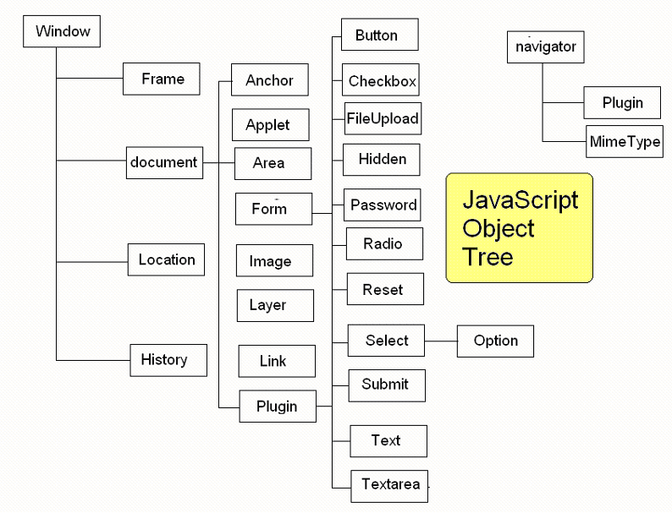
Javascript Workshop COMP 1911

Slide 52
DOM support
The DOM has gone through many versions. The latest is DOM level 3.
Older browsers may not support the latest version. DOM level 0 is supported by virtually all browsers, but is not as powerful as level 3.
http://www.webdevout.net/browser-support-dom
Javascript Workshop COMP 1911

Slide 53
DOM 1: document.getElementById()
getElementById() is used to query or manipulate a page element.
First set both the name and id attributes of an HTML tag, like this:
<img name="boy" id="boy" src="jaden.jpg“ />
Use getElementById() to query or manipulate a page element.
var myImage = document.getElementById(“boy”);
document.write(“The filename for this image is “ + myImage.src);
myImage.src=“joey.jpg”;
Javascript Workshop COMP 1911

Slide 54
Events
JavaScript can detect and react to events.
We can use event handlers to tell the browser what should be done when an event occurs.
For instance, when the mouse rolls over an image, javascript can react (e.g. by changing the image, or the cursor).
Javascript Workshop COMP 1911

Slide 55
Event Handlers
onabort
onblur
onchange
onclick
ondblclick
ondragdrop
onerror
onfocus
onkeydown
onkeypress
onkeyup
onload
onmousedown
onmousemove
onmouseout
onmouseover
onmouseup
onmove
onreset
onresize
onselect
onsubmit
onunload
Javascript Workshop COMP 1911

Slide 56
Events
To respond to a document event, write an event handler.
<head><title>The main event</title></head>
<body bgcolor = “beige” onclick = “alert(‘clicked’);”>
Click me.
</body>
Javascript Workshop COMP 1911

Slide 57
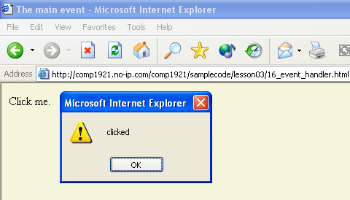
Javascript Workshop COMP 1911

Slide 58
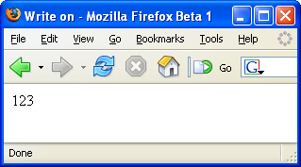
parseInt( )
To get the integer portion of a string which begins with a number, use the parseInt( ) function (instruction). There is also a parseFloat( ) function which works similarly, but with decimal numbers.
var address = “123 west 56th avenue”;
var avenue = parseInt(address);
document.write(avenue); // no quotation marks
Useful for CSS properties such as “100px”, “20%”, “3em”
Javascript Workshop COMP 1911

Slide 59
parseInt( )
var cssProperty = "14px";
var numberAtFront = parseInt(cssProperty);
alert(cssProperty); // 14px
numberAtFront++; // 15
cssProperty = numberAtFront + "px";
alert(cssProperty); // 15px
COMP1911 - JavaScript Workshop - Day 1

Slide 60
indexOf( )
This is a very useful function which determines if a certain character or string exists inside another string. For example, if you ask the user for a URL, you can use indexOf to determine if “http://” or “www” or “.com” are inside the string.
The first character of a string is position zero. So a string with 8 characters such as “Harrison” is built like this:
var name = “Harrison”;
H a r r i s o n
0 1 2 3 4 5 6 7
Here is how indexOf works:
  name.indexOf(“H”) equals 0
  name.indexOf(“a”) equals 1
  name.indexOf(“r”) equals 2, the first instance of r occurs at position 2
  name.indexOf(“u”) equals -1, which means the search text is not found
  name.indexOf(“son”) equals 5, the starting position of the search text
Javascript Workshop COMP 1911

Slide 61
indexOf
var browserInfo = navigator.userAgent;
document.write(browserInfo);
var index = browserInfo.indexOf("MSIE");
if(index == -1)
{
alert("This is not MSIE");
}else{
alert("This is MSIE");
}
Javascript Workshop COMP 1911

Slide 62
indexOf
var string = "british columbia institute of technology";
alert(string.indexOf("col")); // 8
alert(string.indexOf("xyz")); // -1
alert(string.indexOf("briti")); // 0
alert(string.indexOf("BRITI")); // -1
// -1 means "not found"
if(navigator.appName.indexOf("Internet Explorer") != -1){
alert("you are using internet explorer");
}
COMP1911 - JavaScript Workshop - Day 1

Slide 63
window.onload
After the window finishes loading, we can set up JavaScript behaviors
window.onload=function(){}
This is an anonymous (unnamed) function.
Very common.
COMP1911 - JavaScript Workshop - Day 1

Slide 64
<html>
<head>
<script type="text/javascript">
for(var i = 0; i < document.images.length; i++)
{
document.images[i].width = 100;
}
</script>
</head>
<body>
<img src="dog.jpg"/> <br/>
<img src="cat.jpg"/> <br/>
<img src="bird.jpg"/> <br/>
<img src="fish.jpg"/> <br/>
</body>
</html>
COMP1911 - JavaScript Workshop - Day 1

Slide 65
Good Quiz Question
<html><head>
<script type="text/javascript">
window.onload=function() {
for(var i = 0; i < document.images.length; i++)
{
document.images[i].width = 100;
}
}
</script>
</head>
<body>
<img src="dog.jpg"/> <br/>
<img src="cat.jpg"/> <br/>
<img src="bird.jpg"/> <br/>
<img src="fish.jpg"/> <br/>
</body>
</html>
COMP1911 - JavaScript Workshop - Day 1

Slide 66
Last Quizzable Material
window.onload = function(){
// DOM 1
// could also getElementsByTagName("p"), etc...
var allImages = document.getElementsByTagName("img");
for(var i = 0; i < allImages.length; i++) {
allImages[i].width = 400;
}
}
COMP1911 - JavaScript Workshop - Day 1

Slide 67
Due Next Week
Lab 2
Quiz at the start of next lesson
COMP1911 - JavaScript Workshop - Day 1

