Slide 1
COMP 1409
Introduction to Software Development 1
session 1

Slide 2
Course Contents
Introduction to object-oriented programming…
…with a strong software engineering foundation…
…aimed at producing and maintaining large, high-quality software systems.
Objects First with Java - A Practical Introduction using BlueJ, © David J. Barnes, Michael Kölling
Notes:
Objects First with Java
© David J. Barnes and Michael Kölling

Slide 3
Goals
Sound knowledge of programming principles
Sound knowledge of object-orientation
Able to critically assess the quality of a (small) software system
Able to implement a small software system in Java
Objects First with Java - A Practical Introduction using BlueJ, © David J. Barnes, Michael Kölling

Slide 4
Book
David J. Barnes & Michael Kölling
Objects First with Java
A Practical Introduction using BlueJ
5th edition,
Pearson Education, 2012
ISBN 0-13-249266-0
978-0-13-249266-9
Objects First with Java - A Practical Introduction using BlueJ, © David J. Barnes, Michael Kölling

Slide 5
Webpage
The course web page is at
http://learn.bcit.ca
Please check it regularly.
It will be used for announcements and distribution of material.

Slide 6
Logging on to D2L
Notes:
Here, I start discussing objects and classes. I talk to the students
about it for a while, then I do an extensive demo of the shapes example in
BlueJ. All important points of this lecture are encountered and pointed
out during this demo.
All following slides serve only as summary, or reminder. No new material
is introduced after the demo.

Slide 7
BlueJ Demo
(figures project)‏
Notes:
Here, I start discussing objects and classes. I talk to the students
about it for a while, then I do an extensive demo of the shapes example in
BlueJ. All important points of this lecture are encountered and pointed
out during this demo.
All following slides serve only as summary, or reminder. No new material
is introduced after the demo.

Slide 8
Course overview
Objects and classes
Understanding class definitions
Object interaction
Grouping objects
Objects First with Java - A Practical Introduction using BlueJ, © David J. Barnes, Michael Kölling

Slide 9
Fundamental concepts
object
class
method
parameter
data type
Objects First with Java - A Practical Introduction using BlueJ, © David J. Barnes, Michael Kölling
Notes:
Objects First with Java
© David J. Barnes and Michael Kölling
You don’t always need to show all these slides in class.
These are intended as summaries. Discuss these topics
with a demo, or in a dialog, or in any way you like.

Slide 10
Objects and classes
objects
  represent ‘things’ from the real world, or from some problem domain (example: “the red car down there in the car park”)
classes
  represent all objects of a kind (example: “car”)
Objects First with Java - A Practical Introduction using BlueJ, © David J. Barnes, Michael Kölling

Slide 11
Methods and parameters
Objects have operations which can be invoked (Java calls them methods).
Methods may have parameters to pass additional information needed to execute.
Objects First with Java - A Practical Introduction using BlueJ, © David J. Barnes, Michael Kölling

Slide 12
Data types
computer programs consist of instructions and data
the programmer must specify what sort of data the program uses, e.g. numbers, letters
this tells the computer how much memory is required

Slide 13
Data types
some common data types:
  integer (whole numbers) e.g. 78, 490
  floating point (decimal numbers) e.g. 23.6, 199.3
  string (Unicode characters) e.g.
  “OO Programming”, “hello”, “abc123”
  character (single) e.g. ‘A’, ‘8’, ‘$’
  boolean e.g. true, false

Slide 14
Data types in Java
Java datatypes - primitive types (also known as value types)‏
  int is default integer type - whole numbers
  double is default floating-point type, numbers with decimal places
  boolean - true or false
  char - a single Unicode character

Slide 15
Data types in Java
Java datatypes - object types (also known as reference types)‏
  String is an object type in Java - every string is an object of the String class
  a string is enclosed in double quotes,
  e.g. “this is a string”
  everything that is not a primitive type is an object type

Slide 16
Classes and objects
Class Dog . . .
  Possible attributes?
  Possible methods?

Slide 17
Other observations
Many instances can be created from a single class.
An object has attributes: values stored in fields.
The class defines what fields an object has, but each object stores its own set of values (the state of the object).
Objects First with Java - A Practical Introduction using BlueJ, © David J. Barnes, Michael Kölling

Slide 18
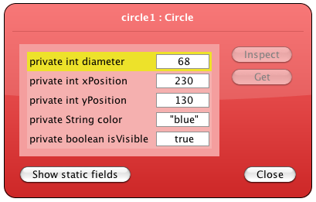
State
Objects First with Java - A Practical Introduction using BlueJ, © David J. Barnes, Michael Kölling

Slide 19
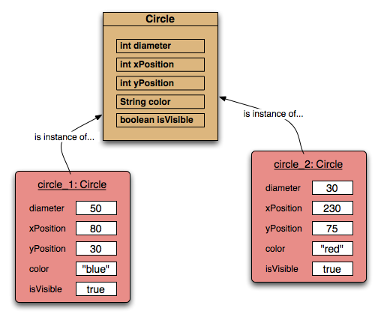
Two circle objects
Objects First with Java - A Practical Introduction using BlueJ, © David J. Barnes, Michael Kölling

Slide 20
Default values
When no specific value is put into a field, Java will assign a default value. Different data types have different defaults.

Slide 21
Source code
Each class has source code (Java code) associated with it that defines its details (fields and methods).
Objects First with Java - A Practical Introduction using BlueJ, © David J. Barnes, Michael Kölling

Slide 22
Return values
All the methods in the figures project have void return types; but …
… methods may return a result via a return value.
Such methods have a non-void return type.
More on this in the next chapter.
Objects First with Java - A Practical Introduction using BlueJ, © David J. Barnes, Michael Kölling

