Slide 1
COMP 1409
Introduction to Software Development 1
session 2

Slide 2
Understanding class definitions
Looking inside classes
5.0
Notes:
Objects First with Java
© David J. Barnes and Michael Kölling

Slide 3
Main concepts to be covered
fields
constructors (including default)
parameters
assignment statements
accessor methods
Javadoc comments
Objects First with Java - A Practical Introduction using BlueJ, © David J. Barnes, Michael Kölling
Notes:
Objects First with Java
© David J. Barnes and Michael Kölling

Slide 4
Ticket machines – an external view
Exploring the behavior of a typical ticket machine.
  Use the naive-ticket-machine project.
  Machines supply tickets of a fixed price.
    How is that price determined?
  How is ‘money’ entered into a machine?
  How does a machine keep track of the money that is entered?
Objects First with Java - A Practical Introduction using BlueJ, © David J. Barnes, Michael Kölling
Notes:
Objects First with Java
© David J. Barnes and Michael Kölling

Slide 5
Ticket machines
Demo
Objects First with Java - A Practical Introduction using BlueJ, © David J. Barnes, Michael Kölling
Notes:
Objects First with Java
© David J. Barnes and Michael Kölling

Slide 6
Ticket machines – an internal view
Interacting with an object gives us clues about its behaviour.
Looking inside allows us to determine how that behaviour is provided or implemented.
All Java classes have a similar-looking internal view.
Objects First with Java - A Practical Introduction using BlueJ, © David J. Barnes, Michael Kölling
Notes:
Objects First with Java
© David J. Barnes and Michael Kölling

Slide 7
Basic class structure
The outer wrapper of TicketMachine
public class TicketMachine
{
Inner part omitted.
}
public class ClassName
{
Fields
Constructors
Methods
}
The inner contents of a class
Objects First with Java - A Practical Introduction using BlueJ, © David J. Barnes, Michael Kölling
Notes:
Objects First with Java
© David J. Barnes and Michael Kölling

Slide 8
Keywords
Words with a special meaning in the language:
  public
  class
  private
  int
Also known as reserved words.

Slide 9
Fields
Fields store values for an object.
They are also known as instance variables.
Fields define the state of an object.
Use Inspect to view the state.
Some values change often.
Some change rarely (or not at all).
public class TicketMachine
{
private int price;
private int balance;
private int total;
Further details omitted.
}
type
visibility modifier
variable name
private int price;
Objects First with Java - A Practical Introduction using BlueJ, © David J. Barnes, Michael Kölling
Notes:
Objects First with Java
© David J. Barnes and Michael Kölling

Slide 10
Constructors
public TicketMachine(int cost)
{
price = cost;
balance = 0;
total = 0;
}
Initialize an object.
Have the same name as their class.
Close association with the fields.
Store initial values into the fields.
External parameter values for this.
Objects First with Java - A Practical Introduction using BlueJ, © David J. Barnes, Michael Kölling
Notes:
Objects First with Java
© David J. Barnes and Michael Kölling

Slide 11
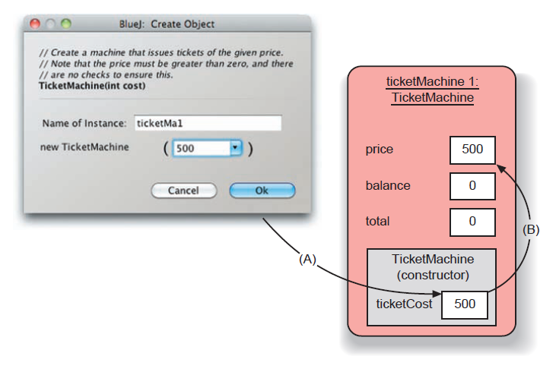
Passing data via parameters
Parameters are another sort of variable.
Objects First with Java - A Practical Introduction using BlueJ, © David J. Barnes, Michael Kölling
Notes:
Objects First with Java
© David J. Barnes and Michael Kölling

Slide 12
Assignment
Values are stored into fields (and other variables) via assignment statements:
  variable = expression;
  price = cost;
A variable stores a single value, so any previous value is lost.
The variable receiving the value is on the left.
Objects First with Java - A Practical Introduction using BlueJ, © David J. Barnes, Michael Kölling
Notes:
Objects First with Java
© David J. Barnes and Michael Kölling

Slide 13
Choosing variable names
There is a lot of freedom over choice of names. Use it wisely!
Choose expressive names to make code easier to understand:
  price, amount, name, age, etc.
Avoid single-letter or cryptic names:
  w, t5, xyz123

Slide 14
Default constructor
When a constructor is not provided, Java will automatically generate one with no parameters.
This default constructor will initialize the fields to default values.
If we provide a constructor with parameters, then Java will not generate a default.
For future use we will include a default constructor for each class.
Objects First with Java - A Practical Introduction using BlueJ, © David J. Barnes, Michael Kölling
Notes:
Objects First with Java
© David J. Barnes and Michael Kölling

Slide 15
Default constructor for the Ticket Machine class
/**
Default constructor
*/
public TicketMachine()
{
}
All three fields will be set to their default value, i.e. 0 because they are of type int.
Objects First with Java - A Practical Introduction using BlueJ, © David J. Barnes, Michael Kölling
Notes:
Objects First with Java
© David J. Barnes and Michael Kölling

Slide 16
Methods
Methods implement the behavior of objects.
Methods have a consistent structure comprised of a header and a body.
Accessor methods provide information about an object.
Objects First with Java - A Practical Introduction using BlueJ, © David J. Barnes, Michael Kölling
Notes:
Objects First with Java
© David J. Barnes and Michael Kölling

Slide 17
Method structure
The header provides the method’s signature:
  public int getPrice()
The header tells us:
  the name of the method
  what parameters it takes
  whether it returns a result
  its visibility to objects of other classes
The body encloses the method’s statements.

Slide 18
Accessor (get) methods
return type
visibility modifier
method name
parameter list (empty)
public int getPrice()
{
return price;
}
return statement
start and end of method body (block)
Objects First with Java - A Practical Introduction using BlueJ, © David J. Barnes, Michael Kölling
Notes:
Objects First with Java
© David J. Barnes and Michael Kölling

Slide 19
Accessor methods
An accessor method always has a return type that is not void.
An accessor method returns a value (result) of the type given in the header.
The method will contain a return statement to return the value.
NB: Returning is not printing!

Slide 20
Javadoc comments
Every class has a comment at the top that explains what the class is.
Every method has a comment that includes information about parameters (if any) and return value (if any).
Javadoc comments and tags e.g. @author, @version, @return, @param are used to generate documentation for the class.
Objects First with Java - A Practical Introduction using BlueJ, © David J. Barnes, Michael Kölling
Notes:
Objects First with Java
© David J. Barnes and Michael Kölling

Slide 21
Review
Class bodies contain fields, constructors and methods.
Fields store values that determine an object’s state.
Constructors initialize objects – particularly their fields.
Accessor methods ( “getters” ) return the contents of fields.
Objects First with Java - A Practical Introduction using BlueJ, © David J. Barnes, Michael Kölling
Notes:
Objects First with Java
© David J. Barnes and Michael Kölling

