Slide 1
COMP 1409
Introduction to Software Development 1
session 4

Slide 2
Understanding class definitions
Looking inside classes
5.0
Notes:
Objects First with Java
© David J. Barnes and Michael Kölling

Slide 3
Main concepts to be covered
program logic
making more complex choices
local variables
static variables
symbolic constants

Slide 4
Program logic
Boolean operators:
  && and
  || or
  ! not

Slide 5
Now we can make more complex choices
/** TicketMachine constructor sets the price of a ticket and limits it to 500 or less */
public TicketMachine(int cost)
{
  if(cost >= 0 && cost <= 500) {
  price = cost;
  }
  balance = 0;
  total = 0;
  }

Slide 6
Now we can make more complex choices
/** Sets the price of a ticket and limits it to 500 or less */
public void setPrice(int cost)
{
  if(cost >= 0 && cost <= 500) {
  price = cost;
  }
  // else invalid
  }

Slide 7
Alternately...
/** Sets the price of a ticket and limits it to 500 or less */
public void setPrice(int cost)
{
  if(cost < 0 || cost > 500) {
// invalid
  }
  else {
  price = cost;
  }
  }

Slide 8
Alternately...
/** Sets the price of a ticket and limits it to 500 or less */
public void setPrice(int cost)
{
if(!(cost >= 0 && cost <= 500)) {
// invalid
}
  else {
  price = cost;
  }
  }

Slide 9
Alternately...
/** Sets the price of a ticket and limits it to 500 or less */
public void setPrice(int cost)
{
  if(!(cost < 0 || cost > 500)) {
price = cost;
  }
  // else invalid
  }

Slide 10
How do we write 'refundBalance'
for the TicketMachine?
Objects First with Java - A Practical Introduction using BlueJ, © David J. Barnes, Michael Kölling
Notes:
Objects First with Java
© David J. Barnes and Michael Kölling
write method in BlueJ;
first: do it wrong

Slide 11
Variables – a recap
Fields are one sort of variable.
  They store values through the life of an object.
  They are accessible throughout the class.
Parameters are another sort of variable:
  They receive values from outside the method.
  They help a method complete its task.
  Each call to the method receives a fresh set of values.
  Parameter values are short lived.
Objects First with Java - A Practical Introduction using BlueJ, © David J. Barnes, Michael Kölling
Notes:
Objects First with Java
© David J. Barnes and Michael Kölling

Slide 12
Local variables
Methods can define their own, local variables:
  Short lived, like parameters.
  The method sets their values – unlike parameters, they do not receive external values.
  Used for ‘temporary’ calculation and storage.
  They exist only as long as the method is being executed.
  They are only accessible from within the method.

Slide 13
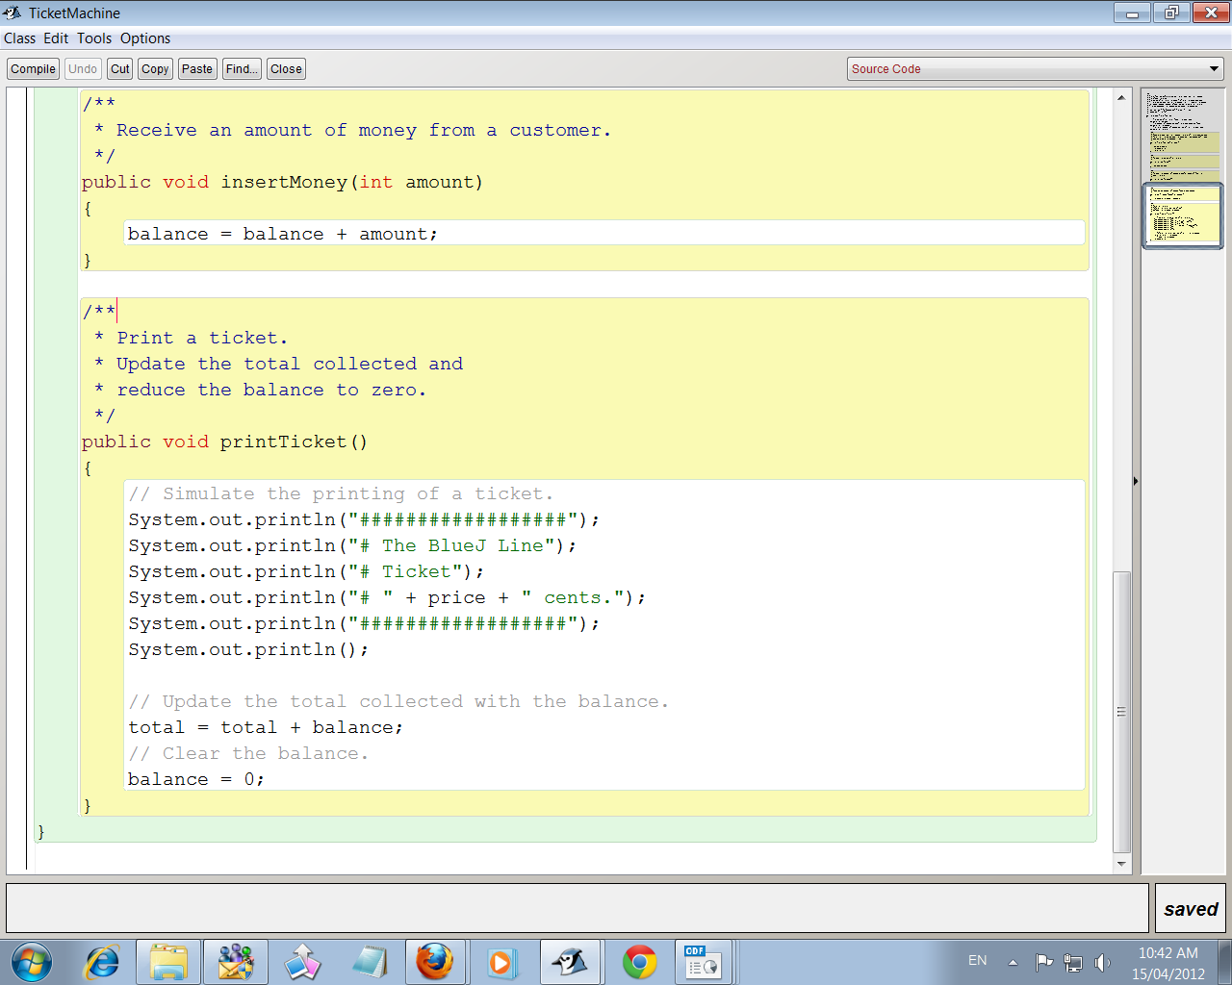
Scope highlighting

Slide 14
Scope and lifetime
Each block defines a new scope.
  Class, method and statement.
Scopes may be nested:
  statement block inside another block inside a method body inside a class body.
Scope is static (textual).
Lifetime is dynamic (runtime).
Objects First with Java - A Practical Introduction using BlueJ, © David J. Barnes, Michael Kölling
Notes:
Objects First with Java
© David J. Barnes and Michael Kölling

Slide 15
Local variables
A local variable
public int refundBalance()
{
int amountToRefund;
amountToRefund = balance;
balance = 0;
return amountToRefund;
}
No visibility
modifier
Objects First with Java - A Practical Introduction using BlueJ, © David J. Barnes, Michael Kölling
Notes:
Objects First with Java
© David J. Barnes and Michael Kölling

Slide 16
Scope and lifetime
The scope of a local variable is the block in which it is declared.
The lifetime of a local variable is the time of execution of the block in which it is declared.
The scope of a field is its whole class.
The lifetime of a field is the lifetime of its containing object.

Slide 17
Static variables
'Static' is a Java key word that describes variables (or methods) that belong to the class rather than to the individual instances (objects) of the class.
Only one copy exists in memory and all objects of that class share it.

Slide 18
Static variables
public class DemoStatic
{
private static int count = 0;
public DemoStatic()
{
// keeps count of objects
count = count + 1;
}
}

Slide 19
Symbolic constants
A constant is a value that will not change, e.g. literal values like 5, -20, “hello”.
The key word ‘final’ indicates a memory location set aside for a value that will not change while the program is running.

Slide 20
Symbolic constants
Static and final together indicate a symbolic constant in Java.
Symbolic constant is a synonym for a constant value.
Must be assigned its value when declared.
static final double PI = 3.14159;
static final double PRIME_RATE = 4.25;

Slide 21
Review (1)
Fields, parameters and local variables are all variables.
Fields persist for the lifetime of an object.
Parameters are used to receive values into a constructor or method.
Local variables are used for short-lived temporary storage.
Objects First with Java - A Practical Introduction using BlueJ, © David J. Barnes, Michael Kölling
Notes:
Objects First with Java
© David J. Barnes and Michael Kölling

Slide 22
Review (2)
Methods have a return type.
void methods do not return anything.
non-void methods return a value.
non-void methods have a return statement.

Slide 23
Review (3)
‘Correct’ behavior often requires objects to make decisions.
Objects can make decisions via conditional (if) statements.
A true-or-false test allows one of two alternative courses of actions to be taken.
Objects First with Java - A Practical Introduction using BlueJ, © David J. Barnes, Michael Kölling
Notes:
Objects First with Java
© David J. Barnes and Michael Kölling

Slide 24
Review (4)
Static variables are shared by all objects of the class.
Static and final together are used to define symbolic constants.
Objects First with Java - A Practical Introduction using BlueJ, © David J. Barnes, Michael Kölling
Notes:
Objects First with Java
© David J. Barnes and Michael Kölling

