Slide 1
COMP 1409
Introduction to Software Development 1
session 6

Slide 2
Main concepts to be covered
object interaction
abstraction
modularization
classes as data types
external method calls

Slide 3
Object interaction
Creating cooperating objects
5.0
Notes:
Objects First with Java
© David J. Barnes and Michael Kölling

Slide 4
Abstraction and modularization
Abstraction is the ability to ignore details of parts to focus attention on a higher level of a problem.
Modularization is the process of dividing a whole into well-defined parts, which can be built and examined separately, and which interact in well-defined ways.
Objects First with Java - A Practical Introduction using BlueJ, © David J. Barnes, Michael Kölling
Notes:
Objects First with Java
© David J. Barnes and Michael Kölling

Slide 5
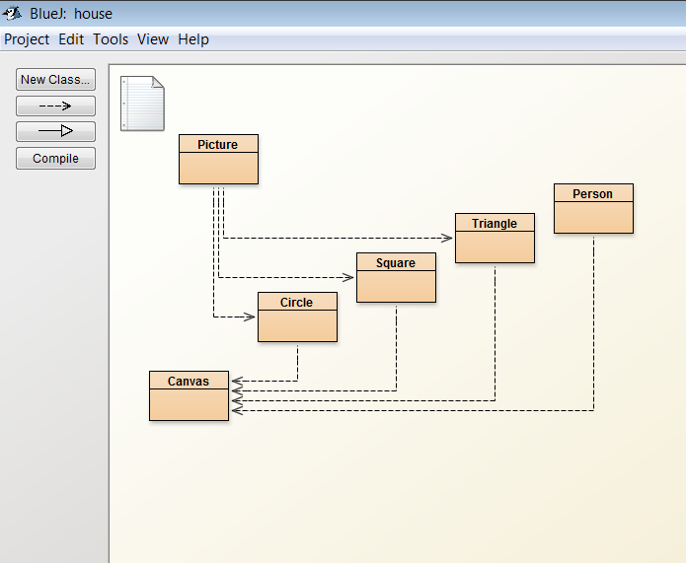
Let's revisit the Picture class
Objects First with Java - A Practical Introduction using BlueJ, © David J. Barnes, Michael Kölling
Notes:
Objects First with Java
© David J. Barnes and Michael Kölling

Slide 6
Abstraction and modularization
Picture is modular – composed of wall, window, roof and sun.
public class Picture
{
private Square wall;
private Square window;
private Triangle roof;
private Circle sun;
Objects First with Java - A Practical Introduction using BlueJ, © David J. Barnes, Michael Kölling
Notes:
Objects First with Java
© David J. Barnes and Michael Kölling

Slide 7
Abstraction and modularization
Picture uses abstraction – we work with the components without worrying about their details.
public void draw()
{
wall = new Square();
wall.moveHorizontal(-140);
wall.moveVertical(20);
Objects First with Java - A Practical Introduction using BlueJ, © David J. Barnes, Michael Kölling
Notes:
Objects First with Java
© David J. Barnes and Michael Kölling

Slide 8
Classes as data types
Anything that is not a primitive data type in Java is an object type. We have worked with String objects.
Now we will work with other objects.
private Square wall;
private Square window;
private Triangle roof;
private Circle sun;
Objects First with Java - A Practical Introduction using BlueJ, © David J. Barnes, Michael Kölling
Notes:
Objects First with Java
© David J. Barnes and Michael Kölling

Slide 9
BlueJ code pad
We can create objects on the BlueJ object bench by right-clicking and selecting 'new' e.g. 'new Circle()'
We then right-click on the object and invoke (call) its methods.
We can also use the code pad to create objects and invoke their methods.
Objects First with Java - A Practical Introduction using BlueJ, © David J. Barnes, Michael Kölling
Notes:
Objects First with Java
© David J. Barnes and Michael Kölling

Slide 10
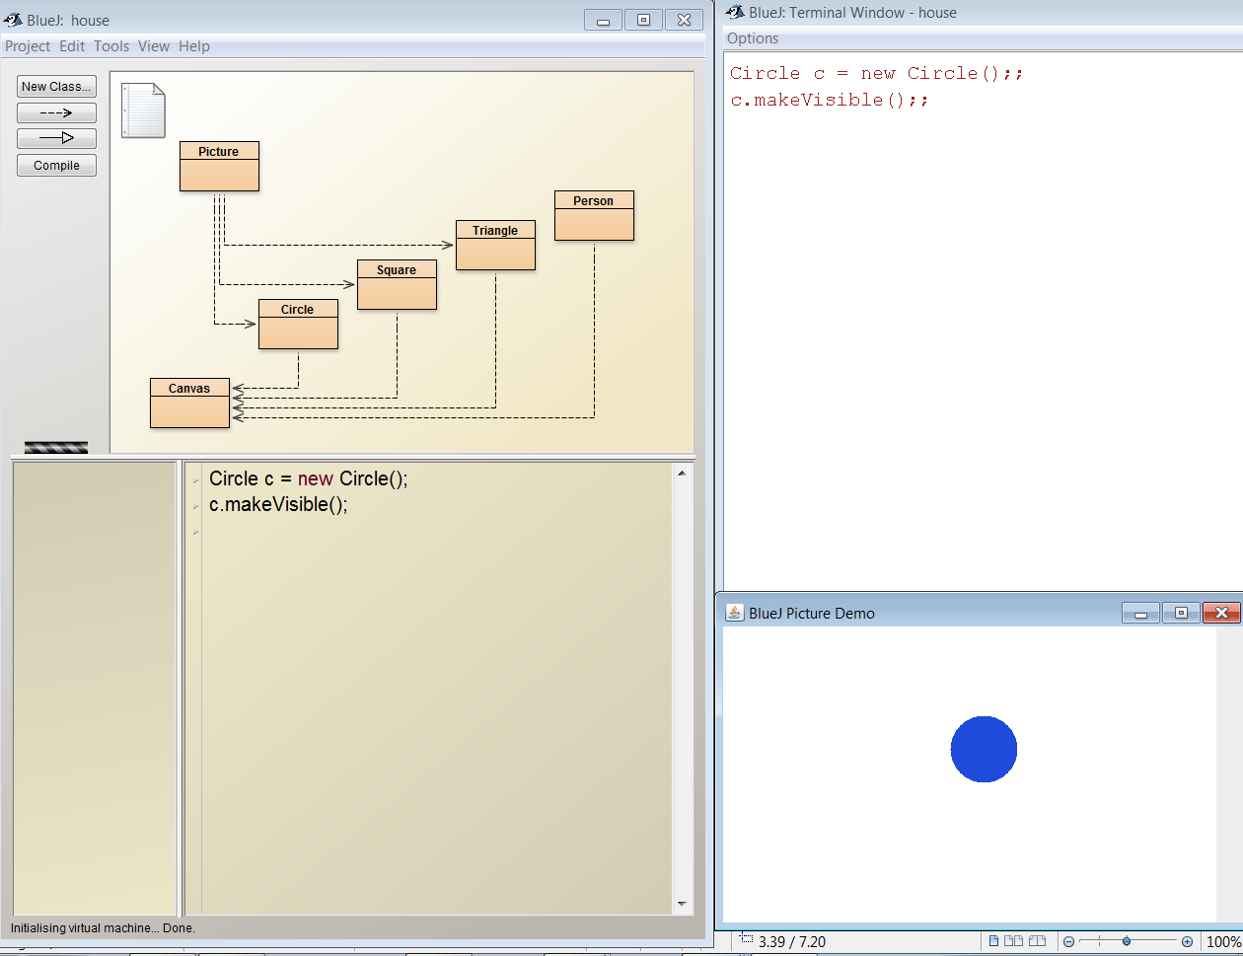
Objects First with Java - A Practical Introduction using BlueJ, © David J. Barnes, Michael Kölling
Notes:
Objects First with Java
© David J. Barnes and Michael Kölling

Slide 11
Creating objects
An object is created by using the Java key word 'new' and calling the object's constructor.
new Circle() creates an object from the Circle class.
When this object is on the object bench it has a name, e.g. circle1
Objects First with Java - A Practical Introduction using BlueJ, © David J. Barnes, Michael Kölling
Notes:
Objects First with Java
© David J. Barnes and Michael Kölling

Slide 12
Creating objects
When creating an object with the code pad we first declare a variable and assign the new object to that variable, e.g.
Circle c = new Circle();
The data type is Circle.
The variable name is c.
Objects First with Java - A Practical Introduction using BlueJ, © David J. Barnes, Michael Kölling
Notes:
Objects First with Java
© David J. Barnes and Michael Kölling

Slide 13
Calling methods
We have created an object:
Circle c = new Circle();
Now we can call methods of the Circle class, e.g.
c.makeVisible();
c.changeColor(“red”);
c.moveDown();
Objects First with Java - A Practical Introduction using BlueJ, © David J. Barnes, Michael Kölling
Notes:
Objects First with Java
© David J. Barnes and Michael Kölling

Slide 14
Calling methods
When we created the object we put its location into the variable c.
To call a method we first specify the variable, e.g.
c.slowMoveVertical();
c.moveHorizontal(40);
c.changeSize(500);
Objects First with Java - A Practical Introduction using BlueJ, © David J. Barnes, Michael Kölling
Notes:
Objects First with Java
© David J. Barnes and Michael Kölling

Slide 15
Code pad
The BlueJ code pad can be used to evaluate expressions. An expression is something that can be evaluated and a result returned, e.g.
String s1 = “hello”;
s1.length()// no semicolon!
5 (int) // the result
Objects First with Java - A Practical Introduction using BlueJ, © David J. Barnes, Michael Kölling
Notes:
Objects First with Java
© David J. Barnes and Michael Kölling

Slide 16
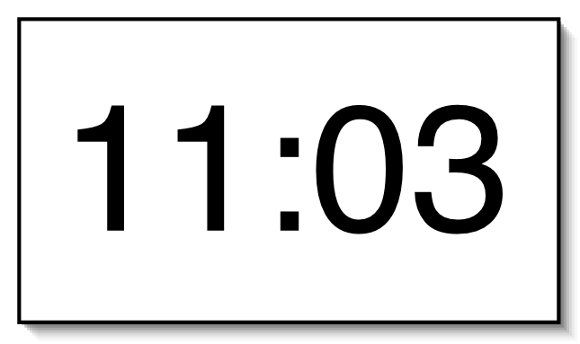
A digital clock
Objects First with Java - A Practical Introduction using BlueJ, © David J. Barnes, Michael Kölling
Notes:
Objects First with Java
© David J. Barnes and Michael Kölling

Slide 17



Modularizing the clock display
One four-digit display?
Or two two-digit displays?
Objects First with Java - A Practical Introduction using BlueJ, © David J. Barnes, Michael Kölling
Notes:
Objects First with Java
© David J. Barnes and Michael Kölling

Slide 18
Implementation - NumberDisplay
public class NumberDisplay
{
private int limit;
private int value;
Constructor and
methods omitted.
}
Objects First with Java - A Practical Introduction using BlueJ, © David J. Barnes, Michael Kölling
Notes:
Objects First with Java
© David J. Barnes and Michael Kölling

Slide 19
Implementation - ClockDisplay
public class ClockDisplay
{
private NumberDisplay hours;
private NumberDisplay minutes;
Constructor and
methods omitted.
}
Objects First with Java - A Practical Introduction using BlueJ, © David J. Barnes, Michael Kölling
Notes:
Objects First with Java
© David J. Barnes and Michael Kölling

Slide 20
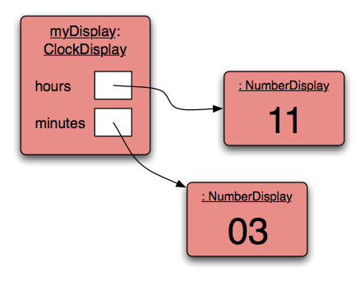
Object diagram
Objects First with Java - A Practical Introduction using BlueJ, © David J. Barnes, Michael Kölling
Notes:
Objects First with Java
© David J. Barnes and Michael Kölling

Slide 21
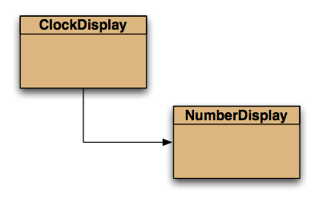
Class diagram
Objects First with Java - A Practical Introduction using BlueJ, © David J. Barnes, Michael Kölling
Notes:
Objects First with Java
© David J. Barnes and Michael Kölling

Slide 22
Source code: NumberDisplay
    public NumberDisplay(int rollOverLimit)
    {
    limit = rollOverLimit;
    value = 0;
    }
    public void increment()
    {
    value = (value + 1) % limit;
    }
Objects First with Java - A Practical Introduction using BlueJ, © David J. Barnes, Michael Kölling
Notes:
Objects First with Java
© David J. Barnes and Michael Kölling

Slide 23
The modulo operator
The 'division' operator (/), when applied to int operands, returns the result of an integer division.
The 'modulo' operator (%) returns the remainder of an integer division.
E.g., generally:
17 / 5 gives result 3, remainder 2
In Java:
17 / 5 == 3
17 % 5 == 2
Objects First with Java - A Practical Introduction using BlueJ, © David J. Barnes, Michael Kölling

Slide 24
Source code: NumberDisplay
    public String getDisplayValue()
    {
    if(value < 10) {
    return "0" + value;
    }
    else {
    return "" + value;
    }
    }
Objects First with Java - A Practical Introduction using BlueJ, © David J. Barnes, Michael Kölling
Notes:
Objects First with Java
© David J. Barnes and Michael Kölling

