Slide 1
COMP 1409
Introduction to Software Development 1
session 8
Notes:
Objects First with Java
© David J. Barnes and Michael Kölling

Slide 2
Grouping objects
Introduction to collections
5.0
Notes:
Objects First with Java
© David J. Barnes and Michael Kölling
Objects First with Java
© David J. Barnes and Michael Kölling

Slide 3
Main concepts to be covered
Collections
(especially ArrayList)
Builds on the abstraction theme from the last chapter.
Objects First with Java - A Practical Introduction using BlueJ, © David J. Barnes, Michael Kölling
Notes:
Objects First with Java
© David J. Barnes and Michael Kölling
Objects First with Java
© David J. Barnes and Michael Kölling

Slide 4
The requirement to group objects
Many applications involve collections of objects:
  Personal organizers.
  Library catalogs.
  Student-record system.
The number of items to be stored varies.
  Items added.
  Items deleted.
Objects First with Java - A Practical Introduction using BlueJ, © David J. Barnes, Michael Kölling
Notes:
Objects First with Java
© David J. Barnes and Michael Kölling
Objects First with Java
© David J. Barnes and Michael Kölling

Slide 5
An organizer for music files
Track files may be added.
There is no pre-defined limit to the number of files.
It will tell how many file names are stored in the collection.
It will list individual file names.
Explore the music-organizer-v1 project.
Objects First with Java - A Practical Introduction using BlueJ, © David J. Barnes, Michael Kölling
Notes:
Objects First with Java
© David J. Barnes and Michael Kölling
Objects First with Java
© David J. Barnes and Michael Kölling

Slide 6
Class libraries
Collections of useful classes.
We don’t have to write everything from scratch.
Java calls its libraries, packages.
Grouping objects is a recurring requirement.
  The java.util package contains classes for doing this.
Objects First with Java - A Practical Introduction using BlueJ, © David J. Barnes, Michael Kölling
Notes:
Objects First with Java
© David J. Barnes and Michael Kölling
Objects First with Java
© David J. Barnes and Michael Kölling

Slide 7
import java.util.ArrayList;
/**
* ...
*/
public class MusicOrganizer
{
// Storage for an arbitrary number of file names.
private ArrayList<String> files;
/**
* Perform any initialization required for the
* organizer.
*/
public MusicOrganizer()
{
files = new ArrayList<String>();
}
...
}
Objects First with Java - A Practical Introduction using BlueJ, © David J. Barnes, Michael Kölling
Notes:
Objects First with Java
© David J. Barnes and Michael Kölling
Objects First with Java
© David J. Barnes and Michael Kölling

Slide 8
Collections
We specify:
  the type of collection: ArrayList
  the type of objects it will contain: <String>
  private ArrayList<String> files;
We say, “ArrayList of String”.
Objects First with Java - A Practical Introduction using BlueJ, © David J. Barnes, Michael Kölling
Notes:
Objects First with Java
© David J. Barnes and Michael Kölling
Objects First with Java
© David J. Barnes and Michael Kölling

Slide 9
Generic classes
Collections are known as parameterized or generic types.
ArrayList implements list functionality:
  add, get, size, etc.
The type parameter says what we want a list of:
  ArrayList<Person>
  ArrayList<TicketMachine>
  etc.
Objects First with Java - A Practical Introduction using BlueJ, © David J. Barnes, Michael Kölling
Notes:
Objects First with Java
© David J. Barnes and Michael Kölling
Objects First with Java
© David J. Barnes and Michael Kölling

Slide 10
Creating an ArrayList object
In versions of Java prior to version 7:
  files = new ArrayList<String>();
Java 7 introduced ‘diamond notation’
  files = new ArrayList<>();
The type parameter can be inferred from the variable being assigned to.
  A convenience.
Notes:
Objects First with Java
© David J. Barnes and Michael Kölling

Slide 11
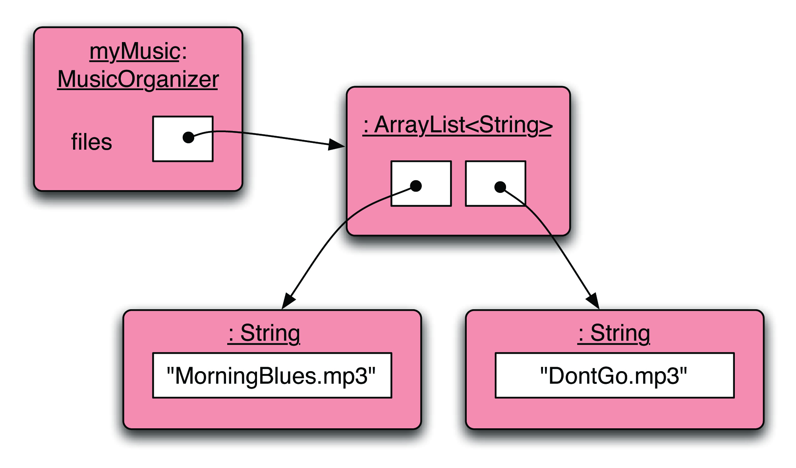
Object structures with collections
Objects First with Java - A Practical Introduction using BlueJ, © David J. Barnes, Michael Kölling
Notes:
Objects First with Java
© David J. Barnes and Michael Kölling
Objects First with Java
© David J. Barnes and Michael Kölling

Slide 12
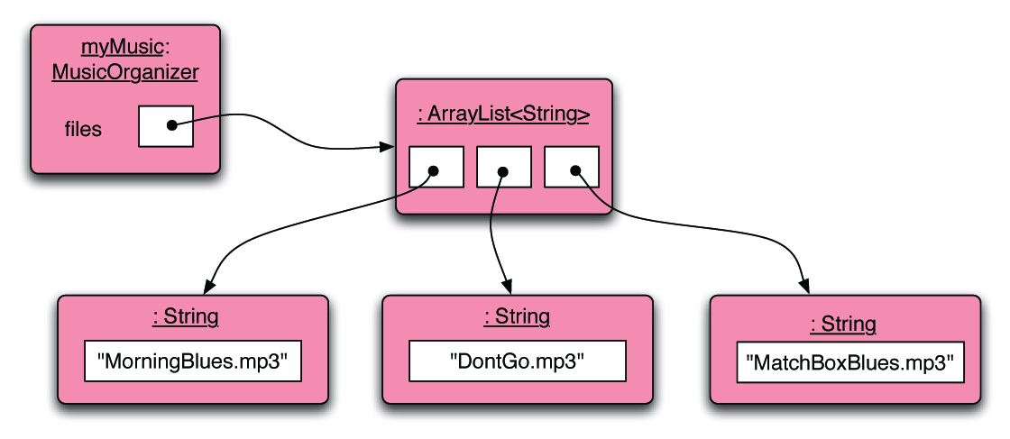
Adding a third file
Objects First with Java - A Practical Introduction using BlueJ, © David J. Barnes, Michael Kölling
Notes:
Objects First with Java
© David J. Barnes and Michael Kölling
Objects First with Java
© David J. Barnes and Michael Kölling

Slide 13
Features of the collection
It increases its capacity as necessary.
It keeps a private count:
  size() accessor.
It keeps the objects in order.
Details of how all this is done are hidden.
  Does that matter? Does not knowing how prevent us from using it?
Objects First with Java - A Practical Introduction using BlueJ, © David J. Barnes, Michael Kölling
Notes:
Objects First with Java
© David J. Barnes and Michael Kölling
Objects First with Java
© David J. Barnes and Michael Kölling

Slide 14
Using the collection
public class MusicOrganizer
{
private ArrayList<String> files;
...
public void addFile(String filename)
{
files.add(filename);
}
public int getNumberOfFiles()
{
return files.size();
}
...
}
Adding a new file
Returning the number of files
(delegation)
Objects First with Java - A Practical Introduction using BlueJ, © David J. Barnes, Michael Kölling
Notes:
Objects First with Java
© David J. Barnes and Michael Kölling
Objects First with Java
© David J. Barnes and Michael Kölling

Slide 15
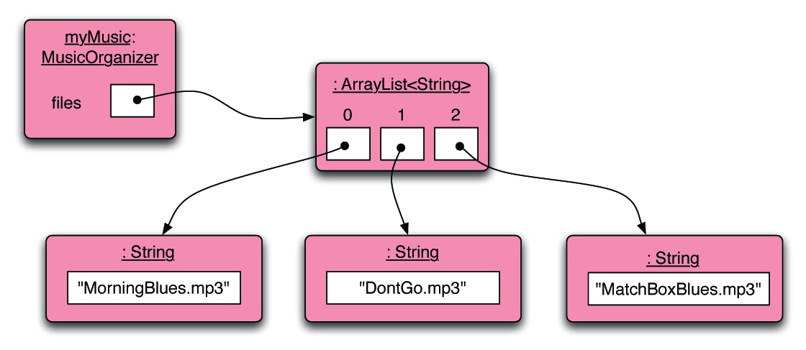
Index numbering
Objects First with Java - A Practical Introduction using BlueJ, © David J. Barnes, Michael Kölling
Notes:
Objects First with Java
© David J. Barnes and Michael Kölling
Objects First with Java
© David J. Barnes and Michael Kölling

Slide 16
Retrieving an object
public void listFile(int index)
{
if(index >= 0 &&
index < files.size()) {
String filename = files.get(index);
System.out.println(filename);
}
else {
// This is not a valid index.
}
}
Index validity checks
Retrieve and print the file name
Needed? (Error message?)
Objects First with Java - A Practical Introduction using BlueJ, © David J. Barnes, Michael Kölling
Notes:
Objects First with Java
© David J. Barnes and Michael Kölling
Objects First with Java
© David J. Barnes and Michael Kölling

Slide 17
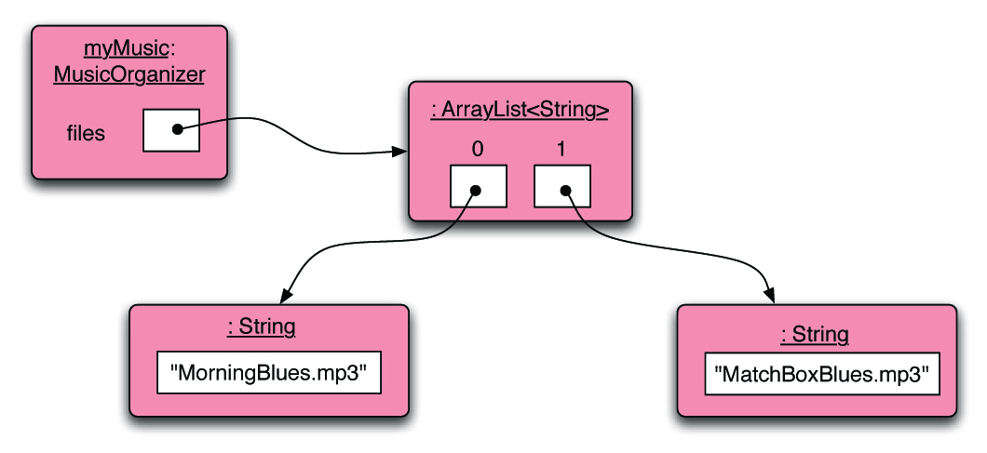
Removal may affect numbering
Objects First with Java - A Practical Introduction using BlueJ, © David J. Barnes, Michael Kölling
Notes:
Objects First with Java
© David J. Barnes and Michael Kölling
Objects First with Java
© David J. Barnes and Michael Kölling

Slide 18
The general utility of indices
Using integers to index collections has a general utility:
  ‘next’ is: index + 1
  ‘previous’ is: index – 1
  ‘last’ is: list.size() – 1
  ‘the first three’ is: the items at indices 0, 1, 2
We could also think about accessing items in sequence: 0, 1, 2, …
Notes:
Objects First with Java
© David J. Barnes and Michael Kölling

Slide 19
Review
Collections allow an arbitrary number of objects to be stored.
Class libraries usually contain tried-and-tested collection classes.
Java’s class libraries are called packages.
We have used the ArrayList class from the java.util package.
Objects First with Java - A Practical Introduction using BlueJ, © David J. Barnes, Michael Kölling
Notes:
Objects First with Java
© David J. Barnes and Michael Kölling
Objects First with Java
© David J. Barnes and Michael Kölling

Slide 20
Review
Items may be added and removed.
Each item has an index.
Index values may change if items are removed (or further items added).
The main ArrayList methods are add, get, remove and size.
ArrayList is a parameterized or generic type.
Objects First with Java - A Practical Introduction using BlueJ, © David J. Barnes, Michael Kölling
Notes:
Objects First with Java
© David J. Barnes and Michael Kölling
Objects First with Java
© David J. Barnes and Michael Kölling

Slide 21
Interlude:
Some popular errors...
Objects First with Java - A Practical Introduction using BlueJ, © David J. Barnes, Michael Kölling
Notes:
Objects First with Java
© David J. Barnes and Michael Kölling
Objects First with Java
© David J. Barnes and Michael Kölling

Slide 22
What’s wrong here?
/**
* Print out info (number of entries).
*/
public void showStatus()
{
if(files.size() == 0); {
System.out.println("Organizer is empty");
}
else {
System.out.print("Organizer holds ");
System.out.println(files.size() + " files");
}
}
Objects First with Java - A Practical Introduction using BlueJ, © David J. Barnes, Michael Kölling
Notes:
Objects First with Java
© David J. Barnes and Michael Kölling
Objects First with Java
© David J. Barnes and Michael Kölling

Slide 23
This is the same as before!
/**
* Print out info (number of entries).
*/
public void showStatus()
{
if(files.size() == 0);
{
System.out.println("Organizer is empty");
}
else {
System.out.print("Organizer holds ");
System.out.println(files.size() + "files");
}
}
Objects First with Java - A Practical Introduction using BlueJ, © David J. Barnes, Michael Kölling
Notes:
Objects First with Java
© David J. Barnes and Michael Kölling
Objects First with Java
© David J. Barnes and Michael Kölling

Slide 24
This is the same again
/**
* Print out info (number of entries).
*/
public void showStatus()
{
if(files.size() == 0)
;
{
System.out.println("Organizer is empty");
}
else {
System.out.print("Organizer holds ");
System.out.println(files.size() + "files");
}
}
Objects First with Java - A Practical Introduction using BlueJ, © David J. Barnes, Michael Kölling
Notes:
Objects First with Java
© David J. Barnes and Michael Kölling
Objects First with Java
© David J. Barnes and Michael Kölling

Slide 25
and the same again…
/**
* Print out info (number of entries).
*/
public void showStatus()
{
if(files.size() == 0) {
;
}
{
System.out.println("Organizer is empty");
}
else {
System.out.print("Organizer holds ");
System.out.println(files.size() + "files");
}
}
Objects First with Java - A Practical Introduction using BlueJ, © David J. Barnes, Michael Kölling
Notes:
Objects First with Java
© David J. Barnes and Michael Kölling
Objects First with Java
© David J. Barnes and Michael Kölling

Slide 26
This time I have a boolean field called ‘isEmpty’...
What’s wrong here?
/**
* Print out info (number of entries).
*/
public void showStatus()
{
if(isEmpty = true) {
System.out.println("Organizer is empty");
}
else {
System.out.print("Organizer holds ");
System.out.println(files.size() + "files");
}
}
Objects First with Java - A Practical Introduction using BlueJ, © David J. Barnes, Michael Kölling
Notes:
Objects First with Java
© David J. Barnes and Michael Kölling
Objects First with Java
© David J. Barnes and Michael Kölling

Slide 27
This time I have a boolean field called ‘isEmpty’...
The correct version
/**
* Print out info (number of entries).
*/
public void showStatus()
{
if(isEmpty == true) {
System.out.println("Organizer is empty");
}
else {
System.out.print("Organizer holds ");
System.out.println(files.size() + "files");
}
}
Objects First with Java - A Practical Introduction using BlueJ, © David J. Barnes, Michael Kölling
Notes:
Objects First with Java
© David J. Barnes and Michael Kölling
Objects First with Java
© David J. Barnes and Michael Kölling

Slide 28
What’s wrong here?
/**
* Store a new file in the organizer. If the
* organizer is full, save it and start a new one.
*/
public void addFile(String filename)
{
if(files.size() == 100)
files.save();
// starting new list
files = new ArrayList<String>();
files.add(filename);
}
Objects First with Java - A Practical Introduction using BlueJ, © David J. Barnes, Michael Kölling
Notes:
Objects First with Java
© David J. Barnes and Michael Kölling
Objects First with Java
© David J. Barnes and Michael Kölling

Slide 29
This is the same.
/**
* Store a new file in the organizer. If the
* organizer is full, save it and start a new one.
*/
public void addFile(String filename)
{
if(files.size == 100)
files.save();
// starting new list
files = new ArrayList<String>();
files.add(filename);
}
Objects First with Java - A Practical Introduction using BlueJ, © David J. Barnes, Michael Kölling
Notes:
Objects First with Java
© David J. Barnes and Michael Kölling
Objects First with Java
© David J. Barnes and Michael Kölling

Slide 30
The correct version
/**
* Store a new file in the organizer. If the
* organizer is full, save it and start a new one.
*/
public void addFile(String filename)
{
if(files.size == 100) {
files.save();
// starting new list
files = new ArrayList<String>();
}
files.add(filename);
}
Objects First with Java - A Practical Introduction using BlueJ, © David J. Barnes, Michael Kölling
Notes:
Objects First with Java
© David J. Barnes and Michael Kölling
Objects First with Java
© David J. Barnes and Michael Kölling

Slide 31
Grouping objects
Collections and the for-each loop
Notes:
Objects First with Java
© David J. Barnes and Michael Kölling
Objects First with Java
© David J. Barnes and Michael Kölling

Slide 32
Main concepts to be covered
Collections
Loops: the for-each loop
Objects First with Java - A Practical Introduction using BlueJ, © David J. Barnes, Michael Kölling
Notes:
Objects First with Java
© David J. Barnes and Michael Kölling
Objects First with Java
© David J. Barnes and Michael Kölling

Slide 33
Iteration
We often want to perform some actions an arbitrary number of times.
  E.g., print all the file names in the organizer. How many are there?
Most programming languages include loop statements to make this possible.
Java has several sorts of loop statement.
  We will start with its for-each loop.
Objects First with Java - A Practical Introduction using BlueJ, © David J. Barnes, Michael Kölling
Notes:
Objects First with Java
© David J. Barnes and Michael Kölling
Objects First with Java
© David J. Barnes and Michael Kölling

Slide 34
Iteration fundamentals
We often want to repeat some actions over and over.
Loops provide us with a way to control how many times we repeat those actions.
With collections, we often want to repeat things once for every object in a particular collection.
Objects First with Java - A Practical Introduction using BlueJ, © David J. Barnes, Michael Kölling
Notes:
Objects First with Java
© David J. Barnes and Michael Kölling
Objects First with Java
© David J. Barnes and Michael Kölling

Slide 35
For-each loop pseudo code
General form of the for-each loop
for keyword
loop header
for(ElementType element : collection) {
loop body
}
Statement(s) to be repeated
Pseudo-code expression of the actions of a for-each loop
For each element in collection, do the things in the loop body.
Objects First with Java - A Practical Introduction using BlueJ, © David J. Barnes, Michael Kölling
Notes:
Objects First with Java
© David J. Barnes and Michael Kölling
Objects First with Java
© David J. Barnes and Michael Kölling

Slide 36
A Java example
/**
* List all file names in the organizer.
*/
public void listAllFiles()
{
for(String filename : files) {
System.out.println(filename);
}
}
for each filename in files, print out filename
Objects First with Java - A Practical Introduction using BlueJ, © David J. Barnes, Michael Kölling
Notes:
Objects First with Java
© David J. Barnes and Michael Kölling
Objects First with Java
© David J. Barnes and Michael Kölling

Slide 37
Review
Loop statements allow a block of statements to be repeated.
The for-each loop allows iteration over a whole collection.
Objects First with Java - A Practical Introduction using BlueJ, © David J. Barnes, Michael Kölling
Notes:
Objects First with Java
© David J. Barnes and Michael Kölling
Objects First with Java
© David J. Barnes and Michael Kölling

Slide 38
Selective processing
Statements can be nested, giving greater selectivity:
public void findFiles(String searchString)
{
for(String filename : files) {
if(filename.contains(searchString)) {
System.out.println(filename);
}
}
}
Notes:
Objects First with Java
© David J. Barnes and Michael Kölling

Slide 39
Critique of for-each
Easy to write.
Termination happens naturally.
The collection cannot be changed.
There is no index provided.
  Not all collections are index-based.
We can’t stop part way through;
  e.g. find-the-first-that-matches.
It provides ‘definite iteration’ – aka ‘bounded iteration’.
Notes:
Objects First with Java
© David J. Barnes and Michael Kölling

