Slide 1
COMP 1409
Introduction to Software Development 1
session 11

Slide 2
Grouping objects
Arrays

Slide 3
Fixed-size collections
Sometimes the maximum collection size can be pre-determined.
Programming languages usually offer a special fixed-size collection type: an array.
Java arrays can store objects or primitive-type values.
Arrays use a special syntax.

Slide 4
The weblog-analyzer project
Web server records details of each access.
Supports webmaster’s tasks.
  Most popular pages.
  Busiest periods.
  How much data is being delivered.
  Broken references.
Analyze accesses by hour.

Slide 5
Creating an array object
public class LogAnalyzer
{
private int[] hourCounts;
private LogfileReader reader;
public LogAnalyzer()‏
{
hourCounts = new int[24];
reader = new LogfileReader();
}
...
}
Array variable declaration
Array object creation

Slide 6
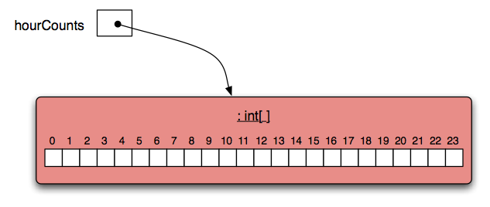
The hourCounts array

Slide 7
Using an array
Square-bracket notation is used to access an array element: hourCounts[...]
Elements are used like ordinary variables.
  On the left of an assignment:
    hourCounts[hour] = ...;
  In an expression:
    adjusted = hourCounts[hour] – 3;
    hourCounts[hour]++;

Slide 8
Standard array use
private int[] hourCounts;
private String[] names;
...
hourCounts = new int[24];
...
hourcounts[i] = 0;
hourcounts[i]++;
System.out.println(hourcounts[i]);
declaration
creation
use

Slide 9
Array literals
declaration and initialisation
private int[] numbers = { 3, 15, 4, 5 };
System.out.println(numbers[i]);
Array literals can only be used in initialisations.

Slide 10
Array length
private int[] numbers = { 3, 15, 4, 5 };
int n = numbers.length;
no brackets!
Note: ‘length’ is not a method!!

Slide 11
The for loop
There are two variations of the for loop, for-each and for.
The for loop is often used to iterate a fixed number of times.
Often used with a variable that changes a fixed amount on each iteration.

Slide 12
For loop pseudo-code
General form of a for loop
for(initialization; condition; post-body action) {
statements to be repeated
}
Equivalent in while-loop form
initialization;
while(condition) {
statements to be repeated
post-body action
}

Slide 13
A Java example
for loop version
for(int hour = 0; hour < hourCounts.length; hour++) {
System.out.println(hour + ": " + hourCounts[hour]);
}
while loop version
int hour = 0;
while(hour < hourCounts.length) {
System.out.println(hour + ": " + hourCounts[hour]);
hour++;
}

Slide 14
Practice
Given an array of numbers, print out all the numbers in the array, using a for loop.
int[] numbers = { 4, 1, 22, 9, 14, 3, 9};
for ...

Slide 15
for loop with bigger step
// Print multiples of 3 that are below 40.
for(int num = 3; num < 40; num = num + 3) {
System.out.println(num);
}

Slide 16
Arrays of objects
Arrays in Java can hold object types.
/*array to hold Dog objects */
Dog[] dogs = new Dog[25];
/* a Dog object */
Dog myDog = new Dog(“Fido”);
/* put object into array */
dogs[0] = myDog;

Slide 17
Arrays of objects
Java initializes object arrays to null, i.e. no object.
Must check for null when accessing the array elements.
Potential for NullPointerException if we try to follow a reference to an object that does not exist.

Slide 18
Arrays of objects
/** show ages of all dogs in the array */
public void showAges()‏
{
for(int i=0; i< dogs.length; i++){
if (dogs[i] != null){
System.out.print(dogs[i].getAge());
}
}
}

Slide 19
Multi-dimensional arrays
An array object can be multi-dimensional, i.e. we can picture it as rows and columns (2-D), or as a cube (3-D).
Arrays of more than three dimensions are more difficult to visualize.
Each dimension requires a separate index variable.

Slide 20
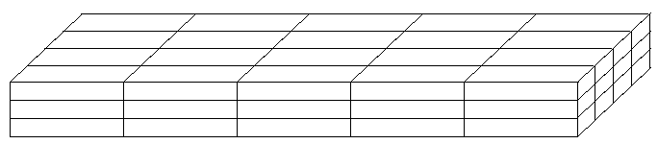
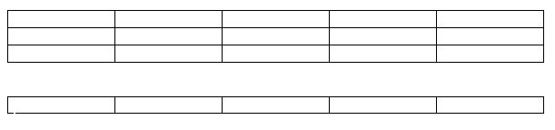
Arrays
Can have multiple dimensions.

Slide 21
// define a two-dimensional array of integers
int rows = 4;
int columns = 6;
int[][] numberGrid = new int[rows][columns];
0
1
2
3
4
5
0
4
8
numberGrid[0][0] = 4;
numberGrid[0][5] = 8;
numberGrid[1][3] = 7;
numberGrid[2][2] = 9;
numberGrid[3][5] = 6;
1
7
2
9
3
6

Slide 22
// create a two-dimensional array of vowel characters
char[][] vowelGrid = new char[5][2];
0
1
0
‘A’
‘a’
vowelGrid[0][0] = ‘A’; vowelGrid[0][1] = ‘a’;
vowelGrid[1][0] = ‘E’; vowelGrid[1][1] = ‘e’;
vowelGrid[2][0] = ‘I’; vowelGrid[2][1] = ‘i’;
vowelGrid[3][0] = ‘O’; vowelGrid[3][1] = ‘o’;
vowelGrid[4][0] = ‘U’; vowelGrid[4][1] = ‘u’;
1
‘E’
‘e’
2
‘I’
‘i’
3
‘O’
‘o’
4
‘U’
‘u’
Alternately...
char[][] vowelGrid = { {‘A’,‘a’}, {‘E’,‘e’}, {‘I’,‘i’},
{‘O’,‘o’}, {‘U’,‘u’} };

Slide 23
// create a two-dimensional array of vowel characters
char[][] vowelGrid = new char[2][5]
0
1
2
3
4
0
‘A’
‘E’
‘I’
‘O’
‘U’
1
‘a’
‘e’
‘i’
‘o’
‘u’
Alternately...
char[][] vowelGrid = { {‘A’,‘E’,‘I’,‘O’,‘U’},
{‘a’,‘e’,‘i’,‘o’,‘u’} },

Slide 24
Iterating over 2-D array
Iterating over a two-dimensional array requires a nested loop.
// print the array contents as a grid
for(int row=0; row < vowelGrid.length; row++){
for (int column=0; column < vowelGrid[row].length; column++)‏
{
System.out.print(vowelGrid[row][column] + “ ”);
}
System.out.println();
}

Slide 25
2-D array of objects
Cat[][] cats = new Cat[3][3];
cats[0][0] = new Cat(“Garbo”);
cats[0][1] = new Cat(“Frost”);
cats[0][2] = new Cat(“Silk”);
...
cats[2][2] = new Cat(“Fang”);

Slide 26
2-D array of objects
Cat oneCat = null; // no object yet
for (int i=0; i< cats.length; i++) {
for (int j=0; j< cats[i].length; j++) {
oneCat = cats[i][j];
if (oneCat != null) {
System.out.println(oneCat.getName());
}
}
}

Slide 27
Review
Arrays are appropriate where a fixed-size collection is required.
Arrays use special syntax.
For loops offer an alternative to while loops when the number of repetitions is known.
For loops are used when an index variable is required.

