Slide 1
PART II: Practical
1. Test bfastSpatial function with different parameters on a prepared dataset
2. Post-processing and exploring results
3. Discuss results and the process of applying the algorithm
4. Discuss the future of BFAST: a faster algorithm for larger AOIs (SciDB)
Go to :
https://github.com/rosca002/FAO_Bfast_workshop

Slide 2
Input data:
NDMI time stack (2000-2016)
NDVI time stack (2000-2016)
Aditional data:
Forest mask 2010
Valodation Forest 2016
How to get from Landsat scenes to a time stack:
Online tutorial
http://www.loicdutrieux.net/bfastSpatial/
Preparing the environment:
https://rosca002.github.io/FAO_Bfast_workshop/tutorial/tutorial_0.html
Parameters to test:
Vegetation index
History period
Monitoring approach
Regression model

Slide 3
Testing scenarios
To open the tutorial for each example: https://github.com/rosca002/FAO_Bfast_workshop

Slide 4
Example 1
time to proccess on 36 CPU cores: 1.9 min
Overall accuracy: 90%
Vegetation index: NDMI
History period: 2000-2010
option: “all”
stack subset: no
Monitoring approach: 2010-2016
option: Full monitoring period approach
Regression model: harmonic order 1
Trend: no
Example 2
time to proccess on 36 CPU cores: 2.3 min
Overall accuracy: 88%
Vegetation index: NDMI
History period: 2000-2010
option: “ROC”
stack subset: no
Monitoring approach: 2010-2016
option: Full monitoring period approach
Regression model: harmonic order 1
Trend: no

Slide 5
Example 3
time to proccess on 36 CPU cores: 2.1 min
Overall accuracy: 90%
Vegetation index: NDMI
History period: 2005-2010
option: “c(2005,1)”
stack subset: no
Monitoring approach: 2010-2016
option: Full monitoring period approach
Regression model: harmonic order 1
Trend: no
Example 4
time to proccess on 36 CPU cores: 1.6 min
Overall accuracy: 89%
Vegetation index: NDMI
History period: 2005-2010
option: “all”
stack subset: yes (from 2005)
Monitoring approach: 2010-2016
option: Full monitoring period approach
Regression model: harmonic order 1
Trend: no

Slide 6
Example 5
time to proccess on 16 CPU cores: 27.7 min
Overall accuracy: 92%
Vegetation index: NDMI
History period: 2000-2010
option: “all”
stack subset: no
Monitoring approach: 2010-2016
option: Sequential monitoring period approach
Regression model: harmonic order 1
Trend: no
Example 7
time to proccess on 36 CPU cores: 11.0 min
Overall accuracy: 93%
Vegetation index: NDMI
History period: 2005-2010
option: “all”
stack subset: yes (from 2005)
Monitoring approach: 2010-2016
option: Sequential monitoring period approach
Regression model: harmonic order 1
Trend: no

Slide 7
Example 6
time to proccess on 36 CPU cores: 9.4 min
Overall accuracy: 91%
History period: 2008-2010
option: “all”
stack subset: yes (from 2008)
Monitoring approach: 2010-2016
option: Sequential monitoring period approach
Regression model: harmonic order 1
Trend: no
Example 10
time to proccess on 36 CPU cores: 1.4 min
Overall accuracy: 83%
Vegetation index: NDMI
History period: 2008-2010
option: “all”
stack subset: yes (from 2008)
Monitoring approach: 2010-2016
option: Full monitoring period approach
Regression model: harmonic order 1
Trend: no

Slide 8
Example 8
time to proccess on 36 CPU cores: 10,4 min
Overall accuracy: 71%
Vegetation index: NDVI
History period: 2005-2010
option: “all”
stack subset: yes (from 2005)
Monitoring approach: 2010-2016
option: Sequential monitoring period approach
Regression model: harmonic order 1
Trend: no
Example 9
time to proccess on 8 CPU cores: 7.7 min
Overall accuracy: 51%
Vegetation index: NDVI
History period: 2000-2010
option: “all”
stack subset: no
Monitoring approach: 2010-2016
option: Full monitoring period approach
Regression model: harmonic order 1
Trend: no

Slide 9
Validation

Slide 10
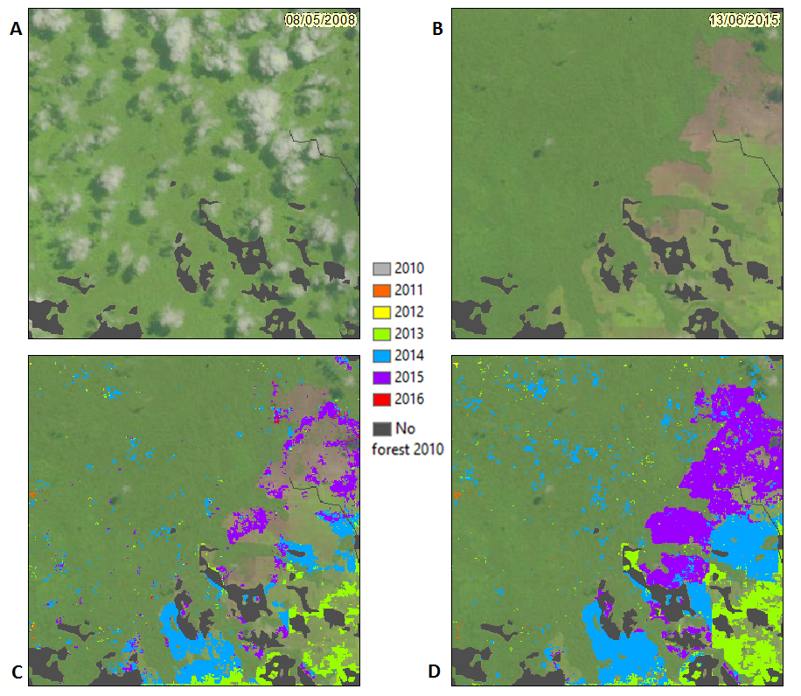
Extra discussion: Case of Gabon
*2 min if time allows

Slide 11
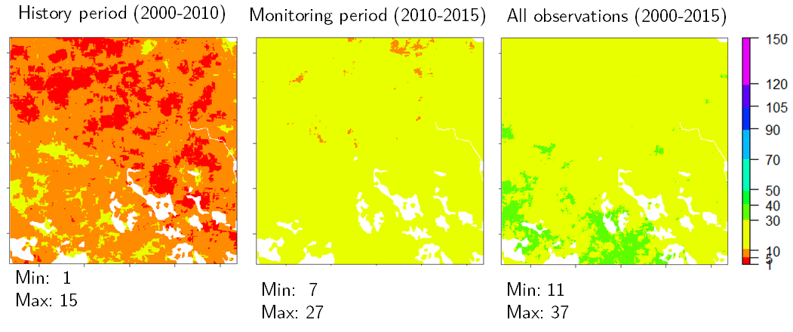
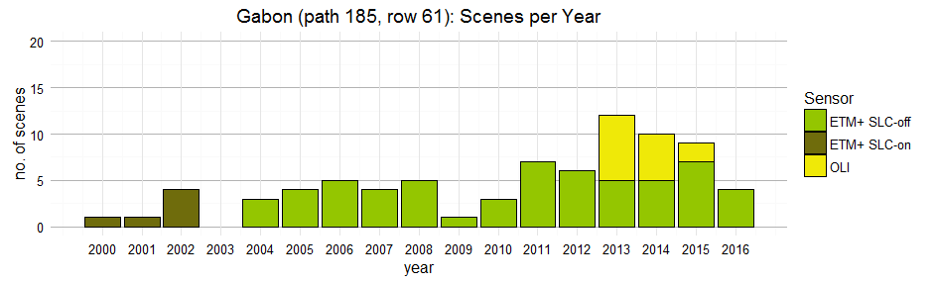

Slide 12
Step by step towards detecting deforestation in your next AOI
1. Understand how Bfast works
2. Read the Bfast guide on how to choose the parameters of the bfastSpatial function
3. Assess your AOI. What is the phenology of the forest? How frequent/ many cloud free scenes are in that area?
4. Based on this information choose the appropriate VI, length of history period, monitoring approach, and regression model.
5. Decide on the data that needs to be acquired and acquire the data.
6. Test the algorithm with the above decided settings on just some sample pixels or/and a small test area (e.g.10 x 10 km) in your AOI following the Introduction to bfastSpatial tutorial.
7. Depending on the results, if needed, change and test again settings.
8. Apply algorithm with final settings on entire AOI.

Slide 13
Discuss the future of BFAST: a faster algorithm for larger AOIs
(SciDB)
https://github.com/appelmar/scalbf-wur/

Slide 14
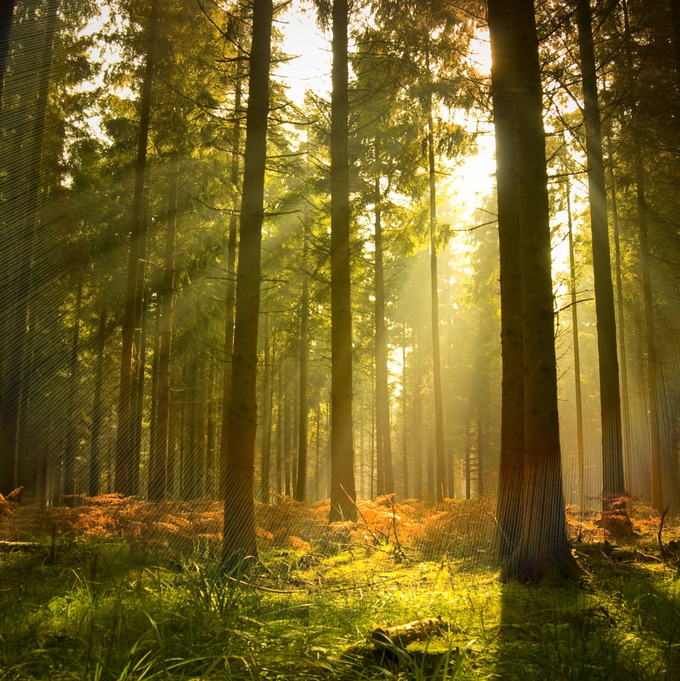
Thank you for your attention!

