Slide 1
PART II: Practical
1. Test bfastSpatial function with different parameters on a prepared dataset
2. Post-processing and exploring results
3. Discuss results and the process of applying the algorithm
4. Discuss the future of BFAST: a faster algorithm for larger AOIs (SciDB)
Go to :
https://github.com/rosca002/FAO_Bfast_workshop

Slide 2
Input data:
NDMI time stack (2000-2016)
NDVI time stack (2000-2016)
Aditional data:
Forest mask 2010
Valodation Forest 2016
How to get from Landsat scenes to a time stack:
Online tutorial
http://www.loicdutrieux.net/bfastSpatial/
Parameters to test:
Vegetation index
History period
Monitoring approach
Regression model

Slide 3
To open the tutorial for each example: https://github.com/rosca002/FAO_Bfast_workshop

Slide 4
Results:
Example 1
time to proccess on 6 CPU cores:
Accuracy assessment:

Slide 5
Step by step towards detecting deforestation in your next AOI
1. Understand how Bfast works
2. Read the Bfast guide on how to choose the parameters of the bfastSpatial function
3. Assess your AOI. What is the phenology of the forest? How frequent/ many cloud free scenes are in that area?
4. Based on this information choose the appropriate VI, length of history period, monitoring approach, and regression model.
5. Decide on the data that needs to be acquired and acquire the data.
6. Test the algorithm with the above decided settings on just some sample pixels or/and a small test area (e.g.10 x 10 km) in your AOI following the Introduction to bfastSpatial tutorial.
7. Depending on the results, if needed, change and test again settings.
8. Apply algorithm with final settings on entire AOI.

Slide 6
Discuss the future of BFAST: a faster algorithm for larger AOIs
(SciDB)
https://github.com/appelmar/scalbf-wur/

Slide 7
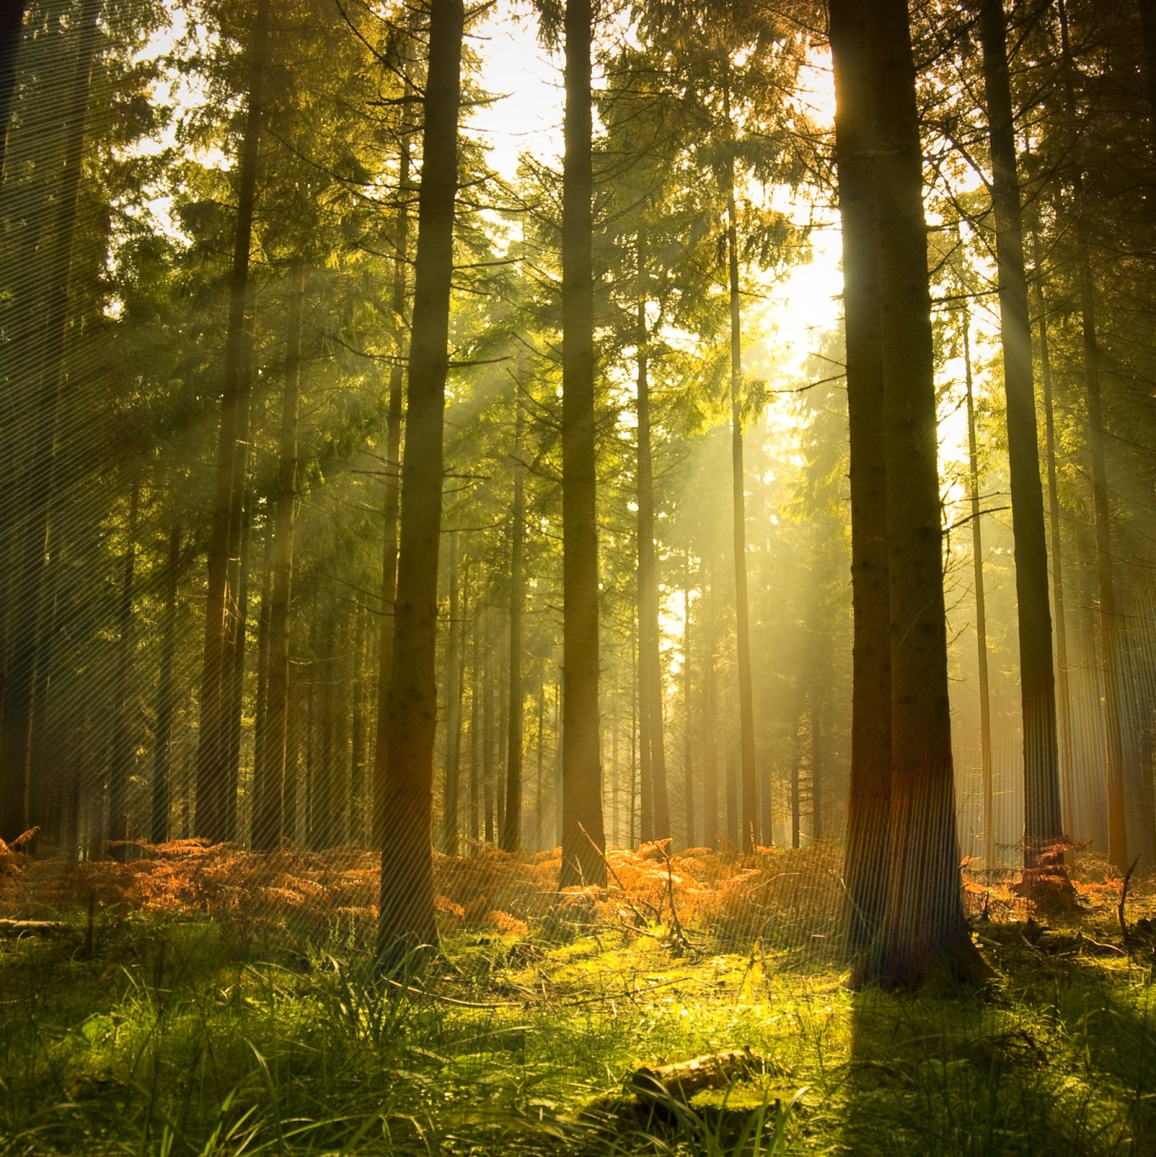
Thank you for your attention!

