Slide 1
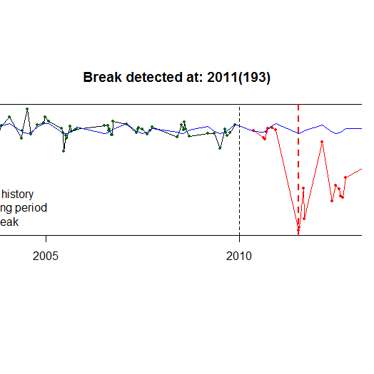
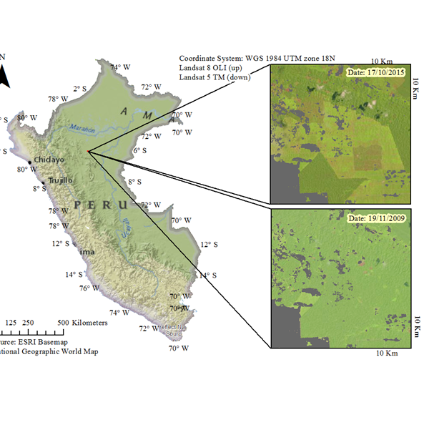
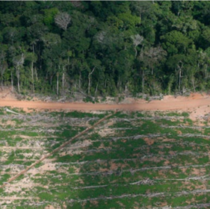
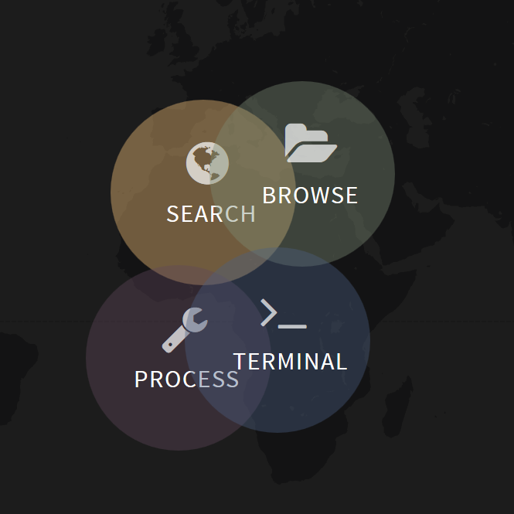
DETECTING DEFORESTATION FROM DENSE TIME-SERIES
BFAST
(Breaks For Additive Season and Trend)
Sabina Roșca
Jan Verbesselt
sabina.rosca@wur.nl

Slide 2
Introduction
Why are we interested in time series/time series analysis?
What is BFAST?
Why is Bfast with SEPAL of interest for FAO?

Slide 3
Workshop summary
Goal: Understand how BFAST works and how to properly apply it
PART I (1,5 hours)
1. Explaining the algorithm: What are BFAST Monitor and bfastSpatial? (15 min)
2. Analysis overview: from Landsat scenes to deforestation detection (15 min)
3. Discuss and understand the parameters of the bfastSpatial function (30 min)
4. Apply the bfastSpatial function on a prepared dataset (15 min)
Break (30 min)
PART II (1,5 hours)
5. Post-processing and exploring results (20 min)
6. Discuss results and the process of applying the algorithm (20 min)
7. Discuss the future of BFAST: a faster algorithm for larger AOI (SciDB) (15 min)

Slide 4

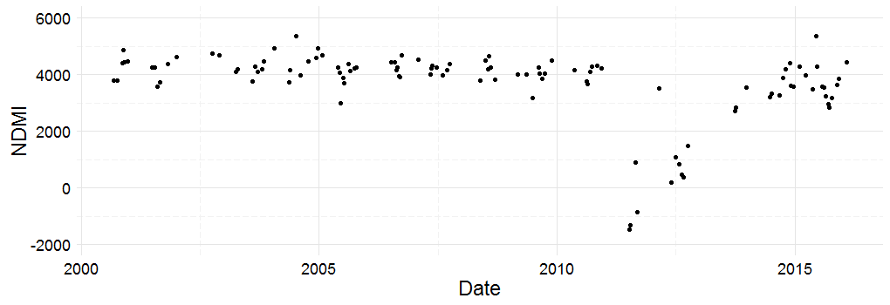
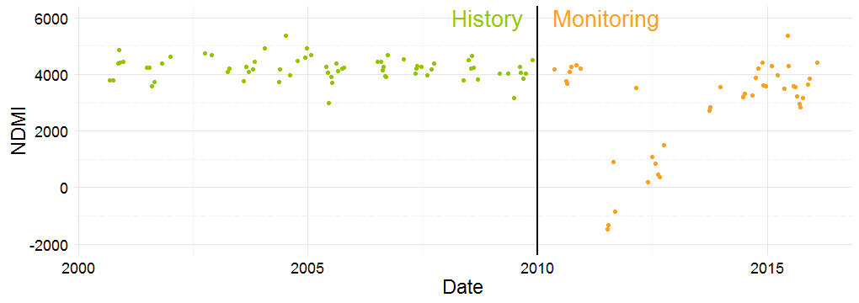
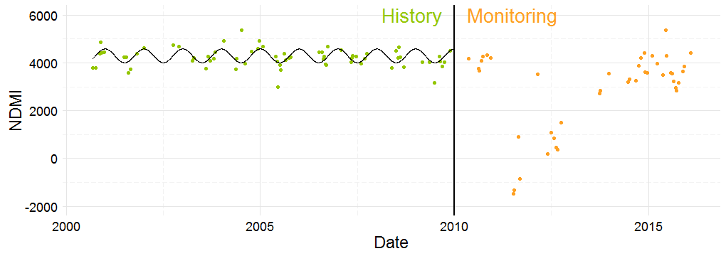
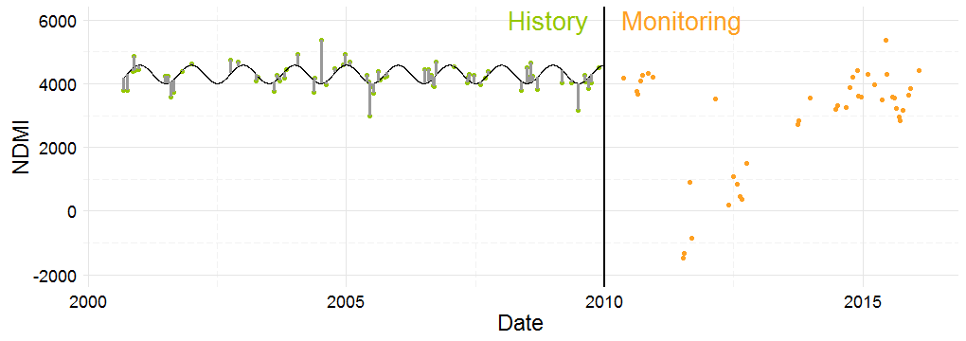
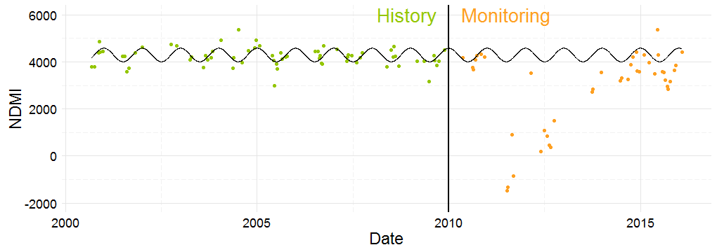
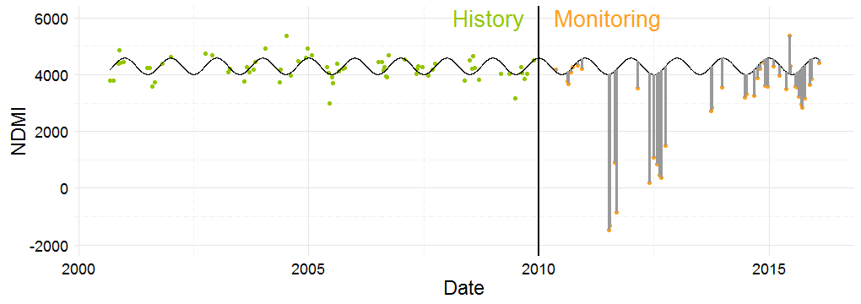
For this, the MOSUM test is applied
BFAST : Breaks For Additive Season and Trend
All observations (NDMI) of one pixel between January 2000 and April 2016.
Total = 111 obs.
The model is projected in the monitoring period
Defined by the user in accordance with the specifications of the project
"Least squares" means that the overall solution minimizes the sum of the squares of the residuals
Family of methods
v
harmonic order 1:
Testing the stability of the model = to check if the „new data” still „fits” the model
If the data still fits => no change is detected
else => a breack is marked
Fully statistical algorithms, that combine techniques for break detection which have been used for liniar regression frameworks, with a seasonal-trend model for detecting change in vegetation dynamics.
BFAST Monitor
The method consists in fitting a model to the data by Ordinary Least Squers (OLS) fitting, on a period defined as stable history, and testing for stability of the same model, during a period defined as monitoring period.
The method consists in fitting a model to the data by Ordinary Least Squers (OLS) fitting, on a period defined as stable history, and testing for stability of the same model, during a period defined as monitoring period.
The method consists in fitting a model to the data by Ordinary Least Squers (OLS) fitting, on a period defined as stable history, and testing for stability of the same model, during a period defined as monitoring period.
The method consists in fitting a model to the data by Ordinary Least Squers (OLS) fitting, on a period defined as stable history, and testing for stability of the same model, during a period defined as monitoring period.
The method consists in fitting a model to the data by Ordinary Least Squers (OLS) fitting, on a period defined as stable history, and testing for stability of the same model, during a period defined as monitoring period.
The method consists in fitting a model to the data by Ordinary Least Squers (OLS) fitting, on a period defined as stable history, and testing for stability of the same model, during a period defined as monitoring period.
The method consists in fitting a model to the data by Ordinary Least Squers (OLS) fitting, on a period defined as stable history, and testing for stability of the same model, during a period defined as monitoring period.

Slide 5
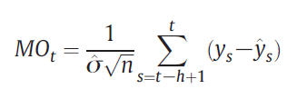
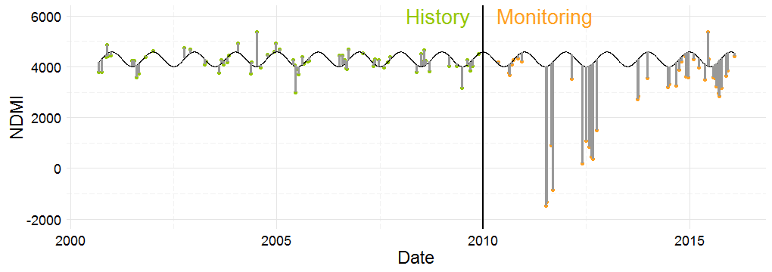
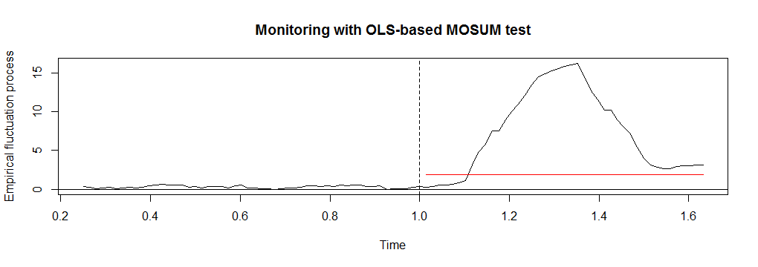
Applying MOSUM
MOSUM detects a break when the MO passes the 95% significance boundary
n=68
h=25% n=17
σ= predicted variance estimated
on the history period
Break detected

Slide 6
BFAST Spatial
Insert drawing explaining bfastSpatial

Slide 7
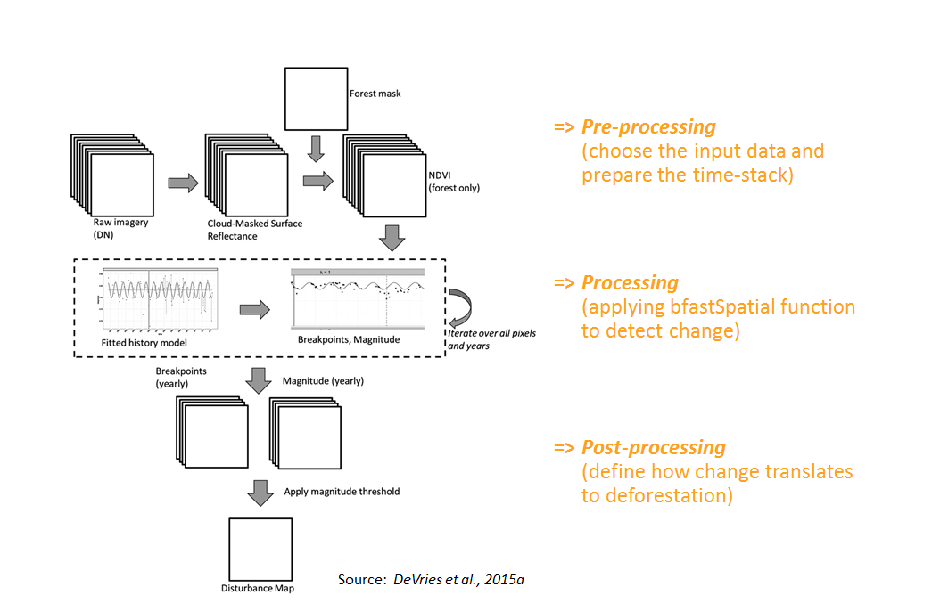
Analysis overview: from Landsat scenes to deforestation detection

Slide 8
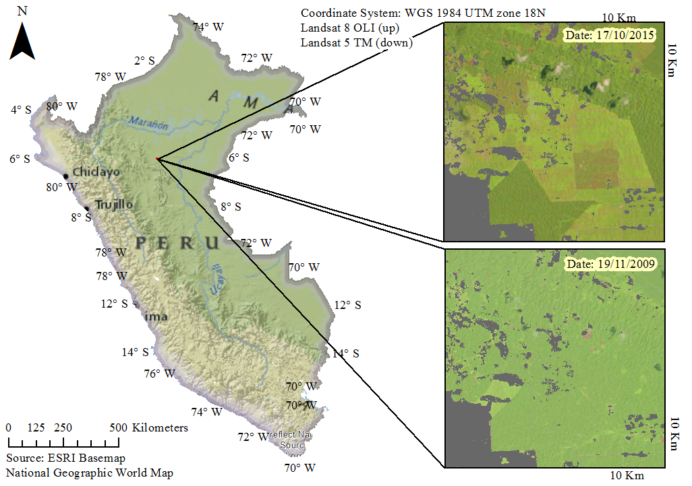
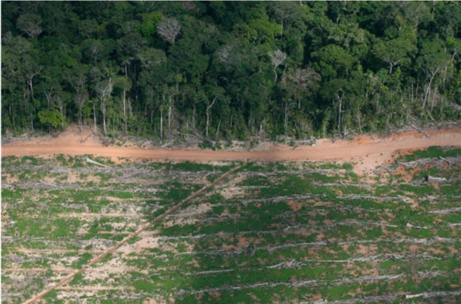
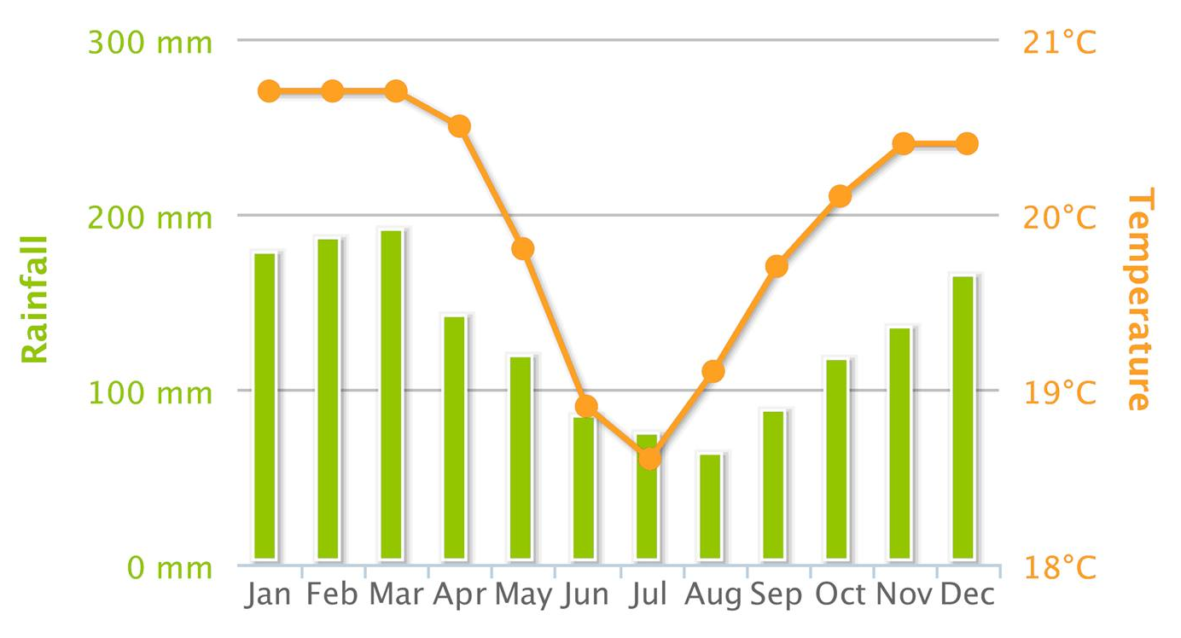

Case study: Peru
Forest Characteristics
Evergreen forest with seasonality: „selva alta”
Loreto is the largest region in Peru and has had more hectares deforested than any other (Peruana, 2015 ”Revealing the hidden”)
Deforestation in large „blocks resulting from agricultural investments (mainly palm oil)
$${\text{Source}\text{: }\text{Barranquita} \text{Resiste}}^{2}$$
$${}_{}^{1}{http://sdwebx.worldbank.org/climateportal/}$$
$${\text{Source}\text{: }Climate change Knowledge Portal}^{1}$$
$${}_{}^{2}{\text{https}\text{://}\text{cordilleraescalera}\text{.}\text{wordpress}\text{.}\text{com}\text{/}\text{bbarranquita}\text{−}\text{resistsb}\text{−2/ }}$$

Slide 9
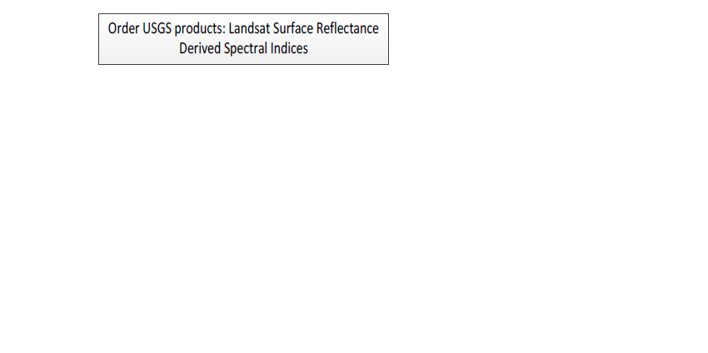
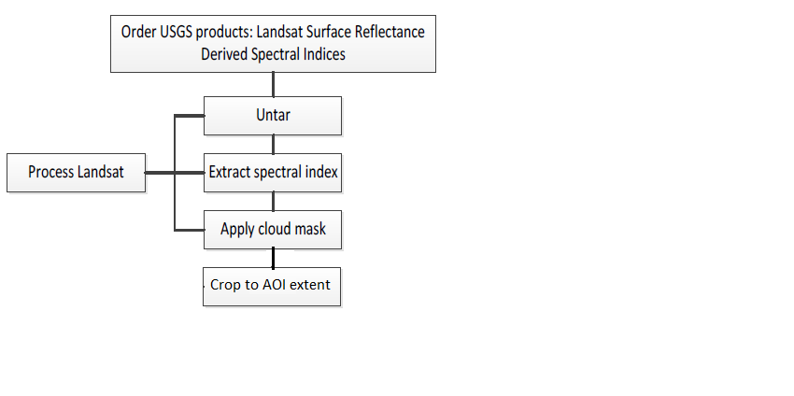
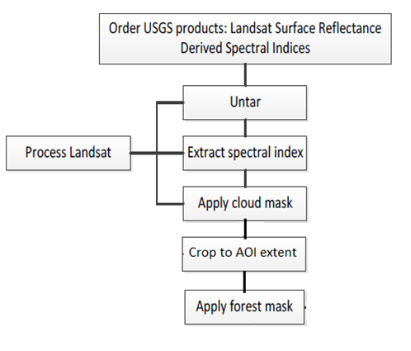
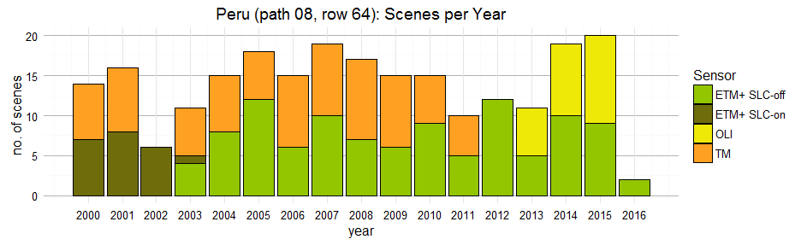
Data acquisition and Pre-processing
Products acquired:
NDVI and NDMI derived from Surface Reflectance products
proccessed and provided by the USGS
Cloud Mask
– computed using unsupervised classification: k-means
Forest Mask (for 2010)
Pre-proccessing
Online tutorial
http://www.loicdutrieux.net/bfastSpatial/
Total scenes: 235

Slide 10
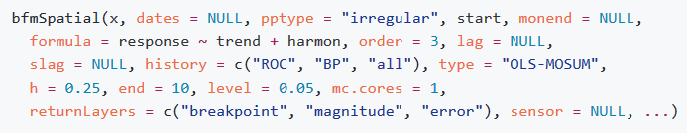
Discuss and understand the parameters of the bfastSpatial function
1. Input data: What vegetation index to use?
Convenient: NDMI or NDVI
Recommended: NDMI
If deforestation is not detcted try others as Schultz et al.(2016) suggest.

Slide 11
2. History Period
(i) How long should the history period be?
- depends on the regression model
- frequently clouded areas:a minimum number of 55-60 scenes in the history period
- enough observations per pixel for the algorithm to fit a model (a min of 20 observations per pixel, and a mean of 40-50 observations per pixel)
- the more cloudy the scenes are, the bigger the number of scenes needed.
(ii) How to have a disturbance free history period?
- options: all, BP (Bai and Perron method), ROC
- a moment that delineates a stable period in the history period can be provided by expert knowledge
- or can be calculated automatically using the reverse-order-cumulative sum (ROC or CUSUM) of residuals
- extremely low number of scenes available (due to cloud coverage, e.g. Gabon) it is recommended to use all scenes available in the history period, with the condition to visually assess the study area for disturbances in this period

Slide 12
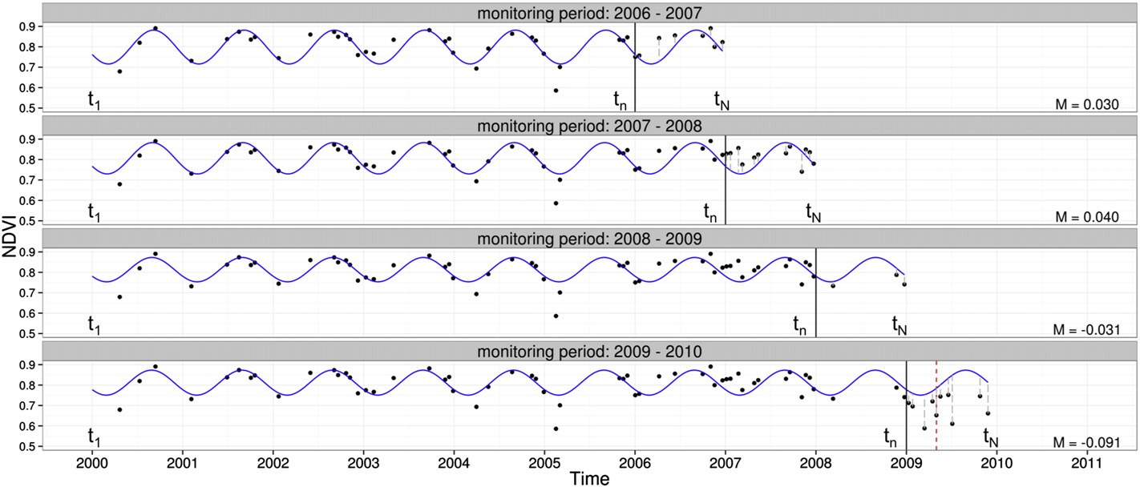
3. Monitoring period
(i) Full monitoring period approach
Limits the monitoring period to one year
(ii) Sequential monitoring approach
Source: DeVries et al., 2015a

Slide 13
(ii) Sequential monitoring approach
- the history period is enlarged with every iteration
- this approach can make a big difference in the cases with very few observations available
4. Regression model
the phenology of the forest
- choose the harmonic order of the model to follow as closely as possible the seasonal patterns
- decide if trend is, or not, to be included in the model
(ii) the number and frequency of the cloud-free available imagery.
- the more complex the regression, more observations are needed in the history period
- even though present, complex seasonal patterns might not be detectable with Landsat data alone, if the AOI is frequently cloud covered

Slide 14
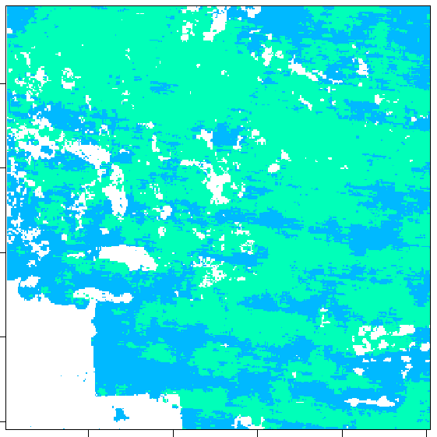
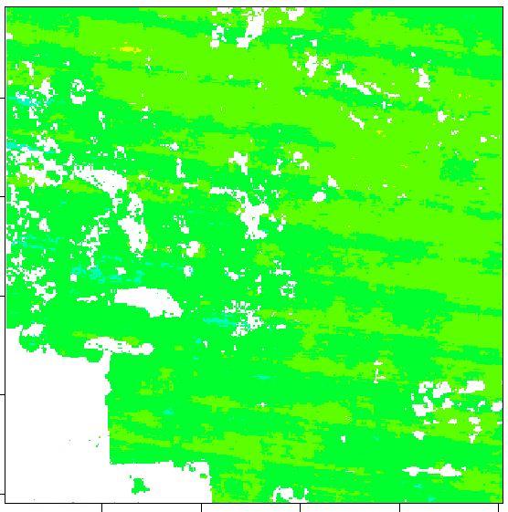
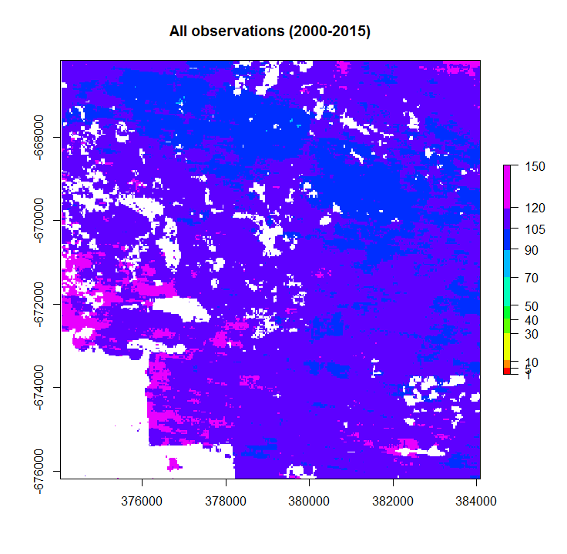
No. Observations per pixel
History period (2000-2010)
Monitoring period (2010-2015)
All observations (2000-2015)
Min: 52
Max: 87
Min: 29
Max: 55
Min: 88
Max: 135
$${\text{Source}\text{: }Climate change Knowledge Portal}^{1}$$

Slide 15
Write the bfmSpatial function
Run the function
Post-process the results
Examine the final results

Slide 16
End slide or section heading
Text

