Slide 1
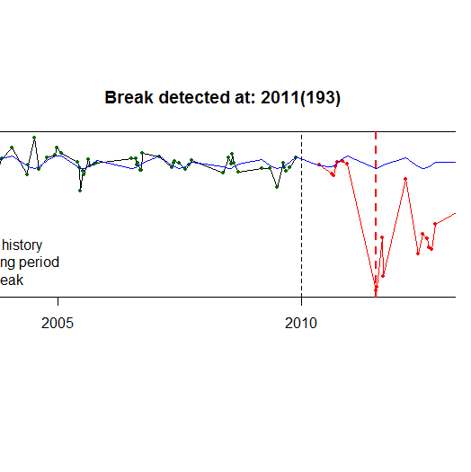
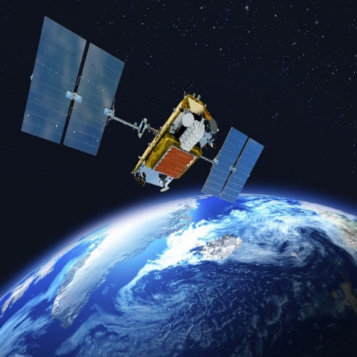
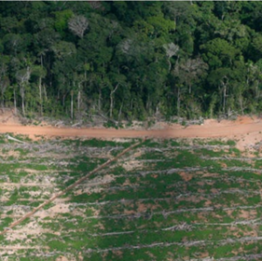
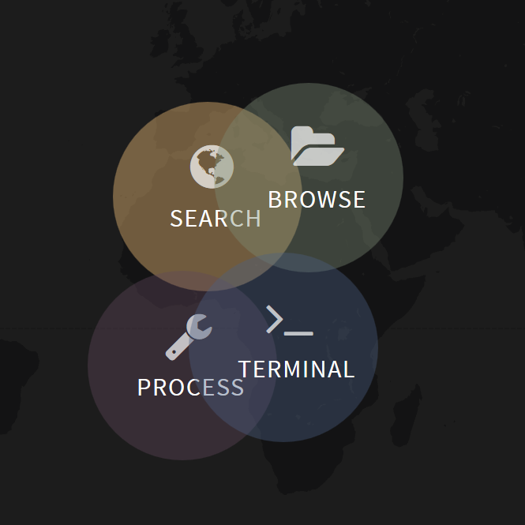
BFAST
Current work
Jan Verbesselt
Sabina Rosca

Slide 2
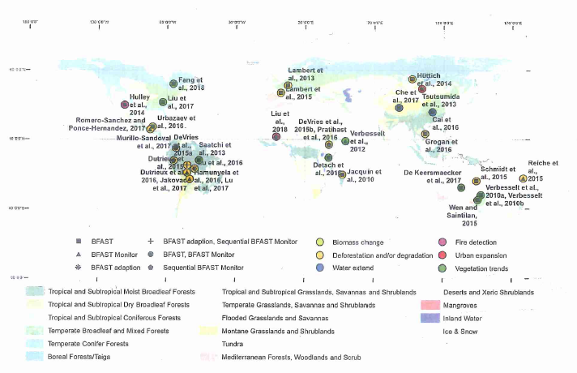
Recap
BFAST family of methods -> satellite imagery time-series analysis algorithms
purpose: detect change in time-series data
main focus: detecting forest loss
BFAST
BFAST01
BFAST Monitor
BFAST Spatial
M. Schultz, 2018

Slide 3
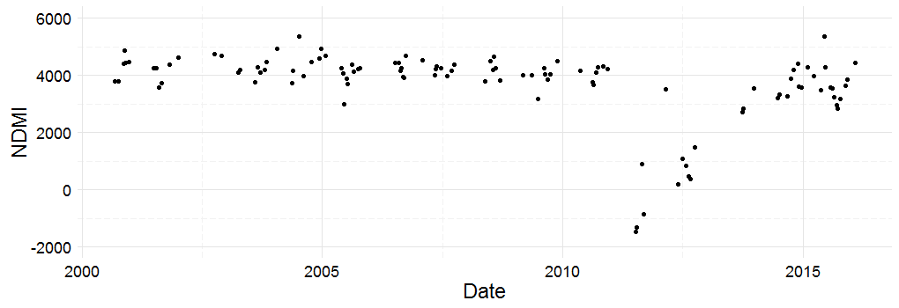

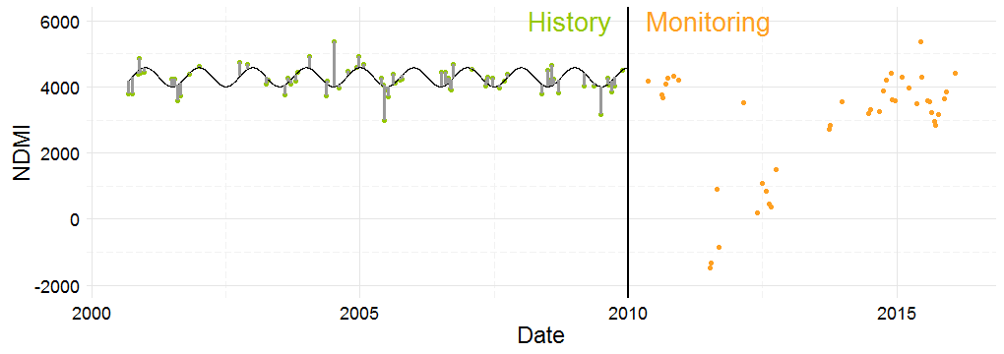
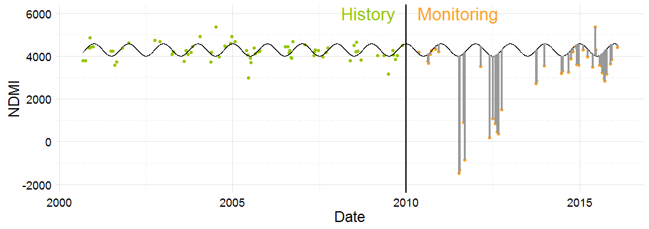
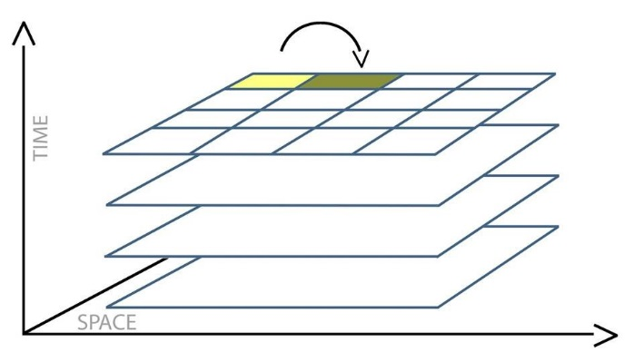
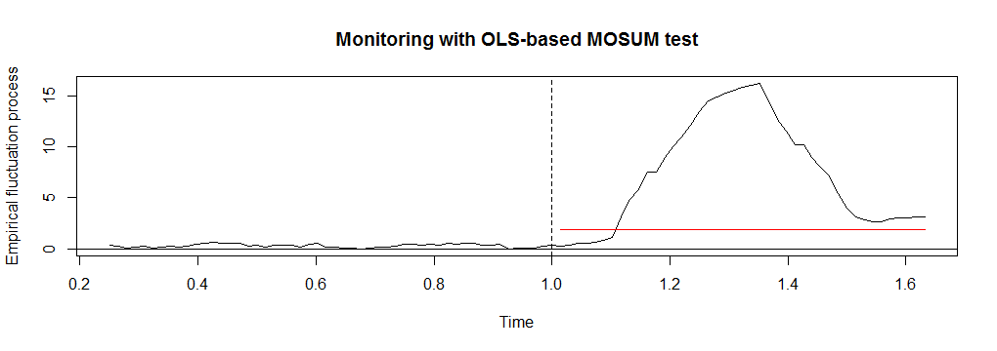
Recap
BFAST Monitor
BFAST Spatial

Slide 4
Focus of the last 6 months:
Going big scale
Consolidating BFAST developments
Offering support for new users of BFAST
Overall goal:
Make BFAST more accessible to users, by advancing the research to address their needs

Slide 5
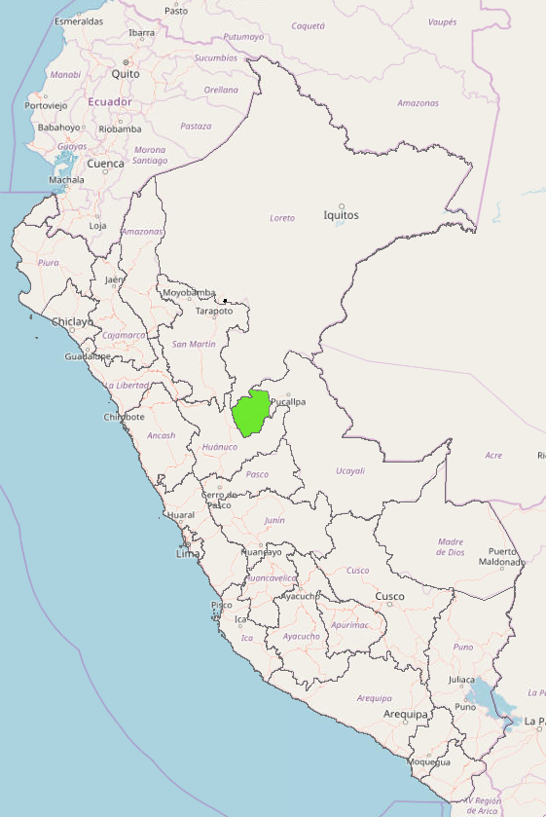
Going big scale
Why?
Motivation:
Peru, Padre Abad
At large scale, forest loss contributes to climate change
National forest assessment
Technically:
Access to cloud computing and storage
New usages of established technologies (GPU computation)
What are the issues?
Running time
Computing and storage necessities
Data access
Spatial heterogeneity of data at large-scale
Padre Abad (16GB) -> SEPAL 64 CPU -> 6.15 h
Peru (more than 2 TB)~ more than 35 days

Slide 6
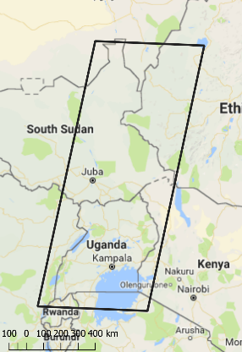
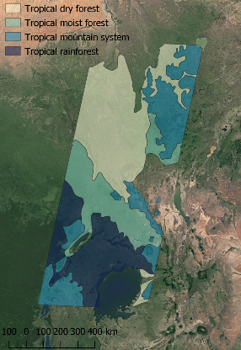
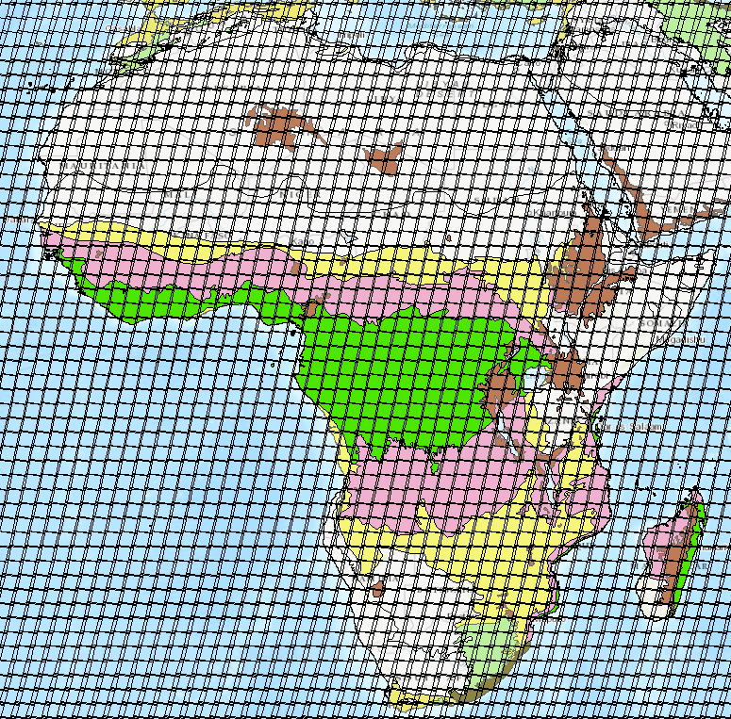
Going big scale
Data access
GEE data download limitations
Is downloading the data way to go?
Spatial heterogeneity of data at large-scale
Research showed that data variability is an error source for detecting deforestation
Automatic algorithm parametrization instead of expert knowledge

Slide 7
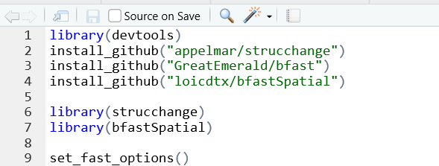
Consolidating BFAST developments
1 CPU
40.55 min
5.77 min
X7 faster
36 CPU
1.85 min
0.37 min
X5 faster

Slide 8
Thank you!

