Slide 1
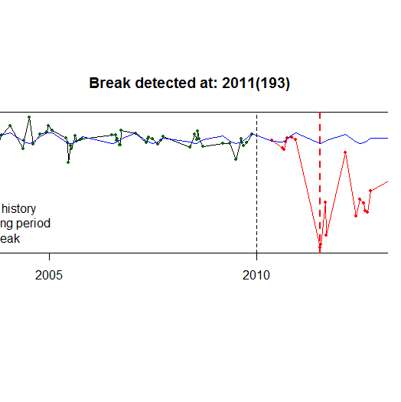

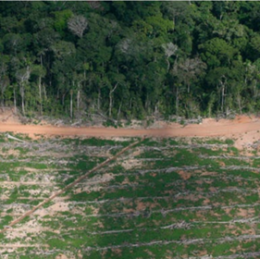
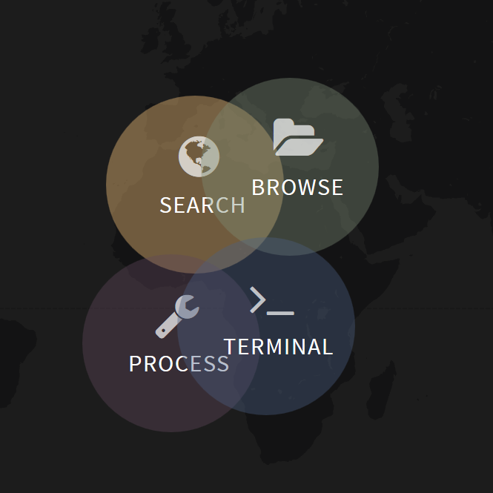
Hands-on session
Modelling the relationship between magnitude and varying degrees of disturbances
Sabina Rosca
Ben DeVries

Slide 2
Detecting degradation from magnitude threshold
https://github.com/bendv/forestChangeModels
https://github.com/rosca002/Rome2FAO/blob/master/README.md
Short link:
https://goo.gl/E1tGJe

