Slide 1
Selenium Grid with Docker
How to run selenium grid with docker
Roscian Frank
Test Architect

Slide 2
Agenda
Basic of docker
Concept of Selenium Grid
How to run selenium grid manually
How to run selenium Grid with docker compose

Slide 3
Selenium Grid
Basically, Selenium Grid is based on a client and server architecture, where the client is a ‘Hub’ and the server is a ‘Node’. When combined they create a grid named ‘Selenium Grid’.
Selenium Grid will allow you to run Selenium test automation for any combination of browser, operating systems, and their versions. Selenium Grid is used to perform testing on different browsers like Chrome, Firefox, Internet Explorer, Microsoft Edge, Safari, etc.
It is platform-agnostic, hence a source code written for Linux would work seamlessly on other operating systems like Windows, macOS, etc.
Key Selenium Grid advantage is that it also brings in parallel testing and distribution when it comes to Selenium test automation.

Slide 4
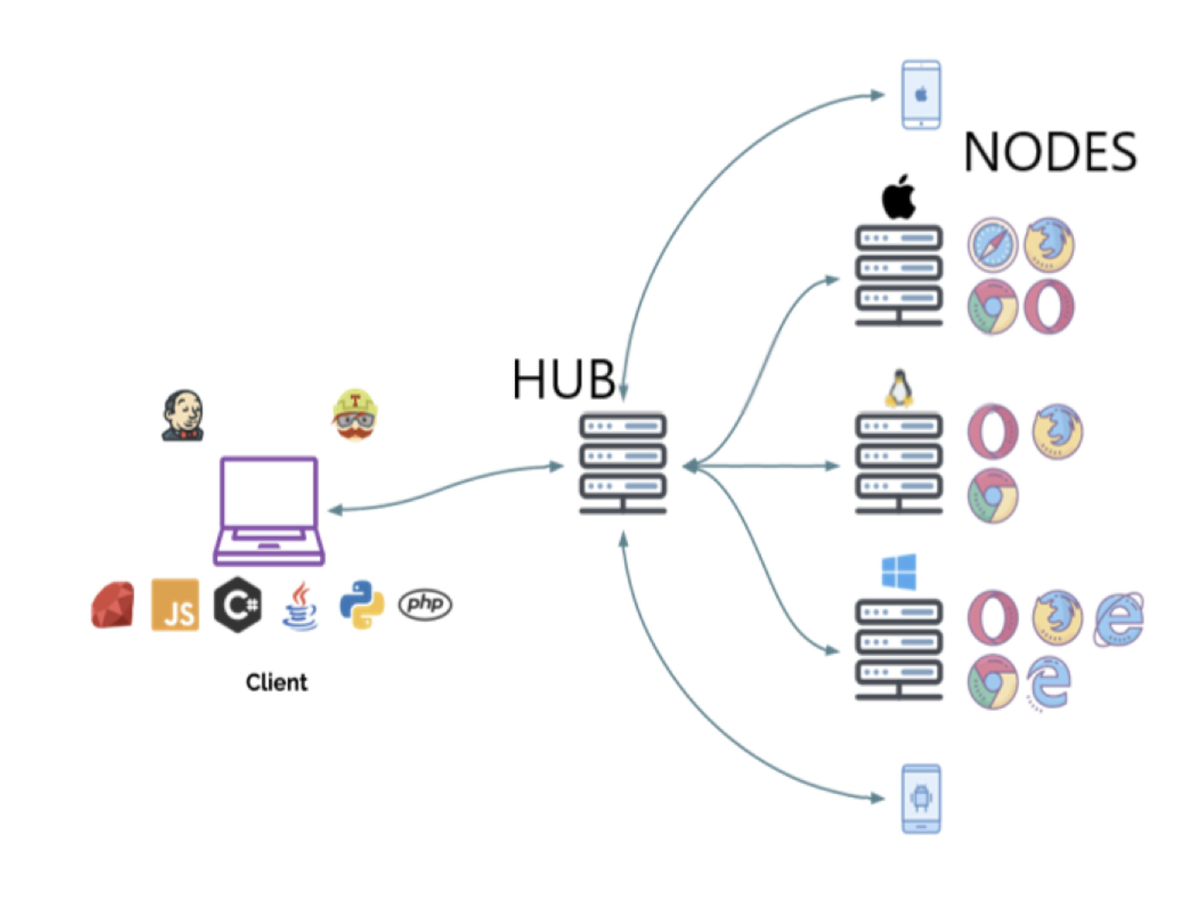
Selenium Grid

Slide 5
Start Selenium Grid manually
Java 11 must be installed
Download the jar
https://www.selenium.dev/downloads/
https://www.selenium.dev/documentation/grid/getting_started/
java -jar selenium-server-4.8.0.jar standalone

Slide 6

Demo

Slide 7
Basic of docker
How to install docker
https://www.docker.com/get-started/
Docker commands
https://docs.docker.com/engine/reference/commandline/docker/
docker info
docker run
docker rm

Slide 8
What is docker File, Image and compose
Docker File - Docker file is a simple text file that consists of instructions to build Docker image
Docker Image – Created from Docker file
Docker Compose – To run Docker image
Learning link - https://www.simplilearn.com/tutorials/docker-tutorial/what-is-dockerfile

Slide 9
What is docker compose
Docker Compose is a tool that assists in defining and sharing multi-container applications. By using Compose, we can define the services in a YAML file, as well as spin them up and tear them down with one single command.
https://www.simplilearn.com/tutorials/docker-tutorial/docker-compose

Slide 10
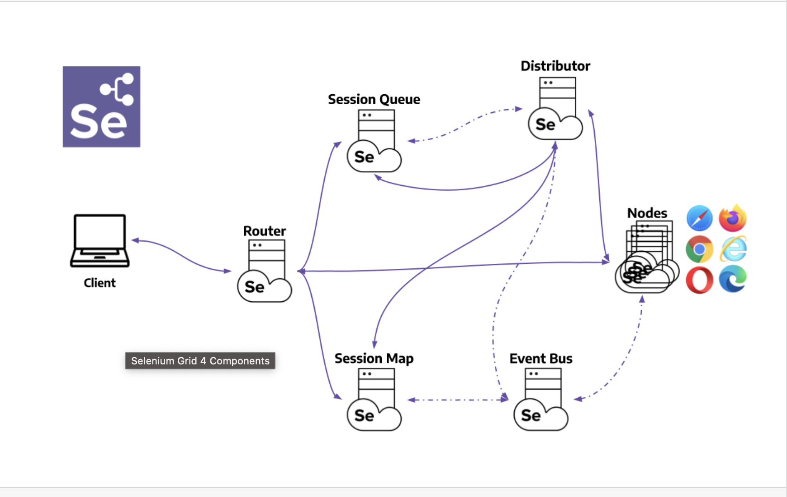
Grid Architecture
https://www.selenium.dev/documentation/grid/components/
Notes:
Router
The Router is the entry point of the Grid, receiving all external requests, and forwards them to the correct component.
If the Router receives a new session request, it will be forwarded to the New Session Queue.
If the request belongs to an existing session, the Router will query the Session Map to get the Node ID where the session is running, and then the request will be forwarded directly to the Node.
The Router balances the load in the Grid by sending the requests to the component that is able to handle them better, without overloading any component that is not needed in the process.
Distributor
The Distributor has two main responsibilities:
Register and keep track of all Nodes and their capabilities
A Node registers to the Distributor by sending a Node registration event through the Event Bus. The Distributor reads it, and then tries to reach the Node via HTTP to confirm its existence. If the request is successful, the Distributor registers the Node and keeps track of all Nodes capabilities through the GridModel.
Query the New Session Queue and process any pending new session requests
When a new session request is sent to the Router, it gets forwarded to the New Session Queue, where it will wait in the queue. The Distributor will poll the New Session Queue for pending new session requests, and then finds a suitable Node where the session can be created. After the session has been created, the Distributor stores in the Session Map the relation between the session id and Node where the session is being executed.
Session Map
The Session Map is a data store that keeps the relationship between the session id and the Node where the session is running. It supports the Router in the process of forwarding a request to the Node. The Router will ask the Session Map for the Node associated to a session id.
New Session Queue
The New Session Queue holds all the new session requests in a FIFO order. It has configurable parameters for setting the request timeout and request retry interval (how often the timeout will be checked).
The Router adds the new session request to the New Session Queue and waits for the response. The New Session Queue regularly checks if any request in the queue has timed out, if so the request is rejected and removed immediately.
The Distributor regularly checks if a slot is available. If so, the Distributor polls the New Session Queue for the first matching request. The Distributor then attempts to create a new session.
Once the requested capabilities match the capabilities of any of the free Node slots, the Distributor attempts to get the available slot. If all the slots are busy, the Distributor will send the request back to the queue. If request times out while retrying or adding to the front of the queue, it will be rejected.
After a session is created successfully, the Distributor sends the session information to the New Session Queue, which then gets sent back to the Router, and finally to the client.
Node
A Grid can contain multiple Nodes. Each Node manages the slots for the available browsers of the machine where it is running.
The Node registers itself to the Distributor through the Event Bus, and its configuration is sent as part of the registration message.
By default, the Node auto-registers all browser drivers available on the path of the machine where it runs. It also creates one slot per available CPU for Chromium based browsers and Firefox. For Safari, only one slot is created. Through a specific configuration, it can run sessions in Docker containers or relay commands.
A Node only executes the received commands, it does not evaluate, make judgments, or control anything other than the flow of commands and responses. The machines where the Node is running does not need to have the same operating system as the other components. For example, A Windows Node might have the capability of offering IE Mode on Edge as a browser option, whereas this would not be possible on Linux or Mac, and a Grid can have multiple Nodes configured with Windows, Mac, or Linux.
Event Bus
The Event Bus serves as a communication path between the Nodes, Distributor, New Session Queue, and Session Map. The Grid does most of its internal communication through messages, avoiding expensive HTTP calls. When starting the Grid in its fully distributed mode, the Event Bus is the first component that should be started.

Slide 11
Run grid with docker compose
I have already created a docker compose file which I will be using to run selenium grid
docker-compose -f docker-compose-v3-full-grid.yml
https://www.simplilearn.com/tutorials/docker-tutorial/docker-compose
https://github.com/SeleniumHQ/docker-selenium
Notes:
Do demo with selenium Docker grid

Slide 12
Docker grid benefit
Capacity to scale
Easy to start docker with selenium
More secure
Very helpful in case of crash
Notes:
CAPACITY TO SCALE
One of the biggest benefits of Docker is its capacity to scale. It’s particularly helpful because running Selenium grid on virtual machines or even separate machines takes up a lot of unnecessary computing overhead. Docker images share some system resources, so you need less resources than a virtual machine. You can easily cram several nodes in a single instance. Both Docker and Compose also handle the networking part easily.
EASY TO START DOCKER WITH SELENIUM
Once Docker installation is complete, SeleniumHQ maintains the whole range of Docker images. These images can be pulled down easily and used right away. The list of images is available at Docker Hub or GitHub repository, and falls into four main categories:
Base - Where you can build your own images.
Hub - A cloud-based registry service where you can link to code repositories so you can create images, test and store them.
Node - Images used in correlation with Hub image and general Selenium grid. It is possible to start a number of node containers with Hub image.
Standalone - Standalone images on the Selenium server. However, it is possible to run only one at a time on the local machine, or there will be a 4444 port conflict.
MORE SECURE
The security levels in Docker-Selenium combination are highly commendable because you do not have to tunnel your local app to third-party solutions. In addition, it is much faster too; in fact, it is twice as fast as the paid, cloud-based Selenium solution.
VERY HELPFUL IN CASE OF CRASH
Selenium crashes easily, so you cannot just set it up and forget all about it. With Docker containers, you can develop a new Selenium instance whenever needed, trash it, and then start a new one. Moreover, if you have to run it for longer periods, then you can just set it to reboot if it crashes.

Slide 13
OTHER BENEFITS AT A GLANCE:
You do not have to manage Selenium server jar because it is automatically managed within the Selenium hub container.
Eliminates the need for downloading browser drivers and setting classpath because that is also done automatically.
You can register and manage the Selenium Grid, so it is easy to register nodes on the hub.
Chances of discrepancies between environments are very, very low because all the team members can use the same container, irrespective of the operating system.

