Slide 1
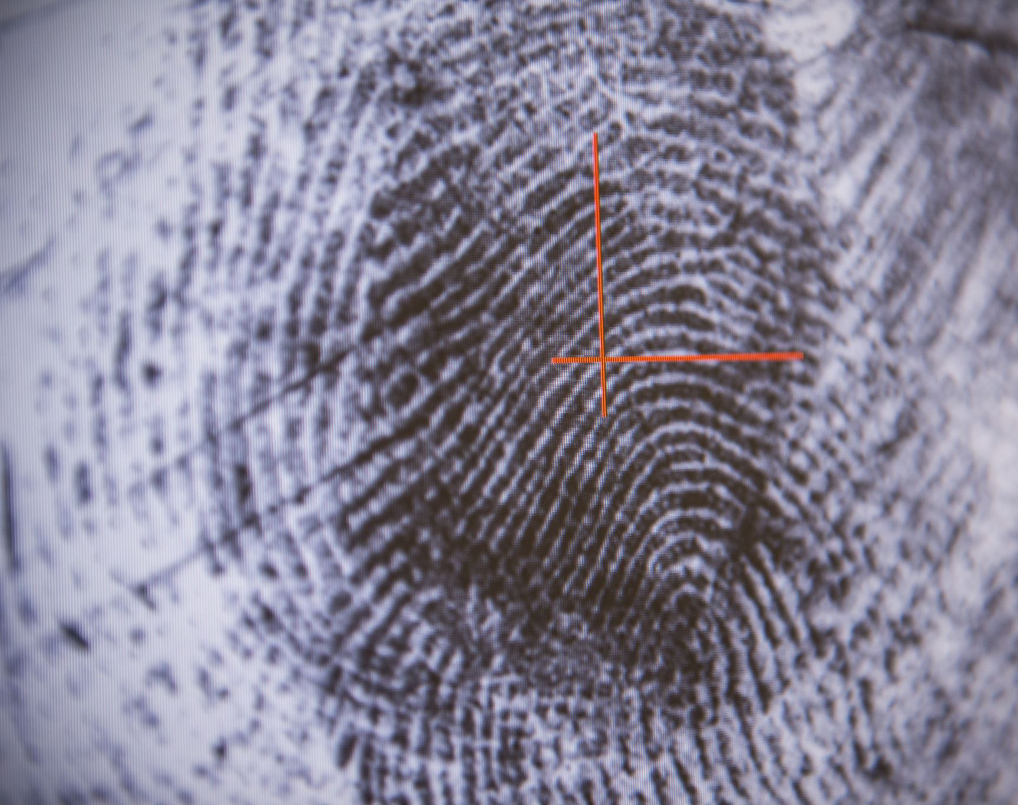
Problem Identification
How can Big Mountain Resort obtain a better value for its ticket price by optimizing its facilities to increase its customer spending volume by at least 15% over the next year?

Slide 2
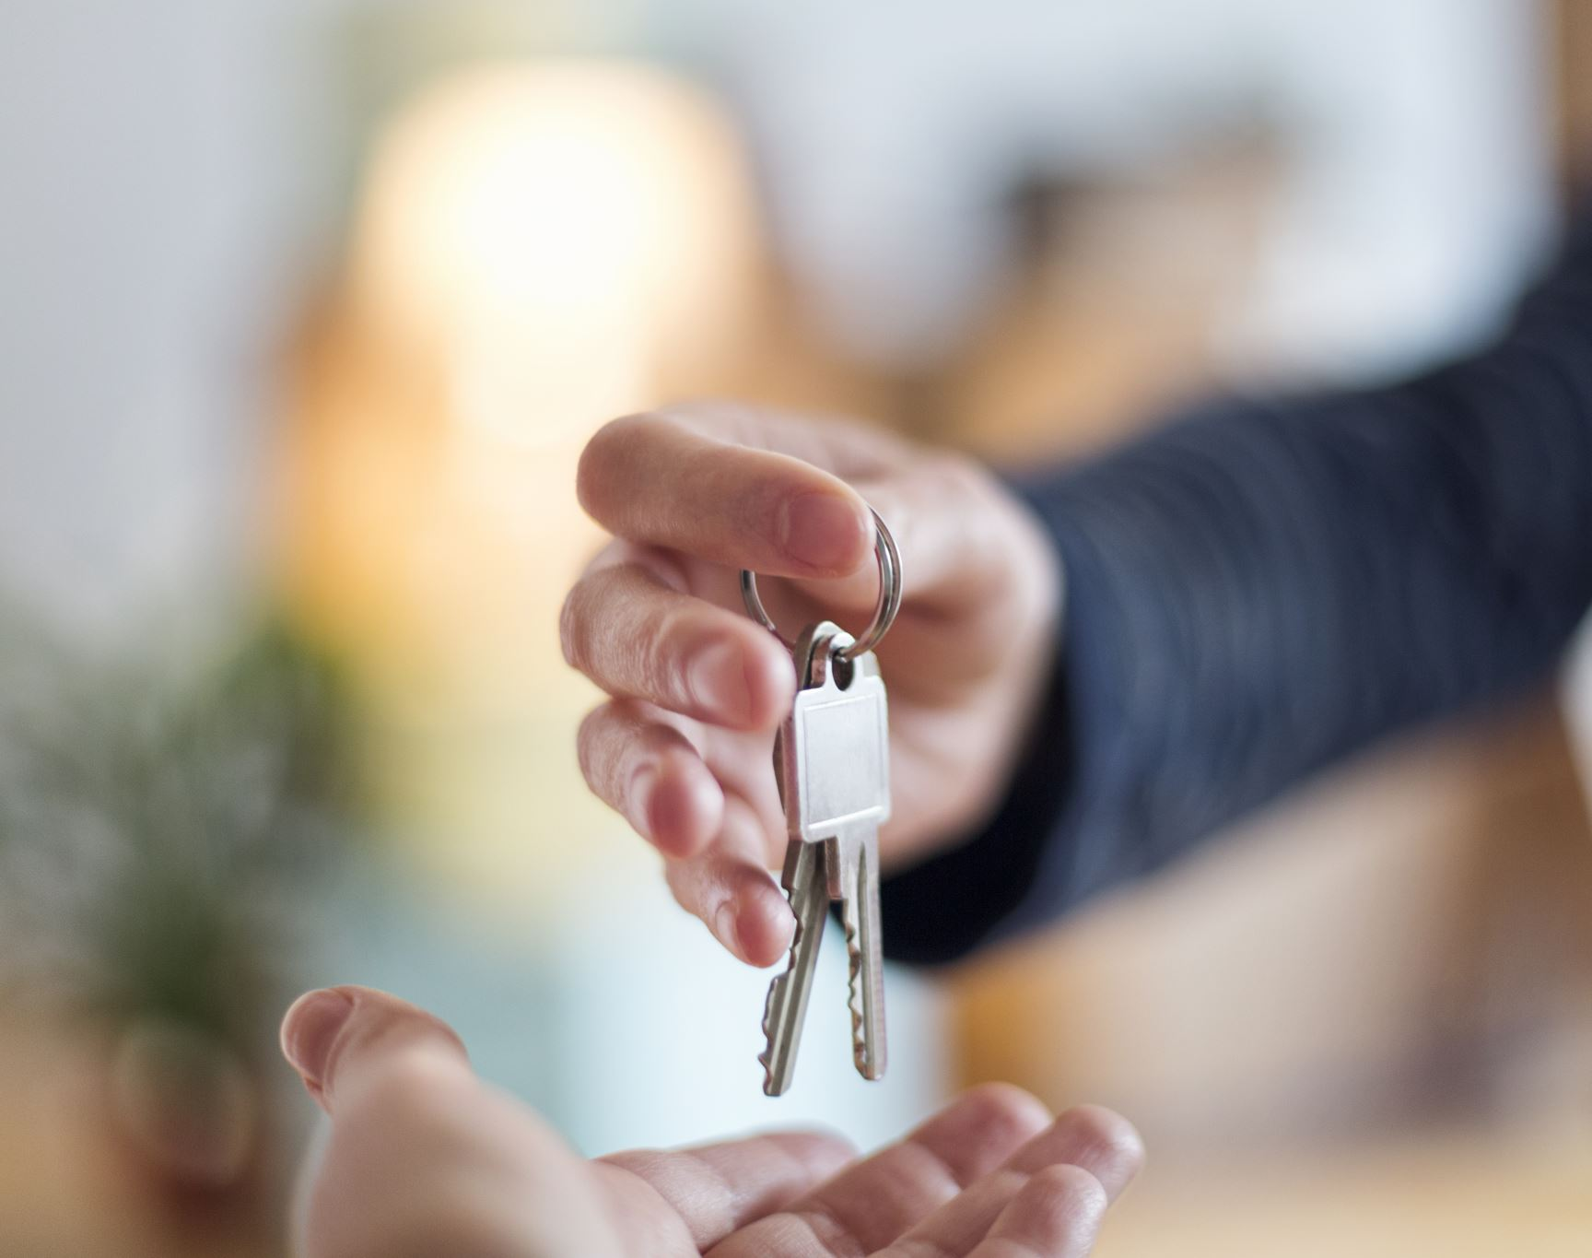
Recommendation and key findings

Slide 3
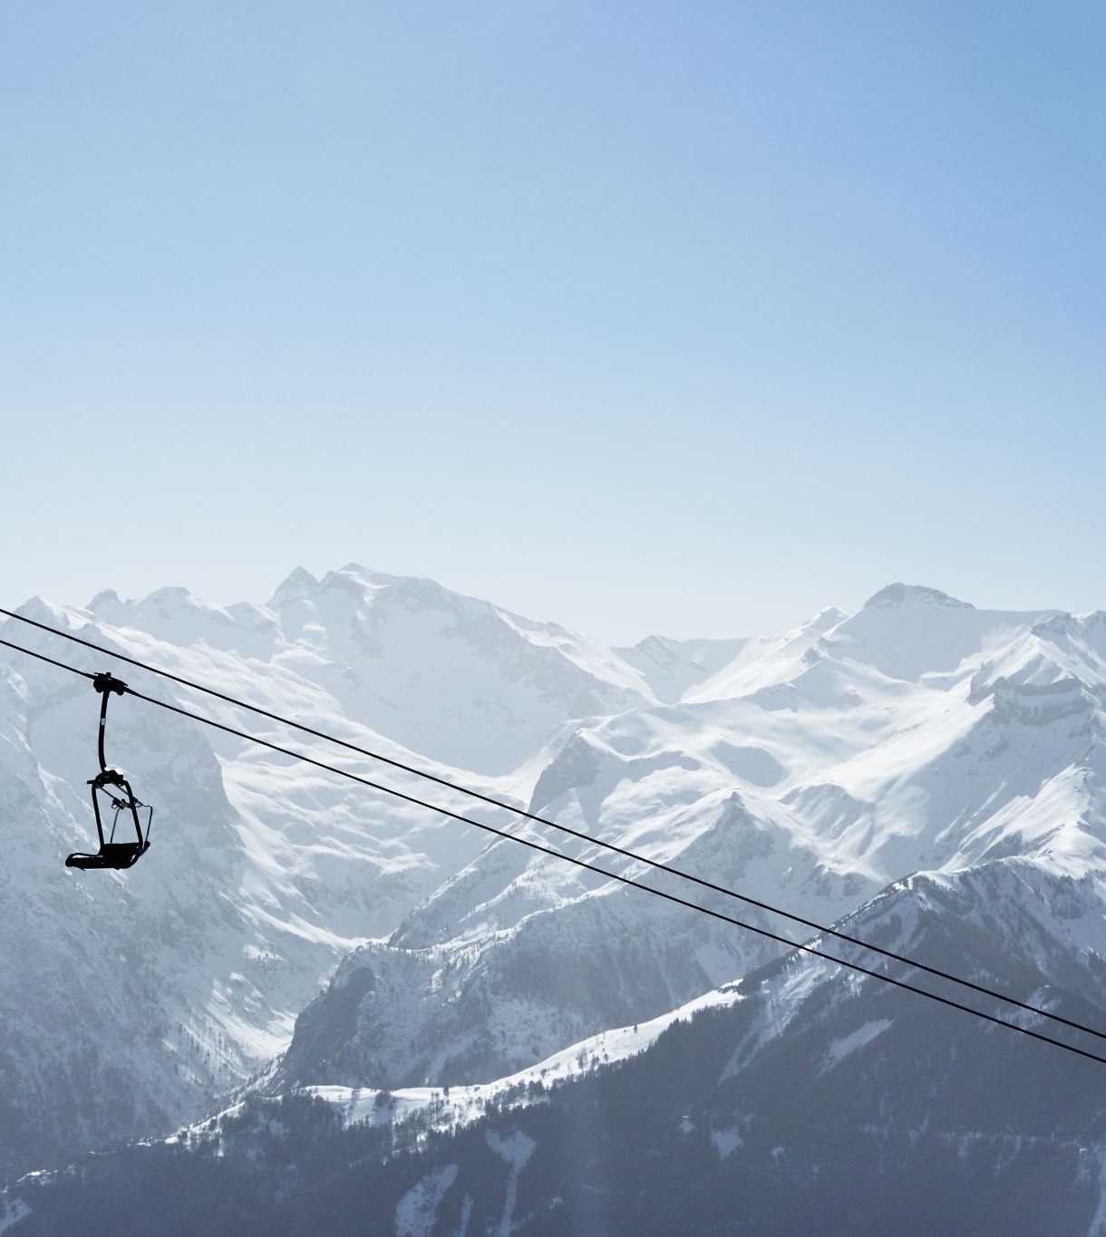
RECOMMENDATIONS
Increase Adult weekend ticket price
Increase the vertical drop by 150 feet
Install an additional chair lift, preferably a fastQuad lift
Add 2 additional acres of snow to the ski grounds

Slide 4

Key Findings
The height of the vertical drop has a strong positive correlation with ticket price for all ski resorts.
The number of fastQuad chairs on the resort property has a positive exponential relationship with ticket prices.

Slide 5
Modeling results and analysis

Slide 6
Important features in the ski resort market
Vertical drop
Producing artificial snow
Total number of chairs
Number of fastQuads in use
Number of runs
Skiable terrain

Slide 7

Consider this:
KEY FACT: Other resorts with comparable features are successfully charging more than $80, which helps to justify raising Big Mountain Resort ticket prices.

Slide 8
MODELING RESULTS
If there is a decision to close down runs to save costs, then closing 5 runs is just as good (in terms of ticket prices) as closing 3 runs.
Increasing the vertical drop by 150 feet and installing an additional chair lift will support increasing the ticket price by $1.99.
If artificial snow making is added to the resort, it should be more than two acres, since adding a smaller amount does not support increasing the ticket price.

Slide 9

Summary and conclusion

Slide 10
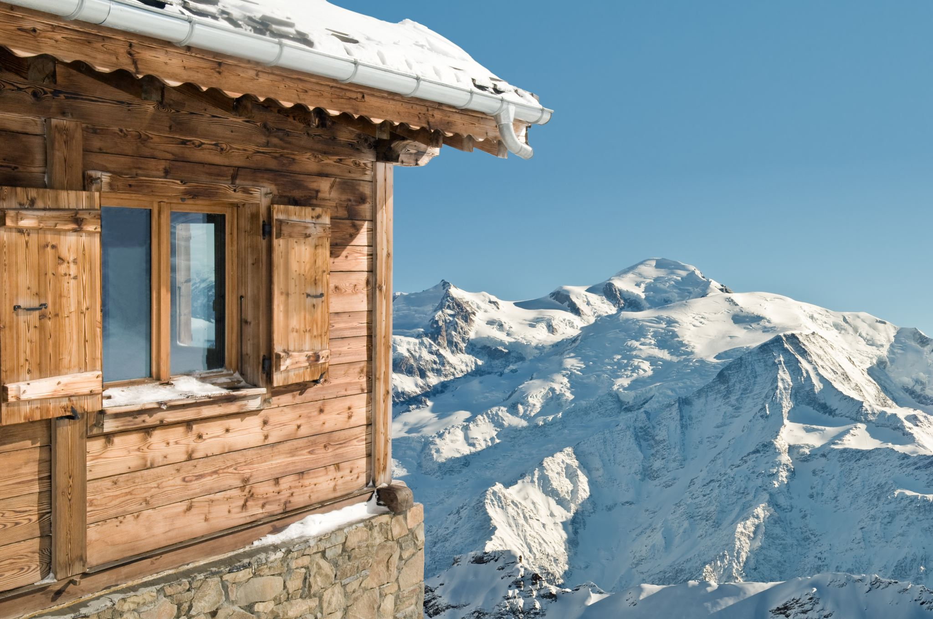
Summary and conclusion
Big Mountain Resort should increase the ticket price.
Big Mountain Resort should optimize its current assets, in particular adding an additional lift, increasing its vertical drop, and adding additional snow.
Increasing the ticket price would still have the Bear Mountain Resort as an affordable resort in comparison with other resorts’ ticket prices.

