Slide 1
ScopeIQ — Go‑to‑Market Roadmap & Architecture
AI‑powered insights for smarter builds • 2025
AI
ScopeIQ

Slide 2
Vision & Opportunity
Empower AEC & facilities teams to interpret plans/specs instantly with AI
$20B+ construction tech market; pain = time wasted, errors, collaboration gaps
ScopeIQ edge: AI querying, continuous ML, secure multi‑tenant SaaS
AI
ScopeIQ

Slide 3
Target Segments
Architecture & Engineering — instant plan/spec queries
Construction PMs — faster answers, fewer RFIs
Facility Owners/Managers — quick retrieval from archives
AI
ScopeIQ

Slide 4
Value Proposition
For Users: Save time • Reduce errors • Collaborate better
For Firms: Lower costs • Win more bids • Future‑proof workflows
AI
ScopeIQ

Slide 5
Product & Pricing
Tier | Price | Who | Key Features
Free | $0 | Solo / trial | 3 uploads/mo, basic AI query
Starter | $49 / user | Small teams | Unlimited uploads, standard AI
Pro | $99–149 / user | Growing teams / API | Multi‑user, faster AI, API access
Enterprise | Custom | Large orgs / SSO | Unlimited, custom AI training, SSO, SLA
AI
ScopeIQ

Slide 6
GTM Roadmap (Overview)
Pre‑Launch (M‑3→M0): pricing, onboarding, beta recruitment, marketing kit
Launch (M0→M3): webinars, PR, LinkedIn ads, outreach, content
Growth (M3→M12): integrations, events, referrals, enterprise sales
AI
ScopeIQ

Slide 7
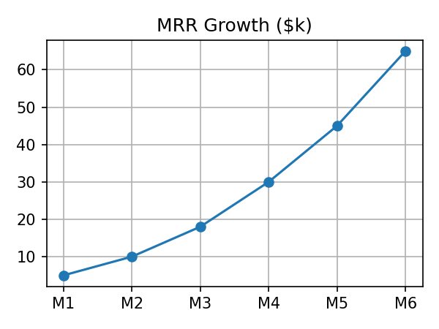
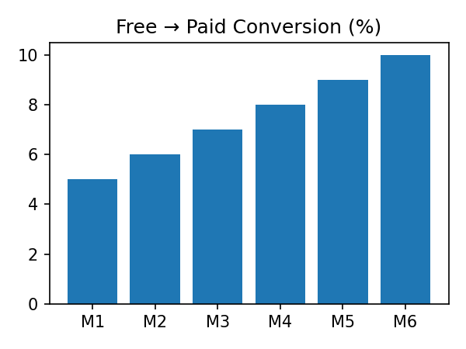
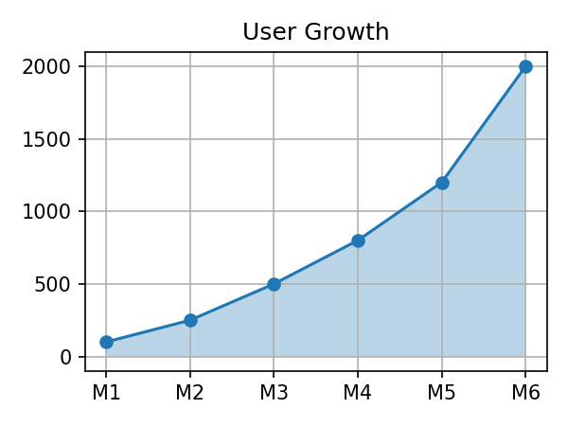
Key Performance Indicators
AI
ScopeIQ

Slide 8
Launch Plan (0–3 Months)
Weekly live demos/webinars (record & publish)
PR to construction tech outlets
LinkedIn ads & targeted outreach (≥500 firms)
2 articles/month — AI for plans/specs, case studies
KPIs: 500 free sign‑ups; 5–8% conversion; CAC < 30% of Year‑1 LTV
AI
ScopeIQ

Slide 9
Risks & Mitigation
Slow adoption → seed case studies and ROI proof
Competitive AI → proprietary training + strategic integrations
Integration complexity → prioritize Autodesk/Procore first
AI
ScopeIQ

Slide 10
Next Steps
Finalize beta recruitment & early access
Publish launch PR & schedule webinars
Implement referral & affiliate programs
Prepare 3 early customer case studies
AI
ScopeIQ

Slide 11
High‑Level Architecture
Client Layer React Web App • PWA • Query Scoping
Amplify / CloudFront
Cognito
AppSync
Lambda
Amazon S3 (Documents & Thumbnails)
DynamoDB (Multi‑Tenant DB)
AI & Search OpenAI • Pinecone • PDF.js
CloudWatch (Monitoring & Logs)
Amplify/CloudFront deliver the app; Cognito secures access; AppSync provides APIs; Lambda handles processing; S3/DynamoDB store content; AI/Search (OpenAI, Pinecone, PDF.js) powers insights; CloudWatch monitors.
AI
ScopeIQ

Slide 12
AI & Data Flow
1) Upload → S3
2) Metadata → DynamoDB
3) Processing → Lambda
4) AI Analysis → Textract • Comprehend • GPT‑4 • PDF.js
5) Embedding/Index → Pinecone
6) Search API → AppSync
7) Monitoring → CloudWatch
S3 stores files; DynamoDB tracks metadata; Lambda orchestrates analysis; embeddings go to Pinecone; AppSync exposes semantic search; CloudWatch monitors.
AI
ScopeIQ

Slide 13
Appendix — Technical Architecture (Simplified)
Client Layer (React, PWA, Query Scoping)
Hosting/CDN (Amplify, CloudFront)
Auth (Cognito, JWT, RBAC)
API Layer (AppSync)
Processing (Lambda)
Storage (S3 Docs/Thumbs)
Database (DynamoDB)
AI & Search (GPT‑4, Textract, Comprehend, Pinecone, PDF.js)
Monitoring (CloudWatch)
AI
ScopeIQ

