Slide 1


Multilingual Stuttering Speech Detection and Transcription Using Advanced Deep Learning Techniques
Comprehensive Viva Voce
SCHOLAR NAME
Mr. MOHANKUMAR M RA2513003011012
Ph.D-Computer Science and Engineering
Category: Full Time
RESEARCH SUPERVISOR Dr. SASIKALA E
Professor,DSBS
Faculty of Engineering and Technology, Kattankulathur
18 Aug 2026
RA2513003011012, Multilingual Stuttering Speech Detection and Transcription Using Advanced Deep Learning Techniques
1

Slide 2
AGENDA
Course Work Details
Introduction
Literature Survey
Research Gap
Problem Statement
Objectives
Publications
Timeline Layout
References
RA2513003011012, Multilingual Stuttering Speech Detection and Transcription Using Advanced Deep Learning Techniques
2

Slide 3
COURSE WORK DETAILS
Course Code | Course Title | Direct Study / Regular | Grade | Month & Year of completion
21IPC501J | Research Methodology | Regular | B | NOV-2025
RPE17001 | Research and Publication Ethics | Regular | B+ | NOV-2025
21CSE637T | Deep Learning and its Application | Regular | B+ | MAY-2026
21CSE583T | Natural Language Processing and its Application | Regular | B+ | MAY-2026
RA2513003011012, Multilingual Stuttering Speech Detection and Transcription Using Advanced Deep Learning Techniques
3

Slide 4
INTRODUCTION
Stuttering is a neuro-developmental speech disorder affecting fluency through repetitions, prolongations, and blocks. It disrupts communication, education, and employment outcomes for millions of speakers worldwide.
Automated stuttering detection and transcription can power scalable speech-language
pathology tools — but almost all existing systems are built and validated only on
English speech.
India's linguistic diversity — Tamil, Hindi, and Indian-accented English — remains
largely unaddressed, leaving a critical gap in accessible, clinically usable speech
technology.
RA2513003011012, Multilingual Stuttering Speech Detection and Transcription Using Advanced Deep Learning Techniques
4

Slide 5
LITERATURE SURVEY
Author | L. S. Chee, O. C. Ai, M. Hariharan, and S. Yaacob
Title, Name of the Journal, Year of the Publications | “MFCC Based Recognition of Repetitions and Prolongations in Stuttered Speech Using k-NN and LDA,” Proc. IEEE Student Conference on Research and Development (SCOReD), Malaysia, pp. 146–149, Nov. 2009.
Proposed Approach / Algorithm/ Methodology | Extracts Mel-Frequency Cepstral Coefficient (MFCC) features from stuttered speech segments and classifies repetitions and prolongations using k-Nearest Neighbour (k-NN) and Linear Discriminant Analysis (LDA) classifiers.
Sailent Features | Handcrafted spectral feature extraction; lightweight classical classifiers requiring no large training corpus; targets two specific dysfluency types (repetitions and prolongations) using well-established acoustic descriptors.
Inferences | LDA combined with MFCC achieved higher classification accuracy than k-NN alone, indicating that spectral-envelope information is discriminative for certain stutter types even with simple statistical classifiers.
Challenges | Small, monolingual (English) dataset; limited generalization to unseen speakers or languages; no coverage of blocks or interjections; purely acoustic, with no linguistic or contextual modeling and no transcription capability.
5 Aug 2026
RA2513003011012, Multilingual Stuttering Speech Detection and Transcription Using Advanced Deep Learning Techniques
6

Slide 6
LITERATURE SURVEY
Author | K. M. Ravikumar, R. Rajagopal, and H. C. Nagaraj
Title, Name of the Journal, Year of the Publications | “An Approach for Objective Assessment of Stuttered Speech Using MFCC Features,” ICGST International Journal on Digital Signal Processing (DSP), vol. 9, pp. 19–24, 2009.
Proposed Approach / Algorithm/ Methodology | Uses MFCC-based acoustic feature vectors together with classical statistical/discriminant classifiers to objectively distinguish fluent speech from stuttered (dysfluent) speech segments.
Sailent Features | Focuses on objective, quantitative severity assessment rather than simple binary detection; combines cepstral features with statistical modeling for clinical interpretability and low computational cost.
Inferences | Demonstrated that MFCC-derived features reliably separate fluent and dysfluent segments, supporting their use as a low-cost, interpretable clinical screening tool rather than a black-box classifier.
Challenges | The rule-based/statistical pipeline does not scale to multiple stutter sub-types or multilingual speech; sensitive to recording conditions and speaker variability; provides assessment only, with no transcription output.
5 Aug 2026
RA2513003011012, Multilingual Stuttering Speech Detection and Transcription Using Advanced Deep Learning Techniques
7

Slide 7
LITERATURE SURVEY
Author | Kourkounakis et al
Title, Name of the Journal, Year of the Publications | “FluentNet: End-to-End Detection of Stuttered Speech Disfluencies With Deep Learning,” IEEE/ACM Transactions on Audio, Speech, and Language Processing, vol. 29, pp. 2986–2999, 2021.
Proposed Approach / Algorithm/ Methodology | Proposes an end-to-end architecture combining Squeeze-and-Excitation Residual CNN blocks for spectral feature learning with Bidirectional LSTM layers for temporal modeling, plus an attention mechanism, trained directly on spectrograms.
Sailent Features | Fully end-to-end (no handcrafted features); attention mechanism highlights salient stutter regions; evaluated on both the UCLASS dataset and the authors' own synthetic LibriStutter dataset; detects multiple disfluency types jointly.
Inferences | Achieved state-of-the-art detection accuracy (~91.75% on UCLASS, ~9.35% miss rate), showing that learned spectral-temporal representations outperform classical handcrafted acoustic features for multi-type stutter detection.
Challenges | Trained and evaluated only on English (real + synthetic) datasets; performs detection only, with no transcription; relies on a fairly large labeled/synthetic corpus; untested on multilingual, accented, or real clinical speech.
6 Aug 2026
8

Slide 8
LITERATURE SURVEY
Author | S. A. Sheikh, M. Sahidullah, F. Hirsch, and S. Ouni
Title, Name of the Journal, Year of the Publications | “StutterNet: Stuttering Detection Using Time Delay Neural Network,” arXiv:2105.05599, 2021.
Proposed Approach / Algorithm/ Methodology | Introduces a Time-Delay Neural Network (TDNN) architecture — originally popular in speaker verification — adapted to model short- and long-range temporal dependencies in speech for stutter-type classification.
Sailent Features | Compact, parameter-efficient architecture compared to CNN-BiLSTM pipelines; models context via dilated temporal convolutions rather than recurrence; benchmarked on the SEP-28k podcast dataset.
Inferences | TDNN-based modeling achieved competitive detection performance with substantially fewer parameters, indicating that efficient temporal-context architectures are a viable lightweight alternative to heavier CNN/RNN pipelines.
Challenges | Still trained and evaluated only on English podcast data (SEP-28k); class imbalance across stutter types affects minority-class performance; no joint transcription output and no multilingual evaluation.
9

Slide 9
LITERATURE SURVEY
Author | S. P. Bayerl, D. Wagner, E. Nöth, and K. Riedhammer
Title, Name of the Journal, Year of the Publications | “Detecting Dysfluencies in Stuttering Therapy Using wav2vec 2.0,” Proc. Interspeech 2022, pp. 2868 –2872.
Proposed Approach / Algorithm/ Methodology | Fine-tunes the self-supervised wav2vec 2.0 model on stuttered speech with multi-task learning, then trains SVM classifiers on the extracted embeddings for six stutter-event types plus therapy-specific speech-modification techniques.
Sailent Features | Leverages large-scale self-supervised pretraining instead of handcrafted or purely supervised features; cross - corpus (English FluencyBank) and cross-lingual (German KSoF) evaluation; also models therapy-technique detection.
Inferences | Fine-tuned wav2vec 2.0 embeddings yielded up to 27% relative F1-score improvement over generic embeddings, showing self-supervised representations transfer well across languages and clinical/therapy contexts.
Challenges | wav2vec 2.0 is computationally heavy for edge/real-time clinical deployment; multi-task fine-tuning requires carefully balanced labeled data per task; not natively designed for joint dysfluency-aware transcription.
10

Slide 10
LITERATURE SURVEY
Author | S. A. Sheikh, M. Sahidullah, F. Hirsch, and S. Ouni
Title, Name of the Journal, Year of the Publications | “Introducing ECAPA-TDNN and Wav2Vec2.0 Embeddings to Stuttering Detection,” arXiv:2204.01564, 2022.
Proposed Approach / Algorithm/ Methodology | Extracts embeddings from two large pretrained models — ECAPA-TDNN (trained on VoxCeleb for speaker verification) and Wav2Vec2.0 (trained on LibriSpeech) — and benchmarks simple classifiers (k-NN, Gaussian Naive Bayes, neural network) on top of them for stutter detection.
Sailent Features | Compares speaker-verification-oriented embeddings against ASR-oriented self-supervised embeddings; addresses limited stuttering-dataset size by transferring representations learned from massive out-of-domain audio corpora.
Inferences | Pretrained embeddings improved overall accuracy by 16.74% relative to a baseline trained only on the limited SEP-28k dataset, confirming that transfer learning from large self-supervised/speaker models mitigates data scarcity in stuttering detection.
Challenges | Embeddings are English/speaker-verification-oriented rather than dysfluency-tuned or multilingual; simple downstream classifiers may not fully exploit the rich embedding space; no transcription or edge-deployment consideration.
RA2513003011012, Multilingual Stuttering Speech Detection and
11
Transcription Using Advanced Deep Learning Techniques

Slide 11
LITERATURE SURVEY
Author | T. Javed, S. Doddapaneni, A. Raman, K. S. Bhogale, G. Ramesh, A. Kunchukuttan, P. Kumar, and M. M. Khapra
Title, Name of the Journal, Year of the Publications | “Towards Building ASR Systems for the Next Billion Users,” Proc. AAAI Conference on Artificial Intelligence, vol. 36, no. 10, pp. 10813–10821, 2022. (IndicWav2Vec)
Proposed Approach / Algorithm/ Methodology | Curates 17,000 hours of raw speech across 40 Indian languages and pretrains wav2vec 2.0-style self-supervised models (IndicWav2Vec), which are then fine-tuned for automatic speech recognition in multiple Indic languages.
Sailent Features | Large-scale, India-specific multilingual pretraining corpus; analyzes shared phoneme-level representations across related languages; open-sourced pretrained/fine-tuned models and language models under the AI4Bharat initiative.
Inferences | Self-supervised pretraining on large unlabelled Indic speech achieves state-of-the-art ASR results on 9 Indic languages across 3 datasets, showing the wav2vec-style paradigm generalizes effectively to low-resource Indian languages.
Challenges | Designed purely for general-purpose ASR, not stuttering or dysfluency detection; language coverage still limited relative to India's full linguistic diversity; large model size restricts direct edge/offline clinical deployment without distillation.
12

Slide 12
LITERATURE SURVEY
Author | V. Pratap, A. Tjandra, B. Shi, P. Tomasello, A. Babu, et al.
Title, Name of the Journal, Year of the Publications | “Scaling Speech Technology to 1,000+ Languages,” Journal of Machine Learning Research, vol. 25, no. 97, pp. 1–52, 2024 (Massively Multilingual Speech / MMS, Meta AI).
Proposed Approach / Algorithm/ Methodology | Builds a new multilingual speech dataset from publicly available religious-text readings and pretrains massively multilingual wav2vec 2.0 models (MMS) covering 1,406 languages, including a single ASR model spanning 1,107 languages.
Sailent Features | Unprecedented language coverage (10–40x prior systems); combines large-scale self-supervised pretraining with a novel low-resource-friendly data-collection strategy; also provides multilingual TTS and language-identification models.
Inferences | The multilingual MMS ASR model more than halves Whisper's word error rate on 54 FLEURS languages despite far less labeled data per language, showing that scale plus self-supervision can compensate for limited labeled multilingual data.
Challenges | Not tailored to dysfluency or stuttering phenomena; extremely large parameter count makes real-time offline/edge clinical deployment impractical without distillation; religious-text training data may mismatch conversational clinical speech.
6 Aug 2026
13

Slide 13
LITERATURE SURVEY
Author | F. Haas and S. P. Bayerl
Title, Name of the Journal, Year of the Publications | "Multilingual Stutter Event Detection for English, German, and Mandarin Speech," Text, Speech, and Dialogue (TSD 2025), Lecture Notes in Computer Science, vol. 16029, 2025.
Proposed Approach / Algorithm/ Methodology | Trains a multi-label stuttering detection model on pooled multi-corpus data spanning English, German, and Mandarin (four corpora total), using a shared wav2vec2.0-based feature extractor to learn language-independent stutter representations.
Sailent Features | First systematic three-language (Germanic + Sino-Tibetan) stuttering detection study; tests whether stuttering has cross-linguistic acoustic consistency; evaluates single-language vs. pooled multilingual training regimes.
Inferences | Multilingual training matched or exceeded single-language baselines, suggesting stuttering exhibits language-agnostic acoustic patterns that support building one shared detector instead of per-language models.
Challenges | Still detection-only (no transcription); no Indic languages (Tamil, Hindi, Indian English) — the language families tested are Germanic and Sino-Tibetan, not Indo-Aryan/Dravidian; no edge or offline deployment evaluation; relies on full wav2vec2.0-scale models.
RA2513003011012, Multilingual Stuttering Speech Detection and Transcription Using Advanced Deep Learning Techniques
14

Slide 14
LITERATURE SURVEY
Author | J. Lian, X. Zhou, Z. Ezzes, J. Vonk, B. Morin, D. P. Baquirin, Z. Miller, M. L. Gorno-Tempini, and G. Anumanchipalli
Title, Name of the Journal, Year of the Publications | "SSDM 2.0: Time-Accurate Speech Rich Transcription with Articulatory-Based Detection of Dysfluencies in Primary Progressive Aphasia," IEEE Journal of Selected Topics in Signal Processing, 2025 (arXiv:2412.00265).
Proposed Approach / Algorithm/ Methodology | Introduces a "Neural Articulatory Flow" for scalable dysfluency-aware speech representations, a full-stack connectionist subsequence aligner for joint text-dysfluency alignment, and an LLM-based in-context pronunciation-learning module — combined into SSDM 2.0, with a lighter non-end-to-end variant (SSDM-L) aimed at clinical deployment.
Sailent Features | Joint transcription + dysfluency detection (not detection-only); explicitly proposes a lightweight, modular clinical-deployment variant (SSDM-L); validated on real pathological speech (primary progressive aphasia) rather than only synthetic/simulated stutter data; releases the large -scale Libri-Co-Dys corpus.
Inferences | SSDM 2.0 substantially outperforms prior SSDM and other dysfluency-transcription models, showing that decoupling representation learning, alignment, and LLM-based pronunciation modeling into separate lightweight modules can beat monolithic end-to-end approaches on both accuracy and deployability.
Challenges | English-only (no multilingual or Indic-language evaluation); "lightweight" here means modular/non-end-to-end, not verified real-time offline inference on actual mobile/edge hardware (no ONNX/Android -style benchmarks like your work); targets aphasia-related articulatory dysfluency rather than developmental stuttering specifically.
15

Slide 15
Problem Statement
There is no accurate, clinically deployable system for joint stuttering detection and transcription across Tamil, Hindi, and Indian English — languages and accents almost entirely absent from existing stuttering-speech research — that can also run offline on low-cost, resource-constrained devices for real-world clinical screening.
1) Language exclusion
Existing tools are trained and validated almost exclusively on English speech.
1)No joint modeling
Detection and transcription are usually solved as separate, disconnected tasks.
1)Deployment barrier
State-of-the-art models are too large for real-time, offline clinical use in India.
RA2513003011012, Multilingual Stuttering Speech Detection and Transcription Using Advanced Deep Learning Techniques
16

Slide 16
Research Gap
Four Gaps This Work Sets Out to Close
Multilingual coverage gap - No stuttering detection/transcription system covers Tamil, Hindi, and Indian English together.
Joint-task gap - Detection and dysfluency-aware transcription are rarely modeled jointly in
a single architecture.
Edge-deployment gap - Large self-supervised teacher models cannot run offline, in real time, on low-cost clinical devices.
Clinical-validation gap - Few systems are validated against clinician-annotated, real patient speech data.
RA2513003011012, Multilingual Stuttering Speech Detection and Transcription Using Advanced Deep Learning Techniques
17

Slide 17



Objectives of the Proposed Work Three Core Objectives
1
Multilingual Dysfluency-Aware Modeling
2
3
Clinical Validation & Dissemination
Edge-Deployable Distillation
Design and develop a joint stuttering detection and transcription framework spanning Tamil, Hindi, and Indian English speech.
Build a teacher–student knowledge-distillation pipeline (MMS-300M / IndicWav2Vec → MobileConformer) for real-time, offline, on-device inference.
Validate the system with SRM Medical College Hospital on clinician-annotated data, and publish outcomes in Q1 journals and reputed conferences.
18 Aug 2026
RA2513003011012, Multilingual Stuttering Speech Detection and Transcription Using Advanced Deep Learning Techniques
18

Slide 18
OBJECTIVE 1
Multilingual Dysfluency-Aware Modeling - DysfluentNet
Speech input first passes through a WavLM-Large encoder, extracting rich, self-supervised acoustic representations. These feed into a Stutter-Aware CTC decoder — designed specifically to jointly predict both the word-level transcription and the stutter event labels, rather than treating them as separate tasks.
Two things make this architecture distinctive
  a curriculum learning strategy during training — the model is exposed to progressively more difficult dysfluency patterns rather than a random mix from the start, which stabilizes learning.
  a new evaluation metric, DI-WER — Dysfluency-Informed Word Error Rate — which more fairly credits the model for correctly identifying dysfluent regions rather than penalizing it the same way a standard WER would.
DysfluentNet has been accepted at Interspeech 2026 in Sydney, Australia.
RA2513003011012, Multilingual Stuttering Speech Detection and Transcription Using Advanced Deep Learning Techniques
19

Slide 19
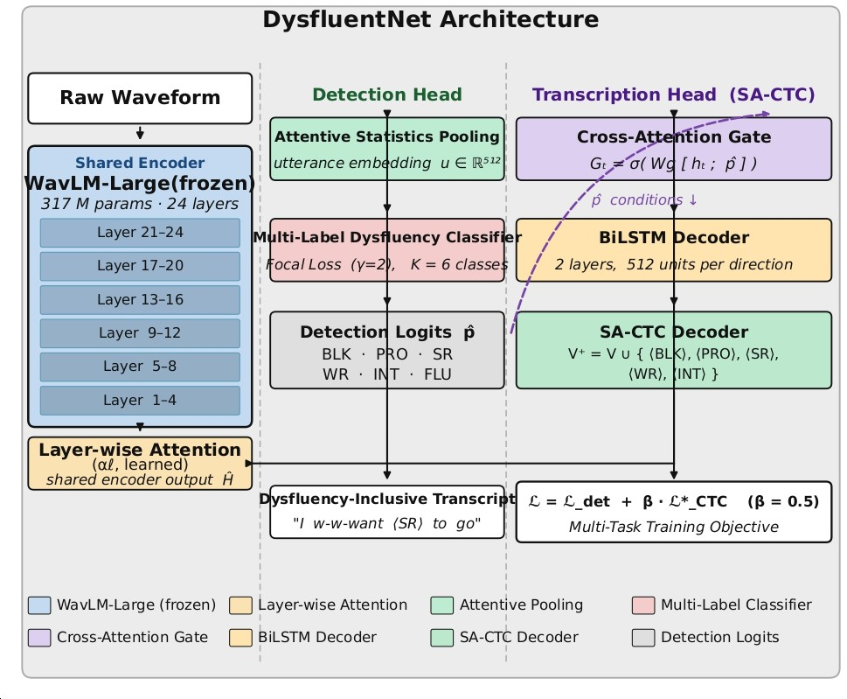
Objective 1 Architecture
RA2513003011012, Multilingual Stuttering Speech Detection and Transcription Using Advanced Deep Learning Techniques
20

Slide 20
DysfluentNet
How DysfluentNet represents speech before detection or transcription happens
Shared Encoder: WavLM-Large (frozen), 317M parameters, 24 transformer layers
  Pretrained via self-supervised masked prediction on large-scale unlabeled speech, then frozen during fine-tuning — retains
general acoustic knowledge while keeping trainable parameters low
  Captures phonetic, prosodic, and speaker-invariant features useful for both fluent and dysfluent speech patterns
Layer-wise Attention: a learned weighting αℓ combines all 24 layers (grouped 1–4 … 21–24) into one shared encoder output H
  Lower layers encode acoustic/phonetic detail; upper layers encode semantic/linguistic content — the model learns which
depth matters most for dysfluency cues
Design rationale: freezing WavLM-Large avoids catastrophic forgetting on our smaller multilingual clinical dataset, while layer-wise attention lets the detection and transcription heads draw on different representation depths as needed
RA2513003011012, Multilingual Stuttering Speech Detection and Transcription Using Advanced Deep Learning Techniques
21

Slide 21
DysfluentNet — Detection & Transcription
How the two output heads work, and how they are trained together
Detection Head — Multi-Label Dysfluency Classifier
  Attentive Statistics Pooling condenses frame-level encoder output into an utterance embedding u ∈ ℝ⁵¹²
  A K=6 multi-label classifier (Block, Prolongation, Sound Rep., Word Rep., Interjection, Fluent) predicts detection logits ρ̂, trained with Focal Loss (γ=2) to counter class imbalance
Transcription Head — Stutter-Aware CTC (SA-CTC)
  A Cross-Attention Gate Gₜ = σ(Wg[hₜ ; ρ̂]) conditions the decoder on the detection head’s output at every time step
  A 2-layer BiLSTM decoder (512 units/direction) processes the gated representation, then the SA-CTC decoder predicts over
an extended vocabulary V⁺ = V ∪ {(BLK),(PRO),(SR),(WR),(INT)} — inserting dysfluency tags directly into the transcript,
e.g. “I w-w-want (SR) to go”
Joint Training Objective: L = L_det + β·L*_CTC (β = 0.5) — detection and transcription are optimized together, so each head informs the other
RA2513003011012, Multilingual Stuttering Speech Detection and Transcription Using Advanced Deep Learning Techniques
22

Slide 22
OBJECTIVE 2
Edge-Deployable Distillation - MobileConformer
Two large teacher models — MMS-300M and IndicWav2Vec — which have strong multilingual representations but are far too large for on-device use. We distill their knowledge into a compact student model, MobileConformer.
In its third iteration, MobileConformer V3 introduces a dual-encoder design: a shared Conformer backbone splits into an ASR-specific encoder and a stutter-specific encoder. The ASR branch includes an Accent Adaptation Layer to handle Indian-English and regional accent variation, while the stutter branch includes Local Stutter Attention, focusing the model on the specific temporal regions where dysfluencies occur. We also use Focal Loss during training to address the natural class imbalance between fluent and dysfluent segments.
Once trained, the model is exported via ONNX and deployed directly onto an Android device — we’ve validated it on a Samsung Galaxy A35 — using a custom Kotlin FFT implementation for real-time, fully offline feature extraction.
Our second-generation model, MobileConformer V2, is already fully trained and deployed, achieving a language-model-decoded word error rate of 9.3 percent and an F1-score of 0.905, using KenLM 4-gram decoding.
RA2513003011012, Multilingual Stuttering Speech Detection and Transcription Using Advanced Deep Learning Techniques
23

Slide 23
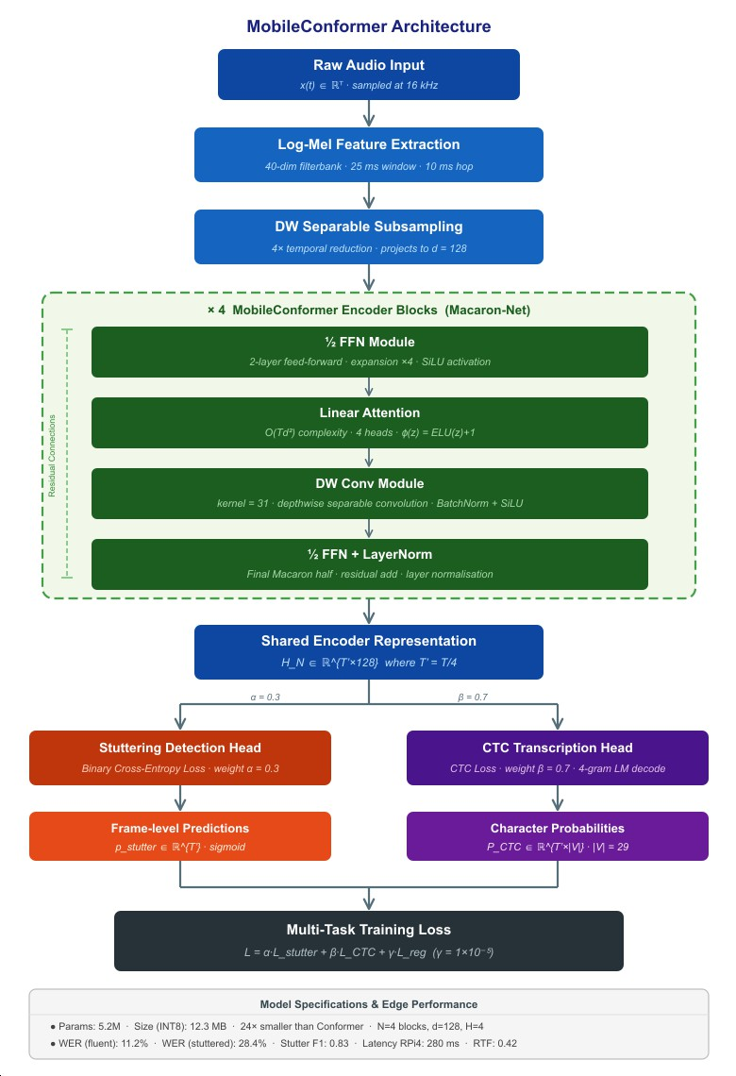
Objective 2 Architecture
18 Aug 2026
PC2413003013041, S.SRI SAYE LAKSHMI
24

Slide 24
MobileConformer — Encoder
How raw audio becomes a compact, mobile-friendly representation
Front-end: raw audio to compact features
  Raw audio x(t) ∈ ℝᴺ at 16 kHz → Log-Mel extraction (40-dim filterbank, 25 ms window, 10 ms hop) → depthwise-separable
subsampling (4× temporal reduction, projects to d = 128)
Encoder: ×4 MobileConformer blocks in a Macaron-Net design, each wrapped in residual connections
  ½ FFN (2-layer feed-forward, ×4 expansion, SiLU) → Linear Attention (O(Td) complexity, 4 heads, feature map φ(x)=ELU(x)+1) → depthwise-conv module (kernel = 31, BatchNorm + SiLU) → ½ FFN + LayerNorm
  Linear Attention replaces standard O(T²d) self-attention — the key change that makes the encoder practical for real-time
mobile inference
Why this is edge-friendly: only 5.2M parameters, 12.3 MB at INT8 quantization — roughly 24× smaller than a comparable standard Conformer, while the Macaron-style structure keeps training stable
RA2513003011012, Multilingual Stuttering Speech Detection and Transcription Using Advanced Deep Learning Techniques
25

Slide 25
MobileConformer — Detection & Transcription
How the two lightweight heads produce detections and transcriptions
Shared representation H_N ∈ ℝ^(T′×128), T′ = T/4, feeds two lightweight parallel heads
Stuttering Detection Head: frame-level predictions p_stutter ∈ ℝ^T′ (sigmoid), trained with Binary Cross-Entropy loss, weighted α =
0.3
CTC Transcription Head: character probabilities P_CTC ∈ ℝ^(T′×|V|), |V| = 29, trained with CTC loss, weighted β = 0.7, decoded with a 4-gram language model
Multi-Task Training Loss: L = α·L_stutter + β·L_CTC + γ·L_reg (γ = 1×10⁻⁴) — jointly optimizes both heads with a small regularization term
Measured edge performance: WER (fluent) 11.2% · WER (stuttered) 28.4% · Stutter F1 0.83 · Latency on Raspberry Pi 4: 280 ms · RTF 0.42
RA2513003011012, Multilingual Stuttering Speech Detection and Transcription Using Advanced Deep Learning Techniques
26

Slide 26
OBJECTIVE 3
Clinical Validation & Dissemination
Validate the system with SRM Medical College Hospital on clinician-annotated data, and
publish outcomes in Q1 journals.
RA2513003011012, Multilingual Stuttering Speech Detection and Transcription Using Advanced Deep Learning Techniques
27

Slide 27



MILESTONE
MobileConformer – Journal Submission(Q1)
Clinical data collection planning
1st Doctoral committee meeting on 17-07-2024
1st sem of Course Work Completion
2nd sem of Course Work Completion
June2025
Dec 2025
May 2026
Dec 2026
May 2027
Jun 2028
Date of Enrollment 01/07/2025
DysfluentNet Unified Models – Systematic Review
Clinical trial with ❖ Pre PhD-SRM MCH Talk
Edge-deployment ❖ Synopsis
Journal submission (Q1)
Submissio n

Slide 28
PUBLICATIONS
DysfluentNet has been accepted at Interspeech 2026, with the camera-ready version complete.
My IEEE conference paper for ICDSBS 2026, on a unified disfluency-detection and ASR
architecture for resource-constrained devices, has been prepared and presented.
https://xplorestaging.ieee.org/document/11634690
The MobileConformer journal manuscript, targeting a Q1 venue such as Computational Linguistics, is currently in preparation.
18 Aug 2026
RA2513003011012, Multilingual Stuttering Speech Detection and Transcription Using Advanced Deep Learning Techniques
29

Slide 29
REFERENCES:
Baevski, A. et al. wav2vec 2.0: A framework for self-supervised learning of speech
representations. NeurIPS, 2020.
Hsu, W.-N. et al. HuBERT: Self-supervised speech representation learning by masked prediction of hidden units. IEEE/ACM TASLP, 2021.
Chen, S. et al. WavLM: Large-scale self-supervised pre-training for full stack speech
processing. IEEE JSTSP, 2022.
Lea, C. et al. SEP-28k: A dataset for stuttering event detection. ICASSP, 2021.
Bernstein Ratner, N. & MacWhinney, B. Fluency Bank: A new resource for fluency research and practice. Journal of Fluency Disorders, 2018.
Graves, A. et al. Connectionist temporal classification: Labelling unsegmented sequence data with recurrent neural networks. ICML, 2006.
Lin, T.-Y. et al. Focal loss for dense object detection. ICCV, 2017.
Gulati, A. et al. Conformer: Convolution-augmented transformer for speech recognition.
Interspeech, 2020.
RA2513003011012, Multilingual Stuttering Speech Detection and Transcription Using Advanced Deep Learning Techniques
30

Slide 30

RA2513003011012, Multilingual Stuttering Speech Detection and Transcription Using Advanced Deep Learning Techniques
31

