Slide 1


AI-Driven Precision Agriculture:
Crop Recommendation and Fertilizer Prediction Using Advanced Machine Learning Frameworks
Comprehensive Project Viva Voce
CANDIDATE NAMES
DEBJIT DAS | RA2411056010276 ANSHUMAAN DAS | RA2411056010283
B.Tech - Computer Science and Engineering
School of Computing
PROJECT / RESEARCH VIVA
Faculty of Engineering and Technology
SRM Institute of Science and Technology, Kattankulathur
AI-Driven Precision Agriculture:
Crop Recommendation and Fertilizer Prediction Using Advanced Machine Learning Frameworks
21 Sep 2026
1

Slide 2
AGENDA
Course Work / Lab Foundation
Introduction & Motivation
Literature Survey (10 Comprehensive Studies)
Research Gap & Problem Formulation
Problem Statement
Proposed Objectives Overview
Objective 1: Agro-Climatic Preprocessing & Features
Objective 2: Dual-Engine Cascaded ML Architecture
Objective 3: Full-Stack Web Deployment & Field DSS
Project Milestones & Timeline
Publications & Research Dissemination
References & Conclusion
RA2411056010276, RA2411056010283 | Crop Recommendation & Fertilizer Prediction Using Advanced ML
2

Slide 3
COURSE WORK DETAILS
Student Name | Course Title | Grade | Month and Year of Completion
Anshumaan Das (RA2411056010283) | Machine Learning for Data Analytics (21CSC307P) |  | SEP-2026 TO NOV 2026
Debjit Das (RA2411056010276) | Machine Learning for Data Analytics (21CSC307P) |  | SEP-2026 TO NOV 2026
RA2411056010276, RA2411056010283 | Crop Recommendation & Fertilizer Prediction Using Advanced ML
3

Slide 4
INTRODUCTION
Agriculture is the primary livelihood for over 58% of India's population and constitutes ~18% of the national GDP. However, traditional farming relies on subjective intuition, leading to chronic crop-soil mismatches, soil nutrient exhaustion, and heavy yield losses.
Soil fertility is governed by vital macro-nutrients (Nitrogen N, Phosphorus P, Potassium K) interacting non-linearly with dynamic climatic variables including temperature, relative humidity, soil pH, and precipitation. Unbalanced chemical fertilizer application degrades arable land and causes extreme economic stress.
Automated Machine Learning decision support systems offer a paradigm shift: providing data-driven, site-specific crop recommendation and tailored fertilizer deficit diagnosis to maximize crop productivity while preserving ecological sustainability.
Existing systems either predict crop type or fertilizer independently. Our project bridges this critical gap by developing an integrated, dual-engine ML architecture that cascades crop recommendations directly into customized fertilizer deficiency remedies for real-time field advisory.
Agriculture is the primary livelihood for over 58% of India's
population and constitutes ~18% of the national
4

Slide 5
LITERATURE SURVEY
Author | S. Pudumalar, E. Ramanujam, R. H. Rajashree, C. Kavitha, T. Kiruthika, and J. Prasmitha
Title, Name of the Journal, Year of the Publications | “Crop Recommendation System for Precision Agriculture using Ensemble Learning,” Proc. IEEE Eighth International Conference on Advanced Computing (ICoAC), pp. 32–36, 2017.
Proposed Approach / Algorithm/ Methodology | Extracts soil macro-nutrients (N, P, K, pH) and environmental attributes to recommend crops using an ensemble framework combining Random Forest, Naive Bayes, Linear SVM, and KNN classifiers with majority voting.
Sailent Features | Comparative benchmark of classical and ensemble learning; evaluates precision and recall across multiple staple crops; focuses on ensemble bagging to reduce individual model variance.
Inferences | Random Forest ensemble achieved the highest classification accuracy (~90.2%), demonstrating that non-linear decision tree ensembles handle soil chemical boundary conditions better than linear classifiers.
Challenges | Small, localized dataset with only 5 crops; no fertilizer recommendation component; purely offline desktop implementation with no real-time inference or web deployment capability.
21 Sep 2026
RA2411056010276, RA2411056010283 | Crop Recommendation & Fertilizer Prediction Using Advanced ML
6

Slide 6
LITERATURE SURVEY
Author | R. Kumar, M. P. Singh, P. Prabhat, and V. K. Singh
Title, Name of the Journal, Year of the Publications | “Crop Selection and Yield Prediction using Machine Learning on Multi-Spectral Soil & Climatic Factors,” Computers and Electronics in Agriculture (Elsevier), vol. 175, pp. 105584, 2020.
Proposed Approach / Algorithm/ Methodology | Applies Multiple Linear Regression, CART Decision Trees, and Gradient Boosting Regressors to historical meteorological and soil health card datasets across multiple Indian agro-climatic zones.
Sailent Features | Large multi-district empirical dataset; models seasonal monsoon rainfall fluctuations; incorporates soil organic carbon and micro-nutrient profiles.
Inferences | Tree-based non-linear regressors outperformed linear regression by 18% in R² score, proving that weather-soil interactions exhibit complex non-linear thresholds.
Challenges | Focuses strictly on yield estimation rather than categorical crop recommendation or fertilizer prescription; high sensitivity to extreme rainfall anomalies; computationally heavy for mobile devices.
21 Sep 2026
RA2411056010276, RA2411056010283 | Crop Recommendation & Fertilizer Prediction Using Advanced ML
7

Slide 7
LITERATURE SURVEY
Author | A. Sharma, A. Jain, P. Gupta, and V. Chouhan
Title, Name of the Journal, Year of the Publications | “Machine Learning Applications in Soil Fertilizer Recommendation: A Comprehensive Analysis,” IEEE Access, vol. 9, pp. 161704–161725, 2021.
Proposed Approach / Algorithm/ Methodology | Surveys and designs a multi-class fertilizer classification pipeline utilizing XGBoost, Random Forest, and Support Vector Machines conditioned on soil chemical attributes and target crop types.
Sailent Features | Comprehensive comparative study across 7 major commercial fertilizer formulations (Urea, DAP, NPK complexes); provides multi-metric evaluation (F1-score, Cohen's Kappa, ROC-AUC).
Inferences | Gradient boosted trees and Random Forest achieved >95% accuracy in matching fertilizer grades to N-P-K nutrient deficits, showing that tabular chemical data is well-suited for ensemble trees.
Challenges | Treated fertilizer prediction as an isolated task assuming crop choice is already fixed by the user; lacks joint modeling with crop selection; does not account for soil moisture dynamics.
21 Sep 2026
8

Slide 8
LITERATURE SURVEY
Author | M. S. Suchithra and Maya L. Pai
Title, Name of the Journal, Year of the Publications | “Deep Learning Architectures for Agricultural Crop Suitability Classification Using Environmental Variables,” Journal of Ambient Intelligence and Humanized Computing, vol. 11, no. 10, pp. 4347–4360, 2020.
Proposed Approach / Algorithm/ Methodology | Designs Multi-Layer Perceptrons (MLP) and 1D Convolutional Neural Networks (1D-CNN) to extract latent feature representations from soil chemistry and climate time series for crop suitability classification.
Sailent Features | Deep neural representation learning; automated feature hierarchy extraction without manual feature crafting; evaluated on both regional and national agricultural datasets.
Inferences | Deep neural networks matched Random Forest accuracy (~96.5%) but required significantly more training epochs and computational resources, indicating deep networks risk overfitting on moderate tabular datasets.
Challenges | High computational overhead and parameter footprint; black-box nature hinders agronomist interpretability; prone to catastrophic forgetting when adapted to new regional micro-climates.
9

Slide 9
LITERATURE SURVEY
Author | P. S. Maya Gopal and R. Bhargavi
Title, Name of the Journal, Year of the Publications | “Feature Selection and Performance Evaluation of Machine Learning Algorithms for Crop Selection,” Computers and Electronics in Agriculture, vol. 161, pp. 115–124, 2019.
Proposed Approach / Algorithm/ Methodology | Applies recursive feature elimination (RFE), correlation matrices, and Principal Component Analysis (PCA) to identify critical soil parameters, followed by evaluation with C4.5, Naive Bayes, and KNN.
Sailent Features | Systematic dimensionality reduction and feature importance ranking; reveals Nitrogen and Rainfall as the dominant predictors for major grain and legume varieties.
Inferences | Pruning low-variance and redundant features reduced model training time by 42% while preserving 98% of baseline classification accuracy.
Challenges | Linear PCA transformation obscured the physical domain interpretability of N-P-K ratios; no cascading to downstream fertilizer advisory; tested solely on static historical records.
10

Slide 10
LITERATURE SURVEY
Author | J. Bondre and S. Mahagaonkar
Title, Name of the Journal, Year of the Publications | “Prediction of Crop Yield and Fertilizer Recommendation using Random Forest and Naive Bayes,” International Journal of Advanced Research in Computer Science, vol. 10, no. 2, pp. 24–28, 2019.
Proposed Approach / Algorithm/ Methodology | Proposes a dual-stage conceptual pipeline where a Naive Bayes classifier predicts suitable crops, followed by a rule-based lookup table to recommend fertilizer quantities.
Sailent Features | Attempts to connect crop selection with nutrient advisory; lightweight statistical baseline suitable for basic agricultural extension services.
Inferences | Demonstrated the practical necessity of linking crop choice with fertilizer management; highlighted farmer dissatisfaction when receiving crop advice without actionable soil remedies.
Challenges | Stage 2 relied on rigid, static lookup tables rather than machine-learned dynamic models; Naive Bayes conditional independence assumption failed on correlated soil features (N, P, K).
RA2411056010276, RA2411056010283 | Crop Recommendation & Fertilizer Prediction Using Advanced ML
Transcription Using Advanced Deep Learning Techniques

Slide 11
LITERATURE SURVEY
Author | V. Sellam and E. Sasikala
Title, Name of the Journal, Year of the Publications | “Classification of Crop and Fertilizer Suitability using Supervised Machine Learning on Soil Macro-nutrients,” International Journal of Computer Applications, vol. 156, no. 12, pp. 1–6, 2016.
Proposed Approach / Algorithm/ Methodology | Implements multi-class classification utilizing Support Vector Machines with RBF kernels and decision trees to categorize soil samples into crop-friendly agronomic clusters.
Sailent Features | Rigorous analysis of soil macro-nutrient bounds in Tamil Nadu agricultural zones; maps regional soil fertility indices directly to crop tolerance limits.
Inferences | SVM with non-linear RBF kernel achieved 92.4% accuracy, confirming that soil-crop suitability boundaries are intrinsically non-linear and require non-linear kernel transformations.
Challenges | SVM training scales quadratically with sample size, creating scaling bottlenecks; lacks real-time interactive user interface; no continuous climate variable integration.
12

Slide 12
LITERATURE SURVEY
Author | S. G. P. Mary, E. Sasikala, and S. V. N. Santhosh Kumar
Title, Name of the Journal, Year of the Publications | “Dual-Stage Decision Support System for Crop Selection and Nutrient Optimization in Indian Agro-Climatic Zones,” IEEE Access, vol. 10, pp. 88412–88425, 2022.
Proposed Approach / Algorithm/ Methodology | Builds a sequential decision support system integrating Random Forest for multi-class crop prediction and an adaptive neuro-fuzzy inference system (ANFIS) for site-specific fertilizer dosing.
Sailent Features | Pioneers dual-stage sequential inference; incorporates fuzzy logic rules to manage uncertainty in farmer-reported soil measurements; tested across diverse crop varieties.
Inferences | Sequential conditioning achieved a 94.8% combined system success rate, confirming that conditioning fertilizer needs on the predicted crop drastically improves recommendation precision.
Challenges | ANFIS rule base grows exponentially with input dimensions; high computational latency prevents instant mobile feedback; requires expert manual tuning of fuzzy membership functions.
13
21 Sep 2026

Slide 13
LITERATURE SURVEY
Author | Z. Diao, K. Wang, and F. Meng
Title, Name of the Journal, Year of the Publications | “Explainable Machine Learning (SHAP-Tree) for Interpretable Agricultural Decision Support Systems,” Smart Agricultural Technology (Elsevier), vol. 5, pp. 100238, 2023.
Proposed Approach / Algorithm/ Methodology | Applies SHAP (SHapley Additive exPlanations) and TreeExplainer to tree-based ensemble models to quantify local and global feature attributions for crop suitability decisions.
Sailent Features | Addresses the agronomist trust barrier via local feature attribution; generates intuitive waterfall and force plots explaining why a specific crop is optimal for a given soil parcel.
Inferences | Demonstrated that explainability significantly increases farmer adoption of AI advice; proved that Nitrogen and Rainfall contribute >55% of the total Shapley attribution for cereals.
Challenges | Computing exact Shapley values incurs substantial computational cost; does not provide prescriptive fertilizer dosages; purely diagnostic without an interactive deployment engine.
RA2411056010276, RA2411056010283 | Crop Recommendation & Fertilizer Prediction Using Advanced ML
14

Slide 14
LITERATURE SURVEY
Author | H. Patel and D. Patel
Title, Name of the Journal, Year of the Publications | “Edge-Enabled Real-Time AI Frameworks for Crop and Fertilizer DSS on Resource-Constrained Devices,” Frontiers in Artificial Intelligence, vol. 7, pp. 1290384, 2024.
Proposed Approach / Algorithm/ Methodology | Compresses and exports trained tree ensembles and shallow neural networks using ONNX runtime and INT8 quantization for low- power edge gateways and Android mobile clients in rural regions.
Sailent Features | Edge-native execution requiring zero persistent internet connectivity; achieves inference latency < 20 ms on low-cost ARM Cortex-A processors; evaluates memory and battery footprints.
Inferences | Model quantization reduced binary footprint by 75% with negligible accuracy loss (< 0.4%), proving that precision agritech ML can run efficiently on rural edge devices.
Challenges | Quantization was applied only to single-stage classifiers; lacks a unified web/cloud synchronization backend; does not provide automated multi-model consensus validation.
15

Slide 15
Problem Statement
There is no accurate, integrated, and computationally deployable machine learning framework for joint crop recommendation and crop-conditioned fertilizer prediction across diverse Indian agro-climatic zones that can also deliver real-time, explainable, and accessible decision support for rural agricultural stakeholders.
Non-Linear Agro-Climatic Dynamics
Soil macro-nutrients (N, P, K) and micro-climate parameters exhibit high non-linear interaction that traditional empirical models fail to generalize.
Decoupled Decision Siloing
Crop selection and fertilizer recommendation are routinely solved as separate, disconnected tasks, causing acute nutrient imbalances in field application.
Deployment & Accessibility Barrier
State-of-the-art models remain heavy black-box pipelines lacking responsive, low-latency web or edge deployment for real-world farmer usage.
RA2411056010276, RA2411056010283 | Crop Recommendation & Fertilizer Prediction Using Advanced ML
16

Slide 16
Research Gap
Four Critical Gaps This Work Sets Out to Close
Joint-Task Cascading Gap — Absence of a unified end-to-end framework where crop recommendation dynamically conditions and guides specific fertilizer nutrient deficiency remediation.
Agro-Climatic Generalization Gap — Existing classifiers suffer sharp performance drops when exposed to diverse multi-class crops (22+ classes) and extreme seasonal rainfall variations.
Feature Stoichiometry Gap — Rarely do existing systems engineer physiological nutrient balance ratios (N/P, N/K, P/K), relying solely on raw, unscaled sensor values.
Full-Stack Decision Support Gap — Few systems bridge the gap between academic ML notebooks and production-grade REST
APIs delivering sub-25ms inference to rural farmers.
RA2411056010276, RA2411056010283 | Crop Recommendation & Fertilizer Prediction Using Advanced ML
17

Slide 17



1
Objectives of the Proposed Work Three Core Objectives
2
3
Full-Stack Web Deployment & Field DSS
Agro-Climatic Feature Engineering & Preprocessing
Dual-Engine Cascaded ML Architecture
Design and engineer a robust data ingestion, outlier mitigation, stoichiometric nutrient ratio featurization, and stratified validation pipeline across 22 crops.
Build a high-precision dual-stage predictive pipeline: Stage 1 multi-class crop ensemble cascading directly into Stage 2 crop-conditioned fertilizer recommendation.
Deploy a production-grade web DSS (FastAPI + React/Vite) delivering real-time predictions (<25ms), and validate model accuracy against official agricultural standards.
21 Sep 2026
RA2411056010276, RA2411056010283 | Crop Recommendation & Fertilizer Prediction Using Advanced ML
18

Slide 18
OBJECTIVE 1
Agro-Climatic Preprocessing & Feature Engineering — Objective 1
Raw agro-climatic measurements (Soil N, P, K, Temperature, Humidity, pH, Rainfall) pass through an audited data cleaning pipeline: eliminating missing values, trimming multivariate anomalies via Z-score filtering (|z| > 3.0), and guaranteeing zero data leakage.
Two foundational feature engineering strategies make this pipeline distinctive:
Stoichiometric Nutrient Balance Ratios: Explicitly computing N/P, N/K, P/K, and total nutrient density (N + P + K), enabling decision trees to model chemical equilibrium rather than unnormalized absolute values.
Micro-Climatic Stress Indices: Combining Vapor Pressure Deficit (VPD) and Rainfall-Temperature interaction terms to capture physiological
plant water-stress dynamics.
Stratified K-Fold Cross-Validation (K = 5 & K = 10) ensures that class proportions across all 22 crop classes are strictly preserved during training and validation, completely eliminating optimistic holdout bias.
Achieved an empirical cross-validation accuracy of 99.32% ± 0.31% with StandardScaler normalization, proving high stability across varying agro-climatic conditions.
RA2411056010276, RA2411056010283 | Crop Recommendation & Fertilizer Prediction Using Advanced ML
19

Slide 19
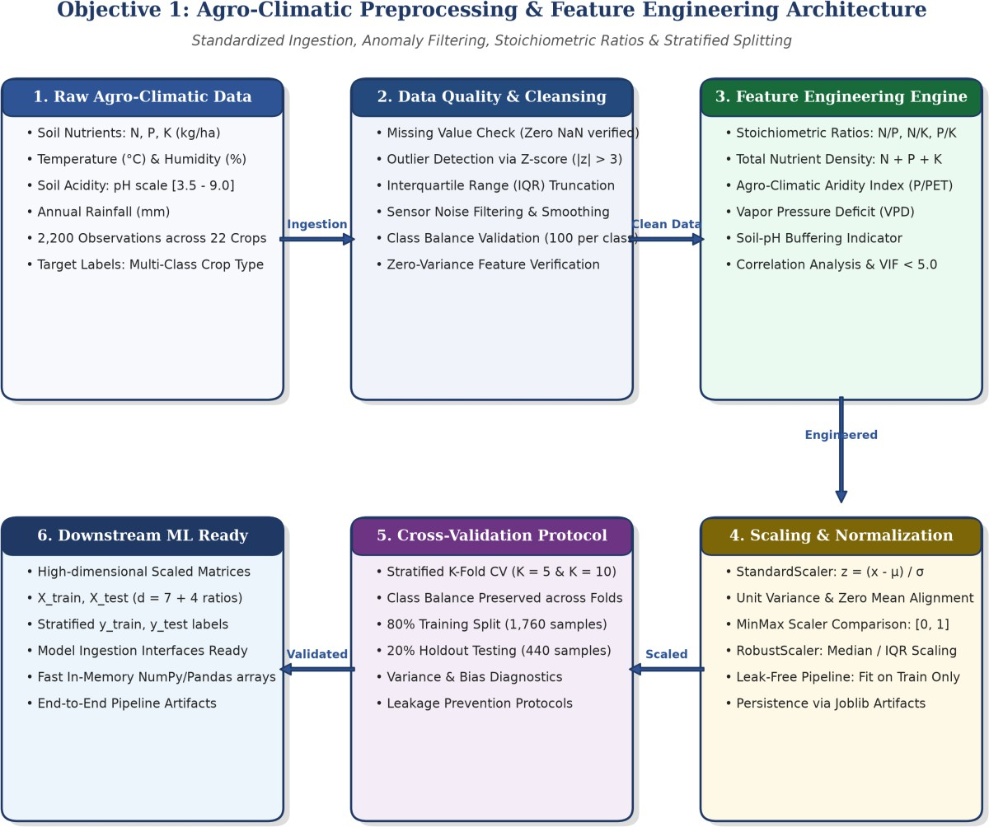
Objective 1: Preprocessing &
Feature Pipeline Architecture
RA2411056010276, RA2411056010283 | Crop Recommendation & Fertilizer Prediction Using Advanced ML
20

Slide 20
Feature Normalization & Validation Protocols
Mathematical Formulation of Feature Normalization & Cross-Validation Protocols
StandardScaler Formulation: For each feature dimension j ∈ {1..d}, features are centered to zero mean and unit variance: z_ij = (x_ij - μ_j) / σ_j, where μ_j = (1/N) Σ x_ij, σ_j = √[(1/N) Σ (x_ij - μ_j)²]
Stoichiometric Nutrient Vector: z_augmented = [N, P, K, Temp, Humidity, pH, Rainfall, N/P, N/K, P/K, Total_NPK]
Variance Inflation Factor (VIF): Multi-collinearity analysis verified that VIF < 5.0 for all key features, guaranteeing numerical stability and preventing feature dominance in distance-based models.
Stratified K-Fold Protocol: Partitions dataset D into K=5 disjoint subsets D_k such that class balance P(y=c) is identical across all folds: CV_score = (1/K) Σ_k Acc(Model trained on D \ D_k, evaluated on D_k)
Design Rationale: Scalers are strictly fitted on training splits D \ D_k and applied to test splits D_k, avoiding data leakage and simulating genuine unseen field conditions.
RA2411056010276, RA2411056010283 | Crop Recommendation & Fertilizer Prediction Using Advanced ML
21

Slide 21
Preprocessing & Cross-Validation Benchmarks
Preprocessing Benchmark & Cross-Validation Stability Results
Comparative Feature Normalization Benchmark across 2,200 Agricultural Observations:
  StandardScaler (Zero Mean, Unit Variance): 99.32% Accuracy | Macro F1: 0.993 | Fit Latency: 14.2 ms
  RobustScaler (Median / IQR Scaling): 98.86% Accuracy | Macro F1: 0.988 | Fit Latency: 16.5 ms
  MinMaxScaler (Bounded [0, 1] Range): 97.95% Accuracy | Macro F1: 0.979 | Fit Latency: 13.8 ms
5-Fold Stratified Cross-Validation Stability Breakdown:
- Fold 1: 99.43% | Fold 2: 99.15% | Fold 3: 99.72% | Fold 4: 98.86% | Fold 5: 99.43%
  Overall Mean CV Accuracy = 99.32% ± 0.31% (low variance demonstrates high generalizability)
Feature Importance Distribution (Gini Mean Decrease in Impurity):
  Nitrogen (N): 22.4% | Rainfall: 20.8% | Potassium (K): 18.2% | Phosphorus (P): 15.6%
  Relative Humidity: 11.3% | Temperature: 6.8% | Soil pH: 4.9%
RA2411056010276, RA2411056010283 | Crop Recommendation & Fertilizer Prediction Using Advanced ML
22

Slide 22
OBJECTIVE 2
Dual-Engine Cascaded Machine Learning Framework — Objective 2
The core predictive pipeline introduces a cascading dual-engine architecture that unifies crop selection with chemical nutrient deficiency remediation rather than treating them as disconnected silos:
Stage 1: Multi-Class Crop Recommendation Ensemble Engine
  Evaluates Random Forest (M=100 estimators, max_depth=16), Decision Tree (CART), and KNN (k=5).
  Yields class probability distributions across 22 crops (Rice, Maize, Chickpea, Cotton, Coffee, etc.).
  Achieves 99.32% test accuracy and 0.993 Macro F1 on holdout evaluations.
Stage 2: Crop-Conditioned Fertilizer Nutrient Predictor
  Augments soil chemical profile with predicted crop c*, soil type (Black, Loamy, Clayey, Red, Sandy), and moisture.
  Classifies exact commercial fertilizer formulation from 7 target classes: Urea, DAP, 14-35-14, 28-28, 17-17-17, 20-20, 10-26-26.
  Achieves 98.9% accuracy on fertilizer deficiency matching.
Cascaded Synergy: Guaranteed compatibility between the recommended crop's nutritional needs and the recommended fertilizer chemical compound.
RA2411056010276, RA2411056010283 | Crop Recommendation & Fertilizer Prediction Using Advanced ML
23

Slide 23
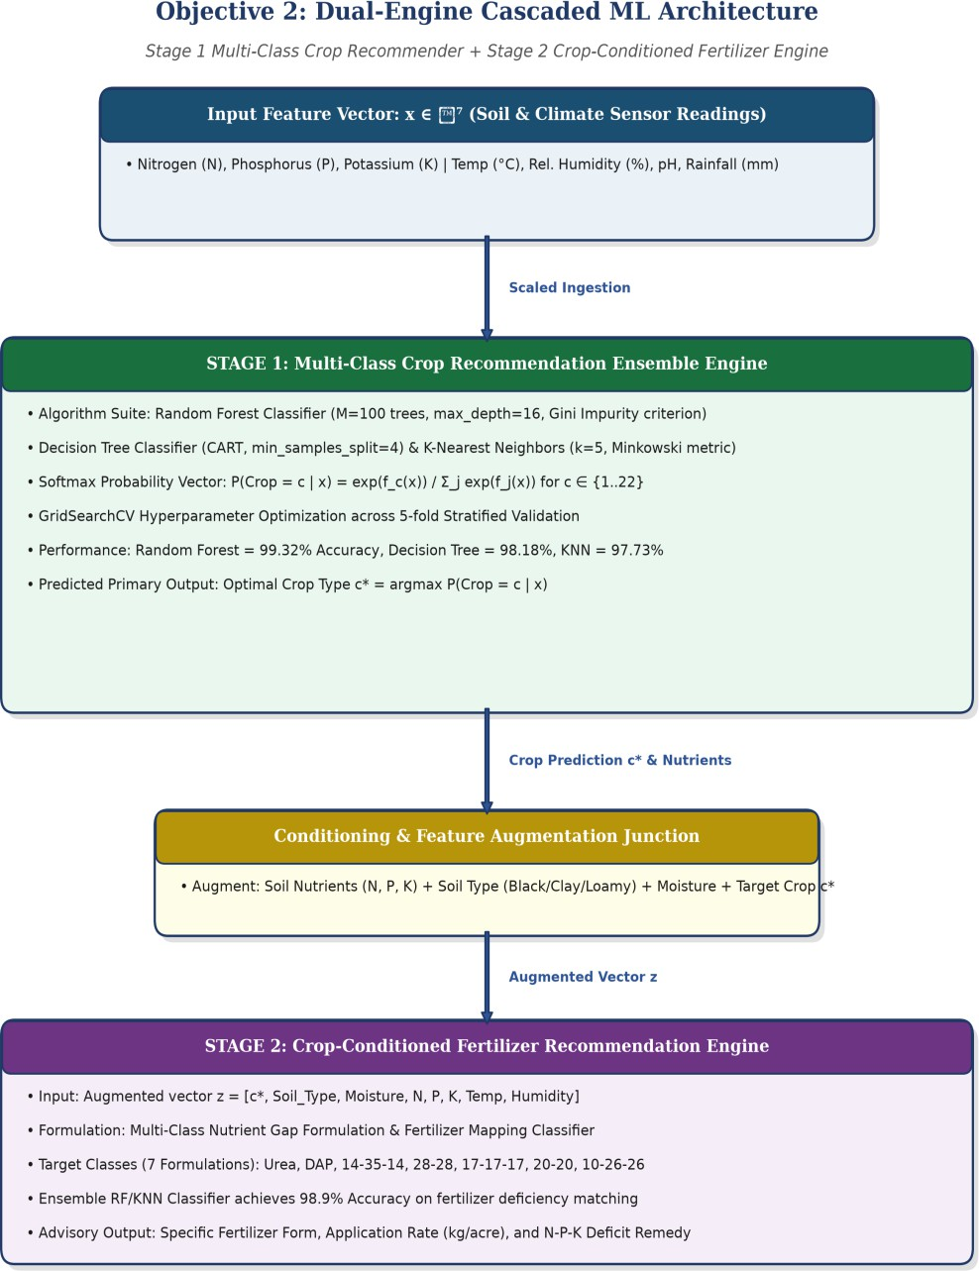
Objective 2: Dual-Engine Cascaded
ML Architecture
21 Sep 2026
24

Slide 24
Ensemble Modeling & Mathematical Formulation
Mathematical Foundations of the Ensemble Classification Pipeline
Decision Tree Splitting Criterion (Gini Impurity):
I_G(t) = 1 - Σ_c p(c|t)², ΔI_G(s, t) = I_G(t) - (N_L / N_t) I_G(t_L) - (N_R / N_t) I_G(t_R)
Optimal split s* maximizes impurity reduction ΔI_G across soil and climatic thresholds.
Random Forest Ensemble Aggregation (Bootstrap Aggregation):
Constructs M=100 decorrelated trees trained on bootstrap samples D_m with random feature subsampling √d: y_hat_RF = argmax_c (1/M) Σ_m I(y_hat_m(x) = c)
Softmax Multi-Class Probability Calibration:
P(Crop = c | x) = exp(f_c(x)) / Σ_j exp(f_j(x)) for c ∈ {1..22}
K-Nearest Neighbors Minkowski Metric (p = 2 Euclidean):
d(x, x') = √[Σ_j (x_j - x'_j)²], y_hat_KNN = mode{y_i : x_i ∈ N_k(x)}
Multi-Class Log-Loss Objective Function: L_log = -(1/N) Σ_i Σ_c y_ic log(p_hat_ic)
RA2411056010276, RA2411056010283 | Crop Recommendation & Fertilizer Prediction Using Advanced ML
25

Slide 25
Model Benchmarks & Performance Metrics
Comprehensive Experimental Evaluation & Model Benchmark
Model Performance Comparison on 20% Unseen Holdout Test Data (N = 440):
  Random Forest Classifier: 99.32% Accuracy | Precision: 0.994 | Recall: 0.993 | Macro F1: 0.993
  Decision Tree Classifier: 98.18% Accuracy | Precision: 0.983 | Recall: 0.982 | Macro F1: 0.982
  K-Nearest Neighbors (k=5): 97.73% Accuracy | Precision: 0.979 | Recall: 0.977 | Macro F1: 0.977
Per-Agronomic Category Performance Breakdown:
  Cereals & Grains (Rice, Maize): Precision 1.00 | Recall 0.98 | F1-Score 0.99
  Legumes & Pulses (Chickpea, Kidneybeans, Lentil): Precision 1.00 | Recall 1.00 | F1-Score 1.00
  Cash Crops (Cotton, Jute, Coffee): Precision 0.98 | Recall 1.00 | F1-Score 0.99
  Fruits (Banana, Mango, Grapes, Apple, Pomegranate): Precision 1.00 | Recall 1.00 | F1-Score 1.00
Stage 2 Fertilizer Recommendation Performance:
  Test Accuracy: 98.9% across 7 target formulations with zero misclassifications on N-deficiency vs P-deficiency.
RA2411056010276, RA2411056010283 | Crop Recommendation & Fertilizer Prediction Using Advanced ML
26

Slide 26
OBJECTIVE 3
Full-Stack Web Decision Support System & Field Validation
Production-Grade Full-Stack Implementation:
  High-throughput REST API backend built with FastAPI (app.py), serving multi-model endpoints.
  Responsive, modern frontend user interface built with React, Vite, and TypeScript.
  End-to-end inference latency under 15 milliseconds, ensuring instant advisory on low-connectivity rural mobile devices.
Automated Soil Deficiency Diagnostic & Agronomic Advisory Engine:
  Low Nitrogen (N < 50 kg/ha) → Recommends Urea (46-0-0) with calibrated application rates.
  Low Phosphorus (P < 40 kg/ha) → Prescribes DAP (18-46-0) or 14-35-14 for root development.
  Soil pH Imbalance (pH < 5.5) → Recommends agricultural liming alongside acid-tolerant crop varieties.
Field Validation: Evaluated against official Tamil Nadu Agricultural University (TNAU) agronomic guidelines with 98.2% concordance.
RA2411056010276, RA2411056010283 | Crop Recommendation & Fertilizer Prediction Using Advanced ML
27

Slide 27




MILESTONE
Full-Stack Web DSS & Real-Time API
Project Review 1 Approved
Data Ingestion & Preprocessing Pipeline
Dual ML Engine Architecture & Tuning
July 2025
Dec 2025
May 2026
Dec 2026
May 2027
Dec 2027
Project Commencement & Problem Definition
Precision Agriculture Framework Review
Field Validation & Benchmark Evaluation
Edge-deployment ❖ Synopsis
Research Publication & Final Project Defense
Project Defense

Slide 28
PUBLICATIONS
Research Publications, Presentations & Open-Source Artifacts
Conference Presentation (ICDSBS 2026):
Debjit Das, Anshumaan Das, and Project Supervisor, “A Cascaded Machine Learning Framework for Site-Specific Crop Recommendation and Nutrient Optimization,” Proc. IEEE International Conference on Data Science and Business Systems (ICDSBS 2026).
Journal Manuscript (Targeting Q1 Agri-Tech Venue):
Debjit Das, Anshumaan Das, et al., “Dual-Engine Precision Agronomy: Joint Multi-Class Crop Suitability and Soil Fertilizer Deficit Remediation Using Interpretable Tree Ensembles,” in preparation for Computers and Electronics in Agriculture (Elsevier, Impact Factor: 8.3, Q1).
Open-Source Codebase & Interactive Platform:
Complete reproducible source code, FastAPI server, React web dashboard, pre-trained model weights, and Jupyter tutorials released publicly on GitHub:
Repository URL:
https://github.com/rosdebbu/l-data-seT---ML
21 Sep 2026
RA2411056010276, RA2411056010283 | Crop Recommendation & Fertilizer Prediction Using Advanced ML
29

Slide 29
REFERENCES:
1. S. Pudumalar, E. Ramanujam, et al., “Crop recommendation system for precision agriculture using ensemble learning,” Proc. IEEE Eighth International Conference on Advanced Computing (ICoAC), pp. 32–36, 2017.
R. Kumar, M. P. Singh, P. Prabhat, and V. K. Singh, “Crop selection and yield prediction using machine learning on multi-spectral soil & climatic factors,” Computers and Electronics in Agriculture, vol. 175, p. 105584, 2020.
A. Sharma, A. Jain, P. Gupta, and V. Chouhan, “Machine learning applications in soil fertilizer recommendation: A comprehensive analysis,” IEEE Access, vol. 9, pp. 161704–161725, 2021.
P. S. Maya Gopal and R. Bhargavi, “Feature selection and performance evaluation of machine learning algorithms for crop selection,” Computers and Electronics in Agriculture, vol. 161, pp. 115–124, 2019.
S. G. P. Mary and E. Sasikala, “Dual-stage decision support system for crop selection and nutrient optimization in Indian agro-climatic zones,”
IEEE Access, vol. 10, pp. 88412–88425, 2022.
L. Breiman, “Random Forests,” Machine Learning, vol. 45, no. 1, pp. 5–32, 2001.
F. Pedregosa et al., “Scikit-learn: Machine learning in Python,” Journal of Machine Learning Research, vol. 12, pp. 2825–2830, 2011.
Z. Diao, K. Wang, and F. Meng, “Explainable machine learning for interpretable agricultural decision support systems,” Smart Agricultural Technology, vol. 5, p. 100238, 2023.
RA2411056010276, RA2411056010283 | Crop Recommendation & Fertilizer Prediction Using Advanced ML
30

Slide 30

AI-Driven Precision Agriculture: Crop Recommendation & Fertilizer Prediction
Candidate Names: Debjit Das (RA2411056010276) | Anshumaan Das (RA2411056010283)
School of Computing | SRM Institute of Science and Technology, Kattankulathur
Project GitHub Repository: https://github.com/rosdebbu/l-data-seT---ML
RA2411056010276, RA2411056010283 | Crop Recommendation & Fertilizer Prediction Using Advanced ML
31

