Slide 1
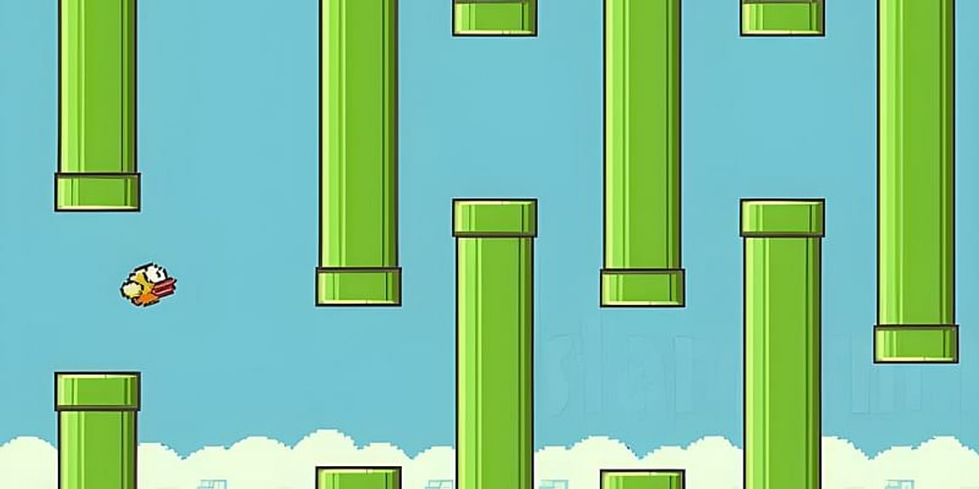
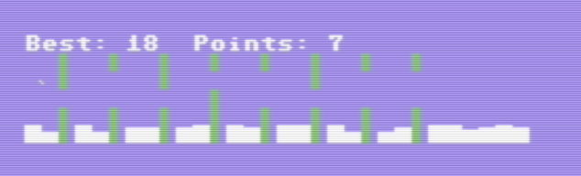
TenFlappy
By
Rosario De Chiara @rosdec
for the
13th Edition of BASIC 10 Liner Contest

Slide 2
The challenge was to convey the animation of the bird, the effect of the gravity and the simple commands to play with it in ten lines of code.
When the game was complete I had one more line of code available.
So I added the clouds and the high score!
The challenge

Slide 3
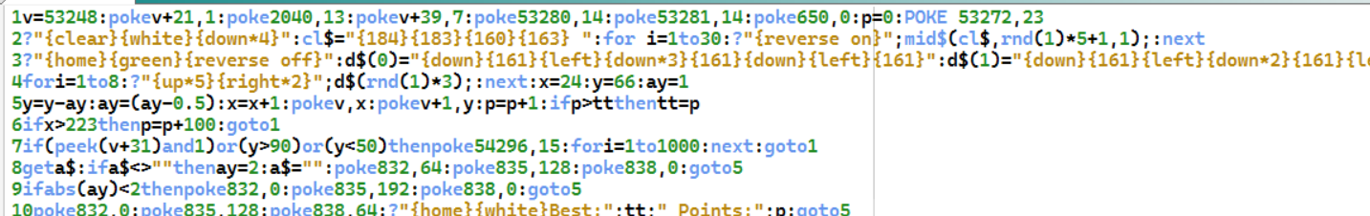
Line 1: just set up of costants
Line 2: draw the clouds random sampling string cl$
Line 3: set the array d$ with the possible pipes configuration (3 at the moment)
Line 4: draw the pipes by randomly printing elements of the array d$
Line 5: move the bird horizontally and applies the gravity. Also checks if we have a new high score
Code description

Slide 4
Line 6: checks if the bird has finished the level: if so add a bonus and starts a new level
Line 7: checks if the bird hit something: plays a sound and restart a new game
Line 8: checks if a key has been pressed: if so changes the sprite shape (pointing up) and applies vertical accelleration
Line 9: if the accelleration changes the sprite shape (flying horizontal)
Line 10: changes the sprite shape (pointing down) and prints the score
Code description

Slide 5
Rosario De Chiara
@rosdec
https://www.dechiara.eu

