Slide 1
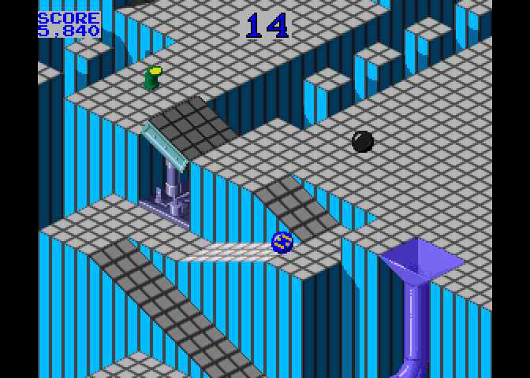




EMBRYO
THE OF MARBLE MADNESS IN TEN LINES OF
PURE
BASIC V2 CODE
Reach the exit tunnel to the next level
Avoid water
Use your energy to the last drop
Take advantage of slopes
How many levels will you be able to survive?

Slide 2
This is the initialization of the constants and the fuel variable: Executed once
0v=53248:q=.5:pOv+33,12:pOv+32,12:pOv+29,1:pOv+23,1:f=99:?"{clear}":x=24:y=58
Lines 1 and 2 are the place where the field is drawn and the sprite is defined. Please note how the sprite is a single byte and is doubled on both dimensions: This is executed on every new level
1?"{light gray}{cm +}";:fOi=1to62:pO199,i*9/8aN1:?mI("{light gray}{sh pound}{dark gray}{cm asterisk}{blue} ",rN(1)*6or1,2);:if((iaN7)=7)tH? 2nE:?"{red}W":pOv+21,1:pO832,128:pO2040,13:pOv+39,2:r=233:z=105
This is the game loop: read the joystick, cleverly update the coords of the sprite depending on which side of a slope the sprite is at the moment: The logic is cramped with the clever (?) manipulation of the result of logic comparisons
3j=pE(56320):u=((jaN2)/4-(jaN1)/2)*2:c=(jaN8)/8-(jaN4)/4:x1=int((x-24)/8)
4y1=int((y-50)/8):xm=x-int(x/8)*8:ym=(y-2-int((y-2)/8)*8):d=2*((xm+ym)<7)+1 5t=2*(xm<ym)+1:k=pE(1024+x1+y1*40):x=x-((k=z)or(k=r))*d*q-((k=95)or(k=223))*t*q 6y=y-((k=z)or(k=r))*d*q+((k=95)or(k=223))*t*q
This is the where we check various conditions: the game ends if the sprite hit a pond, went outside of the map or, sadly, the fuel runs out
7if(k=160)or(f<1)or(x<24)or(y<58)tHpO781,0:sY59903:?"{home}game over":eN
8if(k=215)tHl=l+1:q=q+.1:?"{clear}":x=24:y=58:f=f+20:gO1
Here we update the dashboard and move the sprite
9?"{home}{red}l:";l;"S:";f:f=f+(j<127):x=x-c:y=y-u:pOv,x:pOv+1,y:gO3

Slide 3
Rosario De Chiara
2023
www.dechiara.eu

Slide 4
Thanks to this video from Robin of 8-Bit Show And Tell
Thanks to Arthur Jordison for the fantastic CBM prg Studio!

