Slide 1
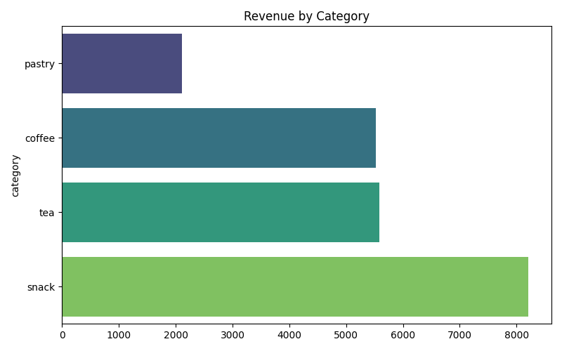
Revenue by Product Category

Slide 2
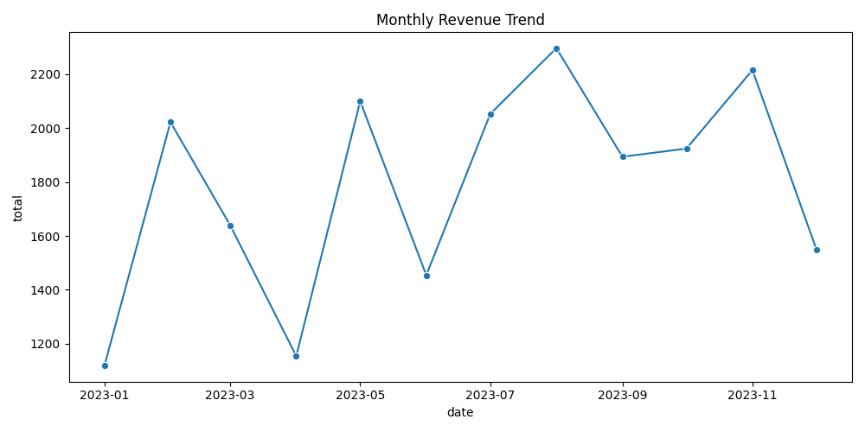
Monthly Revenue Trend

Slide 3
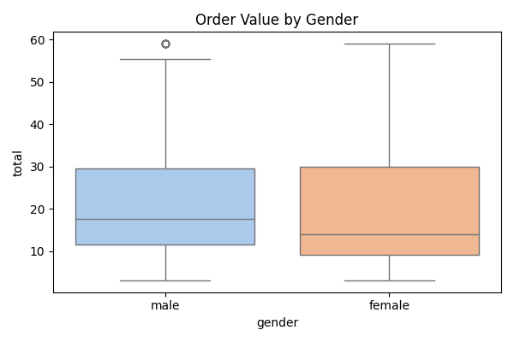
Order Value by Gender

Slide 4
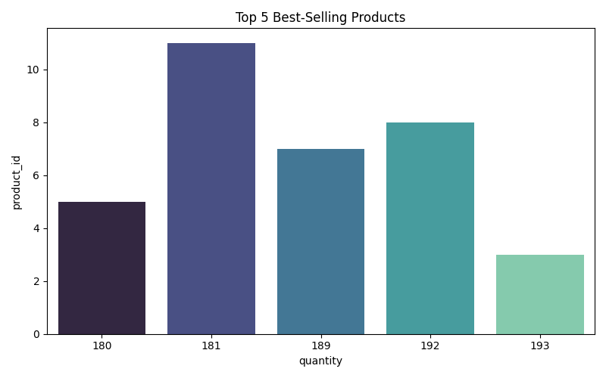
Top 5 Best-Selling Products

Slide 5
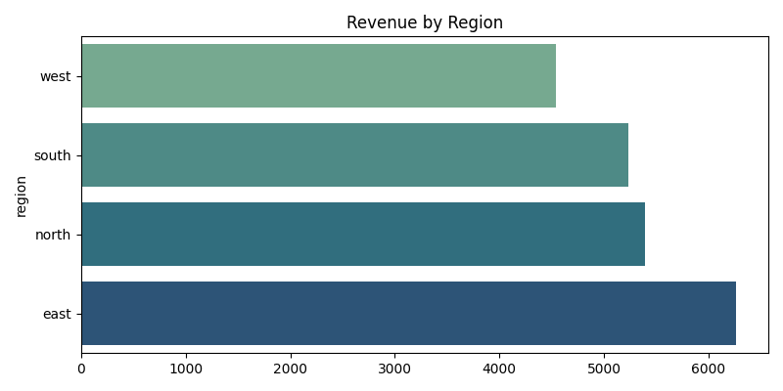
Revenue by Region

Slide 6
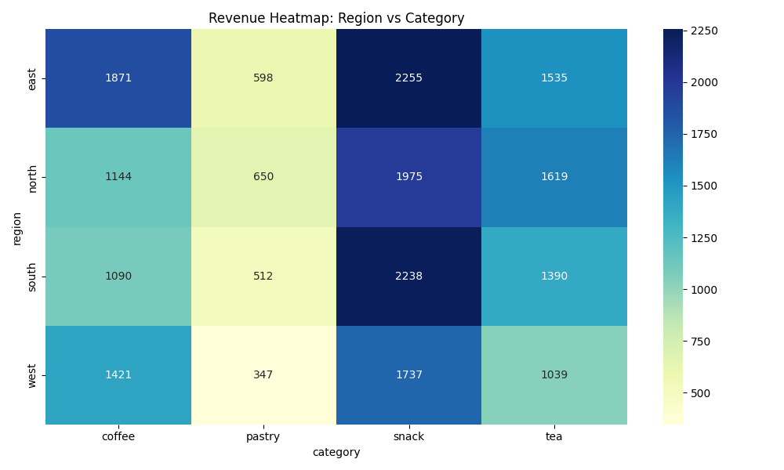
Revenue Heatmap

