Slide 1

NotifyMe
Rosdyana.kusuma@gameloft.com

Slide 2
What is Notify Me
NotifyMe is simple app that have important purpose. This app is written in PHP. NotifyMe will be triggered automatically when programmer commit their codes to SVN. It will generate daily report at 4:30 pm and will send this report file to direct supervisor at 5:00 pm.

Slide 3
Why we need NotifyMe
NotifyMe will help our programmer to create daily report seamlessly. Programmers don’t need to write email to report, basically with this they are reporting while they are working at the same time.
Some advantages of NotifyMe :
NotifyMe help supervisor to create report structured and clear.
NotifyMe help us to supervising subordinate. We will know what they already done in work hours.
NotifyMe can be simple documentation about bug fixing, it will be useful if we found similar bugs in the future.
No More Magabuting with NotifyMe ☺

Slide 4
Work Flow
User Commit Codes to SVN.
NotifyMe will appear.
User need to input data.
At 4:30 working days, NotifyMe will generate report automatically.
Before it send, user need to double check, if they want to add something before send it.

Slide 5
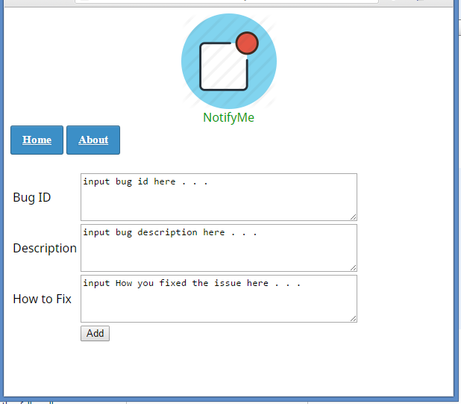
Add data

Slide 6
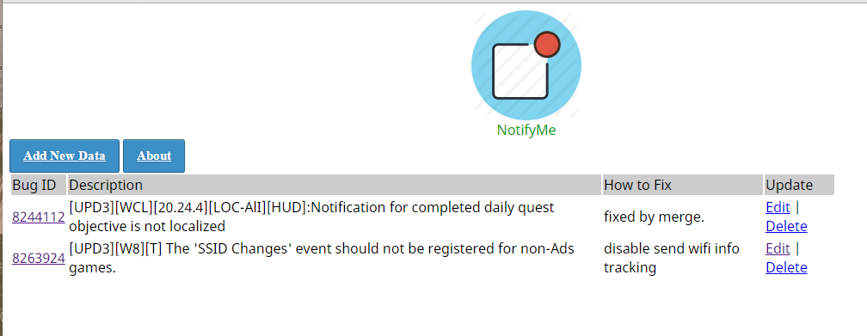
homepage

Slide 7
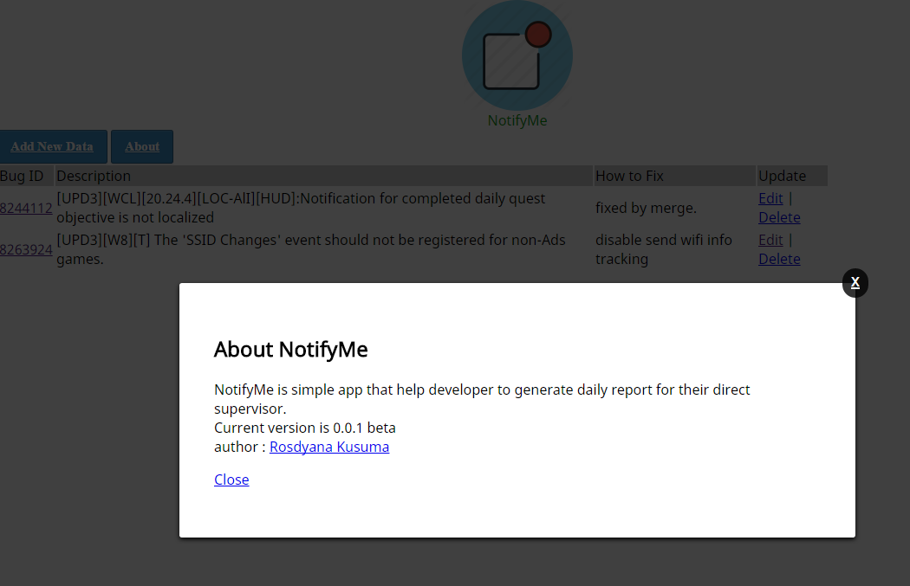

Slide 8
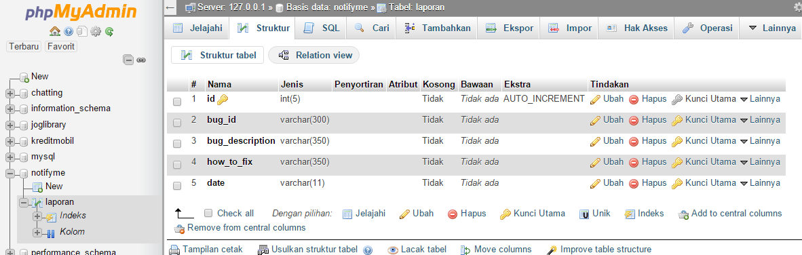
database

Slide 9
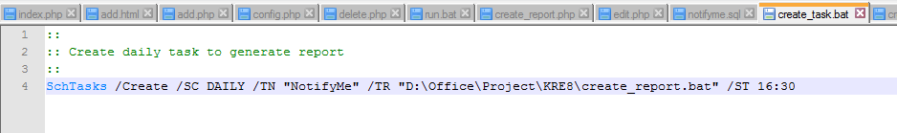
Script task

Slide 10
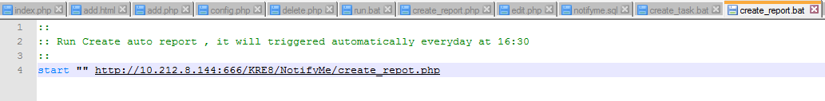
Script create report

Slide 11
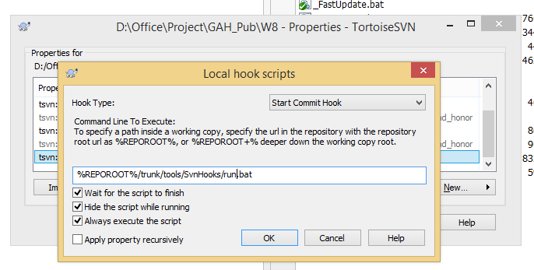
svnhook

Slide 12
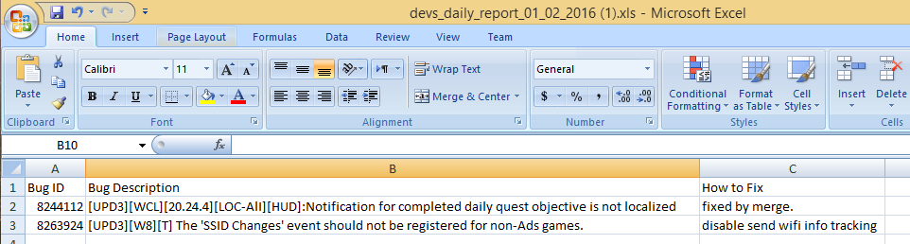
Generated report file

Slide 13
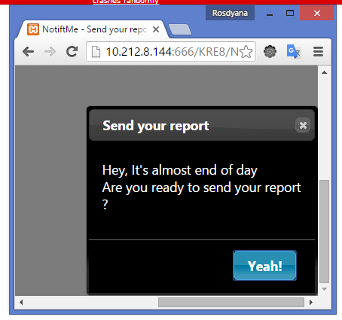
At 4:30PM
NotifyMe will generate report and open mail client
Then they need to check it before send the report. This one will avoid user fill empty report, maybe in that day they still research something.

