Slide 1
A node-level programming model framework for exascale computing*
By Chunhua (Leo) Liao, Stephen Guzik, Dan Quinlan
LLNL-PRES-539073
* Proposed for LDRD FY’12, initially funded by ASC/FRIC and now being moved back to LDRD
Notes:
ASC: : NNSA- Advanced Simulation & Computing
* FRIC: longer-term ASC needs , Focused Research, Innovation, and Collaboration (FRIC) conducts mid-term research targeting code development and V&V

Slide 2
We are building a framework for creating node-level parallel programming models for exascale
Problem:
  Exascale machines: more challenges to programming models
  Parallel programming models: important but increasingly lag behind node-level architectures
Goal:
  Speedup designing/evolving/adopting programming models for exascale
Approach:
  Identify and implement common building blocks in node-level programming models so both researchers and developers can quickly construct or customize their own models
Deliverables:
  A node-level programming model framework (PMF) with building blocks at language, compiler, and library levels
  Example programming models built using the PMF
Notes:
Exascale challenges: parallelism, locality, (performance), heterogeneity, energy, resilience

Slide 3

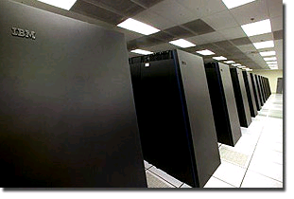
Programming models bridge algorithms and machines and are implemented through components of software stack
Algorithm
Programming Model
Express
Abstract Machine
Software Stack
Measures of success:
Expressiveness
Performance
Programmability
Portability
Efficiency
…
Language
Application
Compiler
Compile/link
Executable
Library
Execute
…
Real
Machine

Slide 4
Parallel programming models are built on top of sequential ones and use a combination of language/compiler/library support
Programming
Model
Parallel
Sequential
Shared Memory (e.g. OpenMP)
Distributed Memory (e.g. MPI)
Interconnect
Abstract
Machine
(overly
simplified)
Memory
Shared Memory
CPU
Memory
Memory
CPU
…
CPU
…
CPU
CPU
General purpose
Languages (GPL)
C/C++/Fortran
Software
Stack:
1. Language
2. Compiler
3. Library
GPL + Directives
GPL + Call to MPI libs
Sequential
Compiler
Seq. Compiler
+ OpenMP support
Seq. Compiler
Optional Seq. Libs
OpenMP Runtime Lib
MPI library

Slide 5
Problem: programming models will become a limiting factor for exascale computing if no drastic measures are taken
Future exascale architectures
  Clusters of many-core nodes, abundant threads
  Deep memory hierarchy, CPU+GPU, …
  Power and resilience constraints, …
(Node level) programming models:
  Increasingly complex design space
  Conflicting goals: performance, power, productivity, expressiveness
Current situation:
  Programming model researchers: struggle to design/build individual models to find the right one in the huge design space
  Application developers: stuck with stale models: insufficient high-level models and tedious low-level ones

Slide 6
Solution: we are building a programming model framework (PMF) to address exascale challenges
A three-level, open framework to facilitate building node-level programming models for exascale architectures
Programming model 1
Directive 1
Reuse & Customize
Language Extensions
Language Ext.
Level 1
…
Directive n
Compiler Sup.
Runtime Lib.
Compiler Support (ROSE)
Tool 1
Programming model 2
Level 2
…
Tool n
Compiler Sup.
Runtime Lib.
Function 1
Level 3
Runtime Library
…
…
Programming model n
Function 1
Runtime Lib.
Notes:
Instead of following the crowd of designing individual parallel programming models, we are interested in finding the fundamental , common building
blocks among various node-level programming models.
These building blocks can come from language, compiler or library layer of software stack.
Language: pragmas to express common semantics
Compiler: tools for analyses, translations, optimizations
Runtime: thread manipulation, data movement, scheduling
With our framework, multiple programming model can be instantiated by selecting building blocks from one of several levels.
This will greatly fasten the design and implementation of parallel programming models.

Slide 7
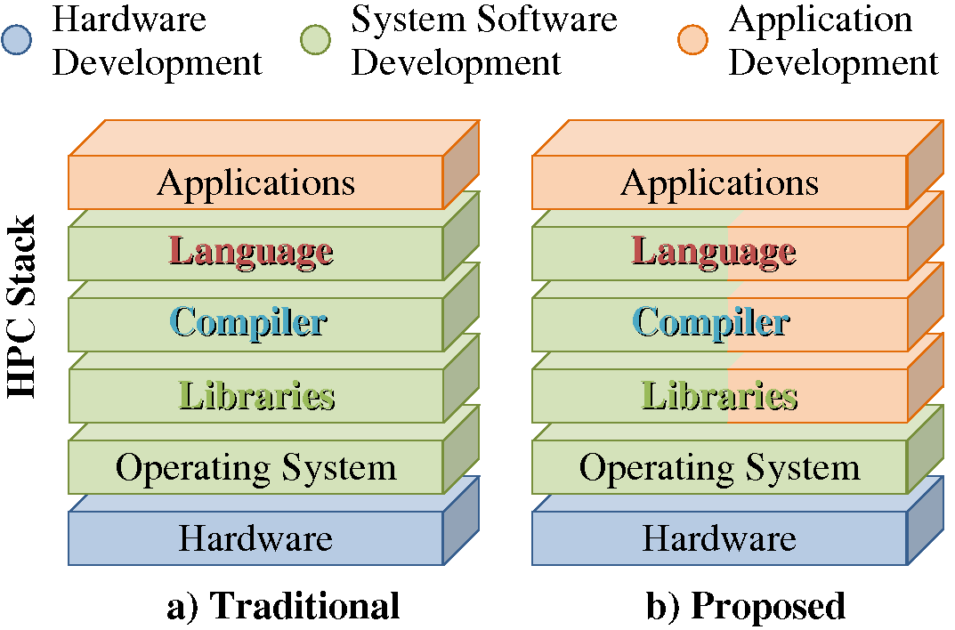
We will serve both researchers and developers, engage lab applications, and target heterogeneous architectures
Users:
  Programming model researchers: explore design space
  Experienced application developers: build custom models targeting current and future machines
Scope of this project
The programming model framework vastly increases the flexibility in how the HPC stack can be used for application development.
  DOE/LLNL applications
  Heterogeneous architectures: CPUs + GPUs
  Example building blocks: parallelism, heterogeneity, data locality, power efficiency, thread scheduling, etc.
  Two major example programming models built using PMF
Notes:
Our framework will expose all three levels of software stack to developers so they can customize programming models to fit their own domain-specific needs.
They can also try out new building blocks to get early experiences of future parallel models and will be more readily to adopt them.
Currently, App. developers are either hacking with poor tools (such as macros) or using very low-level and costly models.
Obviously, building a comprehensive framework coving all applications and exascale architectures is beyond the scope of a 3-year project.
In this proposal, we will limit the scope to engaging lab apps, targeting het, and identify fundamental building blocks
Building a model targetting CPUs and GPUs is our route to getting started – ie., this + OpenMP will help us configure and design the core components.

Slide 8
Example 1: researchers use the programming model framework to extend a higher-level model (OpenMP) to support GPUs
OpenMP: a high level, popular node-level programming model for shared memory programming
  High demand for GPU support (within a node)
PMF: provides a set of selectable, customizable building blocks
  Language: directives, like #acc_region, #data_region, #acc_loop, #data_copy, #device, etc.
  Compiler: parser builder, outliner, loop tiling, loop collapsing, dependence analysis, etc. , based on ROSE
  Runtime: thread management, task scheduling, data transferring, load balancing, etc.
Notes:
Higher level model: OpenMP extended for GPUs
Lower level model: C++ plus CUDA targeting structured-array AMR
Customizable by users

Slide 9
Using PMF to extend OpenMP for GPUs
Programming model framework
OpenMP Extended for GPUs
Directive 1
#pragma omp acc region
#pragma omp acc_loop
#pragma omp acc_region_loop
Level 1
Language Extensions
…
Directive n
Reuse &
Customize
Pragma_parsing()
Outlining_for_GPU()
Insert_runtime_call()
Optimize_memory()
Compiler Support (ROSE)
Tool 1
Level 2
…
Tool n
Function 1
Dispatch_tasks()
Balancing_load()
Transfer_data()
Level 3
Runtime Library
…
Function 1

Slide 10
Example 2: application developers use PMF to explore a lower level, domain-specific programming model
Target lab application:
  Lattice-Boltzmann algorithm with adaptive-mesh refinement for direct numerical simulation studies on how wall-roughness affects turbulence transition.
  Stencil operations on structured arrays
Requirements:
  Concurrent, balanced execution on CPU & GPU
  Users do not like translating OpenMP to GPU
  Want to have the power to express lower level details like data decomposition
  Exploit domain features: a box-based approach for describing data-layout and regions for numerical solvers
  Target current and future architectures
Notes:
Language level:
Mixed C++ , CUDA (to express data parallelism and manage cache), and pragmas (to help other chores)
Structured-array/“box-based” AMR
Box CUDA infrastructure
Compiler level: separate algorithms and implementation
Transform to work-queue threading strategy
Retargeting: translate CUDA to other vector processors
Runtime level
CPU/GPU scheduler
The CUDA programming model is embedded in the overall programming model:
Used CUDA kernels instead of Fortran kernels.
It is a good model that promotes effective programming of the cache and extraction of fine-level parallelism. It forces the developer to think carefully about data layouts and how to structure an algorithm so the cache is used effectively.
Box CUDA helps with writing kernels that implement stencil operations on structured arrays.
For other minor kernels “MINT programming model”
Motivation
Leverage domain expertise
Concurrent execution (load-balancing) of CPU & GPU
Approaches (Risks)
New languages (support/lifetime)
New programming models (lag/features)
PMF: customizable domain-specific programming models directly created by domain experts
Benefits
Reusable components – building blocks
Application developers have flexibility to customize programming models to suite their needs
Provides an extra layer of abstraction between the code for the algorithm and the target architecture

Slide 11
Using the PMF to implement the domain-specific programming model (ongoing work with many unknown details)
C++ (main algorithm infrastructure)
Pragmas (gluing and supplemental semantics)
Compiler Support
Building blocks
Source-code that can be compiled using native compilers
Cuda (describe kernels)
Architecture A
Architecture B
Executable
Language feature
Use a sequential language, CUDA, and pragmas to describe algorithms
Compiler (first compilation)
Generate code to help chores
Custom code generation for multiple architectures
Final compilation using native compilers, linking with a runtime library
* Scheduling among CPUs and GPUs
Notes:
Algorithm, Programming model implementation, final source.
Two stages of compilation
First stage can be performed on any workstation.

Slide 12
Summary
We are building a framework instead of a single programming model for exascale node architectures
  Building blocks : language, compiler, runtime
  Two major example programming models
Programming model researchers
  Quickly design and implementation solutions to exascale challenges
  Eg. Explore OpenMP extensions for GPUs
Experienced application developers
  Ability to directly change the software stack
  Eg. Compose domain-specific programming models
Notes:
Trial lattice-Boltzmann application
Can developers write CUDA kernels if given the right support infrastructure?
Will writing CUDA kernels enable better code (even on classic architectures, e.g., x86 vector registers)?
Can other structured-array applications easily adopt programming models using the building blocks that will be created for this one?
What if a new architecture comes along?
Simply change the ROSE-based translator

Slide 13

Thank you!

