Slide 1
Plotting with Plotly!
WOMEN WHO CODE - DC
NEHA TIWARI

Slide 2
CODE OF CONDUCT
WWCode is a non-profit organization dedicated to inspiring women to excel in technology careers. We are committed to our mission statement and equally committed to providing a harassment-free experience for everyone regardless of gender, gender identity and expression, sexual orientation, ability, physical appearance, body size, race, ethnicity, age, religion, socioeconomic status, caste or creed. We do not tolerate harassment of event participants in any form. Event participants violating these rules may be sanctioned or expelled permanently, at the discretion of the event organizers, which in most cases are members of the WWCode leadership team.
MONTHLY PYTHON LAB
WWCode has a monthly Python lab on the 3rd Wednesday and a Beginners Night @Fiscal Note every other first Wednesday of the Month from 6:30-8:30pm.
JOIN THE SLACK COMMUNITY
Join the Slack community at http://bit.ly/wwcdcslack

Slide 3
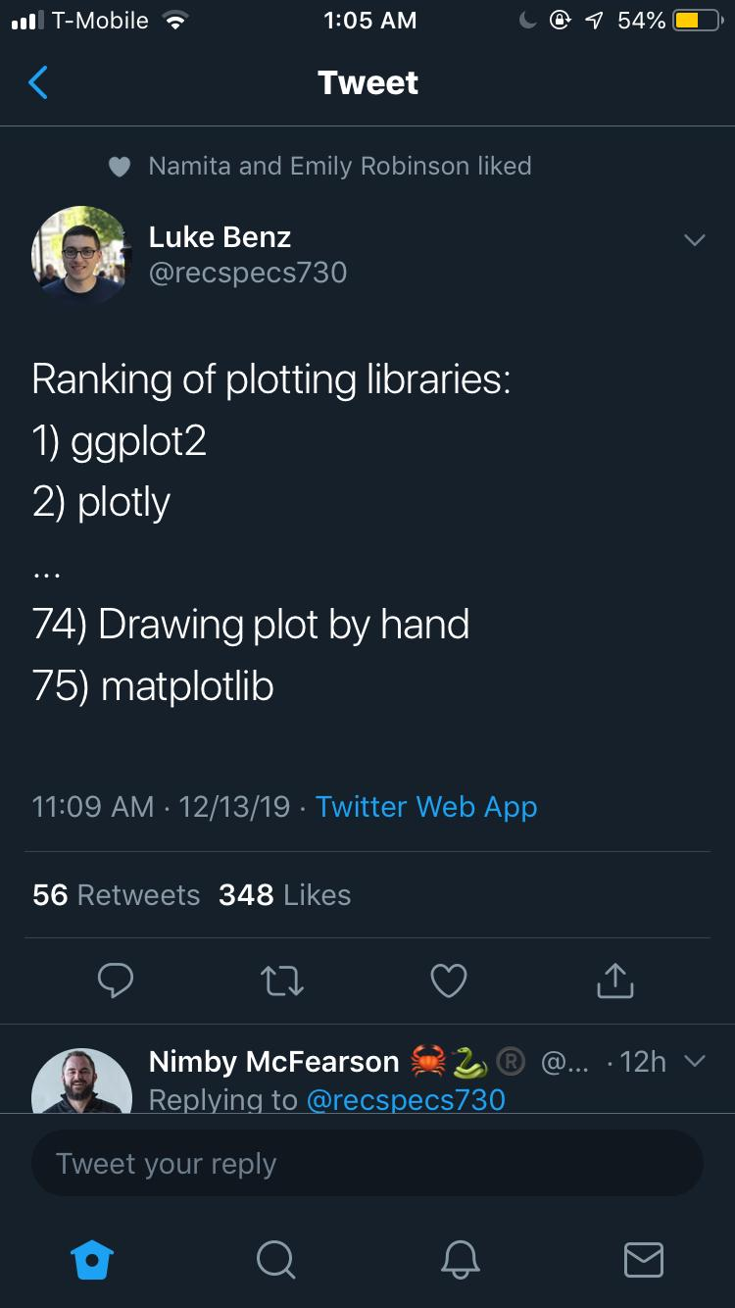

Slide 4
What is a Plot.ly?
It is known for developing and providing online analytics, statistics and graphing tools for individuals or companies.
- develops/provides scientific graphing libraries for Arduino, Julia, MATLAB, Perl, Python, R and REST.
Notes:
The syntax is fairly similar across most languages, with some exceptions.

Slide 5
Why Plotly?
It is interactive
Charts are not saved as images but serialized as JSON
Exports vector for print/publication
Easy to manipulate/embed on web

Slide 6
Installation and Use:
pip install plotly==4.3.0
conda install -c plotly plotly=4.3.0
We will be using Google Colab so no installation needed for now!

Slide 7
Code:
Link to colab notebook: https://colab.research.google.com/drive/1qKnLo0ViVEAinxIeBGwlvb-p0ZfQWxwn

Slide 8
References:
Plot.ly Python reference page
Figure reference - Documentation
Notes:
making them open to be read with R, MATLAB, Julia and others easily

