Slide 1




“A QUICK SYNOPSIS OF MACROECONOMIC EVENTS IMPACTING MARKETS.”
WEEKLY REVIEW
WEEK ENDING AUGUST 30
2024
CONTENT AND GRAPHICS, CREATED AND WRITTEN BY NIKKI ROSE
EMAIL: rrose.n2420@gmail.com

Slide 2


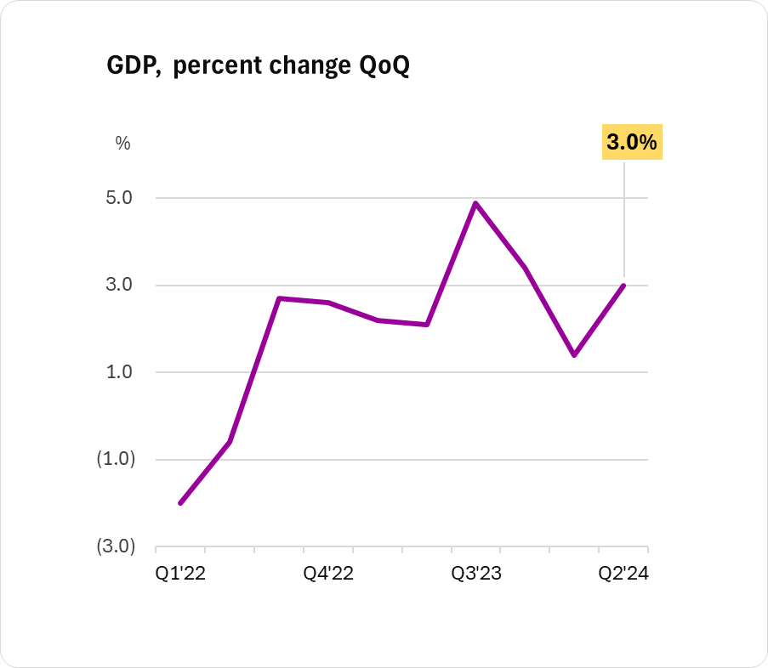
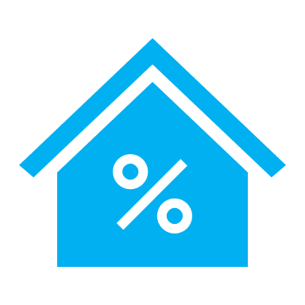

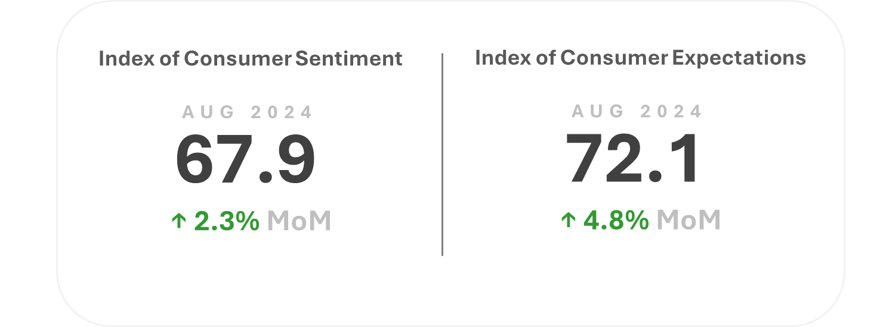
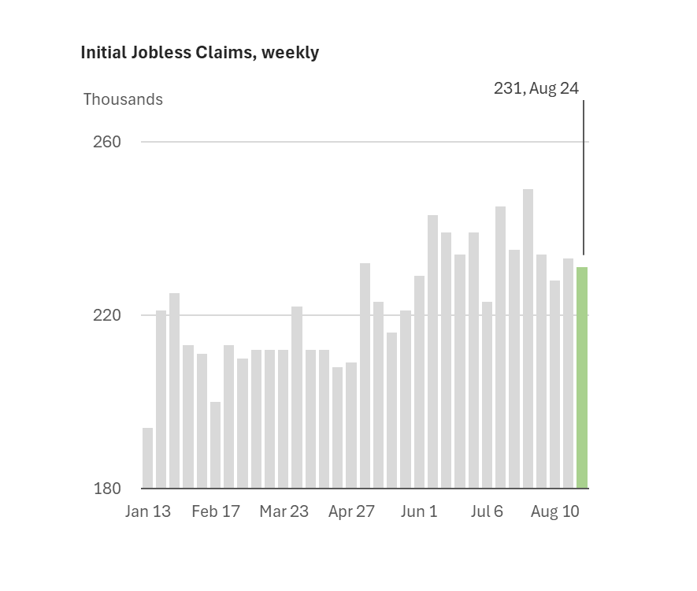
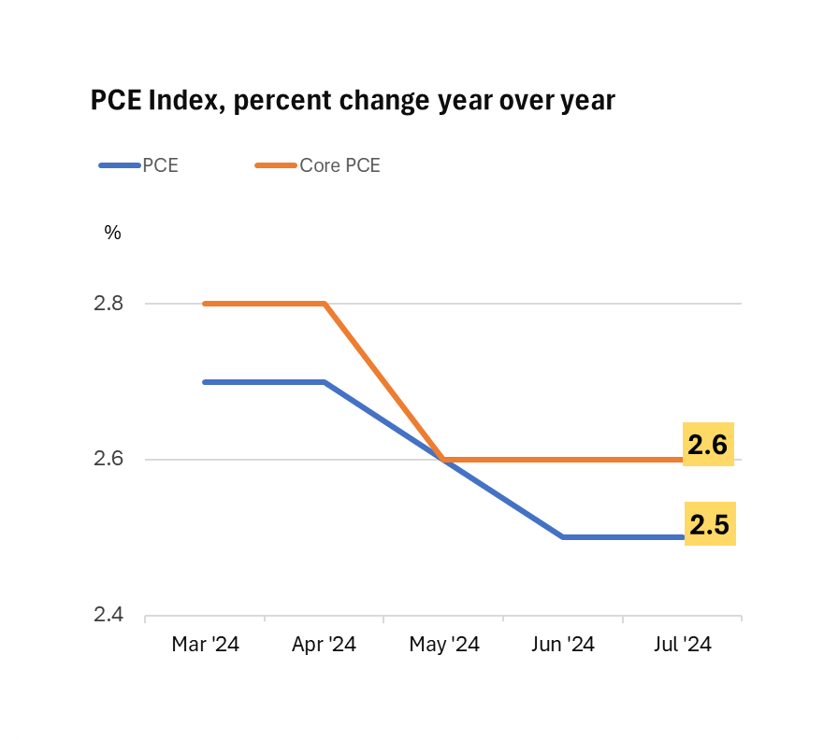
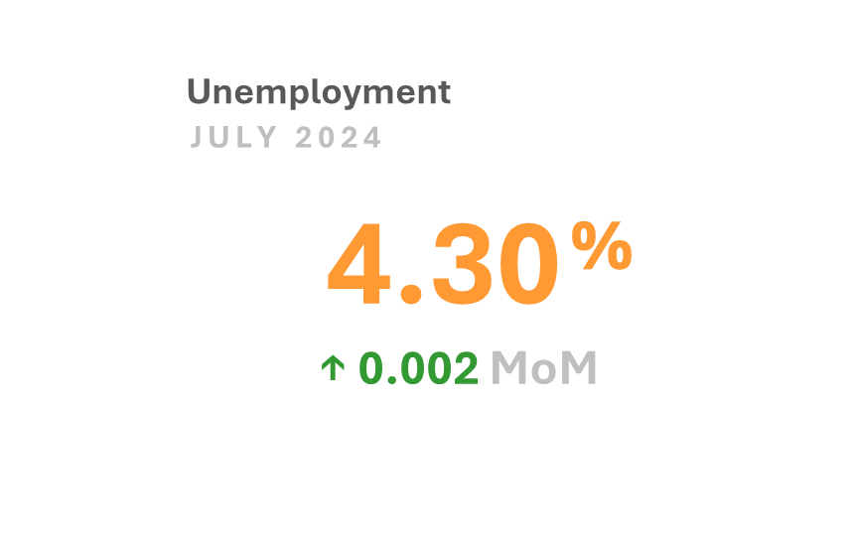
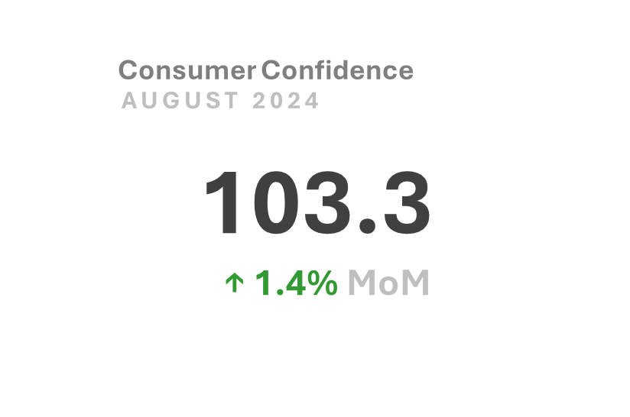
Economic Reports
Week Ending 8/30/2024
Highlights
In Q2, GDP grew at a 3.0% annual rate, led by consumer spending, up 2.9%, and business spending, up 7.5%.
ECONOMY
Inflation is subsiding. The PCE index rose 2.5% YoY, while Core PCE advanced 2.6% YoY, almost in line with the Fed’s 2.0% goal.
RATES
Consumers remain bullish on the economy; confidence improved.
Initial jobless filings held steady, still well below recession levels.
Source: Commerce Department
COMMENTS
Source: University of Michigan
Source: Commerce Department
Source: Conference Board
Source: Labor Department
Source: Commerce Department

Slide 3

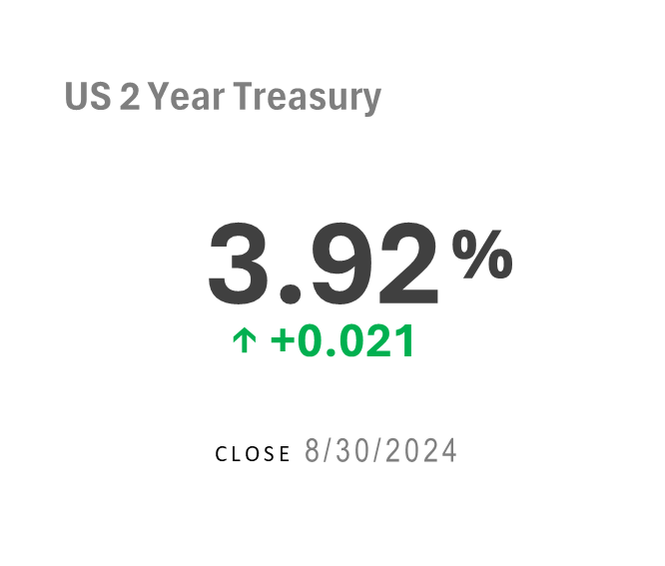
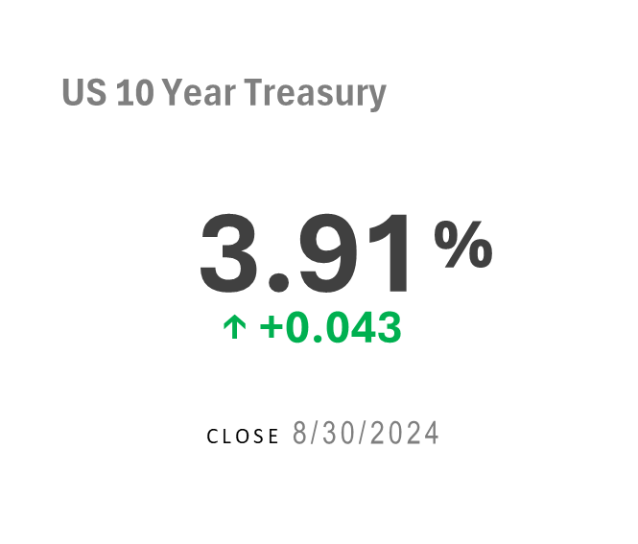
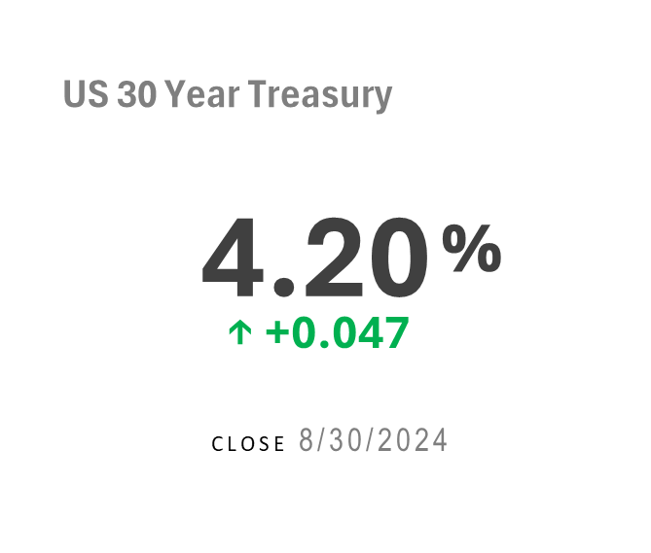
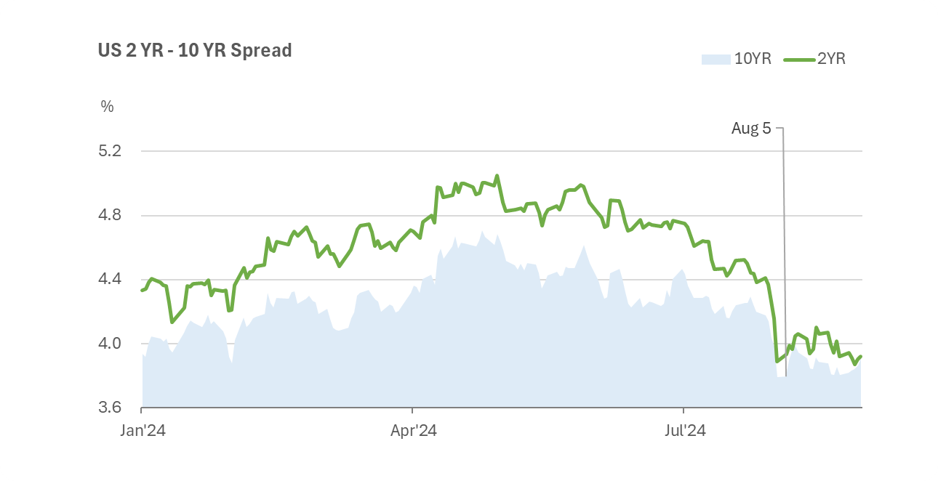
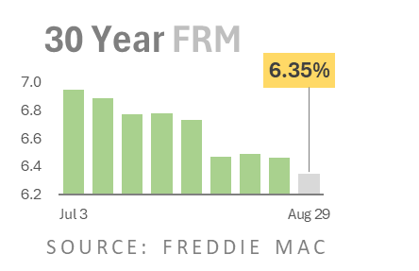
Rates
Week Ending 8/30/2024
Highlights
ECONOMY
Long-term Treasury yields ticked up in anticipation of Fed rate cuts.
RATES
The 2YR/10YR spread was near its low for the year.
Mortgage rates declined for the third consecutive week.
COMMENTS

Slide 4
Commentary
Week Ending 8/30/2024
Labor Market
“The time has come for policy to adjust…the timing and pace of rate cuts will depend on incoming data, the evolving outlook, and the balance of risks.” Recent remarks from Fed Chair Jerome H. Powell at the Jackson Hole symposium set the tone for investors’ expectations, as a slew of economic releases brought the current condition of the consumer and labor market into focus.
According to the Labor Department, initial jobless claims decreased to 231,000 from a revised level of 233,000 a week ago, while the number of continuing claims, a proxy for layoffs, climbed to 1,868,000, the highest level since November 2021, when it peaked at 1,878,000 filings. Despite showing signs of cooling, the job market remains strong and resilient by historic standards.
ECONOMY
RATES
COMMENTS
Consumer Sentiment and Spending
Meanwhile, consumer optimism stoked growing consumer spending. The Conference Board’s Consumer Confidence index edged higher in August, up 1.4% to 103.3, reflecting cautious optimism about the economy despite recent market upheaval.
Bullish business investment and consumer spending, which accounts for about 70% of economic activity, drove second quarter GDP to 3.0%, surpassing the government’s initial expectations. Consumer spending increased 2.9%, fueled by goods consumption, while business investment increased 7.5%, led by capital equipment spending.

Slide 5
Commentary
Week Ending 8/30/2024
Housing Market
Nonetheless, spending remained muted in the housing market. Following a three-week decline, the average rate on a 30-year fixed rate mortgage dropped to 6.35% on Thursday, according to Freddie Mac. Despite lower rates, however, the Mortgage Bankers Association reported that mortgage application volume improved only modestly from a week ago, up 0.50%, as disengaged buyers await lower interest rates.
ECONOMY
RATES
Inflation in Focus
Elsewhere, the Fed’s preferred inflation metric, the personal consumption expenditures price index (PCE) rose 0.2% on the month and 2.5% for the year, while core PCE, which excludes energy and food, climbed 2.6% on a yearly basis. Both readings follow a long-run track of subsiding inflation, progressing towards the Fed’s 2.0% inflation goal. With inflation decelerating, the Fed is expected to pivot to labor market dynamics.
In the coming days, policymakers and investors will watch closely for the Nonfarm Payrolls report, due out Friday, as well as the manufacturing and services PMI reports, due out on Tuesday and Thursday, respectively.
By Nikki Rose
COMMENTS

Slide 6
NIKKI ROSE
ANALYST
CONTACT
MEDIA: https://www.linkedin.com/in/n-r-b06216317
EMAIL: rrose.n2420@gmail.com

