Slide 1




“A QUICK SYNOPSIS OF MACROECONOMIC EVENTS IMPACTING MARKETS.”
WEEKLY REVIEW
WEEK ENDING SEPTEMBER 6
2024
CONTENT AND GRAPHICS, CREATED AND WRITTEN BY NIKKI ROSE
EMAIL: rrose.n2420@gmail.com

Slide 2


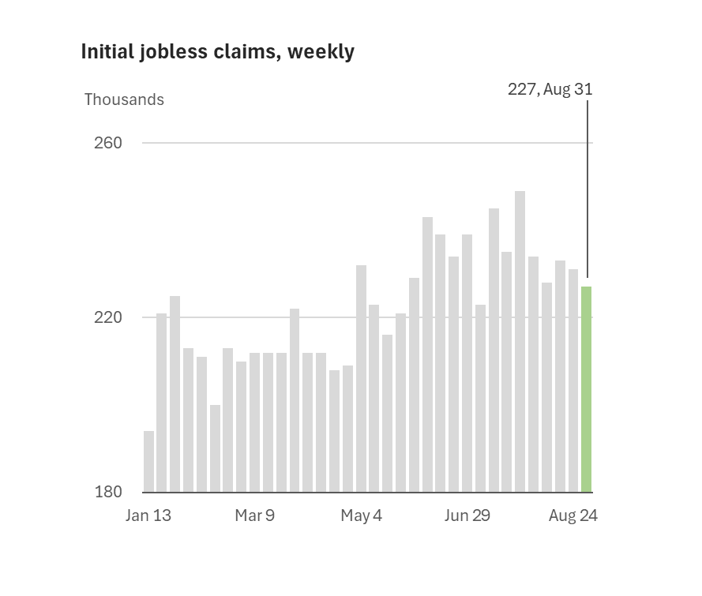


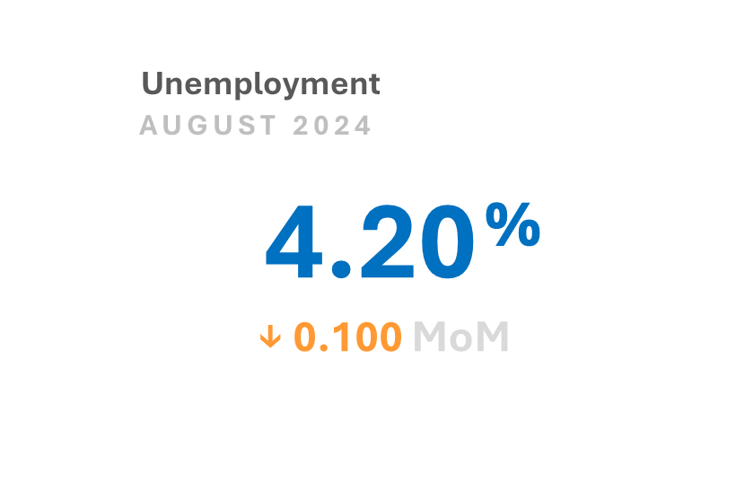
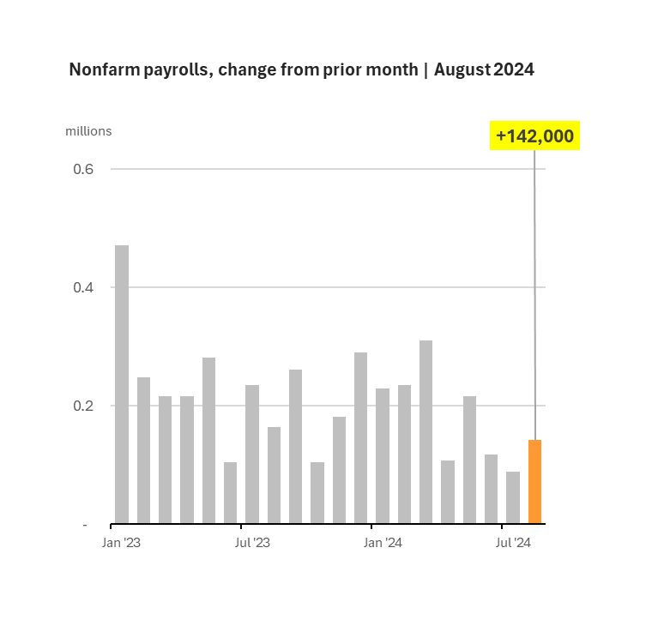
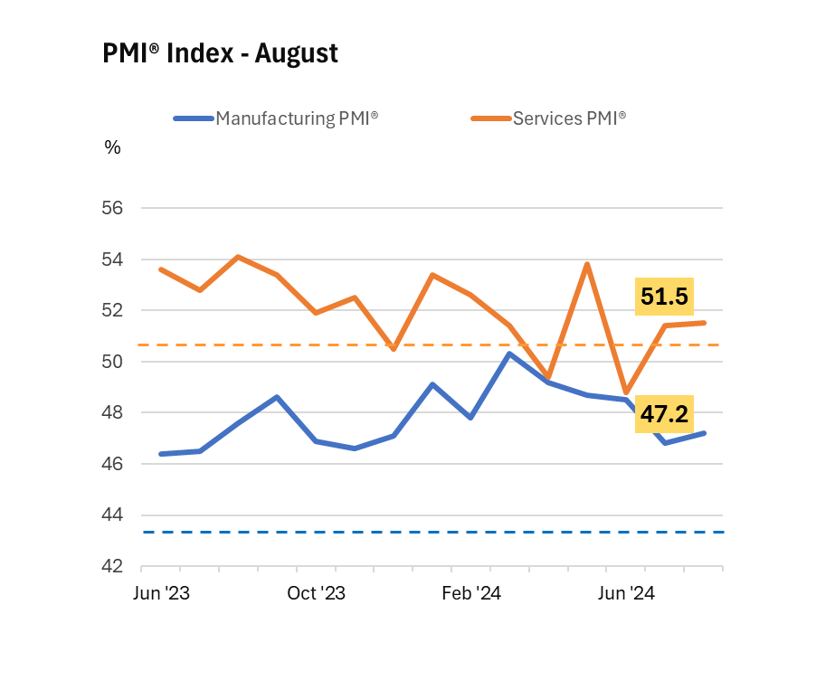
Economic Reports
Week Ending 9/6/2024
Highlights
Initial jobless filings inched down to 227K, from a revised level of 232K the prior week.
ECONOMY
The economy added 142K jobs, primarily in healthcare and construction, driving the unemployment rate down to 4.2%.
RATES
Manufacturing remained weak, shedding 24K jobs, while the Manufacturing PMI index contracted for the fifth consecutive month.
Source: Department of Labor
COMMENTS
Source: Bureau of Labor Statistics
Source: Institute for Supply Management
Source: Bureau of Labor Statistics
Source: Bureau of Labor Statistics

Slide 3
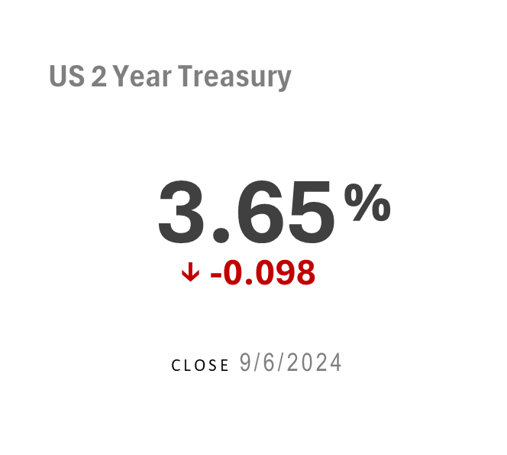
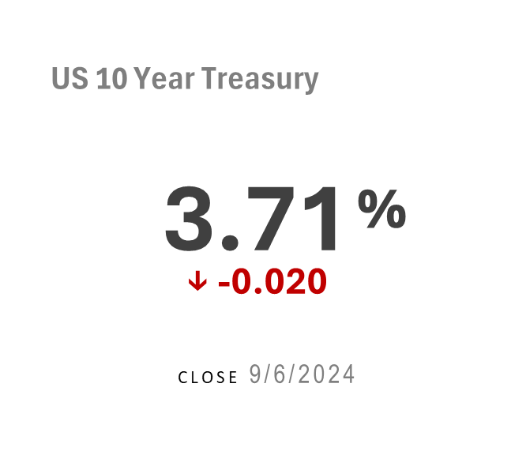
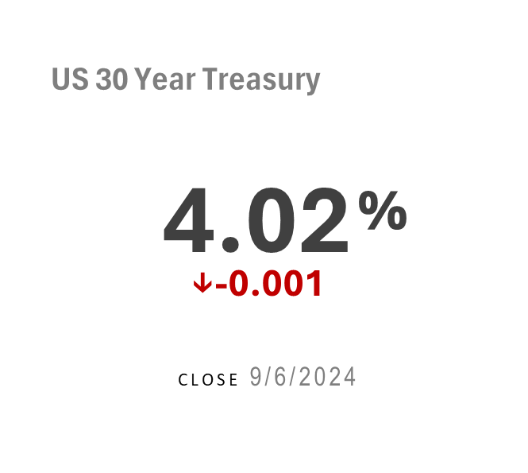

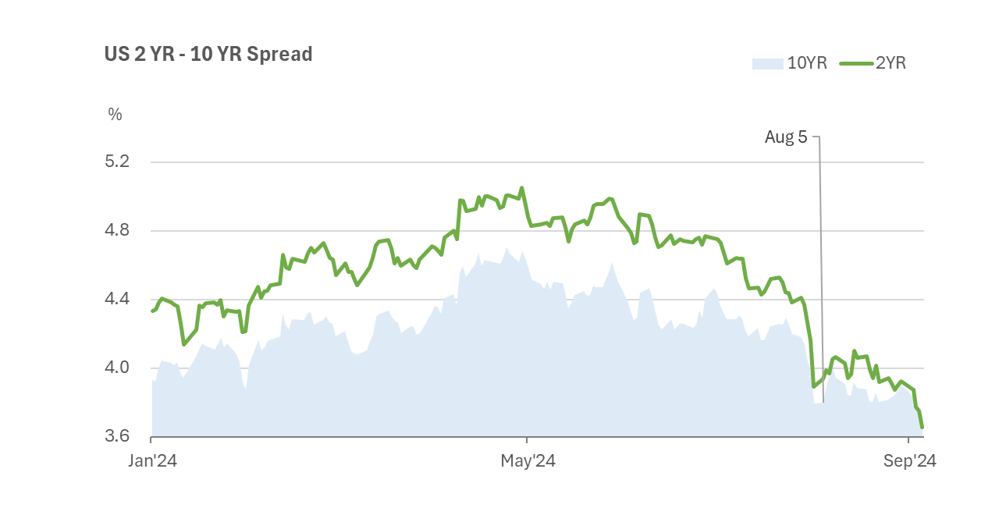
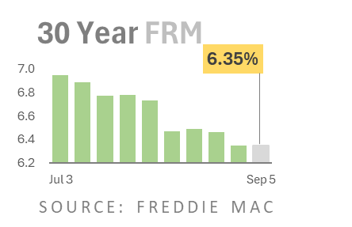
Rates
Week Ending 9/6/2024
Highlights
ECONOMY
Treasury yields edged down after investors digested labor market reports.
The 2/10YR yield curve un-inverted at the week’s close.
RATES
Average rates on 30-YR FRMs plateaued for a second week at 6.35%.
COMMENTS

Slide 4
Commentary
Week Ending 9/6/2024
The Yield Curve Reversion
Treasurys rallied, causing yields to slip as investors weighed the Fed’s next policy rate move amid a slew of recent labor data suggesting a recalibration may be underway. The yield curve un-inverted by week’s end. Two-year Treasury yields closed at 3.654 percent, below 10-year yields, which finished the week at 3.713 percent, a 0.020 percentage decline, marking a recent milestone. An un-inverted yield curve could stoke higher long-term borrowing costs for businesses and consumers alike, particularly in the housing sector.
ECONOMY
RATES
Labor Releases in Focus
Interest rates responded to mixed labor market releases, including the nonfarm payroll report and initial jobless claims. According to the Labor Department, the economy added an underwhelming 142,000 jobs, just below analysts’ consensus of 160,000 jobs. The largest gains were in healthcare and construction, which added 31,000 and 34,000 jobs respectively, while the biggest losses occurred in manufacturing, which shed 24,000 positions. Although modest, job growth was enough to drive unemployment down to 4.2 percent, slightly off from July’s reading of 4.3 percent, the highest in 33 months.
Meanwhile, initial jobless claims also decreased to 227,000, down 5,000, from a revised level of 232,000 the prior week. By comparison, during the pre-pandemic weeks of January and February 2020, initial jobless claims averaged 211,000. And for the fourth consecutive week, continuing claims, a proxy for layoffs, remained at 1.2 percent or nearly 1.8 million, well below the typical recession level of 4.0 million.
COMMENTS

Slide 5
Commentary
Week Ending 9/6/2024
Housing Market and PMI
Whether recent labor market softness was extreme enough to merit a 50-basis-point reduction at the Fed’s mid-September meeting remains to be seen. However, high rates are likely dampening manufacturing hiring and housing markets. According to the Institute of Supply Management, manufacturing economic activity contracted for the fifth consecutive month, causing some business leaders to scale back staffing to accommodate weakening demand, as uncertainty around federal monetary policy and the presidential election looms. The manufacturing PMI index registered 42.7 percent in August, only 0.4 percentage points higher than July, while the services PMI index fared better, registering 51.5 percent.
The average rate on a 30-year fixed-rate mortgage plateaued at 6.35 percent for a second week, whereas average rates on 15-year fixed-rate mortgages dipped to 5.47 percent, down 0.04 percentage points, according to mortgage giant Freddie Mac. The movement coincides with a modest uptick in the Market Composite Index, a measure of loan application volume, which grew 1.6 percent from last week, according to the Mortgage Bankers Association. Interest rates on 30-year fixed-rate mortgages, which are closely tied to US 10-year notes, are expected to fall as the Fed initiates a series of rate cuts, which could reinvigorate the listless housing market.
For now, investors will breathe heavily in anticipation of the long-awaited Federal Reserve meeting on September 17. Until then, expect volatility to continue as market participants divine federal monetary policy and political headwinds further exacerbate turbulence. On Tuesday night, former President Donald Trump and Vice President Kamala Harris will face off in their first presidential debate.
By Nikki Rose
ECONOMY
RATES
COMMENTS
Volatility Ahead

Slide 6
NIKKI ROSE
ANALYST
CONTACT
MEDIA: https://www.linkedin.com/in/n-r-b06216317
EMAIL: rrose.n2420@gmail.com

