Slide 1
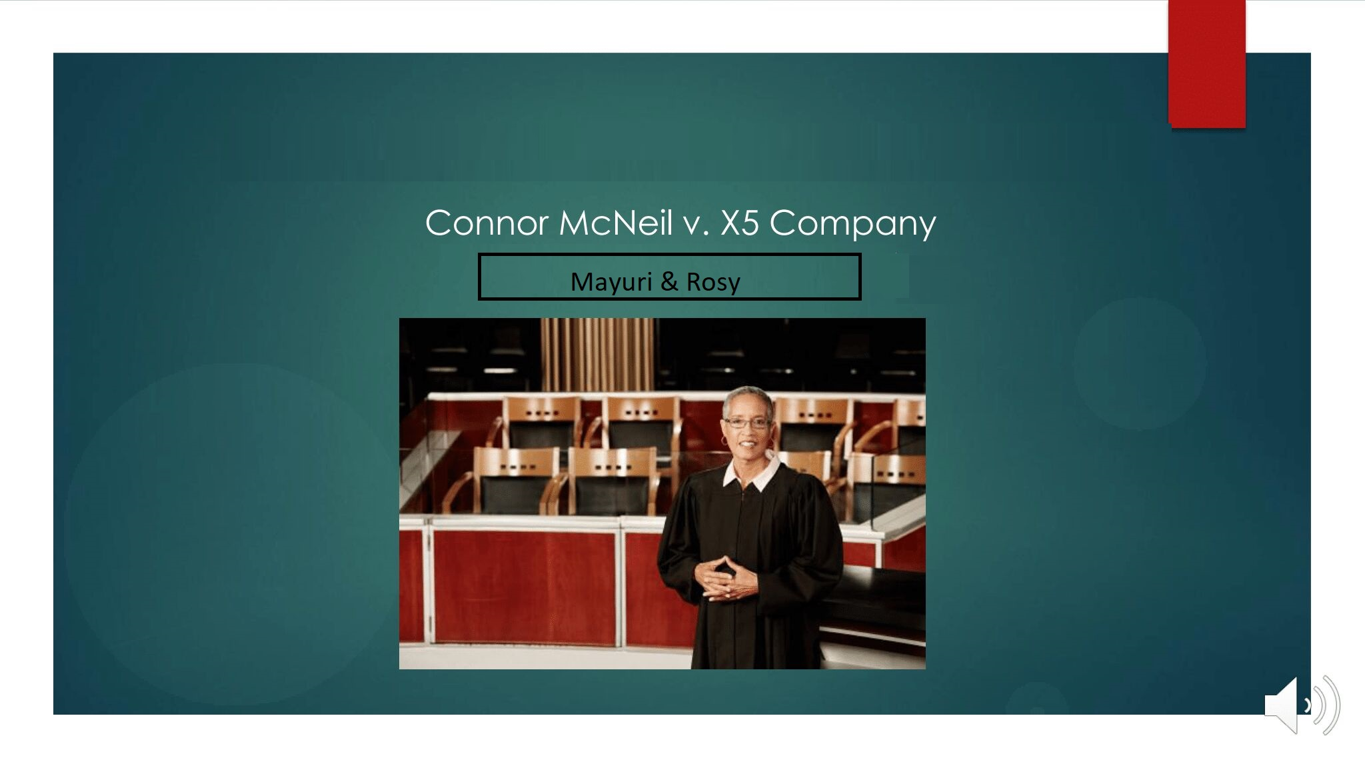
Sn
Snowboard Accident
Mayuri & Rosy

Slide 2
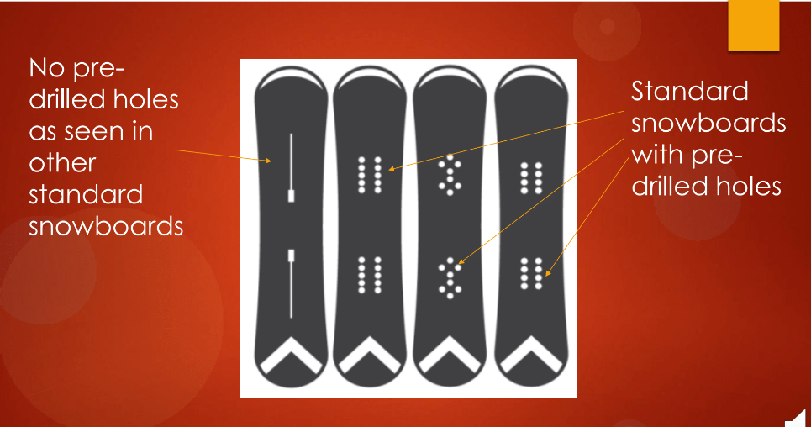
Mcniel was injured in a snowboarding accident. He contended that the snowboard he was using (Carve 3000 X5 was) defective.
Plaintiff Argument : Missing holes from the snowboard, which cause the accident.
500,000$ to compensate his pain and suffering.
Defendent Argument : Safest Design.

Slide 3

Questions to the Jurors and Limiting Juror Instruction
Was McNeil negligent?
If so, was McNeil’s negligence a substantial factor in causing his injuries?
If you find that Mr. McNeil was fault, assign a percentage.

Slide 4
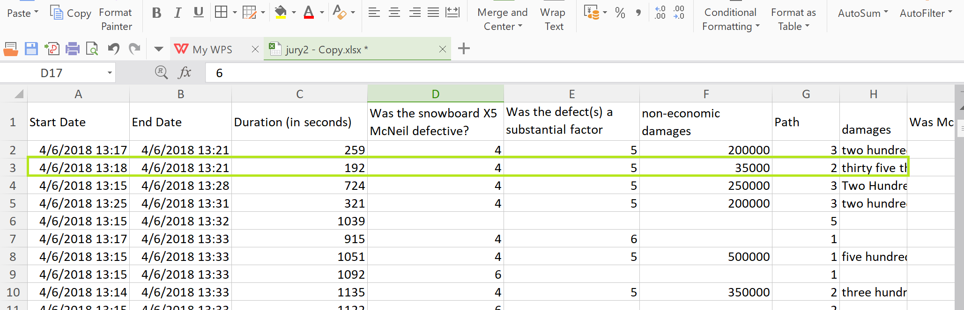
Data Set

Slide 5
Data Attributes
Path (1-8)
Damages(Economic and Non Economic)
Liability(Was snowboard sold McNeil defective?)
Duration
Education
Income

Slide 6
Data munging ,wrangling and statistical summary
Replaced :
Null values for the damages to ‘0’.
Hexadecimal values with empty string
Paths Low Anchor 5,6,7,8 with No Anchor 1,2,3,4.
Converted Damages > 500,000$ -> 500,000 and consided the Damages as the discounted amount.
Dropped Liability with no values.
Removed Special characters (like ‘$’,’,’ etc.).
Converted Duration to integer and filtered the data based on the length of the each path.
Changed data type of required columns like (path to Categorical, damages to numeric, date to datetime)
Verified percentage of responsibility of Plaintiff and defendent totals to 100%.

Slide 7
Research Questions
Regression Analysis for effect of Q40 and Q41 on awarding Liability.
Logistic Regression from Path (1-4) vs Liability for Snowboard and Staircase Dataset.
Path 1-4 vs Path 5-8 Regression Analysis.
Impact of Education, Path and Income on Liability.
Damages calculations for each Path of new dataset.
Damage calculations for the merge dataset.

Slide 8
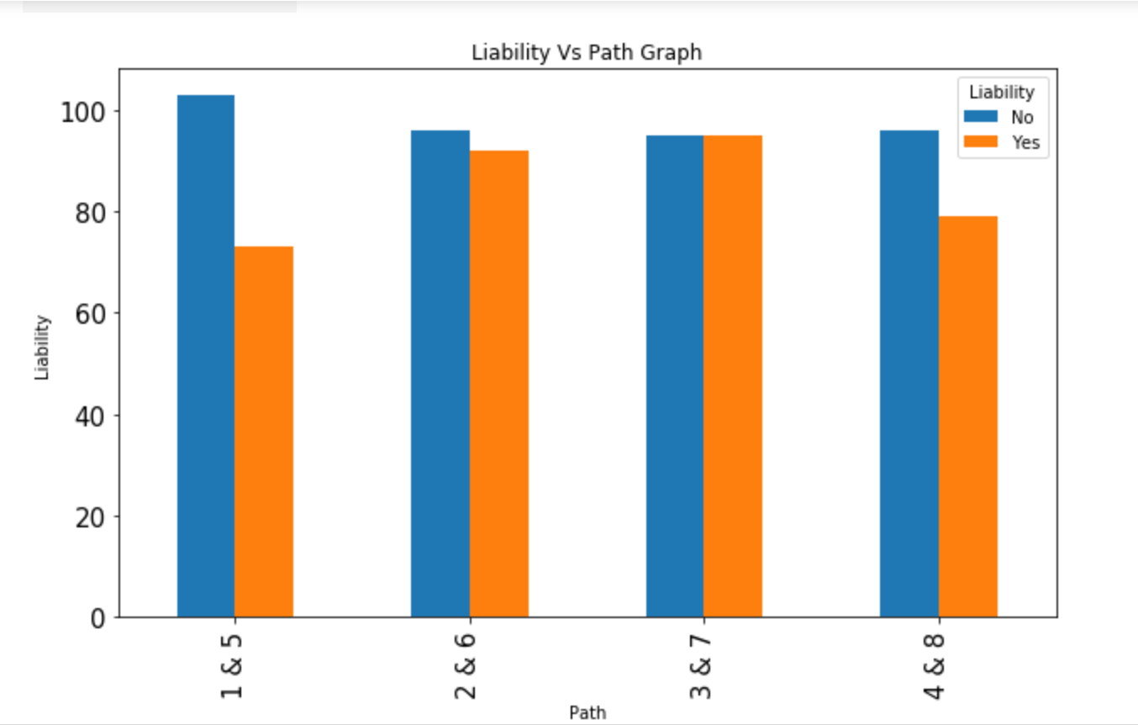
Path vs Liability
Liability | Yes | No | Total
Path
1 | 73(45%) | 103(55%) | 176
2 | 92(59%) | 96(41%) | 188
3 | 95 (55%) | 95 (45%) | 190
4 | 79(52%) | 96 | 175
Total | 399(53%) | 390(47%) | 729
We can see that winrate is more for Path 2 & 6 than Path 1 & 5 after the intrduction of remedial jury measures.
The winrate significantly decrease from path 3 & 7 to Path 4 & 8 after the explanation of limiting jury instruction introduce.

Slide 9
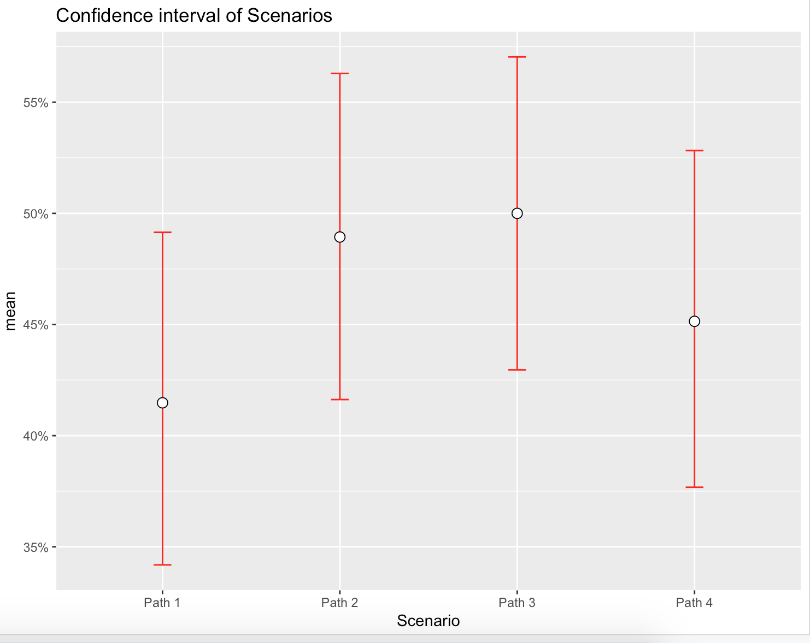
Winrate confidence interval)

Slide 10
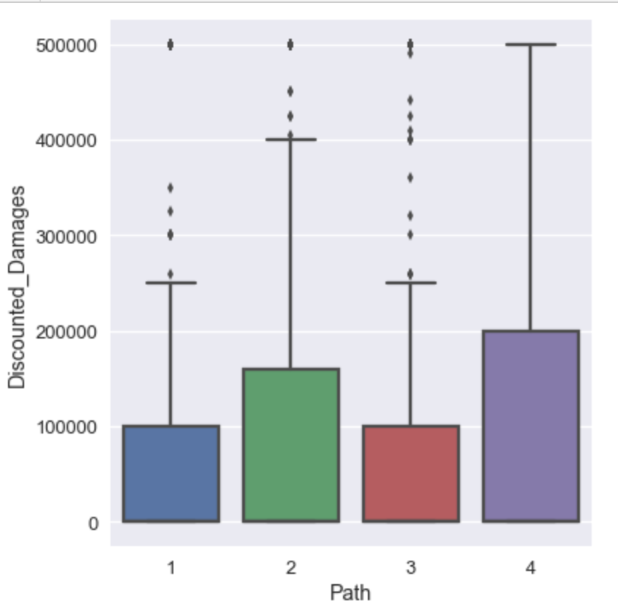
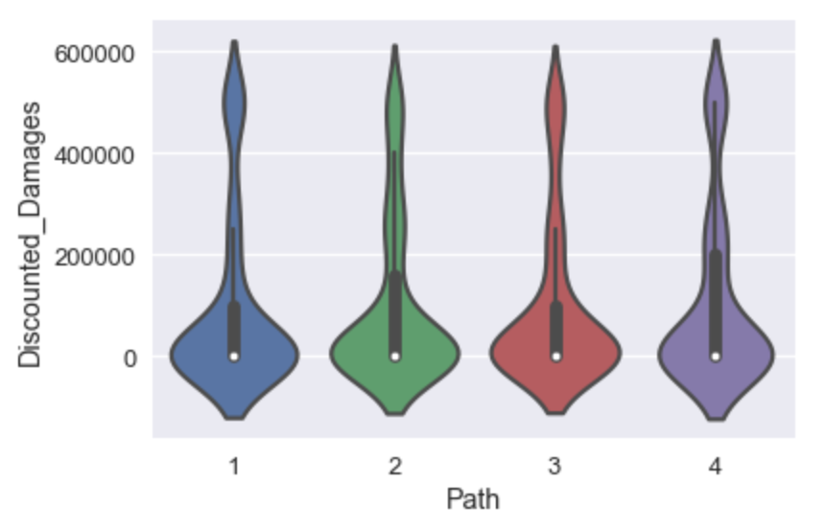
Path vs Total Damages(Discounted)
Violin Plot
Box plot including total damages as 0.

Slide 11
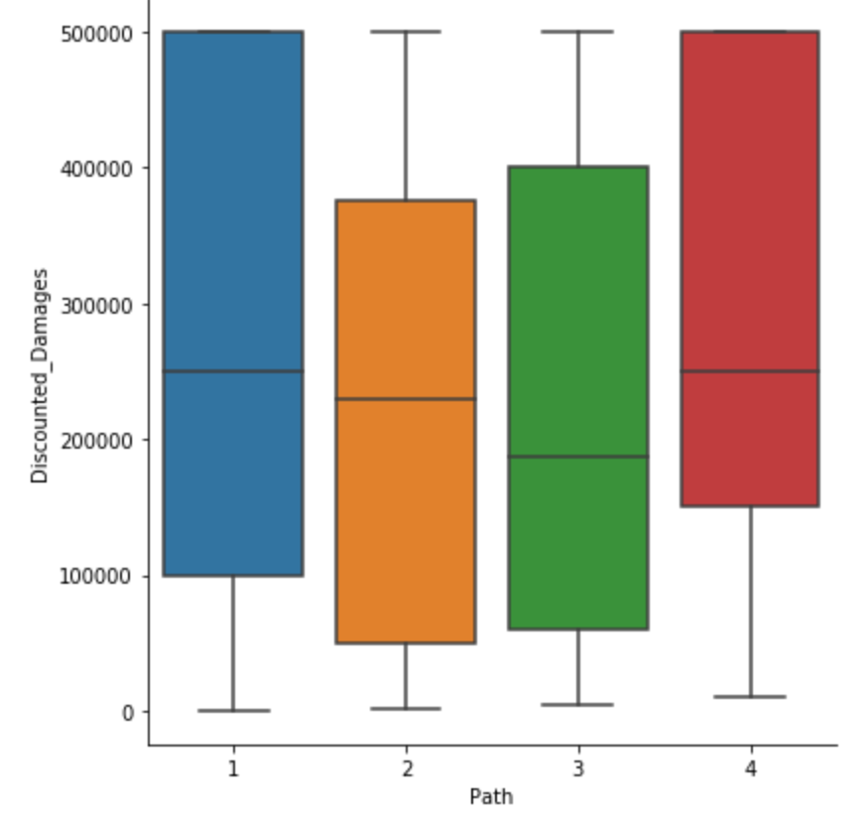
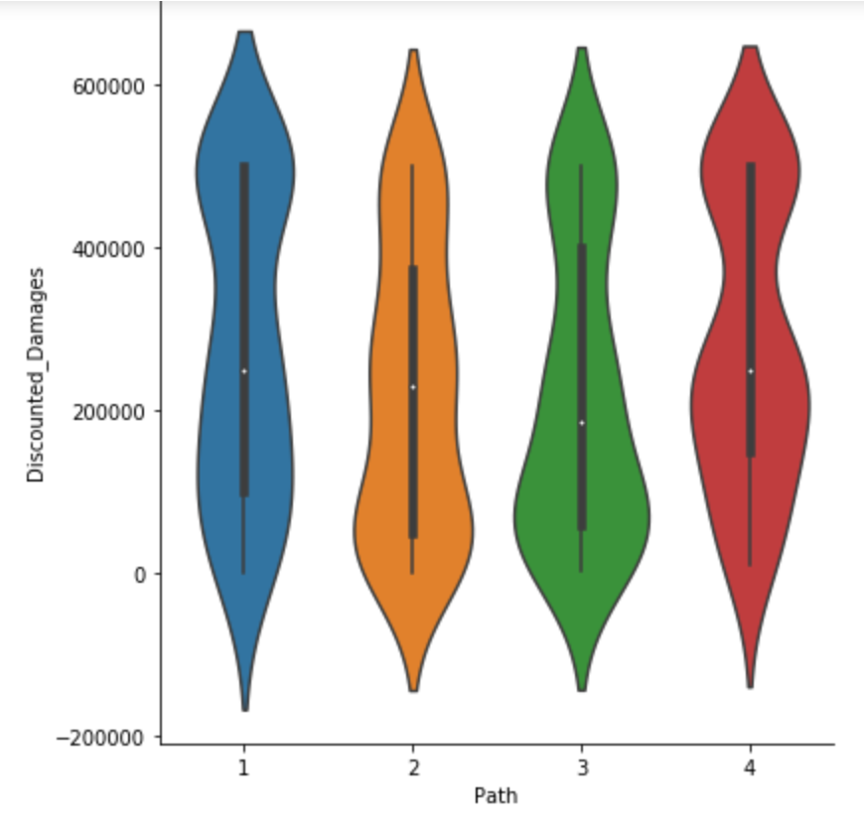
Path vs Discounted Damages
Damages vs Path excluding 0's

Slide 12
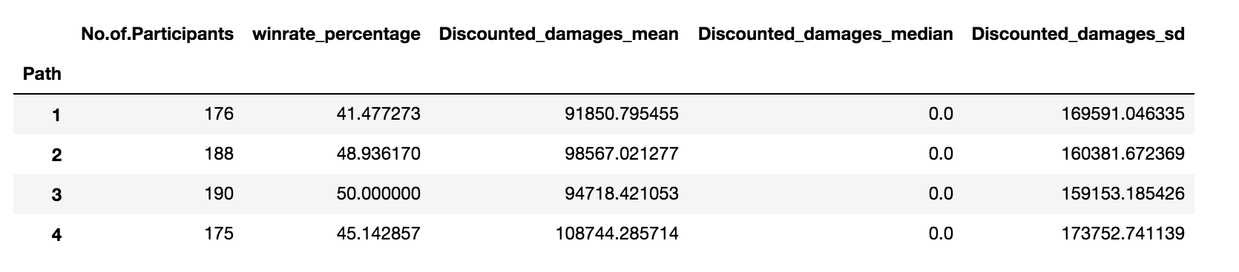
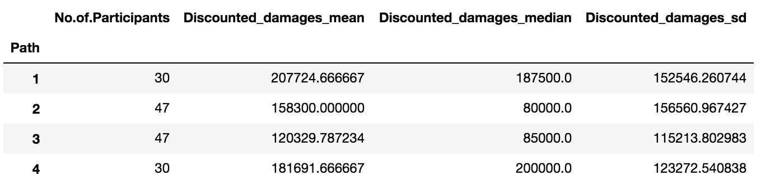
Winrate,Damages(Mean,Median,SD)
Case Expected Value Damages:Showing the total expected damages mean,median and sd with winrate percentage.
Winrate plintiffwins:Showing the damages mean,median and sd of liability awarded to the plaintiff when plaintiff wins

Slide 13
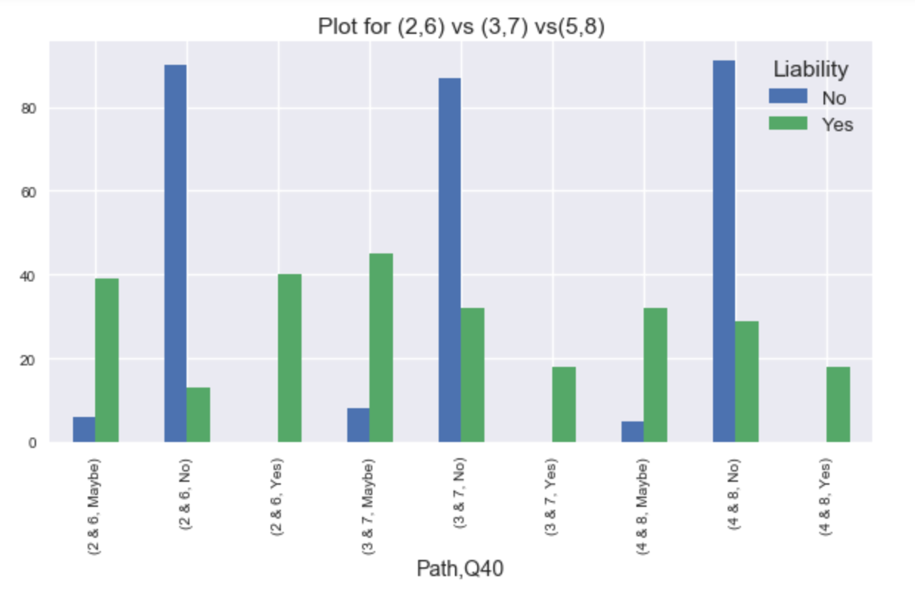
Q40: Did the fact that X5 added core inserts to the later Carve 3000 model, affect your view as to whether the original Carve 3000 was defective?
Q40 | 2 & 6 | 3 & 7 | 4 & 8
Yes | 100% | 100% | 100%
Maybe | 86% | 85% | 86%
No | 12% | 27% | 24%
Obsevation:
All Yes when they strongly support the fact.
Mostly No when they deny the fact.
Mostly yes when they somewhat support the fact.

Slide 14
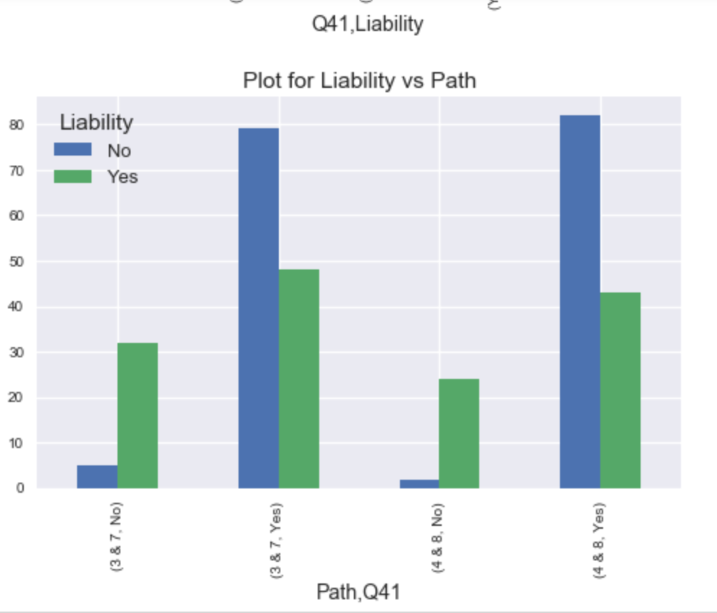
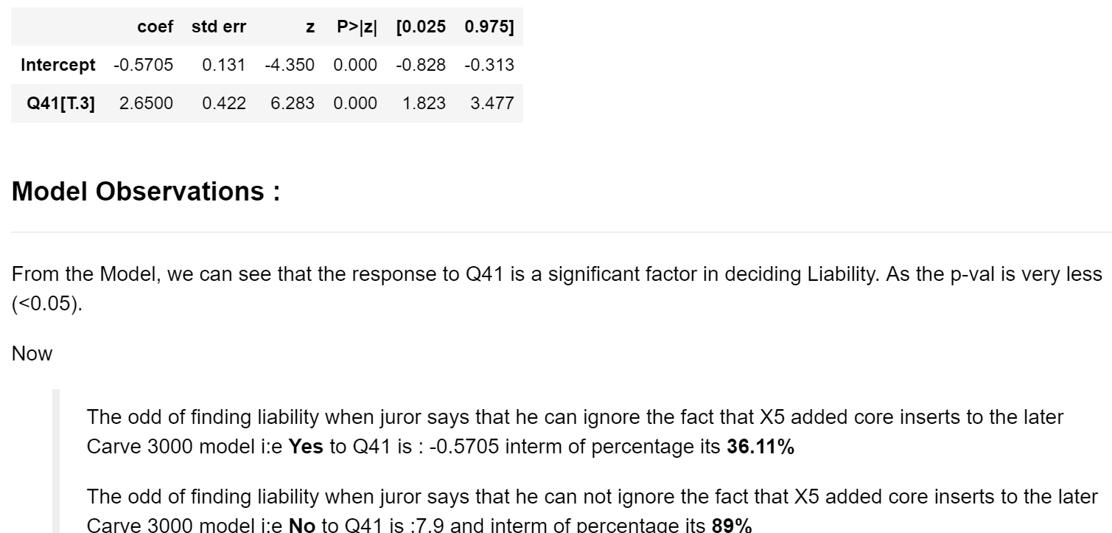
Q41: Were you able to ignore the fact that X5 added core inserts to the later Carve 3000 model when deciding whether the original Carve 3000 was defective?

Slide 15
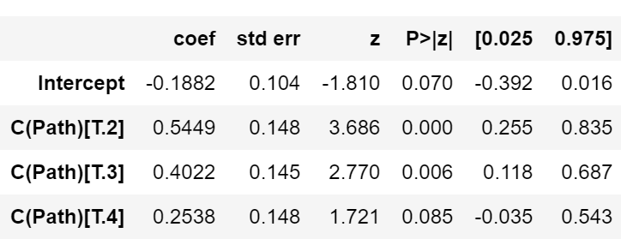
Path (1-4) vs Liability(Snowboard+Staircase)
Staircase Path(2,3,4,5) + Snowboard Path(1,2,3,4) + (5,6,7,8).
Model Observations:
The P-value of Path 2 and 3 are really vary low <0.05. so we can say that these fector is significant factor for awarding liability.
Liability | Yes | No | Total
Path
1 | 204 (45%) | 169 (55%) | 373
2 | 154 (59%) | 220 (41%) | 374
3 | 176 (55%) | 218 (45%) | 394
4 | 177 (52%) | 189 (48%) | 366
Total | 711 (53%) | 796 (47%) | 1507

Slide 16
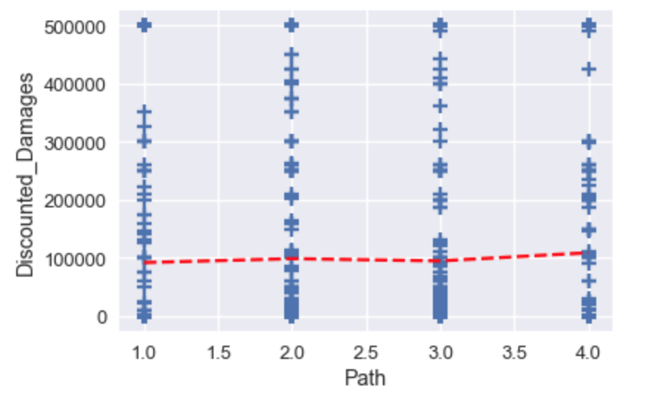
Impact of Path on Discounted Damages
From the Liner Model, Path has no impact on the Damages
From the graph, we can see that mean value is almost same for the discounted damages

Slide 17
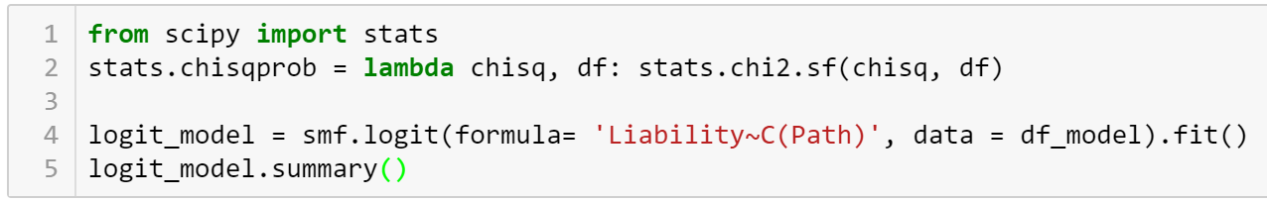
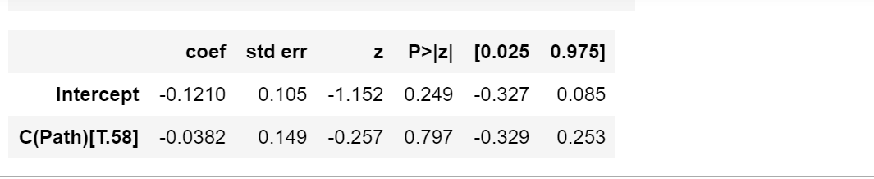
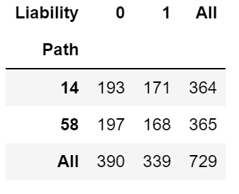
Regression on Low Anchor vs NoLow Anchor Path (1-4) vs Path(1-8)
Model Cofficients:
Observations:
Hence model is not siginificant (p-value > 0.05)
We can interpret model coefficient as Compared to path 1-4, there is 3.74% reduction odd in saying yes for path 5-8.

Slide 18
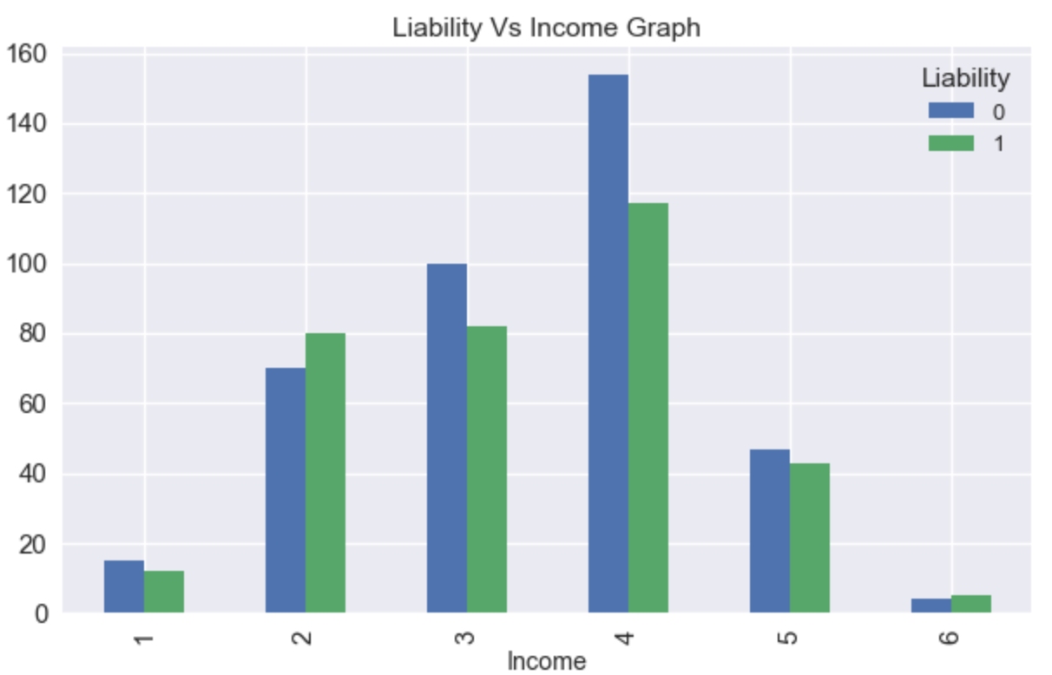
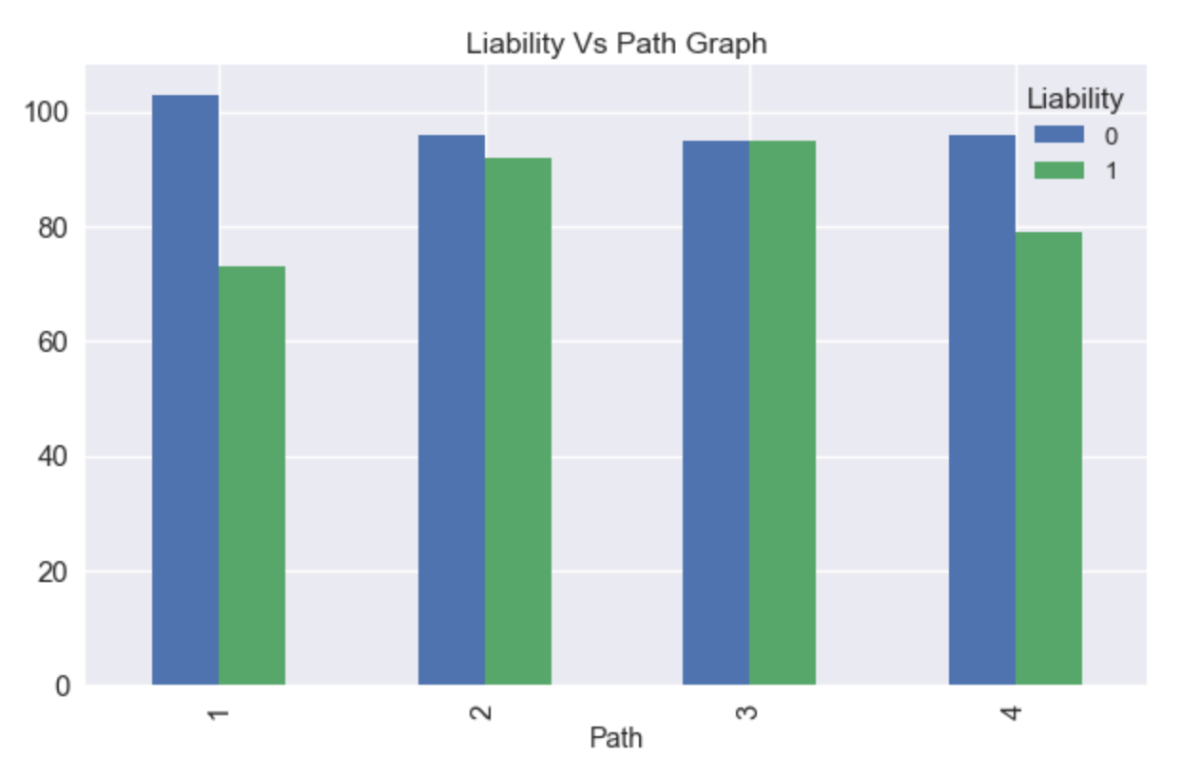
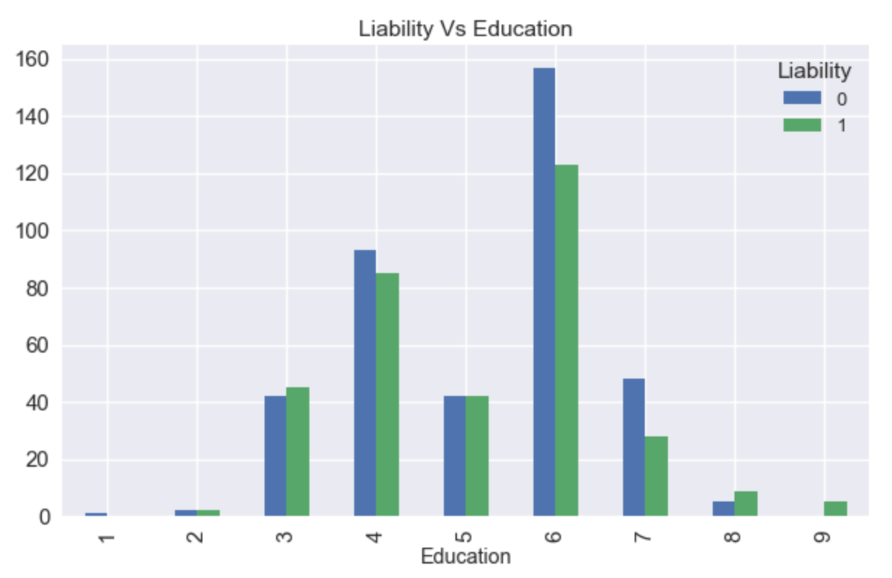
Impact of Education, Income and Path on Liability

Slide 19
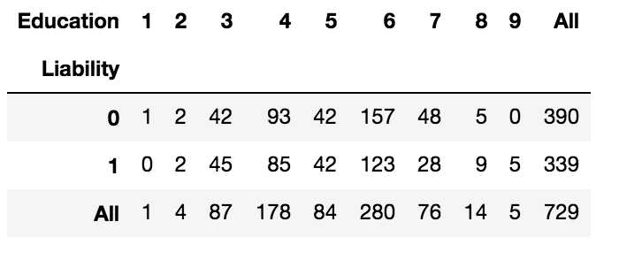
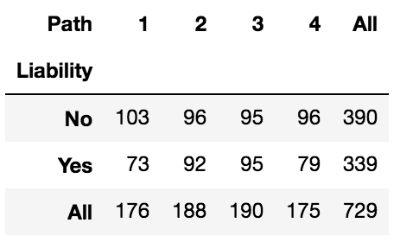
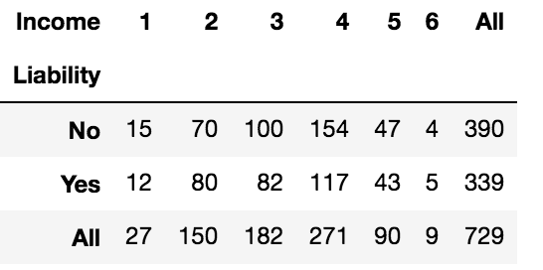
Regression on Final Model Liability ~ Path, Income, Education
Obsevations:
Path has no Impact on Liability
Education has no impact
Income has no impact on Liability

Slide 20
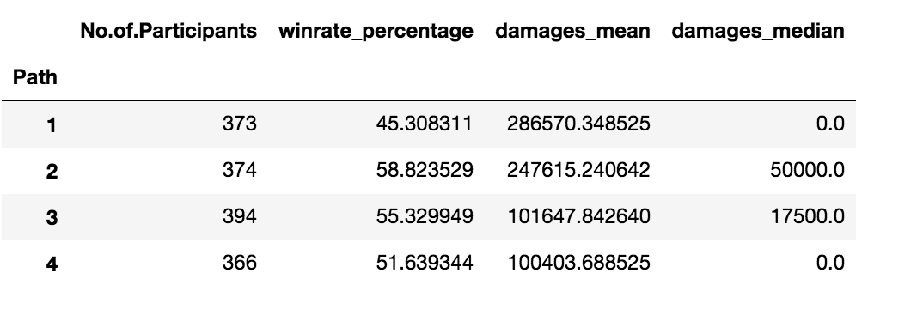
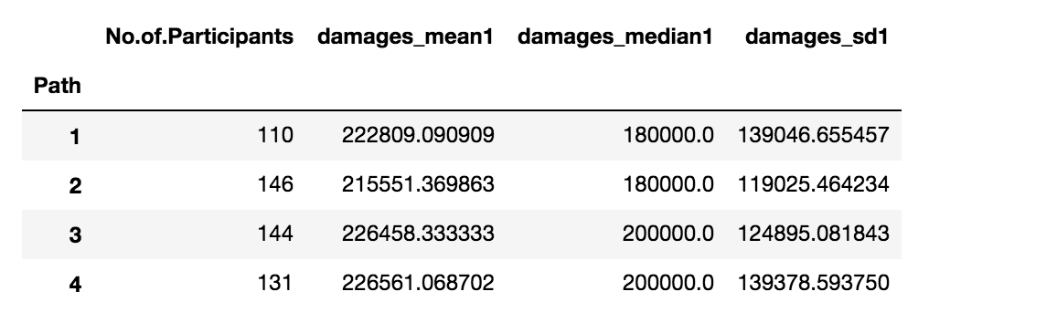
Merge Dataset Damages calculations
Case Expected Value Damages
Plaintiff Wins

Slide 21
Conclusion
Win rate Percentage calculation
Statistical summary using Boxplots, vilolin plot and confidence interval.
Modelling on Q40 and Q41.
Regression on Low Anchor vs NoLow Anchor.
Regression on merged data Path vs Liability
Logistic regression on Liability vs Path, Income, Education.
Linear model on Discounted Damages vs Path

Slide 22
ThankYou

