Slide 1
Iskra SLCS – Street Lightning Control System

Slide 2
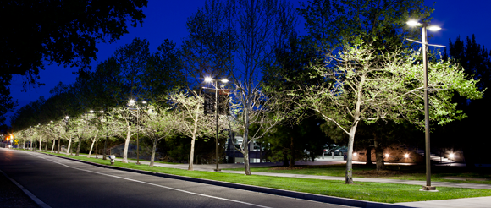
Iskra SLCS
Iskra SLCS® is an integrated TELEMETERING system for intelligent management of public or private lighting systems for LED lamps (also possible with certain HID lamps )

Slide 3
Iskra SLCS – System description
The lighting system is managed by Iskra SLCS® over the Internet (GPRS).
Iskra SLCS® enables receiving data from the lamp in order to know its operating status while simultaneously sending data to the lamp to implement a specific energy saving profile (program).

Slide 4
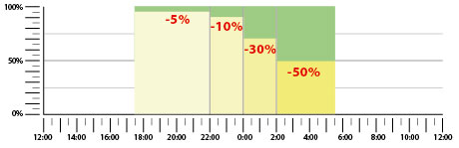
Iskra SLCS – Energy saving programme
Iskra SLCS® allows the owner of the system to save up to 60%, divided into 50% of "energy savings" and 10% of "savings in system management.„
In the photo: energy saving program example

Slide 5
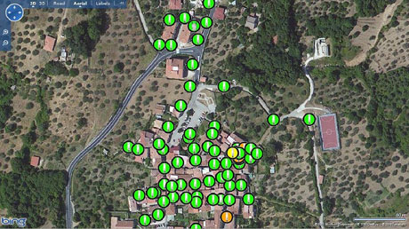
Iskra SLCS - GUI
Iskra SLCS ® enables representing the entire lighting system on a geo-located map and highlighting lamps that have some kind of trouble.
In the photo: the green dots are the lamps installed, while the yellow dots represent lamps with some kind of trouble.

Slide 6
Iskra SLCS
This can be printed out for the benefit of the maintenance engineer.
On the basis of the data collected by Iskra SLCS ® it is possible to classify the various types of problems and decide what work is to be done in a targeted and optimized manner.
In the case of LED lamps, Iskra SLCS ® is ideal because it allows you to combine the benefits of the above-mentioned cost savings with the inherent advantages of LED lighting.

Slide 7
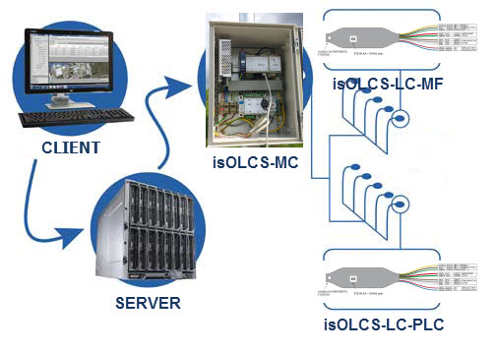
Iskra SLCS - Sytem parts
Central Process and Communication unit (isSLCS-MC)
Lamp Controller (isSLCS-LC)

Slide 8
Iskra SLCS - System Parts: isSLCS-MC
Central Process and communication unit (isSLCS-MC)
Enables communication with server through GSM/GPRS module
Sends data to common database (trends, graphs, …)
Lighting system management (dimming/energy saving programs , FULL control of each lamp, …
Possibility of lights activation through vehicle presence sensors, pedestrian push buttons, …
Possibility of measuring voltage and current on certain phase
Communication with lamp controllers (isSLCS-LC)
  Wireless (435-800MHz)
  PLC – Power Line Communication
  Cable – RS485

Slide 9
Iskra SLCS - System Parts: isSLCS-LC
Lamp controller (isSLCS-LC)
Installed on every separate lamp
Enables control of certain lamp parameters (dimming, error event control, temperature, …)
Communicates with isSLCS-MC and sends and receives
Communication with lamp controllers (isSLCS-LC)
  Wireless (435-800MHz)
  PLC – Power Line Communication
  Cable – RS485

Slide 10
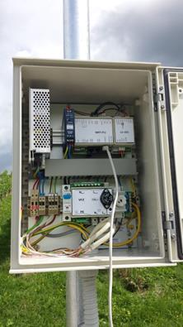
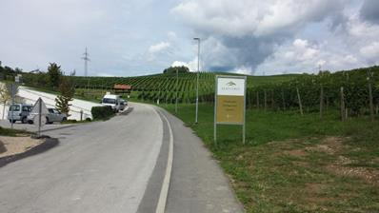
Iskra SLCS – Field installation photos
Installation in Slovenske Konjice, Slovenia

