Slide 1

MUSIC PLAYLIST MANAGER
BY : (GROUP-7)
AMATULLAH SAJIDA
SHEIKH ADIBA NUR
NOUSHIN TABASSUM
SUDIPTO SARKAR

Slide 2
PROJECT OUTLINE
INTRODUCTION 01
REPRESENTATION OF CODES 2-4
INITIAL WINDOW 5
CREATING PLAYLIST 6-7
PLAYLIST CONTROL 8

Slide 3
INTRODUCTION
The goal of this project is to create, arrange, and play music from playlists using a system. One of the main goals is to create a framework for effectively managing music tracks and playlists. Determining whether arrays are required for playlists and music storage, as well as techniques for adding and maintaining music files within the code, are important components. Implementing features for playlist organization, like adding, deleting, and searching for music tracks, is another main goal of the project. The project aims to provide a strong solution for managing and playing music playlists by attending to these needs.

Slide 4
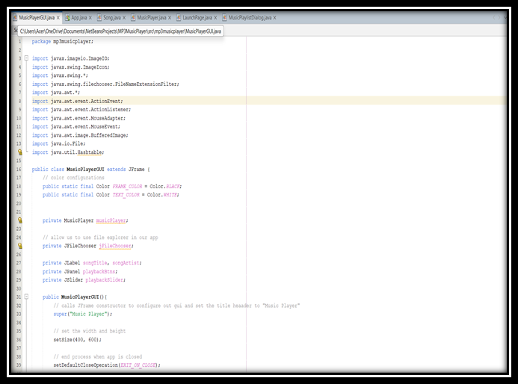
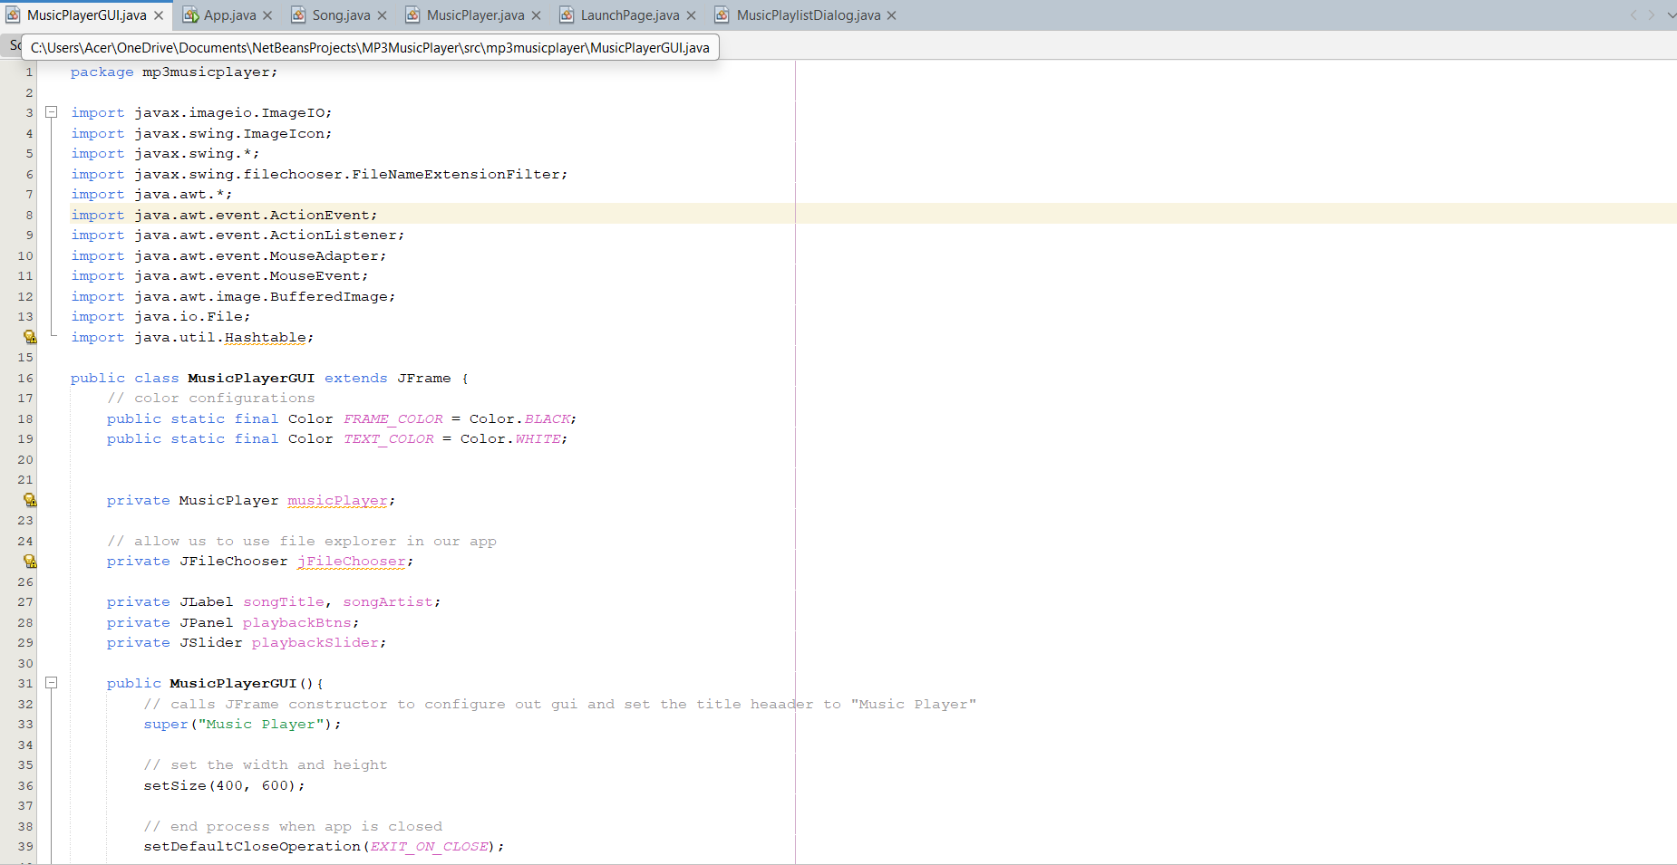
CODE IMPLEMENTATION
MusicPlayer Class
MusicPlayerGUI Class
Controls the playback of music, providing methods to play, pause, skip, and navigate
through songs.
Implements multithreading to separate the playback functionality from the main GUI,
ensuring a smooth user experience.
Fully implemented and integrated with other classes.
Provides the main graphical interface where users can interact with the application.
Includes buttons for controlling playback, a display area for song metadata, and a progress slider for the current song’s position.
Fully implemented and integrates with the MusicPlayer class to provide a seamless user interface.

Slide 5
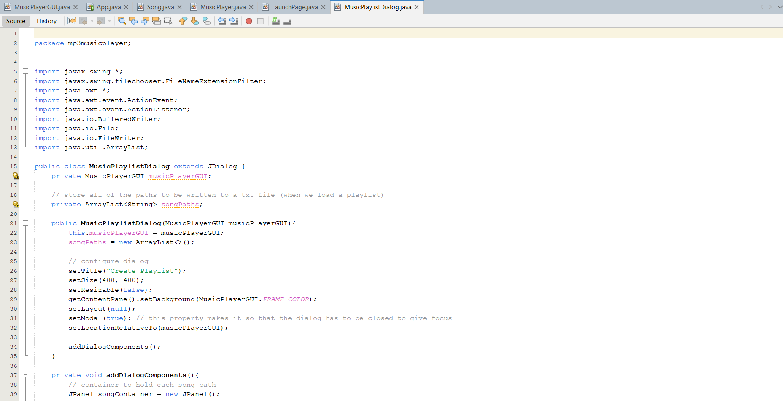
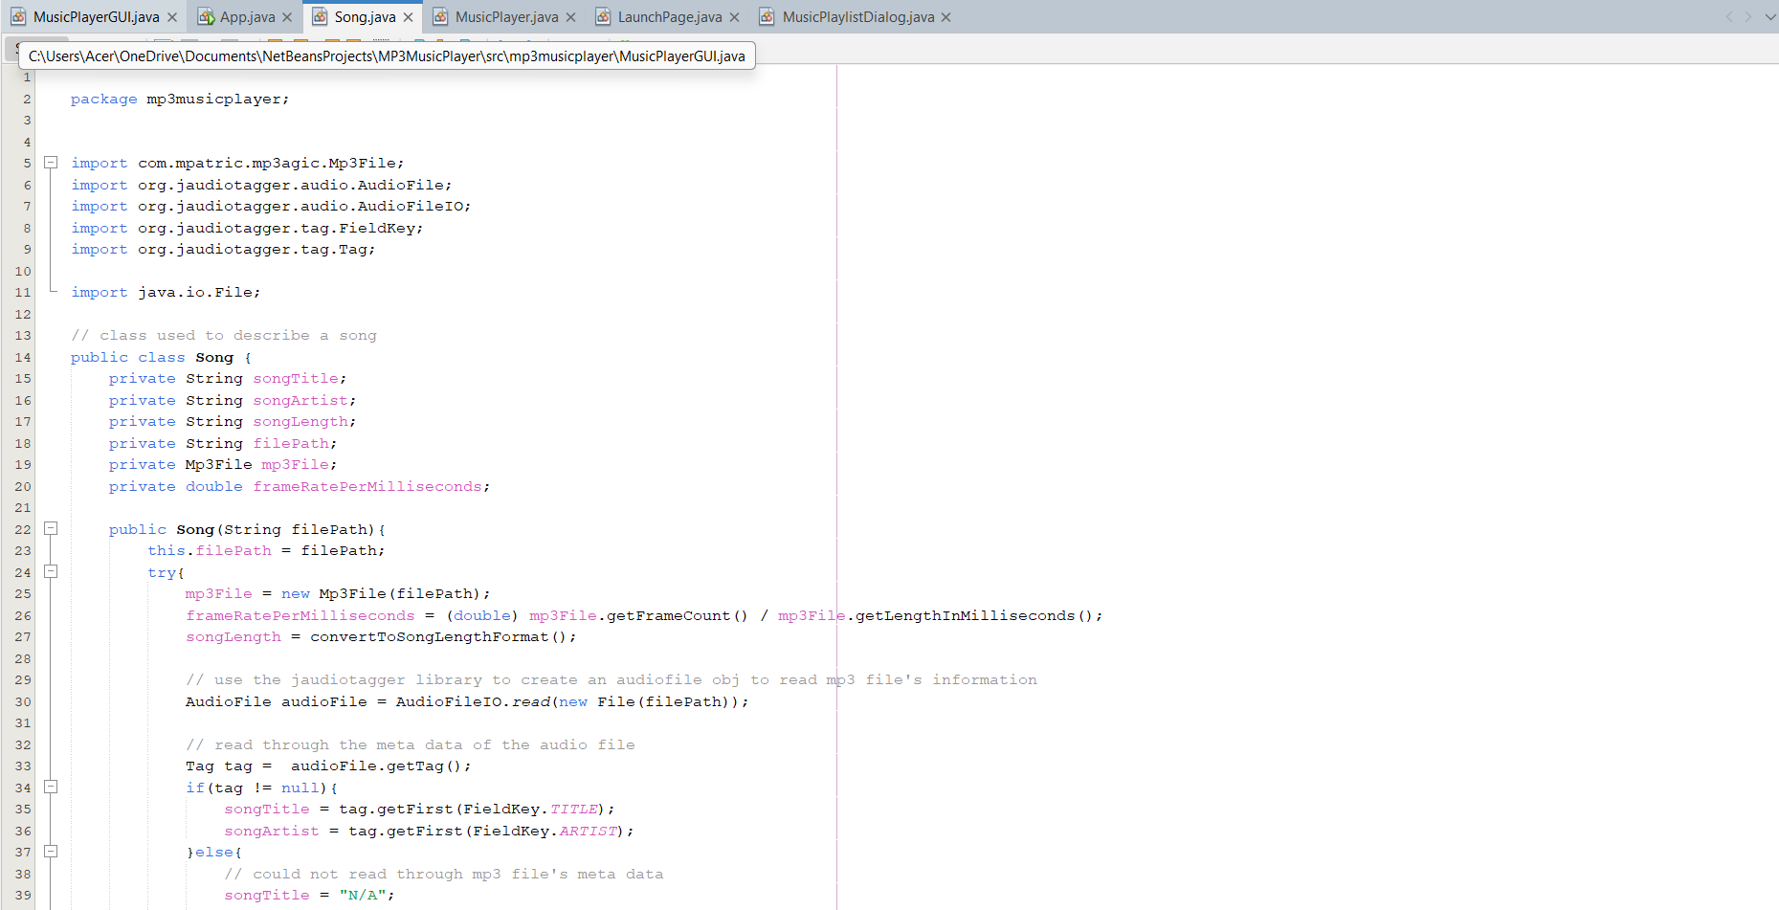
CODE IMPLEMENTATION
MUSIC PLAYLIST DIALOG CLASS
SONG CLASS
Allows users to create, edit, and manage playlists.
Users can add or remove songs from playlists, and save/load playlists to/from files.
Fully implemented, ensuring users can manage their music collections efficiently.
Represents a single song in the system, holding attributes like title, artist, and file path.
Uses external libraries (mp3agic and jaudiotagger) to read and write metadata from audio files.
Fully functional and tested.

Slide 6
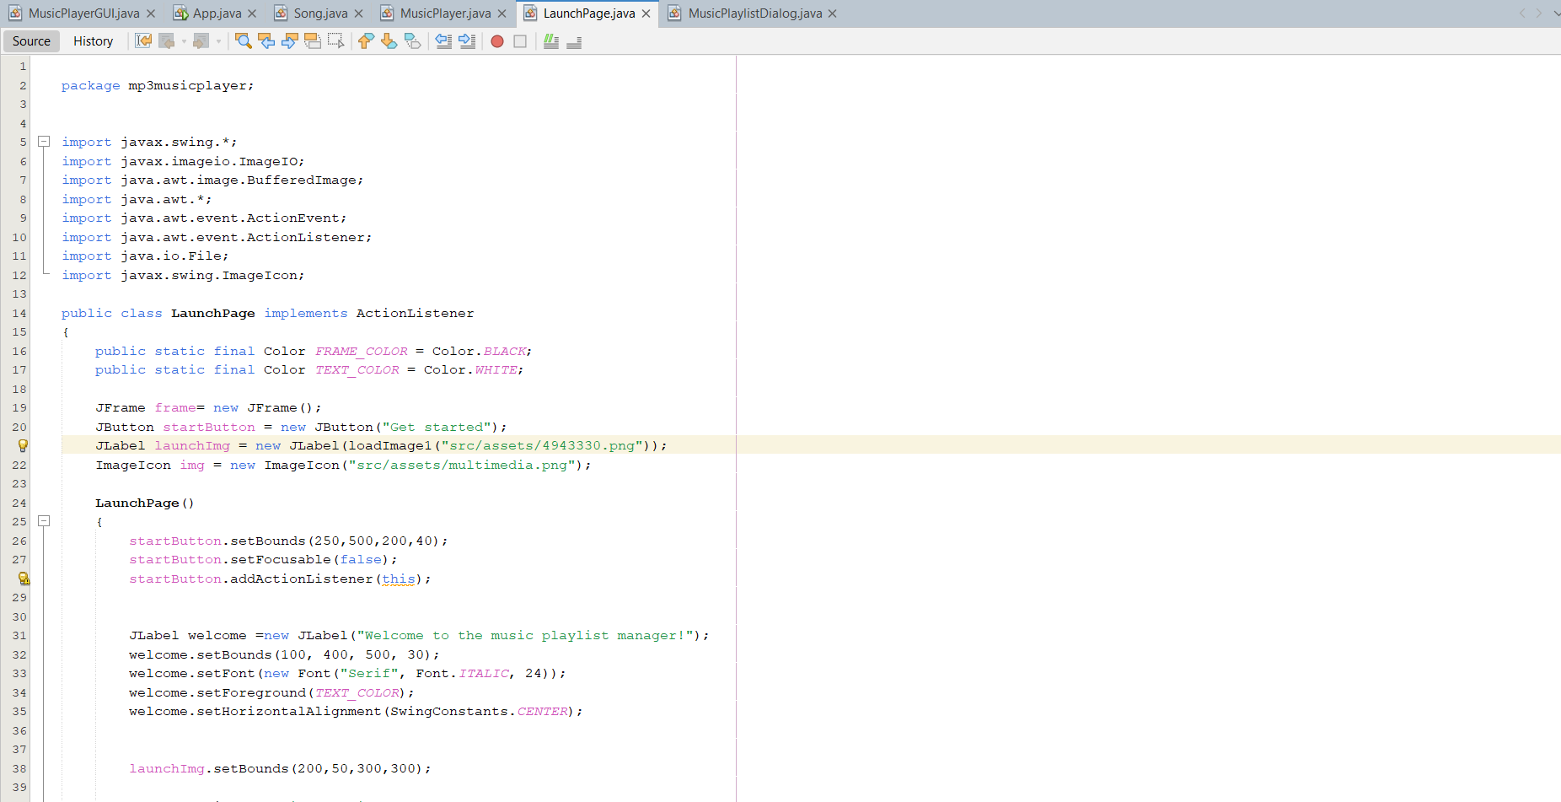
CODE IMPLEMENTATION
LAUNCHPAGE CLASS
The entry point to the application, featuring a welcome screen with the application logo and a button to transition to the main interface.
Fully implemented and integrated into the application workflow.

Slide 7
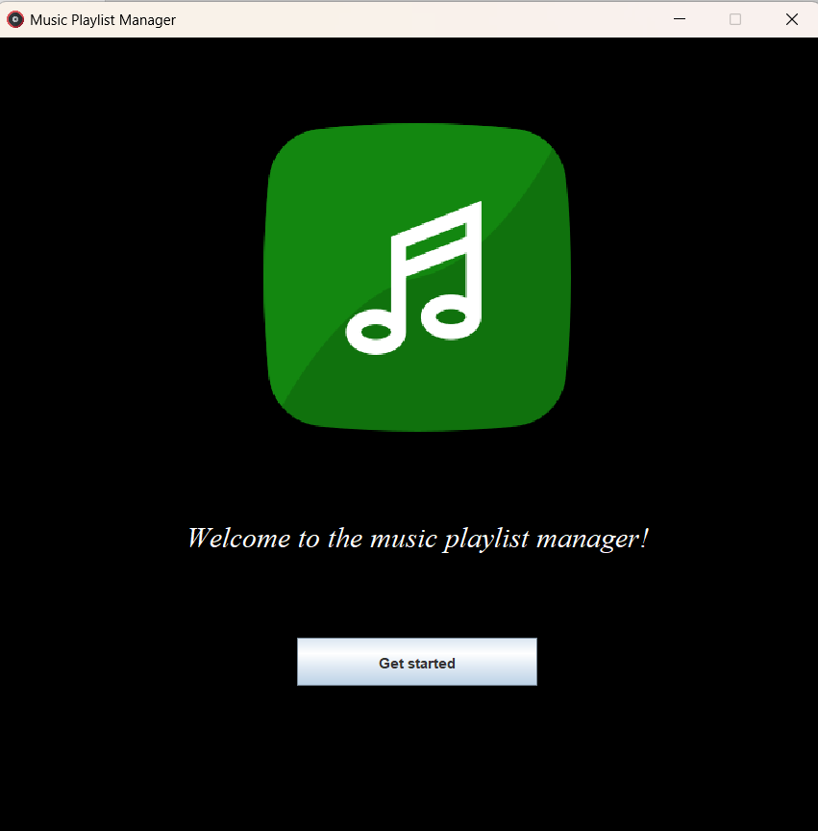
INITIAL WINDOW

Slide 8
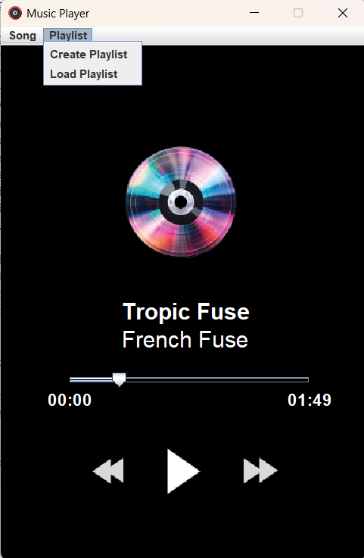
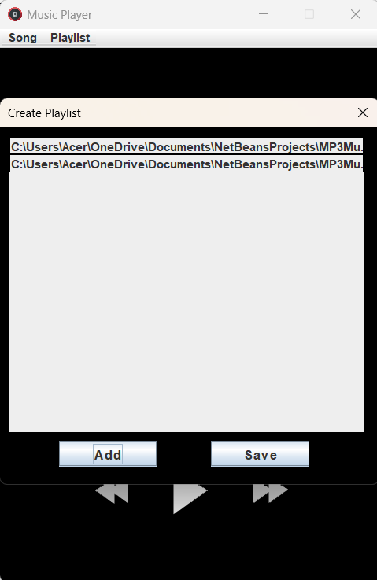
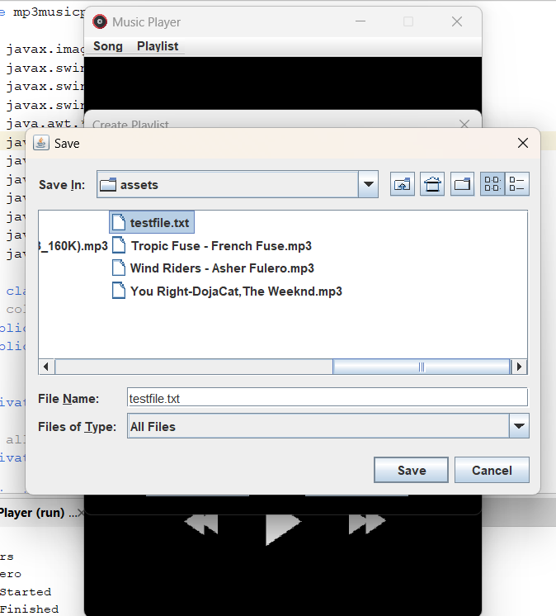
CREATING PLAYLIST

Slide 9
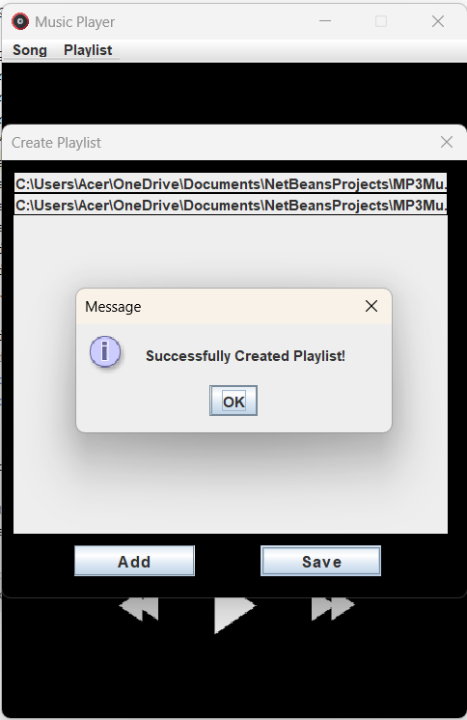
CREATING PLAYLIST

Slide 10
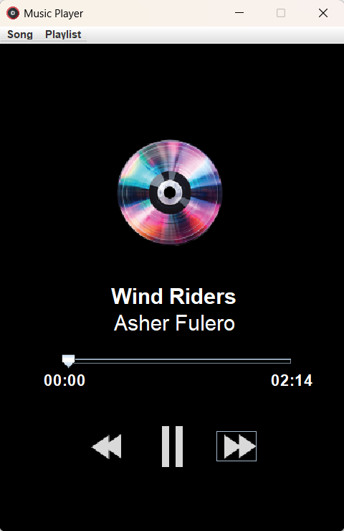
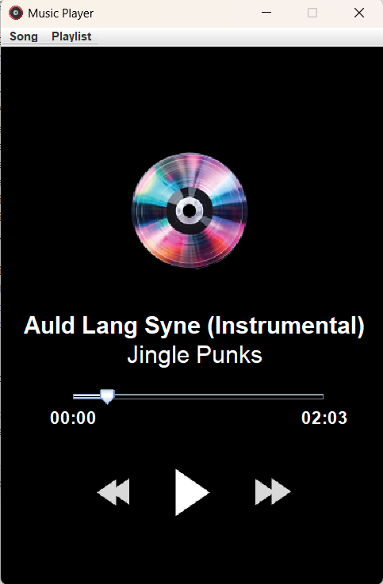
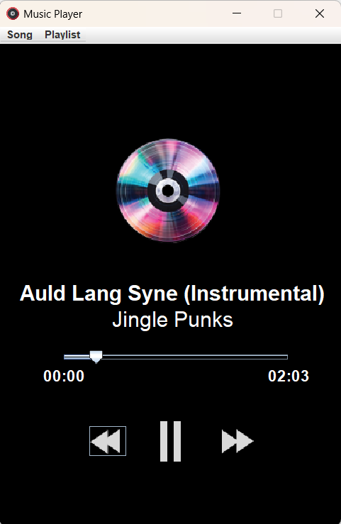
PLAYBACK CONTROL
Forward Button (Next Song)
Pause Button
Backward Button (Previous Song)

Slide 11
THANK YOU!!!

