Slide 1
Week 1- Results
Rosa Maleki

Slide 2
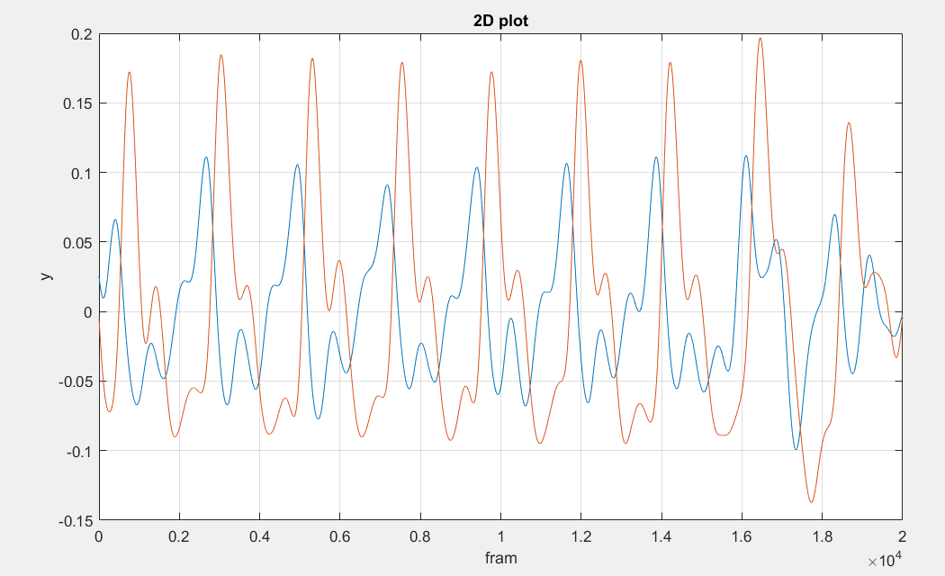
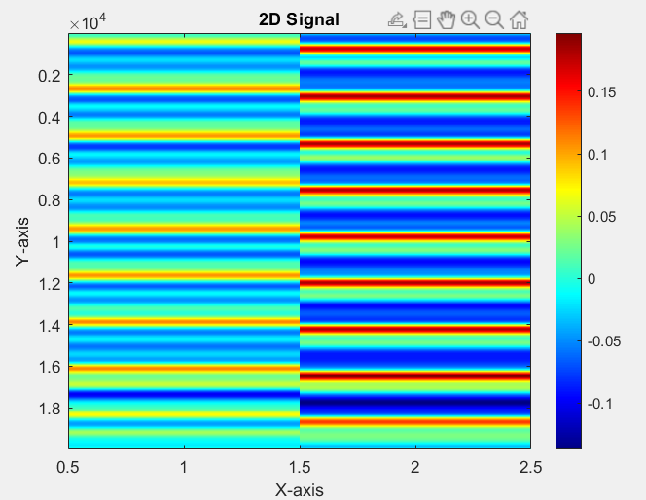
2D Plot

Slide 3
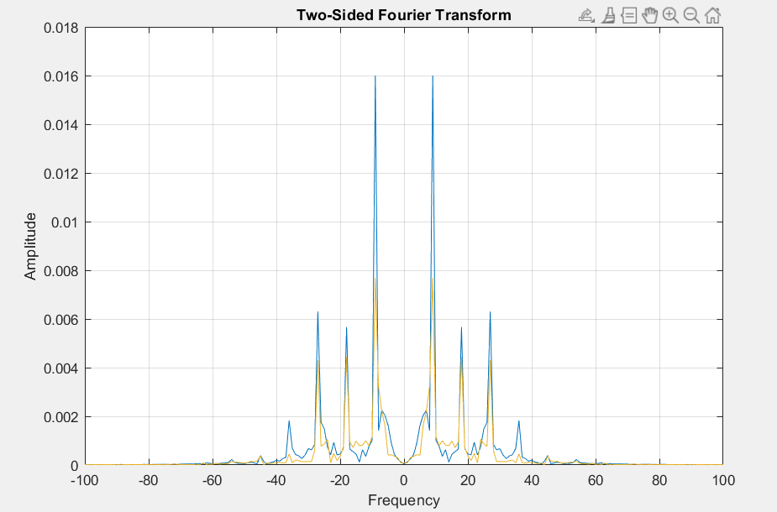
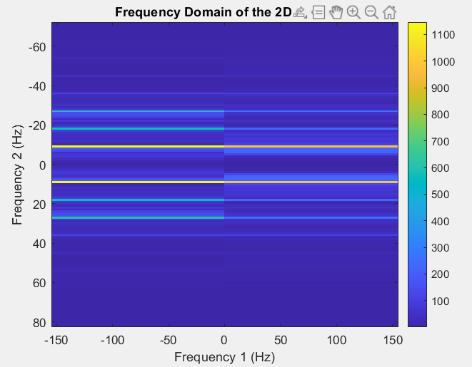
2D frequency domain

Slide 4
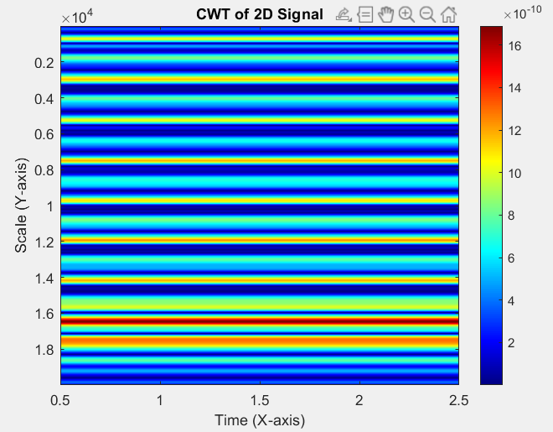
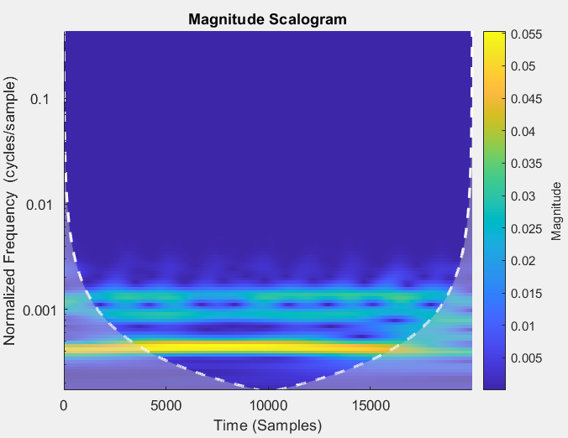
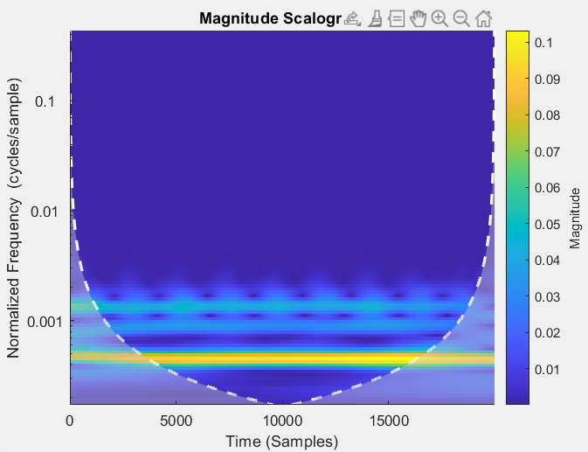
MATLAB-cwt continuous wavelet transform
In MATLAB, the "cwt is a function that performs the continuous wavelet transform on a given signal which is a time-frequency analysis technique that allows for the examination of both time and frequency information simultaneously.

Slide 5
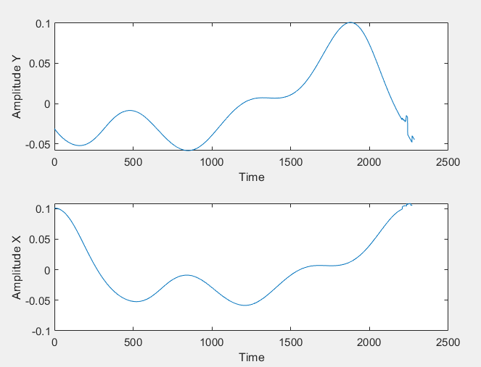
Averaged Pulse of 2D Signal

Slide 6
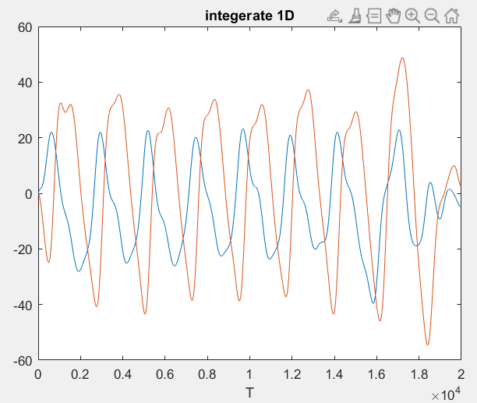
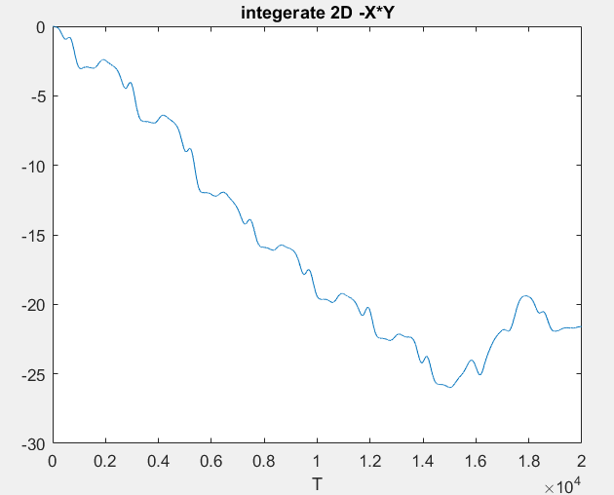
B = cumsum(A) returns the cumulative sum of A starting at the beginning of the first array dimension in A whose size is greater than 1.

